Slide 1
Conventional Collective Titles
BYU Catalog Department Training
9 January 2014

Slide 2
Describing works and expressions
Work is defined in RDA as “a distinct intellectual or artistic creation” (Glossary)
Expression is defined as “the intellectual or artistic realization of a work in the form of alpha-numeric, musical or choreographic notation, sound, image, object, movement, etc.” (Glossary)
The term work or expression can refer to an individual work, an aggregate work, or a component of a work (5.1.2)
So the general rules for works and expressions apply to collections of works and parts of works.

Slide 3
Preferred title
One of the core elements of work is its preferred title, the title or form of title chosen to identify the work (6.2.2)
In general, the preferred title is “the title in the original language by which the work has become known” (6.2.2.4)

Slide 4
Preferred title for a collection
If a collection of works is known by a title that is used in resources embodying that compilation or in reference sources, apply the general rule (previous slide) (6.2.2.10, 1st sentence).
However, if it is not “known” by such a title, record a “conventional collective title” as the preferred title for the collection (6.2.2.10, 2nd sentence).
Cataloger’s judgment is required to decide which sentence to apply. There may not be a “right” answer.
Notes:
You MUST be willing to use your judgment. There are no rules about different kinds of titles being “known” or not. In the following slides it is assumed that the compilation is not “known” by a particular title.

Slide 5
Conventional Collective Titles
If a compilation consists of (or purports to consist of) the complete works of a person, family, or corporate body, the conventional collective title is
Works

Slide 6
Conventional Collective Titles
William Shakespeare, The Riverside Shakespeare (Houghton Mifflin, 1996)
Preferred title = Works

Slide 7
Conventional Collective Titles
If the compilation consists of (or purports to consist of) the complete works in a particular form, choose from this list (6.2.2.10)
Correspondence
Essays
Librettos
Lyrics
Novels
Plays
Poems
Prose works
Short stories
Speeches
If none of these is appropriate, use another term, such as “Posters”, “Lithographs”

Slide 8
Conventional Collective Title
Margaret Thatcher, The Collected Speeches of Margaret Thatcher (Harper, 1998)
Preferred title = Speeches

Slide 9
Selections
For a compilation that is not complete, RDA prefers that each individual work be identified. That is, don’t use a conventional collective title; instead record the preferred title for each work separately.
Alternatively, RDA allows the term “Selections” to be added to the conventional collective title that would have been used for a complete collection

Slide 10
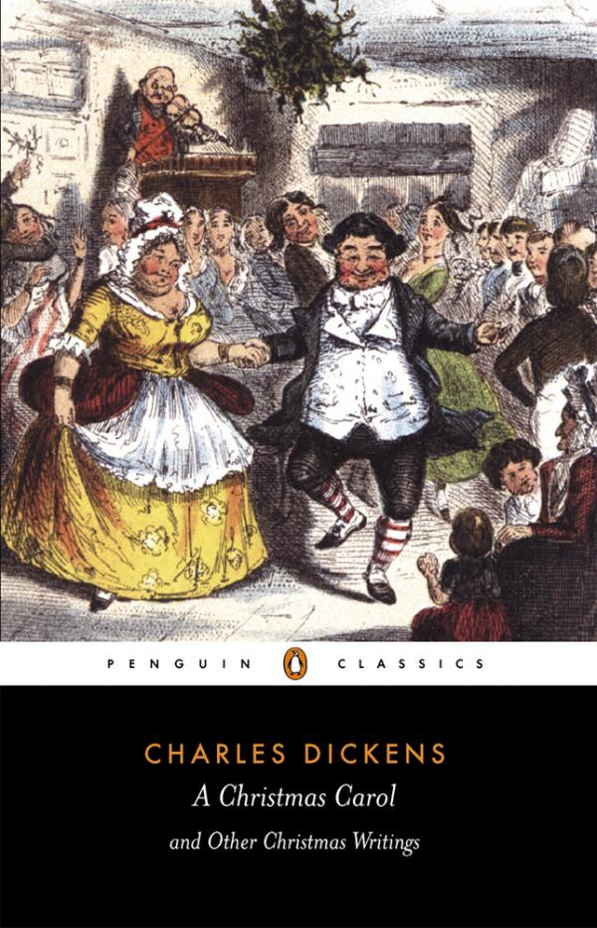
Selections
Charles Dickens, A Christmas Carol and Other Christmas Writings (Penguin, 2003)
Preferred titles:
Christmas festivities
The story of the goblins who stole a sexton
A Christmas carol
The haunted man
A Christmas tree
What Christmas is, as we grow older
The seven poor travellers

Slide 11
Selections (Alternative)
Charle Dickens, A Christmas Carol and Other Christmas Writings (Penguin, 2003)
Preferred title:
Short stories. Selections

Slide 12
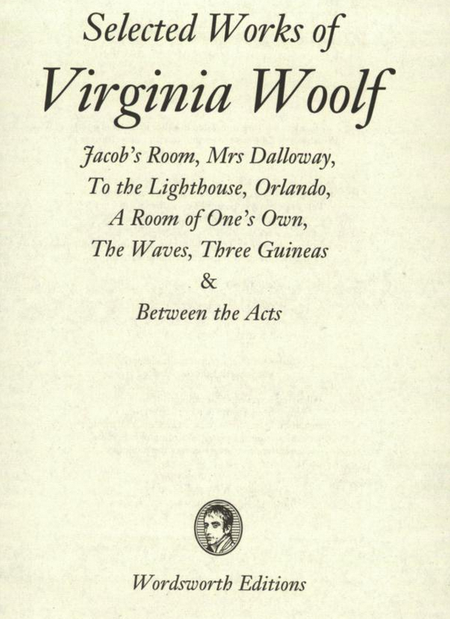
Selections
Virginia Woolf, Selected Works of Virginia Woolf (Wordsworth Editions, 2005)
Preferred titles:
Jacob’s room
Mrs. Dalloway
To the lighthouse
Orlando
A room of one’s own
The waves
Three guineas
Between the acts

Slide 13
Selections (Alternative)
Virginia Woolf, Selected Works of Virginia Woolf (Wordsworth Editions, 2005)
Preferred title:
Works. Selections

Slide 14
Authorized Access Point
RDA 6.27.1.2. If one person, family, or corporate body is responsible for creating the work [including a collection], construct the authorized access point representing the work by combining (in this order):
the authorized access point representing that person, family, or corporate body
the preferred title for the work

Slide 15
Authorized Access Point (single work)
Authorized access point for the person:
Dickens, Charles, 1719-1793
plus
Preferred title for the work:
A Christmas carol
Authorized access point for the work:
Dickens, Charles, 1719-1793. Christmas carol
[initial article dropped following 6.2.1.7 alternative]

Slide 16
Selections (Main Rule)
Charles Dickens, A Christmas Carol and Other Christmas Writings (Penguin, 2003)
Authorized Access Points:
Dickens, Charles, 1719-1793. Christmas festivities
Dickens, Charles, 1719-1793. Story of the goblins who stole a sexton
Dickens, Charles, 1719-1793. Christmas carol
Dickens, Charles, 1719-1793. Haunted man
Dickens, Charles, 1719-1793. Christmas tree
Dickens, Charles, 1719-1793. What Christmas is, as we grow older
Dickens, Charles, 1719-1793. Seven poor travellers

Slide 17
Authorized Access Point (collection using conventional collective title)
Authorized access point for the person:
Thatcher, Margaret
plus
Preferred title for the work:
Speeches
Authorized access point for the work:
Thatcher, Margaret. Speeches

Slide 18
Authorized Access Point (collection using conventional collective title)
Margaret Thatcher, The Collected Speeches of Margaret Thatcher (Harper, 1998)
Authorized access point:
Thatcher, Margaret. Speeches

Slide 19
Conflict
6.27.1.9. Make additions to access points if needed to distinguish the access point for a work from another that is the same but represents a different work. Add one or more of these:
The form of the work
The date of the work
The place of origin of the work
Another distinguishing characteristic of the work

Slide 20
Conflict
Different collections may be different (aggregate) works. Different “selections” are nearly always different aggregate works.

Slide 21
Selections
Virginia Woolf, Selected Works of Virginia Woolf (Wordsworth Editions, 2005)
Preferred title (alternative):
Works. Selections

Slide 22
Selections
Virginia Woolf, The Virginia Woolf Reader (Harcourt Brace Jovanovich, 1984)
Contents (novels, short stories, essays, correspondence):
Part of Moments of being
Part of Mrs. Dalloway
Part of To the lighthouse
Part of Orlando
Part of The waves
“The legacy”
“Lappin and Lapinova”
“The duchess and the Jeweller”
“The mark and the wall”
“Kew Gardens”
Part of A room of one’s own
“Mr. Bennet and Mrs. Brown”
“Life itself”
“Jane Austen”
“How should one read a book?”
“Street haunting”
“A letter to a young poet”
“Professions for women”
“Modern fiction”
Part of The diary of Virginia Woolf
Part of The letters of Virginia Woolf
Notes:
In this case the cataloger decides there are too many individual works in the compilation and will follow the alternative instruction for Selections.

Slide 23
Selections
Virginia Woolf, Selected Works of Virginia Woolf (Wordsworth Editions, 2005)
Virginia Woolf, The Virginia Woolf Reader (Harcourt Brace Jovanovich, 1984)
Each has the same preferred title (alternative): Works. Selections
Each would have the same authorized access point:
Woolf, Virginia, 1882-1941. Works. Selections
But they are different works. A conflict exists.

Slide 24
Conflict
Woolf, Virginia, 1882-1941. Works. Selections
Something needs to be added to differentiate.
What is most helpful to library users?
Form? (not possible, both are the same form)
Date (original publication date of the collection)?
Woolf, Virginia, 1882-1941. Works. Selections. 2005
Woolf, Virginia, 1882-1941. Works. Selections. 1984
Place of origin? (place of publication?)
Woolf, Virginia, 1882-1941. Works. Selections (Ware, England)
Woolf, Virginia, 1882-1941. Works. Selections (San Diego, Calif.)
Notes:
Form might be used when an author creates a short story and a novel with the same preferred title, for example.

Slide 25
Conflict
Woolf, Virginia, 1882-1941. Works. Selections
Editor (available for The Virginia Woolf reader)?
Woolf, Virginia, 1882-1941. Works. Selections (Leaska)
Series (available for Selected Works of Virginia Woolf)?
Woolf, Virginia, 1882-1941. Works. Selections (Wordsworth library collection)
Publisher?
Woolf, Virginia, 1882-1941. Works. Selections (Wordsworth Editions)
Woolf, Virginia, 1882-1941. Works. Selections (Harcourt Brace Jovanovich)
Something else?

Slide 26
Conflict
Woolf, Virginia, 1882-1941. Works. Selections
Another distinguishing characteristic?
Title of manifestation?
Woolf, Virginia, 1882-1941. Works. Selections (The Virginia Woolf Reader)
Woolf, Virginia, 1882-1941. Works. Selections (Selected works of Virginia Woolf)
Notes:
You would only pick one of these for each as the authorized access point—thes different access points are shown as possible ways to differentiate.

Slide 27
The Case of “Works”
Are all collections that purport to be the complete works of an author the same aggregate “work”?
If so, different compilations are different expressions and would be differentiated at the expression level.
If not, different compilations are different works and need to be differentiated at the work level.

Slide 28
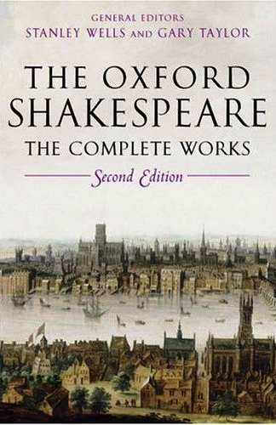
The Case of “Works”
All compilations are the same work?
Shakespeare, William, 1564-1616. Works
Expression authorized access points:
Shakespeare, William, 1564-1616. Works. English (The Riverside Shakespeare)
Shakespeare, William, 1564-1616. Works. English (The Oxford Shakespeare)
Shakespeare, William, 1564-1616. Works. French (Orizons)
Shakespeare, William, 1564-1616. Works. German (Schlegel and Tiek)
Notes:
Differentiation at the expression level.

Slide 29
The Case of “Works”
Each compilation is a different work?
Work authorized access points:
Shakespeare, William, 1564-1616. Works (The Riverside Shakespeare)
Shakespeare, William, 1564-1616. Works (The Oxford Shakespeare)
Shakespeare, William, 1564-1616. Works (Orizons)
Shakespeare, William, 1564-1616. Works (Schlegel and Tiek)
Notes:
Differentiation at the work level. If this is done, we probably don’t need to add anything further to distinguish (like language).

Slide 30
The Case of “Works”
The question of whether all collections that purport to be the complete works of an author the same “work” or not is not yet settled.
Use your judgment in individual cases.

