Slide 1
Introduction to Utah Academic Libraries Consortium September 23, 2010
Robert L. Maxwell
Chair, Special Collections and Formats Catalog Department
Harold B. Lee Library, Brigham Young University
robert_maxwell@byu.edu
Notes:
Acknowledgements
I am grateful to Judy Kuhagen of the Library of Congress for helpful suggestions on an earlier presentation this is based on. Some of the slides are also based on presentations by Barbara Tillett, Chief, Library of Congress Policy & Standards Division, and Adam Schiff, Principal Cataloger, University of Washington Libraries.

Slide 2
What is RDA?
A new standard for information organization (a.k.a. cataloging), meant to replace AACR2
Its title: Resource Description and Access
Its publication date: June 2010 Available in print and online http://www.rdatoolkit.org
Notes:
Why do we need a new standard? AACR2 was first published in 1978. Although it has been updated many times through the revision process that was established by the JSC, it is largely designed for an environment dominated by the card catalog. The International Conference on the Principles and Future Development of AACR that was held in Toronto in 1997 identified substantial problems with AACR2. Although the updates issued in the years following that conference addressed some of these problems, it became clear that a fundamental rethinking of the code was required to respond fully to the challenges and opportunities of the digital world.

Slide 4
Who’s in charge here, anyway?
AACR2 was developed and maintained by an international body called the Joint Steering Committee for Revision of AACR.
RDA has been developed and will be maintained by the Joint Steering Committee for Development of RDA (“the JSC”)

Slide 5
JSC Members
The American Library Association
The Australian Committee on Cataloguing
The British Library
The Canadian Committee on Cataloguing
The Chartered Institute of Library and Information Professionals
The Library of Congress
Notes:
The JSC develops the text.

Slide 6
The Committee of Principals
The JSC makes decisions about the content of RDA. The Committee of Principals (COP) is responsible for policies relating to RDA, especially decisions about publication and funding. The COP consists of representatives of:
The American Library Association
The British Library
The Canadian Library Association
The Chartered Institute of Library and Information Professionals
Library and Archives Canada
The Library of Congress
The National Library of Australia

Slide 7
The Co-Publishers
Copyright in RDA is held by the “co-publishers”:
The American Library Association
The Canadian Library Association
The Chartered Institute of Library and Information Professionals
They jointly serve as publishers of RDA

Slide 8
The Committee on Cataloging: Description and Access
ALA’s representative to the Joint Steering Committee is currently John Attig
Before presenting ALA’s position on anything to do with RDA, John consults with ALA’s Committee on Cataloging: Description and Access, the body which formulates ALA position and policy on cataloging issues

Slide 9
Foundations of RDA
Functional Requirements for Bibliographic Records (FRBR; 1998)
Functional Requirements for Authority Data (FRAD; 2009)
IFLA Statement of International Cataloguing Principles (ICP; 2009)

Slide 10
FRBR
A conceptual model of the bibliographic universe
Based on the entity-relationship model developed for computer databases

Slide 11
FRBR/FRAD Entities
Group 1: The products of intellectual or artistic endeavor. Sometimes called “the primary entities.”
Work: a distinct intellectual or artistic creation
Expression: the intellectual or artistic realization of a work in some form (e.g. alpha-numeric, musical notation)
Manifestation: the physical embodiment of an expression (e.g. a print publication)
Item: a copy of a manifestation
Notes:
Ask people to give examples.

Slide 12
FRBR/FRAD Entities
Group 2: entities responsible for Group 1 entities
Person
Family
Corporate body
Group 3: entities that can be subjects of works
Any group 1 or group 2 entity, and
Concept
Object
Event
Place

Slide 13
FRBR Relationships
In the FRBR model relationships are crucial
Any entity can be related to any other entity in a variety of ways
In a FRBR-based database these relationships would be clear and users should be able to move from one entity to related entities easily

Slide 14
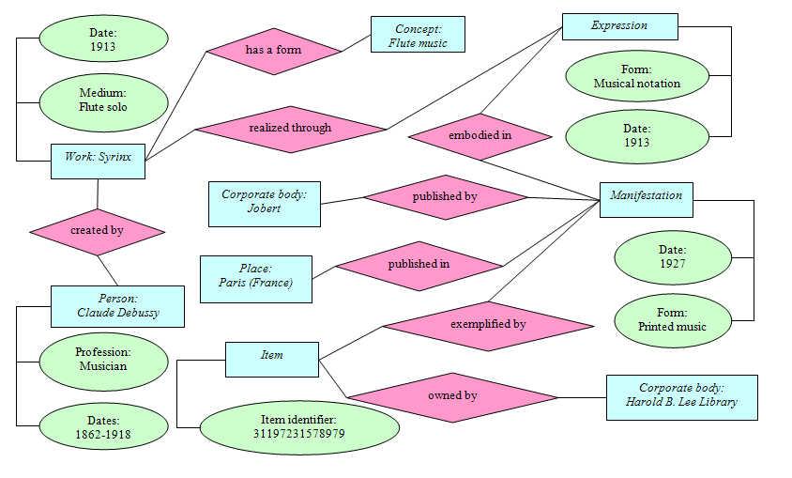
FRBR Entities and Relationships
Notes:
This is one way to visualize an entity relationship database. The blue rectangles are the entities; the pink diamonds are the relationships; the green ovals are attributes of the entities. This particular example is not following FRBR strictly--although all the entities are FRBR entities, in some cases FRBR entity attributes have been shown here instead as relationships between entities. In the database any entity might be related to large numbers of other entities. For example, the work Syrinx has been realized through many expressions--the original notated music expression for flute, shown here; dozens of recorded performances, which are all separate expressions; arrangements for other instruments, etc. These are all expressions related to the work Syrinx. The same holds true of the other entities shown here. The Corporate Body HBLL has millions of “owned by” relationships to items in its collection.

Slide 15
Statement of International Cataloguing Principles (2009)
International statement developed over six years, intended as a replacement for the 1961 Paris Principles
Gives underlying principles that form the basis of cataloging standards and practices, including RDA
http://www.ifla.org/files/cataloguing/icp/icp_2009-en.pdf

Slide 16
Statement of International Cataloguing Principles (2009)
Convenience of the user
Common usage
Representation
Accuracy
Sufficiency and necessity
Significance
Economy
Consistency and standardization
Integration
Notes:
2.1. Convenience of the user. Decisions taken in the making of descriptions and controlled
forms of names for access should be made with the user in mind.
2.2. Common usage. Vocabulary used in descriptions and access should be in accord with that
of the majority of users.
2.3. Representation. Descriptions and controlled forms of names should be based on the way
an entity describes itself.
2.4. Accuracy. The entity described should be faithfully portrayed.
2.5. Sufficiency and necessity. Only those data elements in descriptions and controlled forms
of names for access that are required to fulfil user tasks and are essential to uniquely
identify an entity should be included.
2.6. Significance. Data elements should be bibliographically significant.
2.7. Economy. When alternative ways exist to achieve a goal, preference should be given to
the way that best furthers overall economy (i.e., the least cost or the simplest approach).
2.8. Consistency and standardization. Descriptions and construction of access points should be
standardized as far as possible. This enables greater consistency, which in turn increases
the ability to share bibliographic and authority data.
2.9. Integration. The descriptions for all types of materials and controlled forms of names of all
types of entities should be based on a common set of rules, insofar as it is relevant.

Slide 17
Organization
AACR2 part I is organized by ISBD area
RDA is organized by FRBR entities and relationships

Slide 18
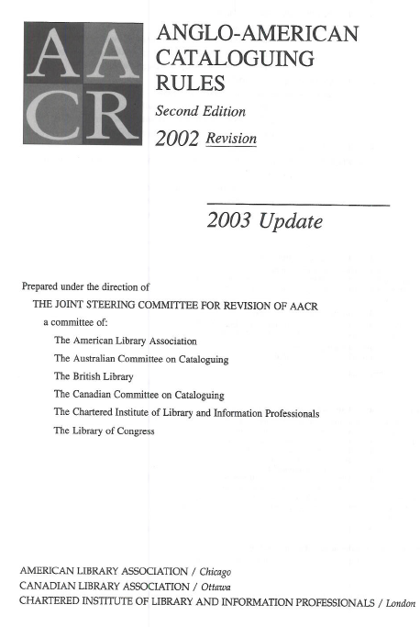
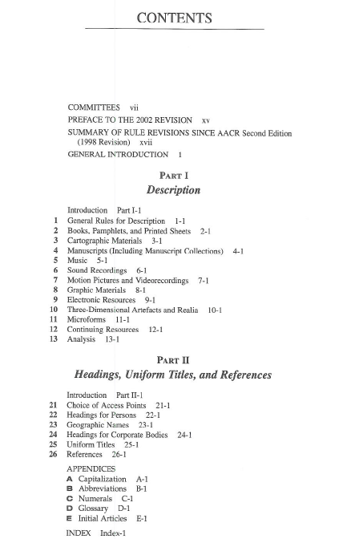

Slide 19
RDA and FRBR
The first part of RDA is organized by FRBR entities and their attributes
Section 1: Recording attributes of manifestations & items
Section 2: Recording attributes of work & expression
Section 3: Recording attributes of person, family & corporate body
Section 4: Recording attributes of concept, object, event & place
Notes:
The first part of RDA is organized by the FRBR attributes, called elements in RDA. Each entity is defined by a number of attributes, and we are given instructions for recording these attributes as “elements” and “subelements.” RDA is organized quite differently from AACR2. AACR2, as we have seen, is organized by ISBD area, and we are instructed how to fill out each area. As we shall see, RDA does not require the use of the ISBD organization. It simply expects us to complete the description of certain elements, without telling us how they should be displayed or connected together.

Slide 20
RDA and FRBR
The second part of RDA is organized by the FRBR entities and their relationships to each other
Section 5: Recording primary relationships between work, expression, manifestation & item
Section 6: Recording relationships to persons, families & corporate bodies
Section 7: Recording relationships to concepts, objects, events & places
Sections 8-10 deal with recording relationships between various FRBR entities

Slide 21
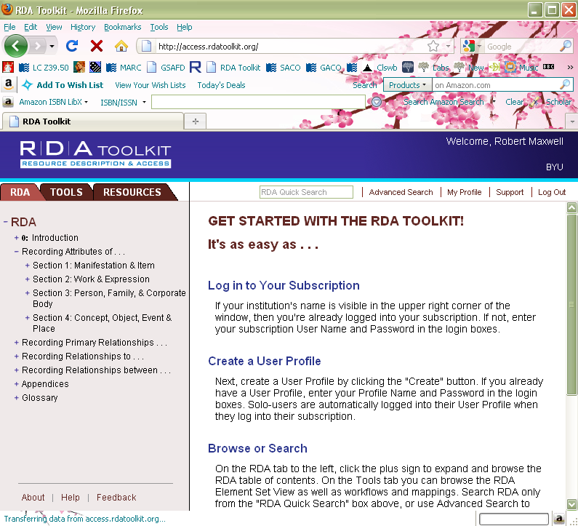
Notes:
This is the initial view, showing the sections of RDA about recording the attributes of the FRBR entities.

Slide 22
Notes:
We’re going to drill down to examine the “title” element. Title is one of the attributes of the FRBR manifestation.

Slide 23
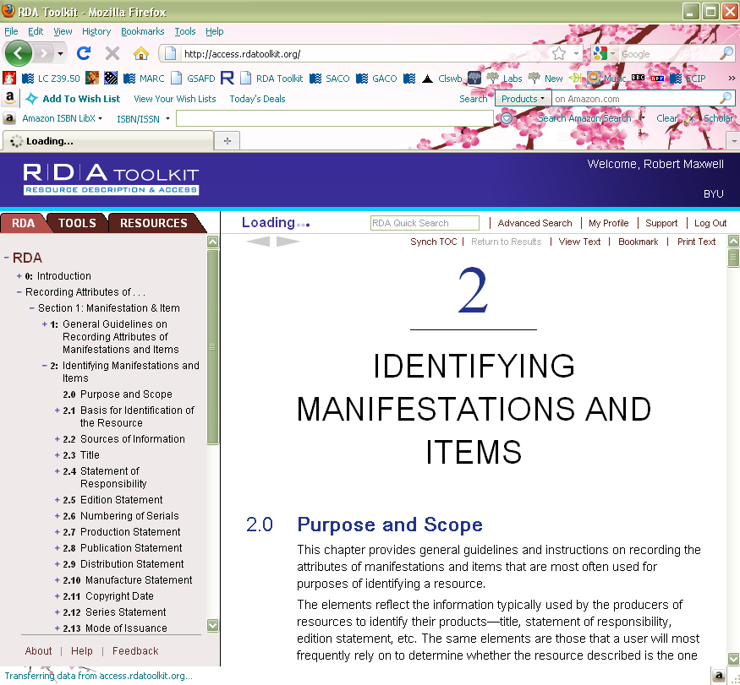
Notes:
Notice in passing some of the other attributes of the FRBR entity manifestation.

Slide 24
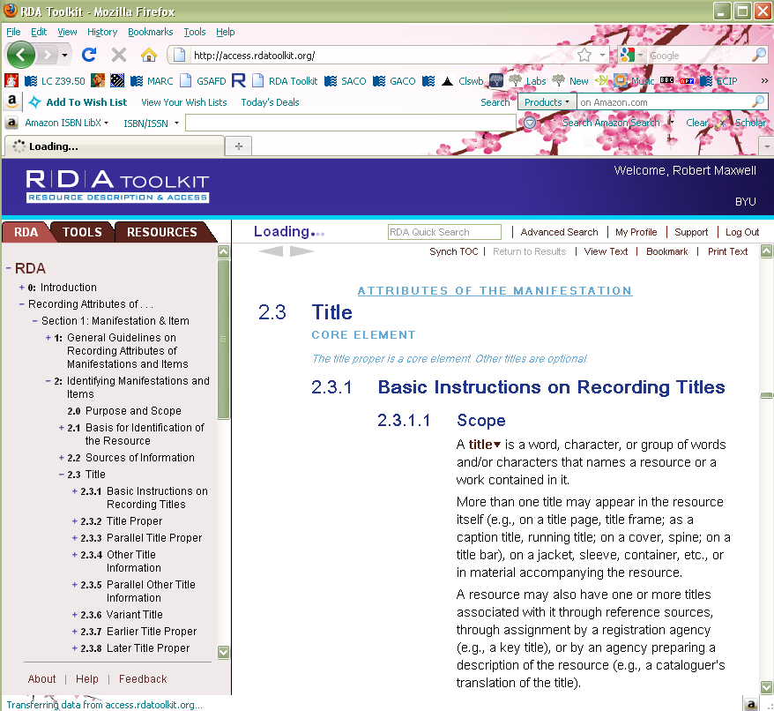
Notes:
Here we are at the basic unit in RDA, the “element”. Note the title is labeled a “core element.” We will come back to this. We are now going to a subelement called “title proper”.

Slide 25
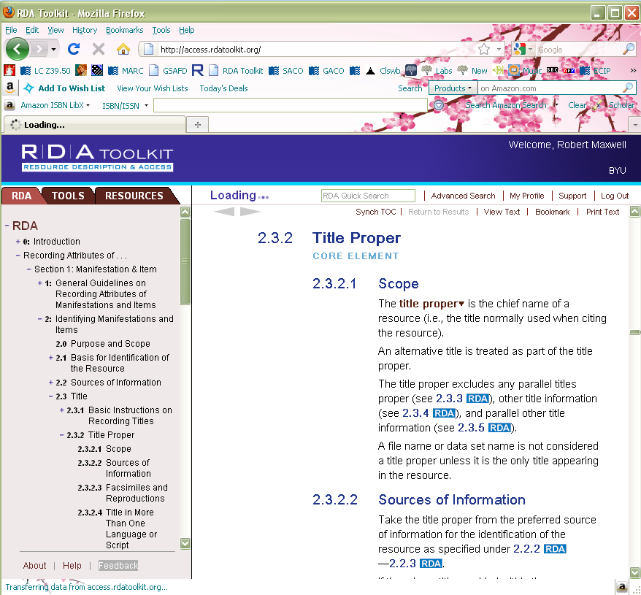
Notes:
RDA elements can be divided into subelements, as here. There are hundreds of elements and subelements, and they all describe FRBR entities. We’ve been looking at the “manifestation” entity. Let’s look at another, “person.” If you were going to describe a person as an entity in a bibliographic database, what attributes would you assign to “person”? How would you describe a person so that he or she was distinct from all other person entities in the database?

Slide 26
Notes:
Back to the initial view, we now go into section 3

Slide 28
Notes:
We’ll look at one element, “name of person”

Slide 29
Notes:
Note this element is, like title proper, labeled “core.”
All the elements in RDA have basically the same organization. The first section is the scope, or definition. Here we have a definition of “name of the person.” (read)

Slide 30
Notes:
Second, we are told the sources of information we are allowed to use for the element. For the “name of the person” element we can get our information from any source. On the other hand, back to title proper ...

Slide 31
Notes:
The title proper should be taken from the preferred source of information.

Slide 32
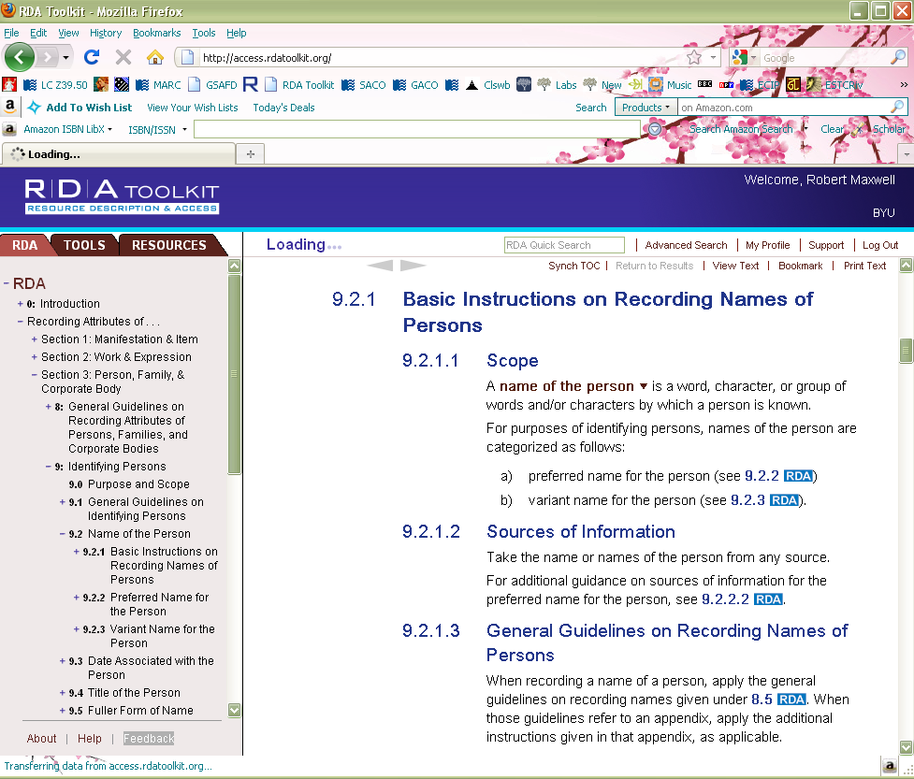
Notes:
Back to the “name of the person” element, the third part of each RDA element entry is information about how to record the information. This may range from quite simple to rather complicated instructions, depending on the nature of the element.
This is how all RDA elements are organized: scope, sources of information, instructions for recording the information.

Slide 33
RDA and MARC
RDA was primarily designed to be implemented in a FRBR-based database
Because we do not yet have a FRBR-based database design, however, RDA is compatible with a MARC environment
Within the MARC environment RDA records will coexist with AACR2 records

Slide 34
RDA and MARC
There are a number of new MARC fields, developed to accomodate the RDA elements
Documentation in Cataloger’s Desktop, or at www.loc.gov/marc
Bibliographic format: new 3XX fields
Authority format: 046, new 3XX fields
Notes:
We’ll go through the new MARC fields one by one, later.

Slide 35
ISBD Punctuation
AACR2 prescribes the use of ISBD punctuation.
RDA does not prescribe any display standard
Since it is understood that most libraries will continue to use ISBD, RDA Appendix D lays out ISBD guidelines, including two new ISBD practices that were not followed in AACR2

Slide 36
ISBD Change: Bracketing
Each adjacent data element that requires square brackets is enclosed in its own set of square brackets.
Current practice
260 $a [Washington, D.C. : $b G.P.O? : $c 2009?]
Future practice
260 $a [Washington, D.C.] : $b [G.P.O?] : $c [2009?]
Notes:
Note this is not an RDA change

Slide 37
ISBD Change: Ending punctuation
When an element or area ends with a full stop, the full stop for prescribed punctuation is also added.
Current practice 250 1st ed.
Future practice
250 1st ed..
Note: this example assumes that the abbreviation “ed.” is being transcribed. The word “edition” would not be abbreviated in RDA.

Slide 38
What might users notice? Representation of errors
In AACR2 the cataloger draws attention to errors found on the piece being transcribed with “[sic]” or “[i.e.]”
Under RDA we transcribe exactly what we see without interposing anything
This means that we will all have to learn to trust each other and assume that the transcription is correct

Slide 39
Representation of errors
AACR2 1.0F1: In an area where transcription from the item is required, transcribe an inaccuracy or a misspelled word as it appears in the item. Follow such an inaccuracy either by [sic] or by i.e. and the correction within square brackets. Supply a missing letter or letters in square brackets.
RDA 1.7.9: When instructed to transcribe an element as it appears on the source of information, transcribe an inaccuracy or a misspelled word as it appears on the source, except where instructed otherwise. Make a note correcting the inaccuracy if it is considered to be important for identification or access (see 2.20). If the inaccuracy appears in a title, record a corrected form of the title as a variant title (see 2.3.6) if it is considered to be important for identification or access.
Notes:
Here is the actual wording of the guidelines.

Slide 40
Representation of errors
AACR2 catalog display*
Title: Distinguishing characristics [sic] of Mormonism / by A.P. Kesler.
RDA catalog display*
Title: Distinguishing characristics of Mormonism / by A.P. Kesler.
Corrected title: Distinguishing characteristics of Mormonism.
*Note: displays are hypothetical throughout this presentation. RDA does not prescribe labels or ISBD display.
Notes:
RDA does not correct, but recommends an added access point for the corrected title if in the cataloger’s judgment it would be helpful to the users of the catalog.

Slide 41
Representation of errors
AACR2 245 10 Habeus [sic] corpus and detentions at Guantanamo Bay … 246 3 Habeas corpus and detentions at Guantanamo Bay
RDA 245 10 Habeus corpus and detentions at Guantanamo Bay … 246 3 Habeas corpus and detentions at Guantanamo Bay
Notes:
Here’s an example coded in MARC

Slide 42
What might users notice? Words in, abbreviations out
AACR2 abbreviates frequently in many areas, including the use of the Latin abbreviations “s.l.”, “s.n.”, “et al.” and others.
RDA abbreviates only very rarely

Slide 43
Words in, abbreviations out
CASES
on the
LAW OF BILLS
AND NOTES
by
Henry W. Humble
Brooklyn - New York
1924
AACR2 catalog display
Publication info: Brooklyn, N.Y. : [s.n.], 1924.
RDA catalog display
Publication info: Brooklyn, New York : [publisher not identified], 1924.

Slide 44
A change users probably won’t notice: Transcription of certain punctuation
AACR2 calls for replacing “…” and “[ ]” with “—” and “( )”
RDA transcribes this punctuation as it appears in the manifestation.
Jeanette Lander
Ein Spatz in der Hand…
Sachgeschichten
Insel
2007
AACR2 245 14 Ein Spatz in der Hand— : $b Sachgeschichten / $c Jeanette Lander.
RDA (core elements)
245 14 Ein Spatz in der Hand … / $c Jeanette Lander.

Slide 45
What might users notice? Levels of Description
AACR2 1.0D has three levels of description.
RDA 0.6 instead designates “core elements”
The core elements are intended to support the FRBR user tasks
identify and select a manifestation
identify works and expressions embodied in a manifestation
identify the creator or creators of a work

Slide 46
Core Elements in RDA
In addition to the list in 0.6, Core elements are identified throughout RDA, as in this example.

Slide 47
Core Elements in RDA
Catalogers are advised to “include any additional elements that are required in a particular case to differentiate the resource from one or more other resources bearing similar identifying information.” (RDA 0.6.1)
They may also include any other elements that in their judgment are needed.

Slide 48
What might users notice? Core Title Elements
In AACR2 second level description (1.0D2) the following elements are required:
Title proper
Parallel title
Other title information
In RDA, only title proper is a core element (RDA 1.3)

Slide 49
Core Title Elements
AACR2 level 2 245 12 A Chinese bestiary : $b strange creatures from the guideways through mountains and seas = Shan hai jing / $c edited and translated with commentary by Richard E. Strassberg.
RDA core 245 12 A Chinese bestiary / $c edited and translated with commentary by Richard E. Strassberg.
Notes:
Note that RDA doesn’t require you to transcribe only the core elements, but you can create a perfectly legitimate RDA record with only core elements.

Slide 50
Core Title Elements Parallel Titles
In AACR2 second level descriptions, we give the first parallel title and any subsequent one in English (1.1D2).
In RDA, parallel titles are not core. They may be recorded but they are not required.

Slide 51
Parallel titles
AACR2 level 2 245 04 $a The orphan tsunami of 1700 : $b Japanese clues to a parent earthquake in North America = Minashigo Genroku tsunami : oya-jishin wa Hokubei nishi kaigan ni ita / $c Brian F. Atwater ... [et al.]

Slide 52
Parallel titles
RDA core (omitting parallel title)
245 14 $a The orphan tsunami of 1700 / $c Brian F. Atwater, Musumi-Rokkaku Satoko, Satake Kenji, Tsuji Yoshinobu, Ueda Kazue, David K. Yamaguchi.
or
245 14 $a The orphan tsunami of 1700 / $c Brian F. Atwater [and five others].
Notes:
Note: RDA core does not necessarily mean shorter than AACR2 level 2! Note in an RDA MARC record, unlike AACR2 (where main entry is title), Atwater will be recorded as first-named creator in a 100 field, and so the first indicator of 245 is “1”.

Slide 53
Allowed Sources for Parallel Titles
AACR2 1.1D1. Transcribe parallel titles in the order indicated by their sequence on, or by the layout of, the chief source of information.
RDA 2.3.3.2. Take parallel titles proper from any source within the resource.
Under RDA parallel titles do not need to come from the AACR2 chief source.

Slide 54
Parallel Titles
AACR2
245 10 $a 3 Preludi-corali : $b dall'op. 122 / $c Johannes Brahms.
246 1 $i Parallel title on cover: $a 3 chorale preludes from op. 122
RDA
245 10 $a 3 Preludi-corali = $b 3 chorale preludes from op. 122 / $c Johannes Brahms.
246 31 $a 3 chorale preludes from op. 122

Slide 55
What might users notice? Core Title Elements Other Title Information
In AACR2 second level descriptions, we give all other title information (1.0D2).
In RDA, other title information is not core. It may be recorded, but it is not required.

Slide 56
Other Title Information
AACR2 level two 245 10 $a Uncommon sense : $b the heretical nature of science / $c Alan Cromer.
RDA core 245 10 $a Uncommon sense / $c Alan Cromer.

Slide 57
Other Title Information
AACR2 1.1E6. If the title proper needs explanation, supply a brief addition as other title information, in the language of the title proper.
RDA does not have a parallel provision because it violates the principle of representation. (Exceptions for cartographic resources and moving image resources: RDA 2.3.4.5, 2.3.4.6)
Reminder: Other title information is not a core element in RDA.

Slide 58
Other Title Information
AACR2 245 10 $a Longfellow : $b [selections] / $c edited by Alfred Noyes. 245 10 $a Conference on Industrial Development in the Arab Countries : $b [proceedings].
RDA 245 10 $a Longfellow / $c edited by Alfred Noyes. 245 10 $a Conference on Industrial Development in the Arab Countries.

Slide 59
What might users notice? Statement of Responsibility
In AACR2 second level descriptions, we give all statements of responsibility.
In RDA a statement of responsibility relating to the title proper is core. If there is more than one, only the first is required. Other statements of responsibility may be recorded but are not core. If not all are recorded, prefer those identifying creators of the intellectual or artistic content (2.4.2.3).
Notes:
RDA 2.4.2.3. If not all statements of responsibility appearing on the source or sources of information are being recorded, give preference to those identifying creators of the intellectual or artistic content. In case of doubt, record the first statement.

Slide 60
Statement of Responsibility
AACR2 level two 245 10 $a Diary, 1901-1969 / $c Kornei Chukovsky ; edited by Victor Erlich ; translated by Michael Henry Heim.
RDA core 245 10 $a Diary, 1901-1969 / $c Kornei Chukovsky.

Slide 61
Statement of Responsibility
Under AACR2 if a statement of responsibility is transcribed from a source other than the chief source, it is bracketed (1.1A2).
RDA expands the available sources. Only statements of responsibility taken from outside the resource are bracketed.

Slide 62
Statement of Responsibility
AACR2 245 10 $a West Side story $h [sound recording] : $b the new Broadway cast recording / $c [based on a conception of Jerome Robbins ; book by Arthur Laurents ; music by Leonard Bernstein ; lyrics by Stephen Sondheim]. 500 $a Statement of responsibility from container.
RDA core + 245 10 $a West Side story / $c based on a conception of Jerome Robbins ; book by Arthur Laurents ; music by Leonard Bernstein ; lyrics by Stephen Sondheim.
Notes:
Note under RDA core this statement of responsibility is probably not required at all. If any of it is, only the first one would be.

Slide 63
Statement of Responsibility Titles, etc.
AACR2 1.1F7 limits transcription of certain words. Titles, qualifications, etc., are usually omitted.
RDA 2.4.1.4 simply says: Transcribe a statement of responsibility in the form in which it appears on the source of information.

Slide 64
Statement of Responsibility Rule of Three (AACR2)
AACR2 1.1F5. If a single statement of responsibility names more than three persons or corporate bodies performing the same function, or with the same degree of responsibility, omit all but the first of each group of such persons or bodies. Indicate the omission by the mark of omission (…) and add et al. (or its equivalent in a nonroman script) in square brackets.

Slide 65
Statement of Responsibility Rule of Three abolished in RDA
RDA 2.4.1.5. Record a statement of responsibility naming more than one person, etc., as a single statement regardless of whether the persons, families, or corporate bodies named in it perform the same function or different functions.

Slide 66
Statement of Responsibility
AACR2 245 00 $a Law of war deskbook / $c authors: Jeff A. Bovarnick ... [et al.] ; editor: Brian J. Bill.

Slide 67
Statement of Responsibility
RDA core 245 10 $a Law of war deskbook / $c authors: LTC Jeff A. Bovarnick, JA, USA, LtCol J. Porter Harlow, USMC, CDR Trevor A. Rusch, JAGC, USN, MAJ Christopher R. Brown, JA, USANG, Maj J. Jeremy Marsh, USAF, MAJ Gregory S. Musselman, JA, USA, MAJ Shane R. Reeves, JA, USA.

Slide 68
Statement of Responsibility RDA Optional Omissions
RDA 2.4.1.4. Optional omission. Abridge a statement of responsibility only if it can be abridged without loss of essential information. Do not use a mark of omission (…) to indicate such an omission. Always record the first name appearing in the statement. When omitting names from a statement of responsibility naming more than one person, etc., apply the instructions given under 2.4.1.5
RDA core transcription omitting titles 245 10 $a Law of war deskbook / $c authors: Jeff A Bovarnick, J. Porter Harlow, Trevor A. Rusch, Christopher R. Brown, J. Jeremy Marsh, Gregory S. Musselman, Shane R. Reeves.

Slide 69
Statement of Responsibility RDA Optional Omissions
RDA 2.4.1.5. Optional omission. If a single statement of responsibility names more than three persons, families, or corporate bodies performing the same function, or with the same degree of responsibility, omit all but the first of each group of such persons, families, or bodies. Indicate the omission by summarizing what has been omitted in the language and script preferred by the agency preparing the description.
RDA core transcription omitting names 245 10 $a Law of war deskbook / $c authors: Jeff A Bovarnick [and six others].
or 245 10 $a Law of war deskbook / $c authors: LTC Jeff A Bovarnick, JA, USA [and six others].

Slide 70
Statement of Responsibility Noun Phrases
AACR2 1.1F12. Treat a noun phrase occurring in conjunction with a statement of responsibility as other title information if it is indicative of the nature of the work. If the noun or noun phrase is indicative of the role of the person(s) or body (bodies) named in the statement of responsibility rather than of the nature of the work, treat it as part of the statement of responsibility.
RDA 2.4.1.8. If a noun or noun phrase occurs with a statement of responsibility, treat the noun or noun phrase as part of the statement of responsibility.

Slide 71
Statement of Responsibility Noun Phrases
AACR2 245 10 $a High performance computing and communications $h [electronic resource] : $b advancing the frontiers of information technology : a report / $c by the Committee on Computing, Information, and Communications, National Science and Technology Council.
RDA core 245 10 $a High performance computing and communications / $c a report by the Committee on Computing, Information, and Communications, National Science and Technology Council.

Slide 72
What might users notice? Edition Statement
AACR2 1.2B1. Transcribe the edition statement as found on the item. Use abbreviations as instructed in appendix B and numerals as instructed in appendix C.
AACR2 B.5A1. Abbreviate words, or substitute one form of abbreviation with the prescribed abbreviation, in the edition statement, according to B.9–B.12, B.14–B.15.
AACR2 C.2B1. Substitute arabic numerals for roman ... in an edition statement.
RDA 2.5.1.4. Transcribe an edition statement as it appears on the source of information.
RDA B.4. For transcribed elements, use only those abbreviations found in the sources of information for the element.
RDA 1.8.1. When recording numbers expressed as numerals or as words in a transcribed element, transcribe them in the form in which they appear on the source of information.

Slide 73
Edition Statement
The designation of edition and designation of a named revision of an edition are core elements in RDA.
Other elements of the edition statement are optional.

Slide 74
Edition Statement
AACR2 250 $a 4th ed. / $b revised by the author.
RDA 250 $a The fourth edition / $b revised by the author.
Notes:
Note: only the designation of edition is a core element. The statement of responsibility is optional.

Slide 75
What might users notice? Publication Information
AACR2 abbreviates and shortens
AACR2 adds information in square brackets
AACR2 has complex rules for multiple places and publishers
AACR2 uses abbreviations “s.l.” and “s.n.” when place or publisher unknown
RDA does not abbreviate or shorten
RDA transcribes as appears, does not add information
RDA records names in the order found in the source
RDA uses phrases to indicate unkown information

Slide 76
Publication Information
Core elements in RDA
First place of publication
First publisher’s name
Date of publication

Slide 77
Publication Information
“Core if” elements
If place of publication is not identified, place of distribution is core; if place of distribution also not identified, place of manufacture is core.
If publisher’s name is not identified, distributor’s name is core; if distributor’s name also not identified, manufacturer’s name is core.
If date of publication is not identified, date of distribution is core; if date of distribution also not identified, copyright date is core; if copyright date also not identified, date of manufacture is core.

Slide 78
Publication Information Place
RDA 2.8.1.4. Transcribe places of publication and publishers' names in the form in which they appear on the source of information.
RDA 2.8.2.3. Record the place of publication applying the basic instructions on recording publication statements given under 2.8.1 . Include both the local place name (city, town, etc.) and the name of the larger jurisdiction or jurisdictions (state, province, etc., and/or country) if present on the source of information

Slide 79
Publication Information Place
AACR2 260 $a Princeton, N.J. : $b Princeton University Press, $c c1999.
RDA core 260 $a Princeton, New Jersey : $b Princeton University Press, $c [1999].

Slide 80
Publication Information More than one place
RDA 2.8.2.4. If more than one place of publication is named on the source of information, record the place names in the order indicated by the sequence, layout, or typography of the names on the source of information.

Slide 81
Publication Information More than one place
AACR2 (U.S. agency) 260 $a London ; $a New York : $b Oxford University Press, $c c1941.
RDA core 260 $a London : $b Oxford University Press, $c [1941].
RDA with optional elements 260 $a London ; $a Toronto ; $a New York : $b Oxford University Press, $c [1941], ©1941.

Slide 82
Publication Information Place of publication not identified
RDA 2.8.2.6. If the place of publication is not identified in the resource, supply the place of publication or probable place of publication ... If neither a known nor a probable local place or country, state, province, etc., of publication can be determined, record Place of publication not identified.
Note: According to the core element set, if a place of publication is not identified the cataloger must attempt to record a place of distribution; if no place of distribution is identified, the cataloger must attempt to record a place of manufacture.
Notes:
Note: according to the core element set, if place of publication is not identified, cataloger must try to identify place of distribution, then place of manufacture.

Slide 83
Publication Information Place of publication not identified
AACR2 260 $a [S.l. : $b s.n.], $c 1909.
RDA 260 $a [Place of publication not identified] : $b [publisher not identified], $c 1909.

Slide 84
Publication Information Publisher’s name
RDA 2.8.1.4. Transcribe places of publication and publishers' names in the form in which they appear on the source of information.
Optional Omission. Omit levels in a corporate hierarchy that are not required to identify the publisher.

Slide 85
Publication Information Publisher’s name
AACR2 260 $a Columbus : $b C.E. Merrill Pub. Co., $c c1966.
RDA 260 $a Columbus, Ohio : $b Charles E. Merrill Publishing Co., A Bell and Howell Company, $c [date of publication not identified], ©1966.
Notes:
Note, corporate hierarchy (Bell and Howell) could have been omitted.

Slide 86
Publication Information More than one publisher
RDA 2.8.4.5. If more than one person, family, or corporate body is named as a publisher of the resource, record the publishers' names in the order indicated by the sequence, layout, or typography of the names on the source of information.

Slide 87
Publication Information More than one publisher
AACR2 260 $a Berkeley : $bUniversity of California Press, $c c2006.
RDA 260 $a Berkeley : $b University of California Press ; $a Chicago : $b Center for Black Music Research, Columbia College, $c [2006].
Notes:
Note: only first publisher is core element.

Slide 88
Publication Information Publisher not identified
RDA 2.8.4.7. For a resource in a published form, if no publisher is named within the resource itself, and the publisher cannot be identified from other sources as specified under 2.2.4 , record publisher not identified.
Note: According to the core element set, if publisher is not identified the cataloger must attempt to record a distributor; if no distributor is identified, the cataloger must attempt to record a manufacturer.

Slide 89
Publication Information Publisher not identified
AACR2 260 $a [S.l. : $b s.n.], $c 1909.
RDA 260 $a [Place of publication not identified] : $b [publisher not identified], $c 1909.

Slide 90
Publication Information Date
RDA 2.8.1.4. Record dates of publication applying the general guidelines on numbers expressed as numerals or as words given under 1.8.
RDA 1.8.2. Record numerals in the form preferred by the agency creating the data, unless the substitution would make the numbering less clear. Alternative rule. Record numerals in the form in which they appear on the source of information.
Note: there is no stipulation in RDA to substitute arabic numerals for roman numerals.

Slide 91
Publication Information Supplied Dates (RDA 1.9.2)
Actual year known [2003]
Either one of two consecutive years [1971 or 1972]
Probable year [1969?]
Probable range of years [between 1970 and 1979?]
Earliest and/or latest possible date known
[not after August 21, 1492]
[not before 1850]
[between August 12, 1899 and March 2, 1900]
Note: “ca.” is not permitted in RDA

Slide 92
Publication Information Supplied Dates (RDA 1.9.2)
AACR2 RDA
[ca. 1960] [1960?], or something like [between 1958 and 1962]
[188-] [between 1880 and 1889]
[17--] [between 1700 and 1799]
[not after Sept. 10, 1495] [not after September 10, 1495]

Slide 93
Publication Information Copyright and Date of Manufacture
AACR2
c2010
p2006
1998 printing
RDA
©2010 or copyright 2010
[if the symbol cannot be reproduced]
℗2006 or phonogram 2006 [if the symbol cannot be reproduced]
1998
[recorded in date of manufacture element]

Slide 94
Publication Information Date
For published materials, the date of publication is a core element in RDA. In other words, something must be recorded in this element.
Record the date of publication found in the manifestation or
Supply a date of publication (in square brackets) or
Record “[date of publication not identified]”
If the date of publication is not identified, the date of distribution becomes core.
If the date of distribution is not identified, copyright date becomes core.
If the copyright date is not identified, date of manufacture becomes core.
Notes:
For unpublished materials, the production statement, including date of production, is core.

Slide 95
Publication Information Publication Date Known
AACR2 260 $a New York : $b Columbia University Press, $c 1959.
RDA 260 $a New York : $b Columbia University Press, $c 1959.

Slide 96
Publication Information Copyright Date
AACR2 260 $a Atlanta : $b Society of Biblical Literature, $c c2003.
RDA
260 $a Atlanta : $b Society of Biblical Literature, $c [2003].
or
260 $a Atlanta : $b Society of Biblical Literature, $c [2003], ©2003.
or 260 $a Atlanta : $b Society of Biblical Literature, $c [date of publication not identified], ©2003.
Notes:
Note second RDA example goes beyond core.

Slide 97
Publication Information Phonogram Date
AACR2 260 $a [Germany] : $b Naxos, $c [2002]. 500 $a Phonogram date on label and container: p1987 [sic].
RDA 260 $a [Germany] : $b Naxos, $c [2002], ℗1987.

Slide 98
Publication Information Date of Manufacture
AACR2 260 $a [Bethesda, Md.] : $b U.S. Dept. of Health and Human Services, National Institutes of Health, National Cancer Institute, Division of Cancer Control and Population Sciences, $c 2008 printing.

Slide 99
Publication Information Date of Manufacture
RDA 260 $a [Bethesda, Maryland] : $b U.S. Department of Health and Human Services, National Institutes of Health, National Cancer Institute, Division of Cancer Control and Population Sciences, $c [2008?] or
260 $a [Bethesda, Maryland] : $b U.S. Department of Health and Human Services, National Institutes of Health, National Cancer Institute, Division of Cancer Control and Population Sciences, $c [date of publication not identified] $g (2008)

Slide 100
Publication Information Publication Date Not Identified
If the publication contains no publication date and it cannot be supplied, use “date of publication not identified” (RDA 2.8.6.6) 260 $a New York : $b Sear Publishing Company, $c [date of publication not identified].
However, it seems unlikely that this formulation would ever need to be used in the absence of distribution, copyright or manufacture date. At the very least the cataloger knows the manifestation was published before the date of cataloging.
260 $a New York : $b Sear Publishing Company, $c [not after October 31, 2010].

Slide 101
What might users notice? Physical Description
AACR2
System of measurement prescribed depending on the material
Metric units considered abbreviations (“cm.”)
Extensive abbreviation used
RDA
Prescribes using metric throughout, but option to record dimensions in system preferred by the agency
Metric units considered symbols (“cm”)
Abbreviation limited to dimensions and duration
Notes:
We’re now moving from RDA Chapter 2, Identifying Manifestations and Items, and moving to Chapter 3, Describing Carriers.

Slide 102
Physical Description Media and Carrier Type
Physical description is covered in RDA chapter 3, Describing Carriers
Part of the physical description is recording the Media Type and Carrier Type (already described)
Carrier Type is a core element, recorded in MARC21 338.

Slide 103
Physical Description Extent
RDA 3.4.1.3. Record the extent of the resource by giving the number of units and an appropriate term for the type of carrier as listed under 3.3.1.3. If the resource consists of more than one type of carrier, record the number of each applicable type.

Slide 104
Carrier Types (RDA 3.3.1.3)
Audio carriers audio cartridge
audio cylinder
audio disc
audio roll
audiocassette
audiotape reel
sound-track reel
Computer carriers computer card
computer chip cartridge
computer disc
computer disc cartridge
computer tape cartridge
computer tape cassette
computer tape reel
online resource
Microform carriers aperture card
microfiche
microfiche cassette
microfilm cartridge
microfilm cassette
microfilm reel
microfilm roll
microfilm slip
microopaque
Projected image carriers film cartridge
film cassette
film reel
film roll
filmslip
filmstrip
filmstrip cartridge
overhead transparency
slide
Unmediated carriers card
flipchart
object
roll
sheet
volume
Video carriers video cartridge
videocassette
videodisc
videotape reel
Microscopic carriers microscope slide
Stereographic carriers stereograph card
stereograph disc

Slide 105
Extent Examples
1 audio disc*
1 online resource
3 microfiches
2 microfilm reels
5 microscope slides
1 overhead transparency
6 cards
2 videodiscs
1 videocassette
* Note: AACR2 designations beginning with “sound” begin with “audio” in RDA.

Slide 106
Extent - Other terms
RDA 3.4.1.5. Use a term in common usage (including a trade name, if applicable) to designate the type of unit:
a) if the carrier is in a newly developed format that is not yet covered in the list under 3.3.1.3
b) if none of the terms listed under 3.3.1.3 is appropriate
or
c) as an alternative to a term listed under 3.3.1.3 , if preferred by the agency preparing the description.
1 USB flash drive [no term in 3.3.1.3 appropriate]
1 DVD [agency prefers this to 1 videodisc]

Slide 107
Extent - Subunits
RDA 3.4.1.7. Specify the number of subunits ... if readily ascertainable and considered important for identification or selection. Record the number of subunits, in parentheses, following the term designating the type of unit.
1 computer disc (184 remote-sensing images)
1 computer disc (1 audio file, 3 video files)
1 filmstrip (28 frames)
3 microfiches (1 score (118 pages)) [Note: pages spelled out]
1 online resource (68 pages)
1 filmstrip (approximately 100 frames) [Note: ca. not used]

Slide 108
Extent
Exceptions to the basic rule of recording the number of units + carrier type term
Cartographic resources (RDA 3.4.2)
Notated music (RDA 3.4.3)
Still images (RDA 3.4.4)
Text (RDA 3.4.5)
Three-dimensional forms (RDA 3.4.6)
Notes:
We’ll only cover text here.

Slide 109
Extent - Text (RDA 3.4.5)
Basically the same as AACR2
Major differences
No abbreviations (use “pages”, “volumes”)
No bracketing for unnumbered pages (use “unnumbered pages”)
No “ca.” (use “approximately”)
No “i.e.” (use “that is”)
No recording both bibliographic and physical volumes (“5 volumes”, not “8 v. in 5”). Multipart monographs record physical volumes; serials record bibliographic volumes.
Notes:
Instructions for physical vs. bibliographic volumes are 3.4.5.16.

Slide 110
Extent examples (text)
AACR2
xvii, 323 p.
[93] p.
ca. 600 p.
3 v. (1397 p.)
33, [31] leaves
329 [i.e. 392] p.
230 p., 25 leaves of plates
v. [e.g, an incomplete serial]
RDA
xvii, 323 pages
93 unnumbered pages
approximately 600 pages
3 volumes (1397 pages)
33 leaves, 31 unnumbered leaves
329, that is, 392 pages
230 pages, 25 leaves of plates
volumes

Slide 111
Illustrative Content (RDA 7.15)
This is basically the same as AACR2, except no abbreviations
Instructions are in Chapter 7 (Describing content) because this describes the content, not the carrier
300 $a 93 unnumbered pages : $b color illustrations ; $c 30 cm
300 $a 1 online resource (45 pages) : $b maps (some colour)
Note: RDA does not prescribe the spelling of “color”. LC will use “color,” not “colour.”

Slide 112
What might users notice? Replacement of GMD
GMD = General Material Designation
A short word or phrase interposed at the end of the title proper to signal up front the physical characteristics of the item as well as the content
AACR2 1.1C1 gives optional lists of general material designations to be inserted after the title proper
Notes:
GMD has never been used for all types of materials, but has been extensively used for non-book materials.

Slide 113
Replacement of GMD
RDA introduces
Media type (3.2)
Carrier type (3.3) (core element, i.e. not optional)
Content type (6.9) (core element, i.e. not optional)

Slide 114
Media type
Categorization reflecting the general type of intermediation device required to view, play, run, etc., the content of a resource (RDA 3.2.1). Media type is not a core element.
audio
computer
microform
microscopic
projected
stereographic
unmediated
video
other
unspecified
Notes:
This is a complete list of the media types in RDA

Slide 115
Media type New MARC field 337
$a audio $2 rdamedia
337 $a unmediated $2 rdamedia
This element may be repeated if there is more than one media type. This can be done either with separate 337 fields, or by repeating subfield $a in a single 337 field.
Notes:
Note: the code rdamedia had been established marcmedia; it was changed June 18, 2010.

Slide 116
Carrier type
Categorization reflecting the format of the storage medium and housing of a carrier in combination with the type of intermediation device required to view, play, run, etc., the content of a resource (RDA 3.3.1). Carrier type is a core element.
A few examples (not a complete list)
audio disc
computer card
microfiche
microscope slide
film cassette
overhead transparency
stereograph card
flipchart
volume
videodisc
other
unspecified

Slide 117
Carrier type New MARC field 338
$a videodisc $2 rdacarrier
338 $a volume $2 rdacarrier
This element may be repeated if there is more than one media type. This can be done either with separate 338 fields, or by repeating subfield $a in a single 338 field.
Notes:
Note: the code rdacarrier had been established marcarrier; it was changed June 18, 2010.

Slide 118
Content type
Categorization reflecting the fundamental form of communication in which the content is expressed and the human sense through which it is intended to be perceived. (RDA 6.9.1). Content type is a core element.
A few examples (not a complete list)
cartographic image
notated music
performed music
spoken word
still image
text
two-dimensional moving image
still image
three-dimensional form
other
unspecified
Notes:
cartographic image includes maps

Slide 119
Content type New MARC field 336
336 $a notated music $2 rdacontent
336 $a spoken word $2 rdacontent
This element may be repeated if there is more than one media type. This can be done either with separate 336 fields, or by repeating subfield $a in a single 336 field.
Notes:
Note: the code rdacontent had been established marccontent; it was changed June 18, 2010.

Slide 120
GMD vs. Types in MARC
AACR2
RDA
245 10 $a Fünf Violinkonzerte $h [electronic resource] / $c Giuseppe Tartini.
300 $a 1 online resource
245 10 $a Fünf Violinkonzerte / $c Giuseppe Tartini.
300 $a 1 online resource
336 $a performed music $2 rdacontent
337 $a computer $2 rdamedia
338 $a online resource $2 rdacarrier

Slide 121
GMD vs. Types in user display
AACR2 catalog display
Title: Crazy heart [sound recording] : original motion picture soundtrack.
RDA catalog display
Title: Crazy heart : original motion picture soundtrack.
Media type: audio
Carrier type: audio disc
Content type: performed music
Alternately, the RDA “types” could be displayed as icons.
Notes:
Note: Media type is not core, might not be in all RDA records (somewhat duplicative of carrier type).
These types are not only clearer than the GMD, they can be used to limit searches in very precise ways.

Slide 122
Advantages of Media, Carrier, and Content types
Because media type, carrier type, and content type are clearer and more specific than general material designations, they will be more useful to patrons in identifying the resources being described.
If we design our systems well, they will also be able to be used to limit searches in very precise ways.

Slide 123
What might users notice? Series
Title proper of series and numbering within series are core elements in RDA
The only substantial difference between AACR2 and RDA is that no abbreviations are used in RDA, and RDA has no equivalent to the AACR2 rule to substitute arabic numerals for roman.
490 $a Volume two of the Ender saga
490 $a Opera omnia / Dietrich von Freiberg ; $v tomus IV
490 $a Sources chrétiennes ; $v no 223 [“no” is abbreviated in source]

Slide 124
What might users notice? Notes
No notes are core in RDA.
There is no special section about notes in RDA. Guidelines about notes are scattered throughout the document.
RDA access points do not need to be justified in the body of the record; therefore notes AACR2 catalogers compose simply to justify an added entry do not need to be made in RDA.

Slide 125
What might users notice? Greater access
In AACR2 there are many situations where transcription and access points are limited; catalogers are not, for example, allowed to transcribe more than three authors for a work of shared responsibility (“rule of three”)
There is no “rule of three” in RDA, so there is potential for inclusion in the catalog of many names and access points that were excluded from an AACR2 catalog

Slide 126
Greater access
AACR2 catalog display
Title: To protect and to serve [electronic resource] : policing in an age of terrorism / David Weisburd ... [et al.], editors.
RDA catalog display
Title: To protect and to serve : policing in an age of terrorism / David Weisburd, Thomas E. Feucht, Idit Hakimi, Lois Felson Mock, Simon Perry, editors.

Slide 127
Greater access
AACR2 catalog access points
Contributor: Weisburd, David.
RDA catalog access points (potential)
Contributor: Weisburd, David, editor.
Contributor: Feucht, Thomas E., editor.
Contributor: Hakimi, Idit, editor.
Contributor: Mock, Lois Felson, editor.
Contributor: Perry, Simon, editor.

Slide 128
Access Points Vocabulary
AACR2
heading
see reference
author
uniform title
main entry
RDA
authorized access point
variant access point
creator
preferred title or conventional collective title
authorized access point for creator + preferred title

Slide 129
Choice of access points
AACR2 Chapter 21 prescribes which main and added entries should (and should not) be made
RDA is much less prescriptive
The creator of a resource is core (0.6.6)
There are no limitations on what AACR2 calls added entries

Slide 130
Creator
RDA 19.2.1. A creator is a person, family, or corporate body responsible for the creation of a work. Creators include persons, families, or corporate bodies jointly responsible for the creation of a work.
Creator is a core element. If there is more than one creator, only the first named creator is required.
Corporate bodies can be creators if the resources fall into the categories listed in 19.2.1.1.1 (equivalent to AACR2 21.1B2)

Slide 131
Creator
RDA core 100 1 $a Bovarnick, Jeff A. 245 10 $a Law of war deskbook / $c authors: Jeff A. Bovarnick, J. Porter Harlow, Trevor A. Rusch, Christopher R. Brown, J. Jeremy Marsh, Gregory S. Musselman, Shane R. Reeves.
Notes:
In AACR2 this resource would have had the title as its main entry. In RDA the first named creator of works of shared responsibility is the principal creator, similar to the AACR2 concept of main entry, and is coded in a MARC 1XX field. NOTE: Carefully distinguish between works of shared responsibility and collections of works by different persons or bodies. Collections are treated the same in RDA as AACR2, that is, title is “main entry.”

Slide 132
Creator
There is no requirement to give other access points; nor is there any restriction. This is left up to the policy of the agency or the judgment of the cataloger. There is no necessary correspondence between the names recorded in the statement of responsibility and the access points. The cataloger can add any or all of the other access points in the example below.
100 1 $a Bovarnick, Jeff A., $e author.
245 10 $a Law of war deskbook / $c authors: Jeff A. Bovarnick, J. Porter Harlow, Trevor A. Rusch, Christopher R. Brown, J. Jeremy Marsh, Gregory S. Musselman, Shane R. Reeves.
700 1 $a Harlow, J. Porter, $e author. 700 1 $a Rusch, Trevor A. , $e author.
700 1 $a Brown, Christopher R., $e author. 700 1 $a Marsh, J. Jeremy, $e author.
700 1 $a Musselman, Gregory S., $e author. 700 1 $a Reeves, Shane R., $e author.

Slide 133
Works of shared responsibility
Under AACR2 works of shared responsibility with more than three authors were named by the title alone
Under RDA works of shared responsiblity are named after the principal or first-named creator

Slide 134
What will users notice? Works of shared responsibility
AACR2 catalog display
Title: Mobile internet for dummies / by Michael J. O'Farrell ... [et al.].
RDA catalog display
Author: O’Farrell, Michael J.
Title: Mobile internet for dummies / by Michael J. O'Farrell, John R. Levine, Jostein Algroy, James Pearce, Daniel Appelquist.

Slide 135
Families as creators
AACR2 ignored family names and except in archival cataloging family names only appeared as subjects.
New to RDA, family names can be recorded as creators or others associated with a work, expression, manifestation, or item.

Slide 136
What might users notice? Changes in formation of access points
For the most part, RDA forms names, titles, and so forth, in the same way AACR2 does.
There are a few important changes, however.

Slide 137
Identifying Entities
RDA guidelines on describing persons, families, corporate bodies, expressions, and works are given in terms of “identifying” them.
Chapter 6. Identifying Works and Expressions
Chapter 9. Identifying Persons
Chapter 10. Identifying Families
Chapter 11. Identifying Corporate Bodies
These chapters first give guidelines for recording attributes of the entities, and then contain a final section on constructing access points for the entity. Do not be confused! Not all the recorded attributes are used to construct the access point.

Slide 138
MARC Authority Changes
Attributes of entities (other than manifestation and item) will be recorded in authority records until we have the ability to record them in an entity-relationship database.
In order to accomodate recording the RDA attributes, the MARC authority format has been revised. Information to be recorded in the new fields is now typically recorded in 670 (if it is recorded at all).

Slide 139
MARC Authority Changes New Fields
046: special coded dates
370: associated place
371: address
372: field of activity
373: affiliation
374: occupation
375: gender
376: family information
377: associated language
380: form of work
381: other distinguishing characteristics of work or expression
382: medium of performance
383: numeric designation of musical work
384: key
Notes:
Note: the information recorded in these fields is not necessarily the same as that in the authorized access point.

Slide 140
What might users notice? Personal names
Under AACR2 only human beings were considered “persons” for purposes of added entries
RDA definition of person: “An individual or an identity established by an individual (either alone or in collaboration with one or more other individuals)” (RDA Glossary); “Persons include fictitious entities” (RDA 9.0).
Notes:
RDA expands the scope of "person" to include fictitious entities (e.g., Bugs Bunny). LC's policy for its testers extends that scope to include real non-human entities (e.g., Flipper).

Slide 141
Changes to AACR2 Practice Persons
Under RDA non-human entities are included under “persons”
Bugs Bunny
Flipper
The practical impact will be that they can be used as added access points (e.g. for animal actors)
These currently reside in the LC Subject file. They will be transferred to the LC/NACO Authority File.
Notes:
RDA 9.0 explicitly extends “person” to fictitious characters. LC Policy Statement extends it to non-human real entities such as Shamu.

Slide 142
Changes to AACR2 Practice Persons
AACR2 practice regarding pseudonyms was complex and depended on when a person lived.
RDA simplifies this practice
RDA 9.2.2.8. If an individual has more than one identity, choose the name associated with each identity as the preferred name for that identity.

Slide 143
Changes to AACR2 Practice Persons
Changes have been made in the way dates are recorded for persons
AACR2 RDA
Abbreviates months Does not abbreviate months
..., 15th cent. ..., 15th century
..., ca. 1837-ca. 1896 ..., approximately 1837- approximately 1896
..., b. 1825 ..., born 1825 or ..., 1825-
..., d. 1945 ..., died 1945 or ..., -1945
..., fl. 1788-1803 ..., flourished 1925-1930
or ..., active 1925-1930
No “fl.” dates in 20th century No restriction
Note labels such as “born,” “died,” “active” and hyphens between dates are not prescribed in RDA, but are inherent in a given element, so only the date is recorded as part of the element. The label or hyphen is added or generated for display purposes.
Notes:
For the RDA test, LC is using the ..., 1825- and ..., -1945 forms, not ..., born 1825 or ..., died 1945.

Slide 144
Changes to AACR2 Practice Persons
RDA 9.2.2.9.5. Record [terms indicating relationship] (e.g., Jr., Sr., fils, père) and numbers (e.g., III) occurring in languages other than Portuguese following the person’s forename or forenames, preceded by a comma.
100 1 $a King, Martin Luther, $c Sr., $d 1899-1984
100 1 $a King, Martin Luther, $c Jr., $d 1929-1968
100 1 $a Smith, Joseph, $c Sr., $d 1771-1840
100 1 $a Smith, Joseph, $c Jr., $d 1805-1844
100 1 $a Smith, Joseph, $c III, $d 1832-1914
AACR2 22.15C. Do not add other titles or terms associated with names entered under surname unless they are required to distinguish ...
100 1 $a King, Martin Luther, $d 1899-1984
100 1 $a King, Martin Luther, $d 1929-1968
100 1 $a Smith, Joseph, $d 1771-1840
100 1 $a Smith, Joseph, $d 1805-1844
100 1 $a Smith, Joseph, $d 1832-1914

Slide 145
What might users notice? Family names
Under AACR2 family names were not recognized for descriptive cataloging (in non-archival cataloging they were only used in subject fields)
RDA recognizes family names, recognizes that families can be creators, and gives guidelines for the form of an access point for a family.

Slide 146
Changes to AACR2 Practice Families
RDA Chapter 10 gives guidelines for recording the attributes of families. It also gives guidelines for creating access points for family names.
Definition (RDA 8.1.2). The term family refers to two or more persons related by birth, marriage, adoption, civil union, or similar legal status, or who otherwise present themselves as a family.

Slide 147
Changes to AACR2 Practice Families
Attributes of families
Preferred name (core element) (10.2.2)
Variant name (10.2.3)
Type of family (core element) (10.3)
Date associated with the family (core element) (10.4)
Place associated with family (10.5)
Prominent member of family (10.6)
Hereditary title (10.7)
Family history (10.8)

Slide 148
Changes to AACR2 Practice Families
Creating access points for families
Start with preferred name (10.10.1.1)
Add type of family (10.10.1.2)
Add date associated with family (10.10.1.3)
Add place associated with family if needed to distinguish (10.10.1.4)
Add prominent mamber of the family if needed to distinguish (10.10.1.5)

Slide 149
Changes to AACR2 Pratice Families
Basic form (preferred name + type of family)
100 3 $a Anderton (Family)
100 3 $a Windsor (Royal house)
With date
100 3 $a Pahlavi (Dynasty : $d 1925–1979)
With place
100 3 $a James (Family : $c Salt Lake City, Utah)
With prominent member
100 3 $a Maxwell (Family : $g Maxwell, John Lambert, 1837-1905)
Notes:
The RDA Beta version as of May 2010 is ambiguous about whether date is required in the access point. 10.10.1.3 simply instructs to add the date without any language about “to distinguish one access point from another.” 10.4 also labels date as a core element. However, most of the examples in RDA 10.10+ of access points for families do not include the date.

Slide 150
Family names
AACR2 catalog display
Title: Austen papers, 1704-1856 / edited by R.A. Austen-Leigh.
RDA catalog display
Creator: Austen (Family : Austen, Jane, 1775–1817)
Title: Austen papers, 1704-1856 / edited by R.A. Austen-Leigh.

Slide 151
A change users are unlikely to notice: Corporate Bodies (meeting names)
AACR2 omits from the name of a conference indication of its number, frequency, or year(s) of convocation (24.7A1)
If the location is part of the name of the conference it is not repeated in the qualifier (24.7B4)
If the date and/or location are an integral part of the name, they are not added in the qualifier (24.8B1)
RDA omits from the name of a conference indications of its number, or year(s) of convocation (11.2.2.11)

Slide 152
Changes to AACR2 Practice Corporate Bodies
AACR2
111 2 $a Paris Symposium on Radio Astronomy $d (1958)
111 2 $a Expo 67 $c (Montréal, Québec)
111 2 $a Conference of the Parliamentary Librarians of Asia and the Pacific $n (1st : $d 1990 : $c Seoul, Korea)
RDA
111 2 $a Paris Symposium on Radio Astronomy $d (1958 : $c Paris, France)
111 2 $a Expo $d (1967 : $c Montréal, Québec)
111 2 $a Biennial conference of the Parliamentary Librarians of Asia and the Pacific $n (1st : $d 1990 : $c Seoul, Korea)

Slide 153
What might users notice? Naming a Work (Uniform Title)
A work is identified in RDA by its preferred title (RDA 0.6.3) plus its relationship to its creator (RDA 19.2)
Access points for works are created, as in AACR2, by combining the authorized form of the creator’s name (if any) with the preferred title
Hemingway, Ernest, 1899–1961. Sun also rises
Barner (Family). Barner family newsletter
American Bar Association. Section of Intellectual Property Law. Membership directory
Best of Broadway
Ocean’s eleven (Motion picture : 2001)

Slide 154
What might users notice? Bible access points
Under AACR2 New Testament and Old Testament were abbreviated “N.T.” and “O.T.” and were interposed between “Bible” and the name of the book.
Under RDA abbreviations are not used, and the name of the book is appended directly to “Bible” without interposition of the testament.

Slide 155
Bible access points
O.T. and N.T. are no longer abbreviated. “Old Testament” and “New Testament” will be used.
Individual books are no longer grouped under a testament.
130 0 $a Bible. $p New Testament
not
130 0 $a Bible. $p N.T.
130 0 $a Bible. $p Leviticus
not
130 0 $a Bible. $p O.T. $p Leviticus
Notes:
This will entail a major cleanup in all our libraries.

Slide 156
Bible access points
AACR2
Bible. O.T. Genesis
Bible. O.T. Pentateuch
Bible. N.T. Mark
Bible. N.T. Pastoral Epistles
Bible. N.T.
RDA
Bible. Genesis
Bible. Pentateuch
Bible. Mark
Bible. Pastoral Epistles
Bible. New Testament [used only for the entire New Testament, not individual books]

Slide 157
What might users notice? Translations
Expressions in a single language are treated the same as in AACR2.
Under AACR2, if a manifestation included expressions in more than one language, the names of the languages were added to the uniform title, or if more than two, “Polyglot” was added.
Under RDA each language expression gets its own access point. “Polyglot” will no longer be used.

Slide 158
Translations
AARC2
100 1 $aRousseau, Jean-Jacques, $d 1712-1778.
240 10 $a Pygmalion. $l English & French
245 10 $a Pygmalion : $b a poem / $c from the French of J. J. Rousseau.
RDA
100 1 $aRousseau, Jean-Jacques, $d 1712-1778.
245 10 $a Pygmalion / $c a poem from the French of J. J. Rousseau.
700 12 $aRousseau, Jean-Jacques, $d 1712-1778. $t Pygmalion. $l English (Berquin)
700 12 $aRousseau, Jean-Jacques, $d 1712-1778. $t Pygmalion. $l French.
Notes:
Because Pygmalian has been translated more than once into English, the translator’s name is added to the RDA authorized access point distinguish between the English language expressions.

Slide 159
What might users notice? Selections
AACR2 used “Selections” as a collective title for items consisting of three or more works; or for items consisting of extracts from the works of one person (25.9A)
AACR2 used “Selections” with the uniform title of the work for items consisting of three or more unnumbered or nonconsecutively numberd parts of a work
RDA does not use “Selections” as a collective title. It is always appended to a preferred or collective title (6.2.2.10.3 alt., 6.12.1.4)
RDA constructs access points for all the parts individually (6.27.2.3). RDA has an alternate guideline, however, that produces the AACR2 result.

Slide 160
Selections
AACR2
100 1 $a Sullivan, Arthur, $d 1842-1900.
240 10 $a Operas. $s Librettos. $k Selections
245 10 $a Gilbert without Sullivan / $c libretti by W.S. Gilbert ; illustrations by Leonard Lubin.
505 0 $a H.M.S. Pinafore -- The pirates of Penzance -- The Mikado -- The gondoliers.
RDA
100 1 $a Gilbert, W. S. $q (William Schwenck), $d 1836-1911, $e author.
245 10 $a Gilbert without Sullivan / $c libretti by W.S. Gilbert ; illustrations by Leonard Lubin.
700 12 $a Gilbert, W. S. $q (William Schwenck), $d 1836-1911. $t Pirates of Penzance.
700 12 $a Gilbert, W. S. $q (William Schwenck), $d 1836-1911. $t Pirates of Penzance.
700 12 $a Gilbert, W. S. $q (William Schwenck), $d 1836-1911. $t Mikado.
700 12 $a Gilbert, W. S. $q (William Schwenck), $d 1836-1911. $t Gondoliers.

Slide 161
What might users notice? Musical works
As seen in the previous slide, librettos are now named using the creator of the libretto, not the composer of the music (6.27.1.2; cf. 6.27.4.3)
Some additions to titles for musical works are no longer abbreviated: “arranged” not “arr.”; “accompaniment” not “acc.”; “unaccompanied” not “unacc.”
100 1 $a Bavicchi, John, $d 1922- $t Songs, $m guitar accompaniment, $n op. 90
100 1 $a Reger, Max, $d 1873-1916. $t Responses, $m mixed voices, unaccompanied
100 1 $a Casadesus, Robert, $d 1899-1972. $t Sonatas, $m oboe, piano, $n op. 23; $o arranged
Notes:
There are many more changes to the treatment of musical works; no time to go over.

Slide 162
What might users notice? Relationships
Relating entities is one of the main goals of FRBR and FRAD, and it is emphasized in RDA.
The second half of RDA is devoted to recording relationships (or in other words, creating links between entities)

Slide 163
Relationships
Relationships can be between persons, families or corporate bodies and resources
Virgil is the author of The Aeneid [work]
Dryden is the translator of Virgil’s Aeneid [expression]
Heritage Press is the publisher of Dryden’s translation [manifestation]
The Harold B. Lee Library is the owner of a copy of the Heritage Press publication[item]

Slide 164
Relationships
Relationships can be between resources
Aspects of Greek History is part of the series Aspects of Classical Civilization
La stratégie Ender is a translation of Ender’s game
The journal Flute is a successor to Pan

Slide 165
Relationships
Relationships can be between persons, families or corporate bodies and other persons, families or corporate bodies
Lewis Carroll is a pseudonym of Charles Dodgson
John Smith is a member of The Smith Family
Unisys Corporation is the successor to Burroughs Corporation

Slide 166
Relationships
RDA encourages making links between FRBR entities and has three conventions for doing this:
Identifiers linking the related entities
Authorized access points linking the related entities
Description of the relationship
See for example RDA 18.4.1
Notes:
Note: Authorized access points are not currently possible if linking related manifestations or related items. RDA has not yet included instructions about creating authorized access points for these two entities (only works and expressions in chapter 6).

Slide 167
Relationships
RDA not only encourages linking related entities, but also encourages spelling out the nature of the relationship
RDA uses relationship designators to indicate the nature of the relationship between entities
Lists of relationship designators are found in Appendices I-K.

Slide 168
Relationships
Relationship of a person with an expression (authorized access point technique and description technique)
100 1 $a Card, Orson Scott, $e author.
240 10 $a First meetings. $l French
245 10 $a Ender Wiggin : $b premières rencontres / $c Orson Scott Card ; traduit de l’anglais par Florence Bury.
700 1 $a Bury, Florence, $e translator.
The link is made between the person Florence Bury and this expression by the access point (which links together all the expressions Bury is related to) and, less helpfully, by the inclusion of the statement of responsibility.
The nature of the relationship is indicated by the presence of the relationship designator. Subfield $e is a longstanding MARC convention.

Slide 169
Relationships
Relationship between an expression and a work (authorized access point technique)
100 1 $a Card, Orson Scott, $e author.
240 10 $a First meetings. $l French
245 10 $a Ender Wiggin : $b premières rencontres / $c Orson Scott Card ; traduit de l’anglais par Florence Bury.
700 1 $i Translation of $a Card, Orson Scott. $t First meetings.
The link is made between the expression Ender Wiggin and the work First Meetings by the access point (which links together all the expressions of First meetings)
The nature of the relationship is indicated by the presence of the relationship designator. Subfield $i is a new MARC subfield.

Slide 170
Relationships
AACR2 catalog display (following LC practice)
Author: Card, Orson Scott.
Uniform title: First meetings. French
Title: Ender Wiggin : premières rencontres / Orson Scott Card ; traduit de l’anglais par Florence Bury.
Other author: Bury, Florence.
Possible RDA catalog display with links
Creator: Card, Orson Scott.
Work title: First meetings. French
Title: Ender Wiggin : premières rencontres / Orson Scott Card ; traduit de l’anglais par Florence Bury.
Contributor: Bury, Florence, translator.
Related work: Translation of: Card, Orson Scott. First meetings.

Slide 171
Relationships
In a MARC database we’re probably limited to links based on authorized forms in heading fields, as in the previous example.
In RDA implemented in an entity-relationship database these limitations disappear. The user should be able easily to link to all related entities, browsing through the database via relationship links.

Slide 172
Concept: Science fiction, American
has a literary form
Person: Orson Scott Card
created by
Work: Speaker for the dead
Work: Ender’s game (Short story)
has a sequel
derived from
Work: Ender’s game (Novel)
Work: Ender’s game (Graphic novel)
derived from
has a subject
Concept: Space warfare—Fiction
Related works, persons, and concepts
Notes:
Reminder: the blue boxes represent entities; the pink diamonds represent relationships.

Slide 173
How do I recognize an RDA record?
040 of both bibliographic and authority records will include $e rda
Fixed field coding
Bibliographic records: “Desc”= “i” (in AACR2 it was “a”)
Authority records: “Rules” = “z” (in AACR2 it was “c”)
To find RDA bib records in OCLC do a command line search “dx:rda”

Slide 174
OCLC and PCC policies Bibliographic Records
Existing full-level and core (level “4”) bibliographic master records are to be left AACR2
Any other level of master record, or master records created according to any other standard, may be upgraded to RDA
Original records may be created using RDA or AACR2. Either may be coded “pcc” if appropriate.

Slide 175
PCC policies Authority Records
Original authority records may be created by the National Testing Partners in RDA
Existing AACR2 authority records are not to be upgraded to RDA (i.e. the 1XX is not to be changed)
However, RDA elements may be added to AACR2 records
The RDA form of the heading will be recorded in 7XX
Other RDA fields (046, 3XX, etc.) may be added

Slide 176
RDA Records
RDA bibliographic and authority records already exist in the OCLC database and in the LC/NACO Authority File
Is your system ready to accept them??

Slide 177
The U.S. National Libraries Test of RDA
Organized by the Library of Congress, the National Library of Medicine, and the National Agricultural Library
Includes approximately 20 other test partners, including all types of libraries, library schools, and vendors
In Utah, BYU and Backstage are participating in the test

Slide 178
RDA Test Timeline
July-September 2010. Testing partners train, practice creating RDA records.
October-December 2010. Testing partners create RDA records and contribute them to the test for evaluation, as well as complete a survey instrument about record creation
Common set
Extra set
Copy set

Slide 179
RDA Test Timeline
January-March 2011. The three national libraries evaluate the records produced and the survey instrument
April 2011 or later. A decision will be made about national implementation of RDA; also suggestions might be made for revision or RDA based on the test results.

Slide 180
Helps for RDA
General background on RDA: http://www.rda-jsc.org/rda.html
Presentations on RDA: http://www.rda-jsc.org/rdapresentations.html

Slide 181
Helps for RDA
LC Documentation for the RDA Test: http://www.loc.gov/catdir/cpso/RDAtest/rdatest.html
Library of Congress Policy Statements (LCPS’s): http://www.loc.gov/catdir/cpso/RDAtest/rda_lcps.html

Slide 182
Helps for RDA
Examples of RDA record data provided by the Joint Steering Committee:
Bibliographic records: http://www.rda-jsc.org/docs/6JSC_RDA_Complete_Examples_%28Bibliographic%29_revised.pdf
Authority records: http://www.rda-jsc.org/docs/6JSC_RDA_Complete_Examples_%28Authority%29.pdf

Slide 183
Helps for RDA
Examples of RDA records in OCLC: Do the command line search “dx:rda”. As of September 21, 2010 there were about 800 RDA records in OCLC.
To see all the records, you must set your “settings” in the “search WorldCat” window” to “Display institution record(s) for single record” and “Include institution record indexes when searching WorldCat.” Most of the RDA records currently in OCLC come from BYU, and the majority of these are institution records, so if you do not set your search settings this way you will not find them.

Slide 184
QUESTIONS?
robert_maxwell@byu.edu

