Slide 1
Module 12 Describing Audio Recordings
RDA Training
Harold B. Lee Library, Brigham Young University
Fall 2015
Notes:
This module is intended to cover special procedures for audio recordings that differ from books. We’ve already covered thoroughly how to describe a book. We won’t go over all that again, exept to note when you do the same thing for an audio recording.

Slide 2
Please log in to RDA
http://access.rdatoolkit.org/login
Notes:
From now on, as I show slides of RDA, please feel free to go ahead and look yourself in the Toolkit.

Slide 3
Mode of Issuance
Single unit monograph?
Multipart monograph?
Serial?
Integrating resource?
Notes:
This module only covers monographs.

Slide 4
Basis for Identification RDA 2.1
Single unit monograph
The item itself
Multipart monograph
The first unit
Notes:
This module only covers monographs.

Slide 5
Preferred Source of Information RDA 2.2.2
Choose, in the part chosen as the basis for identification, either
a label bearing a title that is permanently printed on or affixed to the resource
or
embedded metadata in textual form
If neither is available, use
another source forming part of the resource itself, preferring a source where the information is formally presented
Notes:
Label is the preferred source. If the label does not include the information you need, you can go to another source forming part of the resource itself, e.g., the container.

Slide 6
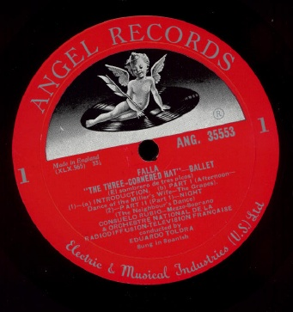
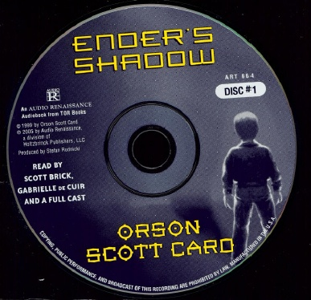
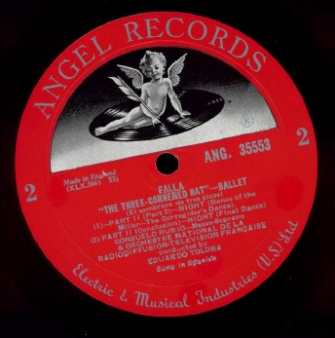
Preferred source

Slide 7
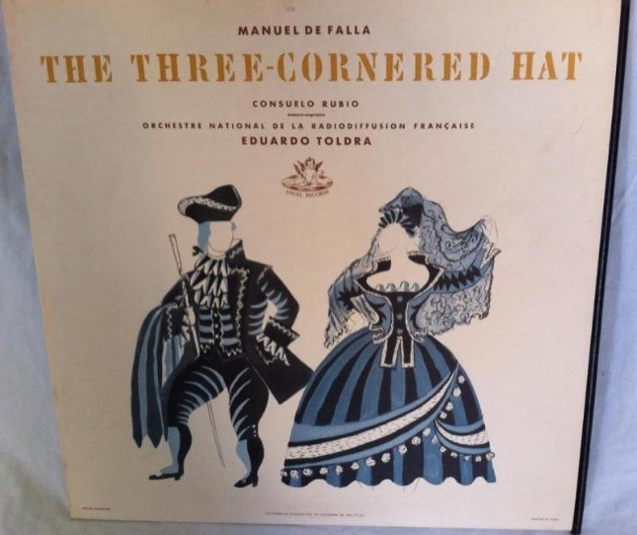
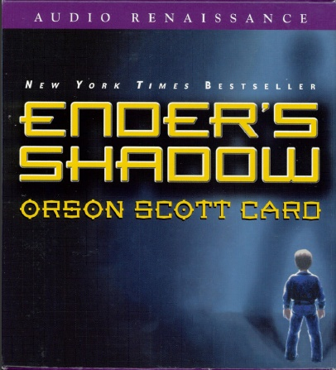
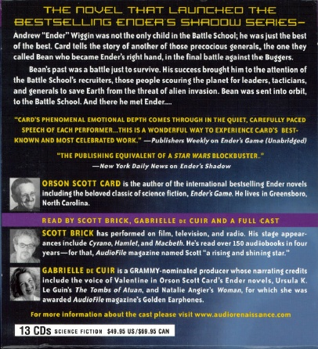
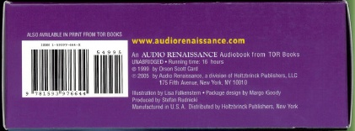
Other sources (container)
Notes:
Use the preferred source for title transcription. Information not available there can come from the container.

Slide 8
Title
Transcribe the title proper, parallel title proper and other title information exactly as found on the preferred source.
245 14 $a The three-cornered hat = $b El sombrero de tres picos : ballet
245 10 $a Ender’s shadow

Slide 9
Statement of Responsibility
Same as for other formats except
Statements identifying performers of music (7.23)
Statements identifying narrators, presenters, other kinds of performers (e.g. actors) (7.23)
Statements identifying contributors to the artistic and/or technical production (7.24)
These statements are recorded as notes (511 or 508 field)
Notes:
Read together 2.4.1.1, exceptions for performers and narrators--click through to 7.23.

Slide 10
Statement of Responsibility
Side 1 label reads:
falla
THE THREE CORNERED HAT - BALLET
(El sombrero de tres picos)
[list of tracks]
CONSUELO RUBIO - Mezzo-soprano
& ORCHESTRE NATIONAL DE LA RADIODIFFUSION-Télévision française
Conducted by Eduardo Toldrá
Sung in Spanish
245 14 $a The three-cornered hat = $b El sombrero de tres picos : ballet / $c Falla.
Notes:
Don’t transcribe the part about the performers.

Slide 11
Statement of Responsibility
Disc 1 label reads:
Ender’s Shadow
Orson Scott Card
Read by Scott Brick, Gabrielle de Cuir
and a full cast
produced by stefan rudnicki
245 10 $a Ender’s shadow / $c Orson Scott Card.
Notes:
Read together 2.4.1.1, exceptions for performers and narrators--click through to 7.23.

Slide 12
Edition Statement
Transcribe any edition statement you find.
“Unabridged” is considered an edition statement.
245 10 $a Ender’s shadow / $c Orson Scott Card.
250 $a Unabridged.

Slide 13
Publication Statement
Record publication information as you find it.
264 _1 $a [New York City] : $b Angel Records, $c [1958]
264 _1 $a New York, NY : $b Audio Renaissance, $c [2005]
Notes:
Place of publication is often omitted in resources, so you may have to search to find out where the publisher was located. Also be careful to distinguish publishers from distributors.
I learned from Wikipedia that Angel Records was a subsidiary of the British recording company EMI, and it was located in New York City. Gramophone magazine (freely available online) reviewed the Falla recording in July 1958, so I estimated the date of publication as that year.
The date of publication for the Card recording was supplied based on the phonogram date.

Slide 14
Copyright information
Phonogram is a copyright in a sound recording.
Current RDA: Not core, but if you record it, record the latest copyright date (whether it’s a copyright or phonogram date)
264 _4 $c ℗2005
Multiple copyright dates that apply to different aspects of the resource can all be recorded
264 _4 $c ℗2005
264 _4 $c ©2001

Slide 15
Distribution information
Optionally record distribution information
264 _2 $b Universal Music & Video Distribution
Source reads: Distributed by Universal Music & Video Distribution; no place given
Notes:
You don’t need to record a place, in fact you don’t need to record any of it--none of it is core unless publication information has not been identified.

Slide 16
Manufacture information
Optionally record manufacture information
264 _3 $a Studio City, CA : $b Varèse Sarabande Records, Inc.
Source reads: Studio City, CA Manufactured by Varèse Sarabande Records, Inc.

Slide 17
Extent (3.4.1)
Record the number of units with an audio term from the carrier type list in 3.3.1.3
300 $a 1 audio disc
300 $a 13 audio discs
Notes:
Go to 3.3.1.3

Slide 18
Duration (7.22)
Record the duration in parentheses following the extent if it can be determined. Abbreviate “hr.” “min.” “sec.”
300 $a 1 audio disc
300 $a 13 audio discs (16 hr.)
Notes:
7.22. Note this is an attribute of the expression, not the manifestation. The duration for the Falla isn’t given on the item, so I don’t record it. The duration of the Card book is given on the box. Note that unusually “min.” and “hr.” are abbreviated.

Slide 19
Dimensions (3.5)
Record dimensions according to the appropriate format in 3.5.1.4
Discs: record diameter (LC records in inches)
Compact disc
300 ... ; $c 4 3/4 in. or 12 cm
LP
300 ... ; $c 12 in. or 30 cm
Cassettes: record length x height, followed by the width of the tape (LC records in inches)
300 ... ; $c 3 7/8 x 2 1/2 in., 1/8 in. tape. or 10 × 7 cm, 4 mm tape.
Notes:
Everyone open to 3.5.1.4. The preferred unit of measure is metric, but alternatively the cataloging agency can choose another unit of measure. For discs, LC has chosen to measure in inches. Note this is abbreviated.

Slide 20
Record content, media, and carrier type (3.2, 3.3, 6.9)
245 14 $a The three-cornered hat = $b El sombrero de tres picos : ballet / $c Falla.
336 $a performed music $2 rdacontent
337 $a audio $2 rdamedia
338 $a audio disc $2 rdacarrier
245 10 $a Ender’s shadow / $c Orson Scott Card.
336 $a spoken word $2 rdacontent
337 $a audio $2 rdamedia
338 $a audio disc $2 rdacarrier

Slide 21
Sound Characteristic (3.16)
Record in 344 field
type of recording in $a
344 $a digital
344 $a analog
recording medium in $b
344 $b magnetic [for tapes]
344 $b magneto-optical
344 $b optical [for digital discs]
Notes:
Note: this information used to be recorded in 300 subfield $b.

Slide 22
Sound Characteristic (3.16)
Record in 344 field
playing speed in subfield $c
344 $c 33 1/3 rpm
344 $c 45 rpm
playback configuration in $g
344 $g mono
344 $g stereo
344 $g quadraphonic
344 $g surround
Notes:
There are other sound characteristics but these are the most commonly recorded.

Slide 23
Sound Characteristic (3.16)
End the 344 field with $2 rda if you’ve used the vocabulary prescribed by RDA.
245 14 $a The three-cornered hat = $b El sombrero de tres picos : ballet / $c Falla.
344 $a analog $c 33 1/3 rpm $g mono $2 rda
245 10 $a Ender’s shadow / $c Orson Scott Card.
344 $a digital $b optical $g stereo $2 rda

Slide 24
Digital File Characteristic (3.19)
Record in 347
File type in $a
347 $a audio file
Encoding format in $b
347 $b CD audio
347 $b MP3
347 $b SACD
Notes:
Everyone look at 3.19.

Slide 25
Digital File Characteristic (3.19)
End the 347 field with $2 rda if you’ve used the vocabulary prescribed by RDA.
245 10 $a Ender’s shadow / $c Orson Scott Card.
347 $a audio file $b CD audio $2 rda
Notes:
Everyone look at 3.19. The Falla recording is not digital and so this element will not be recorded.

Slide 26
Series Statement
Record series statement if present on the item (no different from any other format)

Slide 27
Notes
Record notes as appropriate.
summary of content (RDA 7.10, MARC 520)
520 $a A magistrate infatuated with a miller’s faithful wife attempts to seduce her.
520 $a An orphan named Bean is found on the streets of Amsterdam and taken to Battle School, where he becomes both friend and rival to Ender Wiggin. Parallel story to Ender’s game.
date and place of capture (RDA 7.11, MARC 518)
518 $a Recorded at Saint Martin-in-the-Fields, London, January 16, 2010.

Slide 28
Notes: Performer, Narrator, Presenter (7.23)
Record in 511.
List the names as concisely as possible, together with information about what each did.
245 14 $a The three-cornered hat = $b El sombrero de tres picos : ballet / $c Falla.
511 0_ $a Consuelo Rubio, mezzo-soprano; Orchestre national de la Radiodiffusion-télévision française; Eduardo Toldrá, conductor.
245 10 $a Ender’s shadow / $c Orson Scott Card.
511 0_ $a Read by Scott Brick, Gabrielle de Cuir and a full cast.

Slide 29
Notes: Artistic or Technical Credit (7.24)
Record in 508.
List the names as concisely as possible, together with information about what each did.
245 10 $a Ender’s shadow / $c Orson Scott Card.
508 $a Producer, Stefan Rudniki.

Slide 30
Identifier for the manifestation (2.15)
Record identifiers
ISBN in 020
Publisher number in 028 02
028 02 $a ANG. 35553 $b Angel Records
245 14 $a The three-cornered hat = $b El sombrero de tres picos : ballet / $c Falla.
020 $a 159397664X
028 02 $a ART 664 $b Audio Renaissance
245 10 $a Ender’s shadow / $c Orson Scott Card.

Slide 31
Record Relationships
Record the principal creator. For a musical work this will usually be the composer.
100 1 $a Falla, Manuel de, $d 1876-1946, $e composer.
245 14 $a The three-cornered hat = $b El sombrero de tres picos : ballet / $c Falla.
100 1 $a Card, Orson Scott, $e author.
245 10 $a Ender’s shadow / $c Orson Scott Card.

Slide 32
Record Relationships
Record the relationship of the resource to the work embodied in it.
100 1 $a Falla, Manuel de, $d 1876-1946, $e composer.
240 10 $a Sombrero de tres picos
245 14 $a The three-cornered hat = $b El sombrero de tres picos : ballet / $c Falla.
100 1 $a Card, Orson Scott, $e author.
240 10 $a Ender’s shadow. $l English. $h Spoken word
245 10 $a Ender’s shadow / $c Orson Scott Card.
or
100 1 $a Card, Orson Scott, $e author.
245 10 $a Ender’s shadow / $c Orson Scott Card.
Notes:
Reminder: this is done by embedding the authorized access point for the work in the record. I looked up the authorized access point for the three-cornered hat and recorded it as established.
For the Card work, we can do this by recording the authorized access point for the expression, which contains the authorized access point for the work. Alternately, this relationship can be recorded by the combination of the 100 + 245 $a because the title proper is also the preferred title of the work.
In 240 for Ender’s shadow, subfield $h does not currently work in OCLC. Until they activate that subfield, we will use subfield $s

Slide 33
Record Relationships
Record other relationships you consider important.
245 14 $a The three-cornered hat = $b El sombrero de tres picos : ballet / $c Falla.
700 1_ $a Rubio, Consuelo, $e singer.
700 1_ $a Toldrà, Eduardo, $e conductor.
710 2_ $a Radiodiffusion-Télévision française. $b Orchestre national, $e performer.
245 10 $a Ender’s shadow / $c Orson Scott Card.
700 1_ $a Rudnicki, Stefan, $d 1945- $e producer.
700 1_ $a Brick, Scott, $e performer.
700 1_ $a De Cuir, Gabrielle, $e performer.
Notes:
I checked the authority file for all these forms.

Slide 34
Exercise
Work together to catalog audio materials workshop participants have brought, if any.

Slide 35
Module 12 Describing Audio Recordings Questions?
RDA Training
Harold B. Lee Library, Brigham Young University
Fall 2015

Slide 36
This Presentation is available at
http://net.lib.byu.edu/~catalog/people/rlm/RDAUtah201511/index.htm
For further information
contact Robert L. Maxwell
robert_maxwell@byu.edu

