Slide 1
Module 15 Describing Printed Maps
RDA Training Utah State Library
Harold B. Lee Library, Brigham Young University
April 2014
Notes:
This module is intended to cover special procedures for maps that differ from books. We’ve already covered thoroughly how to describe a book. We won’t go over all that again, exept to note when you do the same thing for a map.

Slide 2
Please log in to RDA
http://access.rdatoolkit.org/login
ID: aprilrda
Password: training
Please feel free to sign up later for a month’s free access so you can practice (see handout)
Notes:
From now on, as I show slides of RDA, please feel free to go ahead and look yourself in the Toolkit.

Slide 3
Mode of Issuance
Single unit monograph?
Multipart monograph?
Serial?
Integrating resource?
Notes:
This module only covers monographs.

Slide 4
Basis for Identification RDA 2.1
Single unit monograph
The item itself
Multipart monograph
The first unit
Notes:
The Brahms sonata is an example.

Slide 5
Preferred Source of Information RDA 2.2.2
Choose, in the part chosen as the basis for identification,
the title sheet (e.g. for a map in a series of sheets), title page (e.g. for an atlas), or title card
if none of these is available, use (in this order)
cover
caption (very common for maps)
masthead
colophon

Slide 6
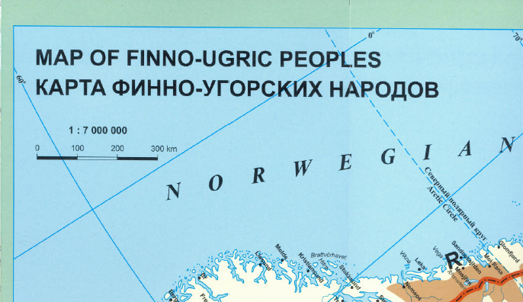
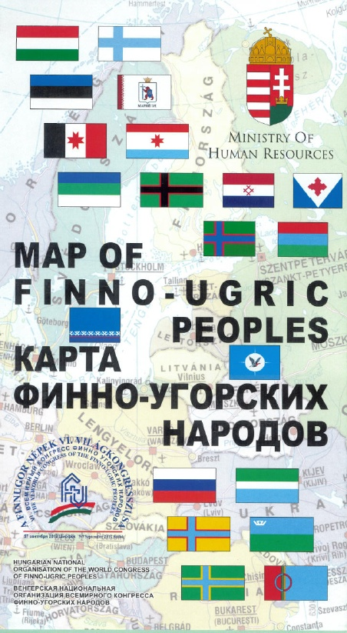
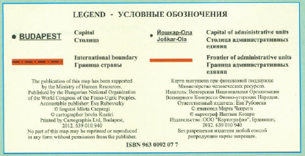
Preferred source
Notes:
No title page. We have a cover and a caption. Which one?

Slide 7
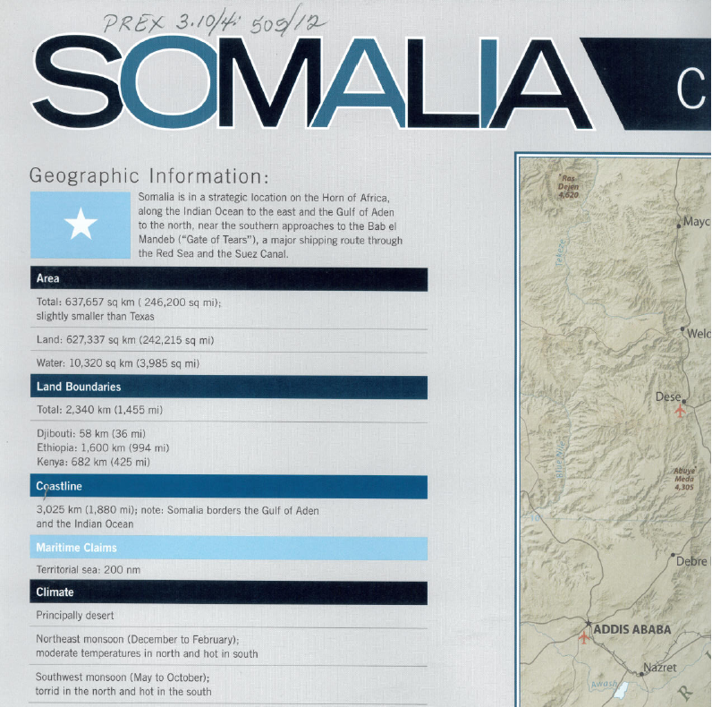
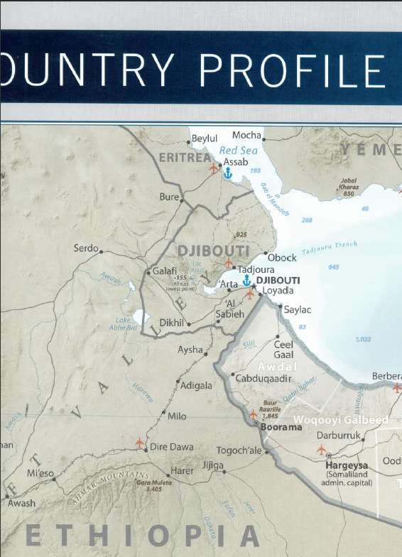
Preferred source
Notes:
No title page. We have a title page and a caption. Which one?

Slide 8
Title
Transcribe the title proper, parallel title proper and other title information exactly as found on the preferred source.
245 00 $a Map of Finno-Ugric peoples = $b Карта финно-угорских народов
245 10 $a Somalia : $b country profile
Notes:
Note parallel title proper is not core so you can catalog this map even if you don’t know how to transliterate the cyrillic alphabet (or don’t have help like I did).

Slide 9
Other title information
Record, just as with other resources
For cartographic resources, you may supply other title information if the title proper does not include an indication of the area covered
245 10 $a National parks : $b [in South Africa]

Slide 10
Variant title
Variant titles are not core. Record any variant titles you think would help a library user find the resource in a 246 field
245 00 $a Map of Finno-Ugric peoples = $b Карта финно-угорских народов
246 11 $a Карта финно-угорских народов
246 11 $a Karta finno-ugorskikh narodov

Slide 11
Statement of Responsibility
Same as for other formats
The first statement of responsibility relating to the title proper is core, i.e., required. Others are optional.
Statements of responsibility relating to the title proper may be taken from any source in the resource, i.e., they do not have to appear with the title proper
Record in 245 subfield $c following space-slash-space

Slide 12
Statement of Responsibility
245 00 $a Map of Finno-Ugric peoples = $b Карта финно-угорских народов / $c Hungarian National Organisation of the World Congress of Finno-Ugric Peoples

Slide 13
Edition Statement
Transcribe any edition statement you find.
245 10 $a State of Mississippi : $b base map / $c compiled, edited and published by the Geological Survey.
250 $a Edition of 1972.
245 10 $a The Americas / $c compiled in 1952 by the American Geographical Society ; prepared by the Army Map Service.
250 $a Edition 1-AMS, No. 1111.
Notes:
A couple of examples of map edition statements.

Slide 14
Scale (RDA 7.25)
Scale = the ratio of the dimensions of an image . . . to the dimensions of the entity it represents
Record as a representative fraction (1:XXXX)
Scale is core for maps
If scale is not given and cannot be supplied, record “Scale not given”
Record scale in 255 subfield $a

Slide 15
Scale (RDA 7.25)
245 00 $a Map of Finno-Ugric peoples = $b Карта финно-угорских народов / $c Hungarian National Organisation of the World Congress of Finno-Ugric Peoples.
255 $a Scale 1:7,000,000
245 10 $a Somalia : $b country profile.
255 $a Scale 1:3,500,000
Notes:
In both of these cases scale was found on the resource.

Slide 16
Projection of Cartographic Content (RDA 7.26)
The method or system used to represent the surface of a sphere on a flat surface
Transcribe a statement of projection if it appears on the resource
Transcribe in 255 subfield $b

Slide 17
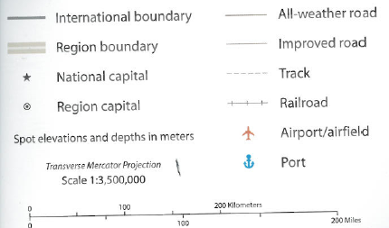
Projection of Cartographic Content (RDA 7.26)
245 10 $a Somalia : $b country profile.
255 $a Scale 1:3,500,000 ; $b transverse Mercator projection

Slide 18
Coordinates (RDA 7.4)
Longitude and latitude
Take the information from the resource, or from any other source
Record westernmost and easternmost longitude, then northernmost and southernmost latitude
Record in 255 subfield $c
Notes:
Longitude and latitude are usually marked on maps

Slide 19
Coordinates (RDA 7.4)
245 10 $a Somalia : $b country profile.
255 $a Scale 1:3,500,000 ; $b Transverse Mercator projection $c (E 38°--E 52°/N 13°--S 3°).
245 00 $a Map of Finno-Ugric peoples = $b Карта финно-угорских народов / $c Hungarian National Organisation of the World Congress of Finno-Ugric Peoples.
255 $a Scale 1:7,000,000 $c (E 0°--E 110°/N 80°--N 40°).

Slide 20
Publication Statement
Record publication information as you find it (or supply)
245 10 $a Somalia : $b country profile.
264 _1 $a [Washington, D.C.] : $b [Central Intelligence Agency], $c [2012]
245 00 $a Map of Finno-Ugric peoples = $b Карта финно-угорских народов / $c Hungarian National Organisation of the World Congress of Finno-Ugric Peoples.
264 _1 $a Budapest : $b Hungarian National Organisation of the World Congress of Finno-Ugric Peoples, $c [2012]
Notes:
Somalia: information came with the map, but not on the map. The Finn-Ugric peoples map had a printing date; since that was the same year as we received the map, I assumed it was also the publication date.

Slide 21
Copyright information
Copyright is not core, but may be recorded if present
264 _4 $c ©2008

Slide 22
Distribution or Manufacture information
Optionally record distribution or manufacture information
245 00 $a Map of Finno-Ugric peoples = $b Карта финно-угорских народов / $c Hungarian National Organisation of the World Congress of Finno-Ugric Peoples.
264 _1 $a Budapest : $b Hungarian National Organisation of the World Congress of Finno-Ugric Peoples, $c [2012]
264 _3 $a Budapest : $b Cartographia Ltd., $c 2012.
Source reads: Printed by Cartographia Ltd., Budapest, 2012.
Notes:
Note in this case Hal Leonard Corp. is both the printer and the distributor.

Slide 23
Extent (3.4.2)
Record the number of units with a term from the list in 3.4.2.2
300 $a 1 map
300 $a 1 globe
For an atlas, specify the number of pages, volumes, etc.
300 $a 1 atlas (3 volumes)
300 $a 1 atlas (xx, 432 pages)

Slide 24
Extent (3.4.2)
245 00 $a Map of Finno-Ugric peoples = $b Карта финно-угорских народов / $c Hungarian National Organisation of the World Congress of Finno-Ugric Peoples.
300 $a 1 map
245 10 $a Somalia : $b country profile.
300 $a 1 map

Slide 25
Extent (3.4.2)
More than one map on a sheet (not including insets)
300 $a 5 maps on 2 sheets
300 $a 2 maps on 1 sheet
Notes:
Remember that a single sheet has two sides--it’s common for separate maps to be on either side of one sheet.

Slide 26
Color Content (7.17)
If colors other than black and white are present, record “color”.
Record in 300 subfield $b
245 00 $a Map of Finno-Ugric peoples = $b Карта финно-угорских народов / $c Hungarian National Organisation of the World Congress of Finno-Ugric Peoples.
300 $a 1 map : $b color
245 10 $a Somalia : $b country profile.
300 $a 1 map : $b color

Slide 27
Dimensions (3.5.2.2)
Measure within the neat lines (lines marking the outer edge of a map or chart, separating its detail from any border or margin)
Record height x width in 300 subfield $c
245 00 $a Map of Finno-Ugric peoples = $b Карта финно-угорских народов / $c Hungarian National Organisation of the World Congress of Finno-Ugric Peoples.
300 $a 1 map : $b color ; $c 44 x 97 cm
245 10 $a Somalia : $b country profile.
300 $a 1 map : $b color ; $c 54 x 44 cm
Notes:
Show the neat lines on the maps.

Slide 28
Dimensions (3.5.2.5)
if the map is less than half the size of the sheet, or there is substantial additional information on the sheet, also record the dimensions of the sheet.
245 00 $a Map of Finno-Ugric peoples = $b Карта финно-угорских народов / $c Hungarian National Organisation of the World Congress of Finno-Ugric Peoples.
300 $a 1 map : $b color ; $c 44 x 97 cm, on sheet 66 x 99 cm
245 10 $a Somalia : $b country profile.
300 $a 1 map : $b color ; $c 54 x 44 cm, on sheet 70 x 99 cm

Slide 29
Dimensions (3.5.2.6)
if the map is intended to be folded, add the dimensions of the sheet in folded form
245 00 $a Map of Finno-Ugric peoples = $b Карта финно-угорских народов / $c Hungarian National Organisation of the World Congress of Finno-Ugric Peoples.
300 $a 1 map : $b color ; $c 44 x 97 cm, on sheet 66 x 99 cm, folded to 23 x 13 cm
Notes:
There are lots of other details about recording dimensions of maps in 3.5.2.

Slide 30
Record content, media, and carrier type (3.2, 3.3, 6.9)
Sheet map(s)
336 $a cartographic image $2 rdacontent
337 $a unmediated $2 rdamedia
338 $a sheet $2 rdacarrier
Atlas
336 $a cartographic image $2 rdacontent
337 $a unmediated $2 rdamedia
338 $a volume $2 rdacarrier
Notes:
Some possible combinations for maps

Slide 31
Series Statement
Record series statement if present on the item (no different from any other format)
245 10 $a Geologic map of the Stokes Mountain region, western Sierra Nevada Mountains, California.
490 0 $a Map and chart series / Geological Society of America ; $v MCH100

Slide 32
Notes
Record notes as appropriate.
language (RDA 7.12, MARC 546)
546 $a Legend in English and Russian.
method of showing relief or depth (RDA 7.27, MARC 500)
500 $a Relief shown by shading and spot heights.
500 $a Depth shown by bathymetric tints and soundings.
numbers (MARC 500)
500 $a “446646ID 3-12.”
details of ancillary material (RDA 25, MARC 500 or 505)
500 $a Includes ancillary maps: Clan distribution -- Land use and economic activity -- Somaliland and Puntland -- Population density -- Indian Ocean Range Rings -- Neighborhoods of Mogadishu.
Notes:
A few examples of typical notes for maps.

Slide 33
Notes
245 00 $a Map of Finno-Ugric peoples = $b Карта финно-угорских народов / $c Hungarian National Organisation of the World Congress of Finno-Ugric Peoples.
546 $a Legend in English and Russian.
500 $a Includes ancillary maps: Ancient homelands of the Uralic peoples and the migration of the Hungarians -- Europe in the 10th century -- Routes of some Hungarian research expeditions before 1914.
245 10 $a Somalia : $b country profile.
500 $a “446646ID 3-12.”
500 $a Relief shown by shading and spot heights.
500 $a Depth shown by bathymetric tints and soundings.
500 $a Includes text, timeline of major events between 1887 and 2011, and comparative area map. Shows boundaries, populated places.
500 $a Includes ancillary maps: Clan distribution -- Land use and economic activity -- Somaliland and Puntland -- Population density -- Indian Ocean Range Rings -- Neighborhoods of Mogadishu.

Slide 34
Identifier for the manifestation (2.15)
Record identifiers
ISBN in 020
020 $a 9630092077
245 10 $a Map of Finno-Ugric peoples = $b Карта финно-угорских народов / $c Hungarian National Organisation of the World Congress of Finno-Ugric Peoples ; cartographer István Kozári.
Notes:
Remember also the number recorded as a note in the previous slides. This is probably an identifier for the manifestation.

Slide 35
Record Relationships
Record the principal creator (cf. 19.2.1.1.1e)
100 1_ $a Kozári, István, $e cartographer.
245 10 $a Map of Finno-Ugric peoples = $b Карта финно-угорских народов / $c Hungarian National Organisation of the World Congress of Finno-Ugric Peoples ; cartographer István Kozári.
110 1 $a United States. $b Central Intelligence Agency, $e cartographer.
245 10 $a Somalia : $b country profile.

Slide 36
Record Relationships
Record the relationship of the resource to the work embodied in it.
100 1_ $a Kozári, István, $e cartographer.
245 10 $a Map of Finno-Ugric peoples = $b Карта финно-угорских народов / $c Hungarian National Organisation of the World Congress of Finno-Ugric Peoples ; cartographer István Kozári.
110 1 $a United States. $b Central Intelligence Agency, $e cartographer.
245 10 $a Somalia : $b country profile.
Notes:
Reminder: this is done by embedding the authorized access point for the work in the record.
We’ve talked about the LC policy of not explicitly including an authorized access point for the work if the title proper in the 245 is exactly the same as the preferred title of the work. This will apply to most maps.

Slide 37
Record Relationships
Record other relationships you consider important.
245 10 $a Map of Finno-Ugric peoples = $b Карта финно-угорских народов / $c Hungarian National Organisation of the World Congress of Finno-Ugric Peoples ; cartographer István Kozári.
710 2_ $a World Congress of Finno-Ugric Peoples. $b Hungarian National Organisation, $e publisher.
Notes:
I checked the authority file for all these forms.

Slide 38
Exercise
Work together to catalog maps workshop participants have brought, if any.

Slide 39
Module 15 Describing Printed Maps Questions?
RDA Training Utah State Library
Harold B. Lee Library, Brigham Young University
April 2014

Slide 40
This Presentation is available at
http://net.lib.byu.edu/~catalog/people/rlm/RDAUtah201404/index.htm
For further information
contact Robert L. Maxwell
robert_maxwell@byu.edu

