Slide 1
Module 4 Describing Persons
RDA Training Brigham Young University,
Utah State Library,
University of Utah,
November 2012

Slide 2
Login information for workshop
access.rdatoolkit.org (login at BYU is by IP authentication)
Utah State Library workshop: Please feel free to sign up later for a month’s free access so you can practice (see handout)
Notes:
Please go to RDA 8.1. Have someone read the definition of person in 8.1.2.

Slide 3
Identifying Persons: MARC Coding
Persons are currently described in the MARC authority format.
RDA records identified by “z” in 008/10 (“Rules”) and $e rda in 040

Slide 4
Identifying Persons: Definition
8.1.2. The term person refers to an individual or an identity established by an individual (either alone or in collaboration with one or more other individuals).
This definition includes fictitious entities (RDA 9.0 makes this explicit) and non-human entities such as named animals.
This is a broader definition than AACR2.

Slide 5
Non-traditional person
Authority record
046 ‡f 1976~ ‡g 2003-12-12 ‡2 edtf
100 0 ‡a Keiko,­ ‡d approximately 1976-2003
373 ‡a Marineland
374 ‡a Actor
375 ‡a male
670 ‡a Free Willy, 1993: ‡b credits (Keiko as Willy)
670 ‡a Wikipedia, 3 August 2011 ‡b (Keiko; born approximately 1976, died December 12, 2003; male orca actor who starred in the film Free Willy; captured near Iceland in 1979, later sold to Marineland in Ontario; performed in parks in North America)
Abbreviated bibliographic record
245 00 ‡a Free Willy / ‡c Warner Bros. in association with Le Studio Canal+, Regency Enterprises and Alcor Films.
…
700 0 ‡a Keiko,­ ‡d approximately 1976-2003, ‡e actor.

Slide 6
Identifying Persons: Core Elements
Preferred name
Certain titles
Date of birth and death
Other designation associated with the person
Profession or occupation if the name does not convey the idea of a person
Identifier
Notes:
Open to RDA 8.3, looking for core elements for the person. This is yet another place where core elements are mentioned. CLICK THROUGH as people find them.
Note: these are all core, required, but (a) do not necessarily wind up in the authorized access point for the person; and (b) they don’t necessarily mean what you think they mean. It does mean that they are required to be in the description if applicable and readily ascertainable.
Titles = titles of royalty, nobility in certain cases, certain religious titles if the person does not have a surname.
Other designation = Saint, Spirit; otherwise only core if needed to distinguish.

Slide 7
Identifying Persons: Core if needed to distinguish
Fuller form of name
Profession or occupation
Period of activity
Notes:
Again, these are not necessarily going to be in the access point; and even though they may only be core under certain circumtances, you can certainly record them in the description even if not core.

Slide 8
Identifying Persons: Transcription and Capitalization
8.5.1. Follow Appendix A.2
8.5.4. Diacritical marks: record them as they appear; add them if it is certain that they are integral to the name but were omitted in the source
8.5.5. Retain hyphens if used by the person
8.5.6. Instructions about spacing between initials
8.5.7. Abbreviations. Follow the usage of the person
8.4. Language and script. NACO policy = Romanize vernacular scripts.
Notes:
Go to 8.5.1; have someone read, especially 8.5.6.1. Then go to Appendix A.2 & B.2 and examine together.

Slide 9
RDA 8.12. Source Consulted
Record in 670 field, or 3XX $u/$v
Always include one 670 for the work being cataloged
Others included if needed to justify information in the description
Suggested format:
670 $a Title proper, date: $b citation (data)
Notes:
Everyone go to RDA 8.12.

Slide 10
670 field examples
670 $a Free Willy, 1993: $b credits (Keiko as Willy)
670 $a New York times, via WWW, October 27, 2008 $b (Tony Hillerman; born Anthony Grove Hillerman, May 27, 1925, Sacred Heart, Okla.; died Sunday [October 26, 2008], Albuquerque, aged 83; his lyrical, authentic, and compelling mystery novels set among the Navajos of the Southwest blazed innovative trails in the American detective story)
670 $a Euclid and his modern rivals, 1879: $b title page (Charles L. Dodgson)
670 $a Make money from woodturning, 1994:­ $b title page (Ann Phillips) page 155 (former research scientist; member New Zealand Tree Crops Association)
670 $a OCLC, June 23, 2011 $b (access point: Gaudenzi, Pellegrino, 1749–1784; usage: Pellegrino Gaudenzi)
Notes:
Explain the OCLC 670.
There are lots of ways to form these. The point is, record information justifying what you’ve included in other elements in the description.

Slide 11
Identifying Persons: Sources
Where can we get information about persons?
9.1.1: Take the name or names of the person from any source; take information on other identifying attributes from any source.

Slide 12
Identifying Persons: Sources
Sources to check
The resource you are cataloging
The LC/NACO Authority File (authorities.loc.gov)
Your database (e.g. OCLC)
Optional: Other useful sources
Virtual International Authority File (http://viaf.org)
Wikipedia (http://www.wikipedia.org/)
Other sources such as encyclopedias and dictionaries

Slide 13
Attributes of Persons: Name
Name is a core element
Preferred name
Chosen according to 9.2.2.3: “Choose the name by which the person is commonly known.”
9.2.2.2 and 9.2.2.6 give help in deciding the commonly known form
Note that the name includes terms indicating relationship (Jr., III, etc.). See 9.2.2.9.5. This is a change from AACR2.
Notes:
Please go to 9.2. The basic instructions for choosing the name are the same in RDA as in AACR2: We take names from any source, but one is chosen as the preferred name. READ 9.2.2.1 paragraph 1. Same as AACR2. Basic principle: Choose the name by which the person is commonly known. Same as AACR2.
Point out subtle difference in 9.2.2.2 from AACR2. AACR2 wanted resources “by” the person; RDA wants resources “associated with” the person.
Point out that 9.2.2.3 shows different kinds of names that might be chosen.
READ 9.2.2.6
One important change is that in RDA, if a person uses a term of relationship such as “Jr.” or “III”, that is included with the name. READ 9.2.2.9.5.

Slide 14
Attributes of Persons: Preferred Name (MARC)
Most RDA entity attributes have a discrete place in MARC to record them. Preferred name does not. It can only be recorded as part of the authorized access point for the person.
Record in the MARC authorities format 100 field, first indicator 1 (if the person has a surname) or 0 (if not)
Record the preferred name in subfield $a. Subfields $b and $c may also record part of the preferred name, if appropriate.
Notes:
LOOK AT MARC authority format 100 field.

Slide 15
Attributes of Persons: Preferred Name (MARC examples)
The preferred name is bolded in each example
100 1 $a Carter, Jimmy, $d 1924-
100 1 $a Lindbergh, Charles A. $q (Charles August), $d 1859- 1924
100 1 $a Presley, Elvis, $d 1935-1977 $c (Spirit)
100 0 $a Cher, $d 1946-
100 1 $a Smith, Joseph, $c Jr., $d 1805-1844
100 1 $a Brown, Hiram S., $c Jr. $q (Hiram Staunton),
$d 1909-1979
100 0 $a Elizabeth $b II, $c Queen of Great Britain, $d 1926-
Notes:
LOOK AT MARC authority format 100 field.
Only the bolded words are the preferred name. All other pieces of this field are other elements. Comment on each one. Note the order of elements in the Brown, Hiram S. example.

Slide 16
Preferred Name?
Notes:
Piedra de Sol, a poem by Octavio Paz (1957)
Espiral de Luz, a book by Ianna Andréadis published in 2003.
Given the evidence here, what is the preferred name for the author of Piedra de Sol? Note, either one is a “resource associated with the person”.

Slide 17
Attributes of Persons: Name
9.2.2.4. If the name consists of several parts, record as the first element that part of the name under which the person would normally be listed in authoritative alphabetic lists in his or her language or country of residence or activity, followed by other parts of the name.
Preferred name: Octavio Paz (this is how the name appears in almost all publications of his works)
The preferred name is recorded: Paz, Octavio
Notes:
Open MARC21, look at 100 field.
Begin filling out an authority record worksheet for Octavio Paz. Record the preferred name in 100 $a.

Slide 18
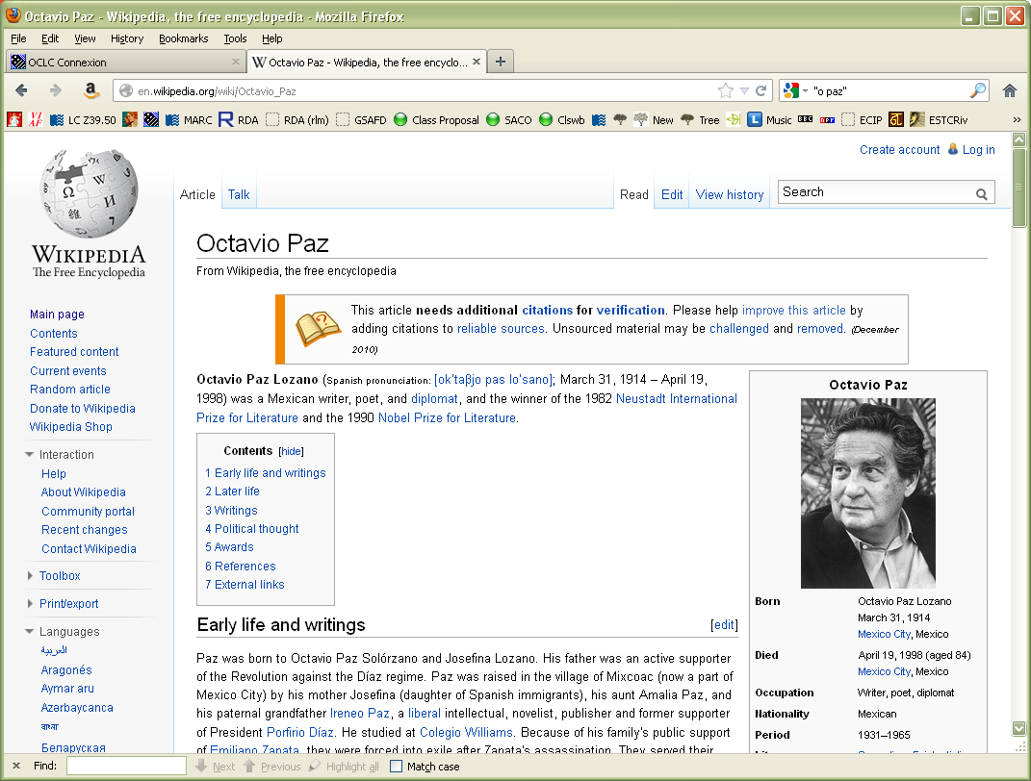
Notes:
Let’s see what Wikipedia has to say about this person. What other attributes do we learn about?
Variant name
Birth and death dates, places
occupations
Nationality
Gender
Language (we learn farther down the page)

Slide 19
Attributes of Persons: Name
9.2.2.6. Different names: if a person is known by more than one name, the commonly known form is chosen as the preferred name. Other names are recorded as variant names.
Octavio Paz is sometimes found as “Octavio Paz Lozano”
Consult 9.2.2.10 on the compound surname
Notes:
Read together 9.2.2.10 on the compound surname. Record the variant name in 400s (check MARC first, though)

Slide 20
Attributes of Person: Name
Compound Surnames. 9.2.2.10
When recording as a preferred name, generally record the first surname as the first part of the preferred name. When recording as variants, record all permutations.
Octavio Paz’s name is sometimes found as Octavio Paz Lozano. This is recorded as a variant name
Variant name recorded: Paz Lozano, Octavio
Variant name recorded: Lozano, Octavio Paz
Notes:
Read 9.2.2.10.
NOTE: We didn’t record “Paz Lozano, Octavio” as this person’s preferred name because he is not commonly known by that name.

Slide 21
Attributes of Persons: Variant Name (MARC)
Like the Preferred Name element, the Variant Name element (RDA 9.2.3) does not have a discrete place in MARC. It can only be recorded as part of the variant access point for the person.
Record in the MARC authorities format 400 field, first indicator 1 (if the person has a surname) or 0 (if not)
Record the variant name in subfield $a. Subfields $b and $c may also record part of the variant name, if appropriate.
Notes:
LOOK AT MARC authority format 400 field.

Slide 22
Attributes of Persons: Variant Name (MARC examples)
The variant name is bolded in each example
400 1 $a Carter, James Earl, $c Jr., $d 1924-
400 1 $a Lindbergh, C. A. $q (Charles August),
$d 1859-1924
400 1 $a Sarkisian, Cherilyn, $d 1946-
400 1 $a スミスジヨセフ, $d 1805-1844
400 1 $a Windsor, Elizabeth, $c Queen of Great Britain, $d 1926-
Notes:
LOOK AT MARC authority format 400 field.
Only the bolded words are the variant name. All other pieces of this field are other elements. Comment on each one. The fourth is a Japanese variant on Joseph Smith.
Record the variant name for Octavio Paz in another 400

Slide 23
Attributes of Persons: Name
9.2.2.7. Change of name
Generally choose the latest form as the preferred name, unless you have reason to believe that an earlier name will persist as the name by which the person is better known
Jacqueline Kennedy Onassis, not Jacqueline Bouvier, not Jacqueline Kennedy
but Caroline Kennedy, not Caroline Kennedy Schlossberg
Notes:
Read 9.2.2.7 together.
This is entirely a matter of judgment.

Slide 24
Attributes of Persons: Name
9.2.2.8. Individuals with more than one identity (pseudonyms, stage names, etc.)
Choose the name associated with each identity as the preferred name for that identity
Notes:
Open to 9.2.2.8.
Note this is a simplification of AACR2. No more contemporary vs. non-contemporary authors; no more worrying about bibliographic identities.

Slide 25
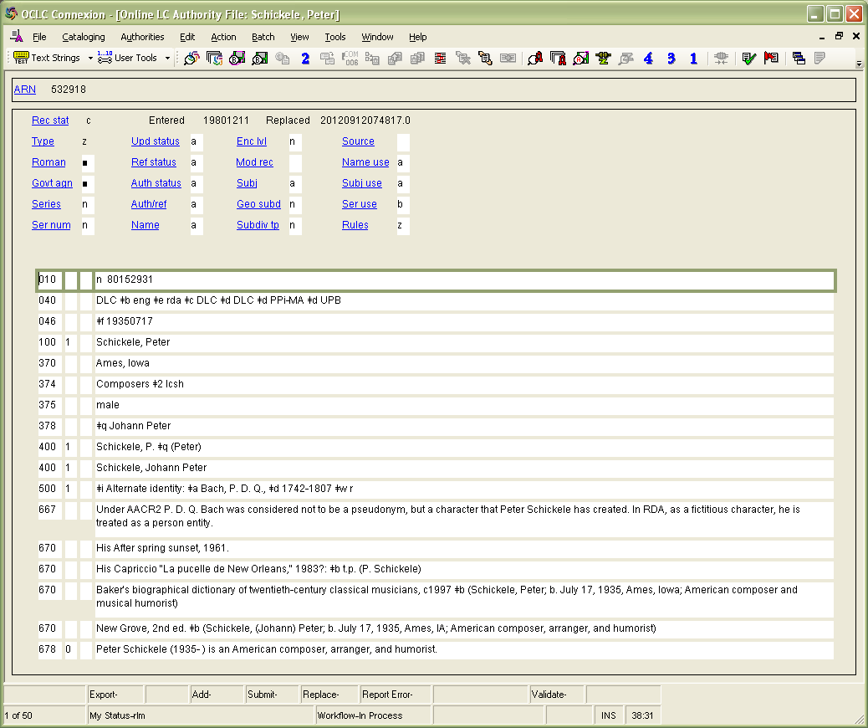
Notes:
Authority record for Peter Schickele: Preferred name = Schickele, Peter

Slide 26
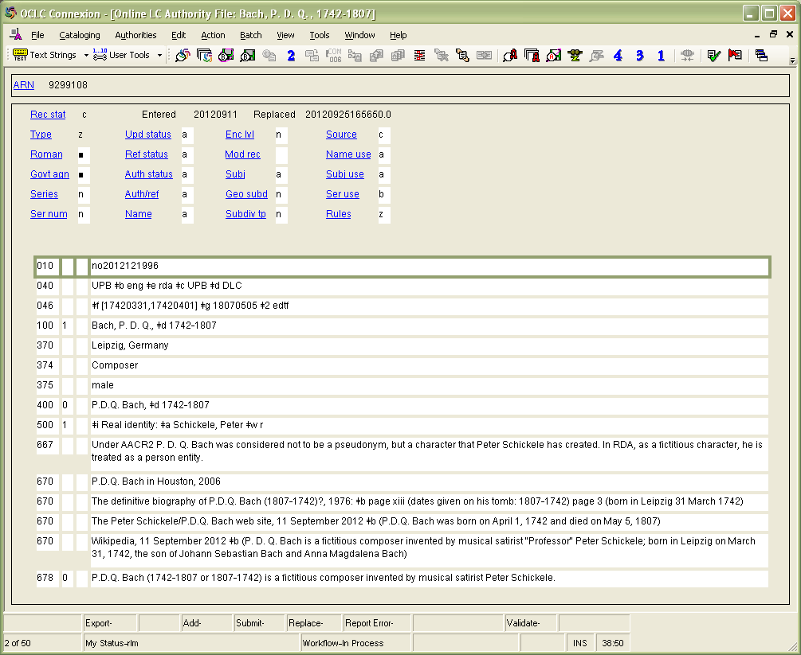
Notes:
Authority record for PDQ Bach. Preferred name: Bach, P. D. Q.

Slide 27
Attributes of Person: Name
9.2.2.11. Surnames with separately written prefixes
First element determined by the usage of the person’s language.
Notes:
Read together 9.2.2.11.

Slide 28
Exercise: How will the preferred name be recorded?
John Van Valkenburg (American)
Van Valkenburg, John
Dirk Van Valkenburg (Dutch)
Valkenburg, Dirk van
Jeroen Van Valkenburg (Afrikaans)
Van Valkenburg, Jeroen
Guy de Maupassant (French)
Maupassant, Guy de
Notes:
Consult Appendix F.11. While in Appendix F note special rules for particular kinds of names.

Slide 29
Attributes of Person: Name
9.2.2.14. Titles of nobility
9.2.2.18. Names without a surname
9.2.2.22. Names consisting of a phrase
Notes:
We don’t have time to go over these, but here is where the guidelines are. Treatment has not changed from AACR2.

Slide 30
Attributes of Person: Dates
Several types of date
Date of birth (9.3.2)
Date of death (9.3.3)
Period of activity (9.3.4)
The date element is core. If it is known it should be recorded as an element
This does not necessarily mean it will be recorded as part of the access point
Notes:
Go to RDA 9.3.2; have someone read the guidelines.

Slide 31
Attributes of Person: Dates
Basic instructions:
Known date: 2005
Probable date: 1957?
One of two years: 1675 or 1676
Approximate date: approximately 1953
Ranges of dates may also be recorded
Notes:
Everyone look at 9.3.1.3, where we learn how to record dates in RDA.

Slide 32
Attributes of Person: Dates
AACR2 RDA
Abbreviates months Does not abbreviate months
..., 15th cent. ..., active 15th century
..., ca. 1837-ca. 1896 ..., approximately 1837- approximately 1896
..., b. 1825 ..., 1825-
..., d. 1945 ..., -1945
..., fl. 1788-1803 ..., active 1788-1803
No “fl.” dates in 20th century No restriction
Note labels such as “born,” “died,” “active” and hyphens between dates are not prescribed in RDA, but are inherent in a given element, so only the date is recorded as part of the element. The label or hyphen is added or generated for display purposes. LC-PCC RDA practice is shown. Other practices would be possible (e.g. “born 1825” rather than “1825-”)
Notes:
LC-PCC Practice is shown.

Slide 33
Attributes of Person: Dates
This element is recorded in MARC 046 in the format YYYYMMDD or YYYY-MM or YYYY
If date information is more complex, use EDTF format http://www.loc.gov/standards/datetime/
Birth date is recorded in $f; death date in $g
Notes:
GO TO MARC 046 field
See LC-PCC PS to 9.3.13 together. Gives a good summary of how to encode dates in 046 field.
RECORD dates for Octavio Paz in 046. Hold off on adding to the access points.

Slide 34
Attributes of Person: Dates
Because these are core elements, if known they must be recorded as elements in 046 or in 100 as part of the authorized access point, or both.
Add dates to the authorized access point when establishing a name if they are known but generally do not add to already established forms.
According to Wikipedia, Octavio Paz was born March 31, 1914 and died April 19, 1998.
Notes:
GO TO MARC 046 field
See LC-PCC PS to 9.3.13 together. Gives a good summary of how to encode dates in 046 field.
RECORD dates for Octavio Paz in 046. Hold off on adding to the access points.

Slide 35
Attributes of Person: Fuller Form
9.5.1.1: A fuller form of name is the full form of a part of a name represented only by an initial or abbreviation in the form chosen as the preferred name, or a part of the name not included in the form chosen as the preferred name.
Unlike dates, fuller form is core only if needed to distinguish one person from another with the same name.
Notes:
Open to 9.5. NOTE: The second part, after “or”, expands the AACR2 definition.

Slide 36
Attributes of Person: Fuller Form
Caution: fuller forms may expand initials or abbreviations.
William may be a fuller form of “Wm.”
George may be a fuller form of “G.”
Fuller forms are not longer forms of different names such as nicknames.
Albert is not a fuller form of “Al”
Christopher is not a fuller form of “Chris”
Notes:
.

Slide 37
Attributes of Person: Fuller Form
Fuller form is recorded in $q of a MARC authorities 378 field.
It may also appear in the authorized access point in subfield $q.

Slide 38
Attributes of Person: Fuller Form
Octavio Paz’s surname sometimes appears as Paz Lozano, as seen in the Wikipedia article. This is a fuller form of the surname Paz.
Notes:
Record Octavio Paz’s fuller form on the worksheet in a 378 field. Do not do anything with the authorized access point yet.

Slide 39
Attributes of Person: Gender
9.7. Gender is recorded using one of these words:
male
female
not known
This attribute is not core, but may be recorded
In the MARC authority record, gender is recorded in 375
Octavio Paz’s gender is “male”.
Notes:
READ RDA 9.7 together.
Record gender in worksheet for Octavio Paz

Slide 40
Attributes of Person: Place
Place elements
9.8 (place of birth);
9.9 (place of death);
9.10 (country associated with the person);
9.11 (place of residence)
The place elements are not core, but may be recorded.
Notes:
Look together at 9.8-9.11.

Slide 41
Recording the Place Attribute
Place is recorded in MARC 370
Place of birth $a
Place of death $b
Associated country $c
Place of residence $e
Other associated place $f

Slide 42
Recording the Place Attribute
The form of the place name is governed by RDA Chapter 16.
Authorized access points for jurisdictional place names are generally formed as in AACR2, e.g. “Paris (France)” However:
16.2.2.4. “If the place name is being used to record ... a place associated with a person ... precede the name of the larger place by a comma.” -- e.g. “Paris, France”

Slide 43
Recording the Place Attribute
Abbreviations. 9.8-11 all say: “Abbreviate the names of countries, states, provinces, territories, etc., as instructed in appendix B (B.11), as applicable.”
So when recording this attribute for a person, use, e.g., “U.S.”, not “United States.”
Notes:
LOOK at B.11

Slide 44
Exercise: Recording the Place Attribute
These RDA forms are all found in the authority file. What form would you use to record the attribute for a person?
London (England) Mexico City (Mexico)
Austin (Tex.) Ontario (Calif.)
Arizona District of Columbia
United States Auckland (N.Z.)
France Puerto Rico
Notes:
Take time to look at Appendix B.11. Write forms on the board before going to the next slide.

Slide 45
Recording the Place Attribute
370 $a London, England [birthplace]
370 $b Mexico City, Mexico [death place]
370 $e Austin, Tex. [place of residence]
370 $f Ontario, Calif. [other associated place]
370 $a Ariz. [birthplace]
370 $b D.C. [death place]
370 $b U.S. [death place]
370 $a Auckland, N.Z. $b P.R. $c France
[birthplace, death place, associated country]
Notes:
Note that 370 can be repeated, or alternately subfields can be repeated within a single 370.

Slide 46
Recording the Place Attribute: LCSH
Place names can also be drawn from LCSH. If so, record them exactly as found and include $2 lcsh.
370 $a Cache Valley (Utah and Idaho) $2 lcsh [birthplace]
370 $b Pompeii (Extinct city) $2 lcsh [death place]
370 $e Tahoe, Lake (Calif. and Nev.) $2 lcsh [place of residence]
Do not mix NACO AF terms and LCSH terms in the same 370 field. If you need to use both, record them in separate fields.
Notes:
Note that 370 can be repeated, or alternately subfields can be repeated within a single 370.

Slide 47
Recording the Place Attribute
Octavio Paz was born and died in Mexico City. He lived parts of his life in Spain, the United States, and India.
Notes:
Record information about places associated with Octavio Paz on your worksheet.
Reference for places: The collected poems of Octavio Paz, 1957-1987, 1991, p. xiii (Spain) xiv (United States) xv (Mexican Ambassador to India in 1962)

Slide 48
Attributes of Person: Affiliation
9.13.1.1. An affiliation is a group with which a person is affiliated or has been affiliated through employment, membership, cultural identity, etc. This element is not core.
Affiliation is recorded in MARC 373.
Octavio Paz taught at Cambridge University, the University of Texas, and Harvard.
Notes:
LOOK TOGETHER AT 9.13.
Affiliation does not need to be recorded in the authorized form, but can be. If you do use the authorized form, include $2 naf in the field.
Record Paz’s affiliation
Reference for affiliation: The collected poems of Octavio Paz, 1957-1987, 1991 p. xv “Paz taught at Cambridge University, the University of Texas, and Harvard.”

Slide 49
Attributes of Person: Language
9.14. Language of the person is a language a person uses when writing for publication, broadcasting, etc.
Recorded in MARC 377, using the MARC language codes
Octavio Paz spoke and wrote in Spanish
Notes:
Look at 9.14 together. Also look at the MARC Language code list.
Record language attribute on the worksheet.

Slide 50
Attributes of Person: Field of Activity/Occupation
Field of Activity and Occupation are separate elements.
9.15.1.1. Field of activity of the person is a field of endeavour, area of expertise, etc., in which a person is engaged or was engaged.
9.16.1.1. Profession or occupation is a profession or occupation in which a person works or has worked.
Field of Activity: MARC 372
Occupation: MARC 374
Notes:
Read carefully 9.15 and 9.16 and look at the examples. The vocabulary is not controlled, but you may use a controlled vocabulary such as LCSH. If you do use a controlled vocabulary, include the code for the vocabulary in $2 (e.g. $2 lcsh).
Show where to find the codes (http://www.loc.gov/standards/sourcelist/ or go via loc.gov/marc => sources); also show the occupations thesauri at http://www.loc.gov/standards/sourcelist/occupation.html)
Record Octavio Paz’s occupation: (we know he was a poet and diplomat) and field of activity (whatever you think is appropriate in whatever form you’d like--show an example of using LCSH terms).

Slide 51
Attributes of Person: Biographical Information
9.17. Information pertaining to the life or history of the person. This element is not core
Record a brief statement about the person. This is entirely free text, in your own words, based on all the sources you have consulted.
Intended to be read by the public
Recommended format:
[Person’s name in direct order] ([dates]) was/is a [describe the person]
Notes:
Look at RDA 9.17 together

Slide 52
Attributes of Person: Biographical Information
Record this element in a MARC authority 678 field, first indicator “0”.
678 0 $a Hiram S. Brown, Jr. (1909-1979) was an American film producer.
678 0 $a Hugh Nibley (1910-2005) was a religion professor and author in Utah. He is well known for his writings on The Church of Jesus Christ of Latter-day Saints.
Notes:
Look at RDA 9.17 together

Slide 53
Attributes of Person: Identifier
A character string uniquely associated with a person or an authority record
LCCN associated with an authority record is an identifier, recorded in 010
The element is core, but it is usually added to record automatically
Notes:
Look at RDA 9.18 together

Slide 54
Constructing the Authorized Access Point for a Person (RDA 9.19.1)
Authorized Access Point is constructed using elements you have already recorded in the description
Begin with the preferred name (9.19.1.1)
Make required additions (9.19.1.2)
Notes:
Read 9.19 together.

Slide 55
Constructing the Authorized Access Point for a Person (RDA 9.19.1)
Make other additions if necessary to distinguish the new authorized access point from another (9.19.1.3-9.19.1.6)
Most of these can also be added even if it isn’t necessary to distinguish, but consult cataloging agency’s policy (e.g. PCC)
Notes:
Read 9.19 together.

Slide 56
Constructing Variant Access Points for a Person (RDA 9.19.2)
Variant access points are not core. Include them if in your judgment they would help the user find or identify the person.
Begin with a variant name (9.2.3)
Make further additions to the name if you consider them to be important for identification in the same way such additions would have been added to a preferred name. These additions are not required.
Notes:
Read 9.19.2 together.

Slide 57
Constructing the Access Points for a Person (RDA 9.19)
Construct the authorized access point for Octavio Paz and any variant access points on your worksheet.

Slide 58
Reminder: Source Consulted
RDA 8.12.1.3. Cite sources used to determine a preferred or variant name, followed by a brief statement of the information found. Identify the specific location within the source where the information was found.
RDA examples reflect NACO practice. Sources consulted are recorded in MARC 670 fields.
Notes:
Record the sources consulted on your worksheet (go back to the TP slide #6 and the Wikipedia slide #18 for Octavio Paz).

Slide 59
Related Persons (RDA 30)
Related persons are recorded in 500 fields, and may include a relationship indicator in subfield $i (from RDA Appendix K), with $w r.
100 1 $a Bach, P. D. Q., $d 1742-1807
500 1 $w r $i Real identity: $a Schickele, Peter
100 1 $a Schickele, Peter
500 1 $w r $i Alternate identity: $a Bach, P. D. Q., $d 1742-1807
Notes:
See slides #24-#26

Slide 60
Related Families (RDA 31)
Related families are also recorded in 500 fields. You may include a relationship indicator in subfield $i (from RDA Appendix K), with $w r.
100 1 $a Nibley, Hugh, $d 1910-2005
500 3 $ w r $i Descendants: $a Nibley (Family : $g Nibley, Hugh, 1910-2005)

Slide 61
Related Corporate Bodies (RDA 32)
Related bodies are recorded in 510 fields, and may include a relationship indicator in subfield $i (from RDA Appendix K), with $w r.
100 1 $a Hawkins, Alan J.
510 2 $w r $i Employer: $a Brigham Young University
100 1 $a Owens, Wayne, $d 1937-2002
510 1 $w r $i Group member of: $a United States. $b Congress. $b House

Slide 62
RDA authority record core and non-core
040 $a UPB $b eng $e rda $c UPB
046 $f 19140331 $g 19980419
100 1 $a Paz, Octavio, $d 1914-1998
400 1 $a Paz Lozano, Octavio, $d 1914-1998
400 1 $a Lozano, Octavio Paz, $d 1914-1998
400 1 $a Paz, O. $q (Octavio), $d 1914-1998
370 $a Mexico City, Mexico $b Mexico City, Mexico $c Spain $c U.S. $c India
373 $a Cambridge University $a University of Texas $a Harvard
374 $a Poet $a Diplomat
375 $a male
377 $a spa
378 $q Paz Lozano
670 $a Piedra de sol, 1957: $b title page (Octavio Paz)
670 $a The collected poems of Octavio Paz, 1957-1987, 1991 $b page xiii (lived in Spain) page xiv (lived in United States) page xv (Mexican Ambassador to India in 1962; taught at Cambridge University, the University of Texas, and Harvard)
670 $a Actas del Primer Congreso Internacional sobre Luis Cernuda (1902-1963), 1990?: $b title page (O. Paz) p. 13 (Octavio Paz)
670 $a Wikipedia, November 5, 2012 $b (Octavio Paz Lozano (March 31, 1914- April 19, 1998); Mexican writer, poet, and diplomat, and the winner of the 1990 Nobel Prize for Literature; lived in U.S., France, Spain, India, etc.)
Notes:
Note very little is core or required in an RDA record. Institutions may declare other elements to be core. For example, the first source consulted (670) is core for PCC. (Language of cataloging is marked in the index as core but not in the rules themselves)
This record had a few more sources than you had, including one that has another variant form of the name.

Slide 63
Exercises
Using your worksheet, create descriptions of the two persons in the following slides
Create descriptions for other names associated with books you have brought
We can do some of these together in the LC/NACO Authority File

Slide 64
Title page
This book was published
in 2012

Slide 65
Cover

Slide 66
Colophon

Slide 67
Title page
This book was
published in 2011

Slide 68
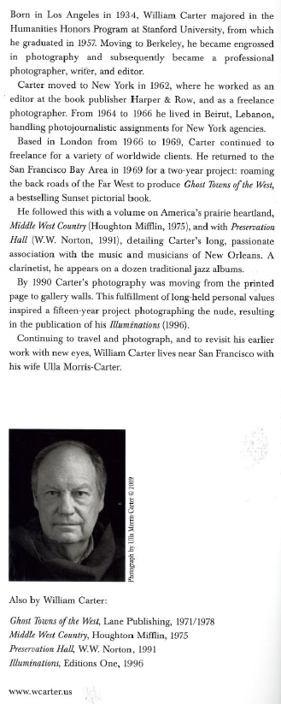
Dust jacket

Slide 69
Module 4 Describing Persons
Questions?
RDA Training Brigham Young University,
Utah State Library,
University of Utah,
November 2012

Slide 70
This Presentation is available at
http://net.lib.byu.edu/~catalog/people/rlm/RDAUtah201211/index.htm
For further information
contact Robert L. Maxwell
robert_maxwell@byu.edu

