Slide 1
Module 3 RDA Basics Using the RDA Toolkit
RDA Training Brigham Young University,
Utah State Library,
University of Utah,
November 2012

Slide 2
Login information for workshop
access.rdatoolkit.org (login at BYU is by IP authentication)
Utah State Library workshop: Please feel free to sign up later for a month’s free access so you can practice (see handout)
Notes:
From now on, as I show slides of RDA, please feel free to go ahead and look yourself in the Toolkit.

Slide 3
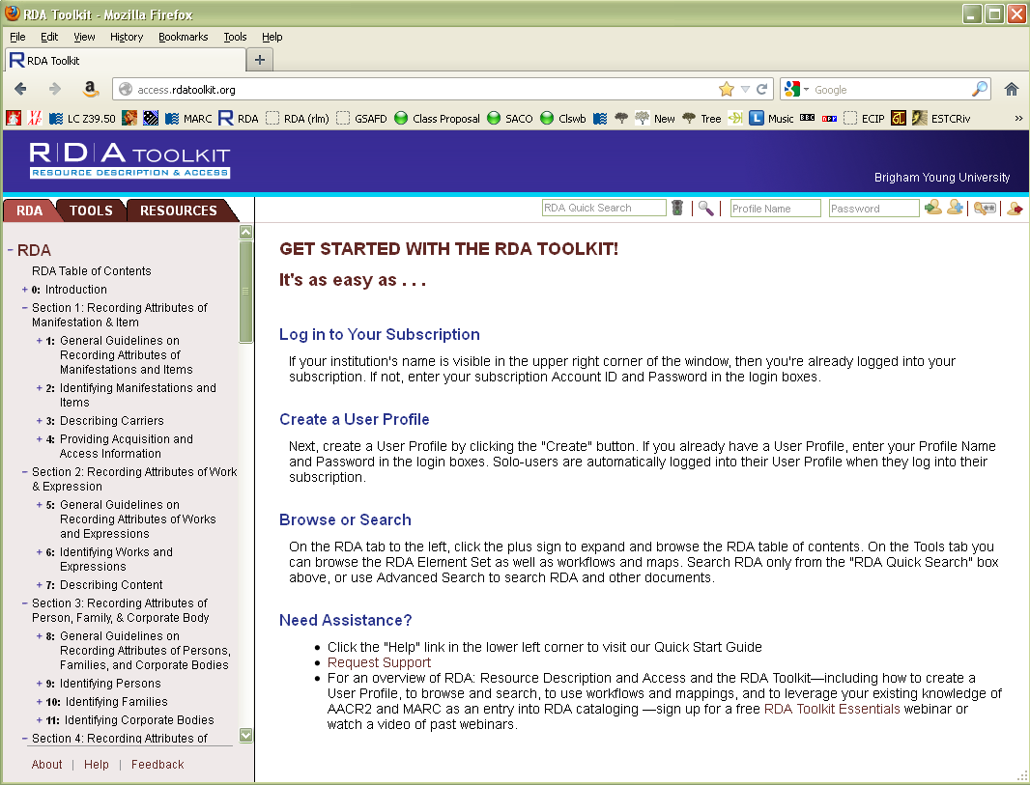
Notes:
You should all be to a screen that looks like this. You can use either Firefox or Internet Explorer and probably other browsers. My slides are from Firefox.
When you login to your own accounts you can create your own user profiles if you wish (please don’t do that here because you’re logged into BYU’s account and you won’t be able to access your profile when you get home). If you create a user profile you can do things like create bookmarks and leave yourself notes within the Toolkit. However, you aren’t required to create a user profile to use the Toolkit.

Slide 4
Notes:
To create a user profile, click on the create icon (circled). Go ahead and click on it, just don’t fill anything out while in BYU’s account, please.

Slide 5
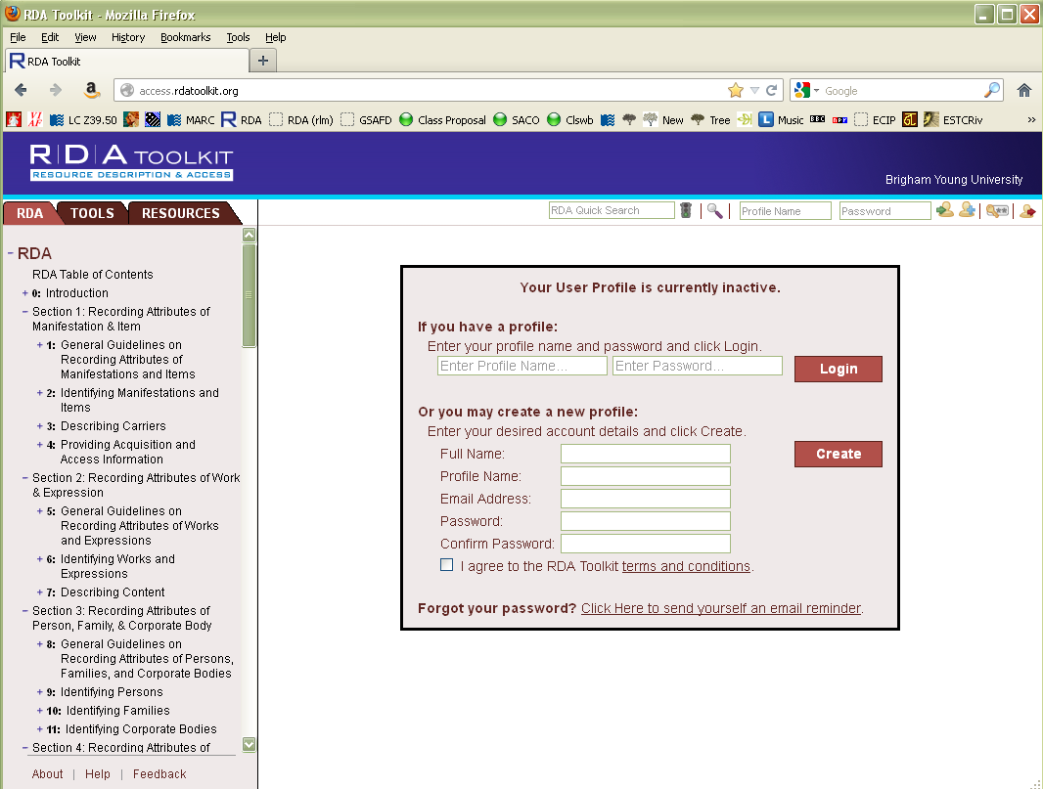
Notes:
You’ll come to a screen that looks like this. If you decide to create a profile in your own account, you’ll fill out the bottom part and then click “create”.

Slide 6
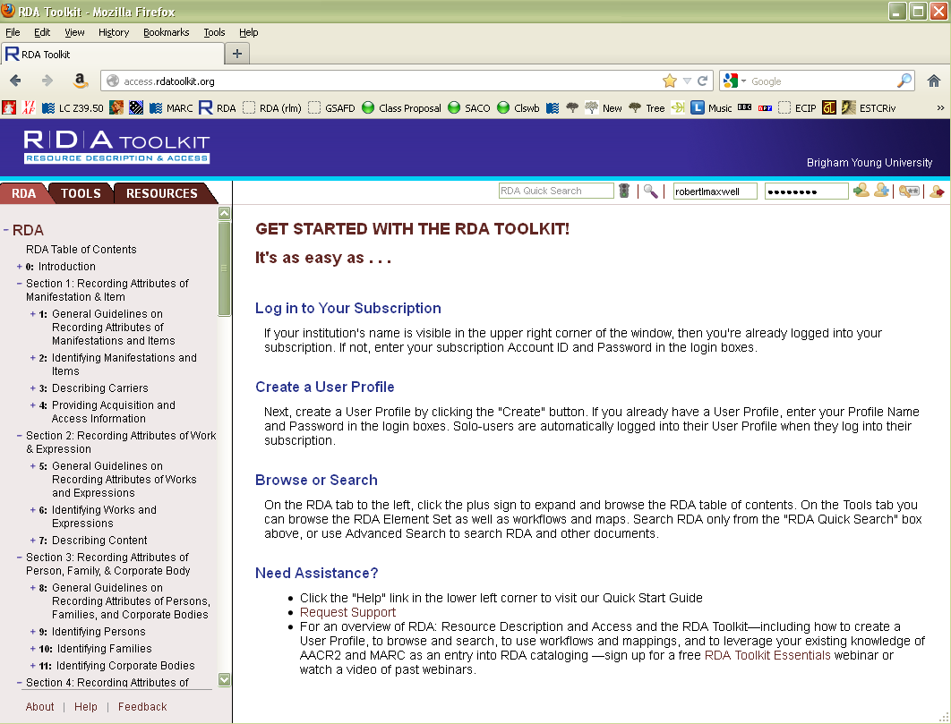
Notes:
After you’ve created your profile, you can login by filling out the circled boxes.

Slide 7
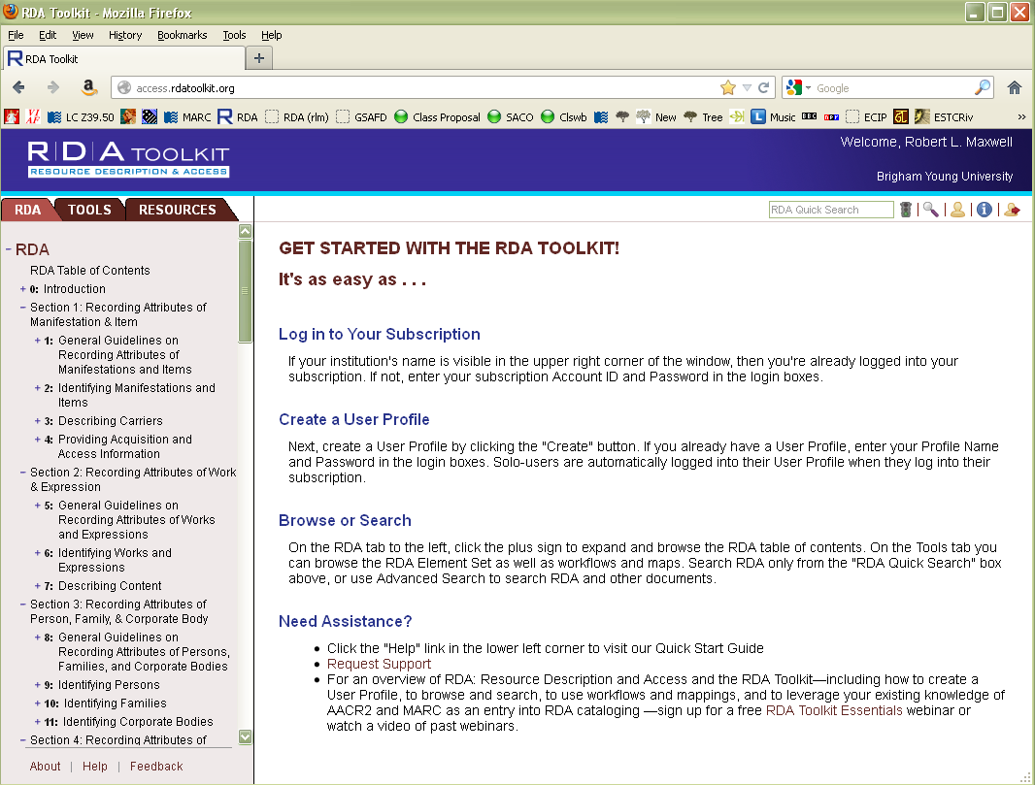
Notes:
If you log in the screen will show your name like this. I’ll let you explore this on your own, later. We won’t be using any personalization during this workshop.

Slide 8
Notes:
Let’s have a look at how the Toolkit is organized. First, look at the tabs over the left hand column. The first tab (c lick) contains RDA itself. The second tab (click) contains Tools, including mappings between RDA and MARC. The third tab (click) contains resources, including the complete text of AACR2, The LC-PCC Policy Statements, and a link to Cataloger’s Desktop. We’ll come back to each of these tabs.

Slide 9
Notes:
I also want to draw your attention to the two search options on this initial page, the RDA quick search (click) and the advanced search (click)

Slide 10
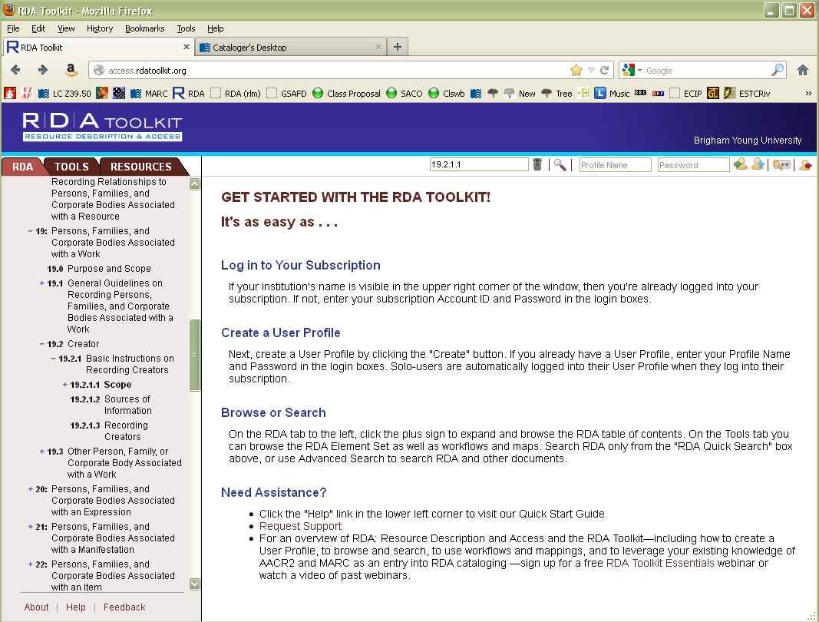
Notes:
You can put any words into the quick search, but it is also the quickest way to get directly to an RDA guideline if you know the RDA number. For example, type 19.2.1.1 in the box and hit enter.

Slide 11
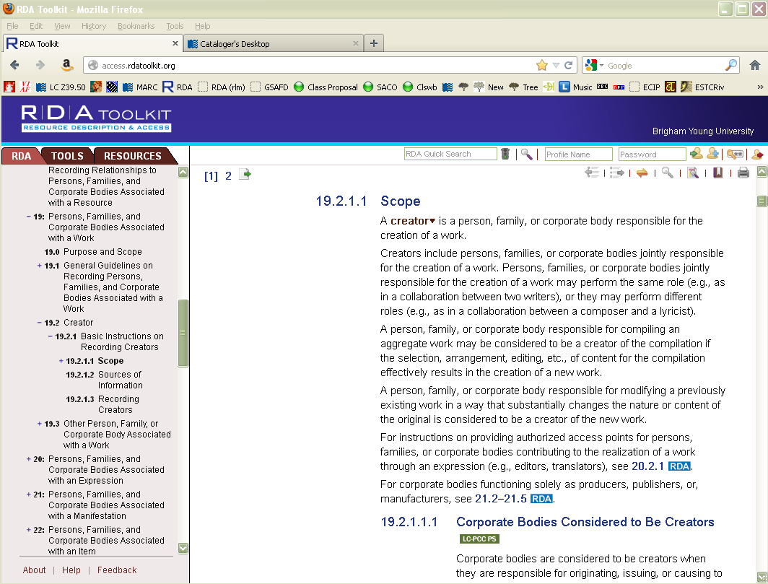
Notes:
You are taken directly to the guideline. This works in most cases, though sometimes you’re instead taken to an index page. Notice the outline to the left has expanded to give you the context of where you are in RDA (click). Now click on the advanced search button (click to show arrow)

Slide 12
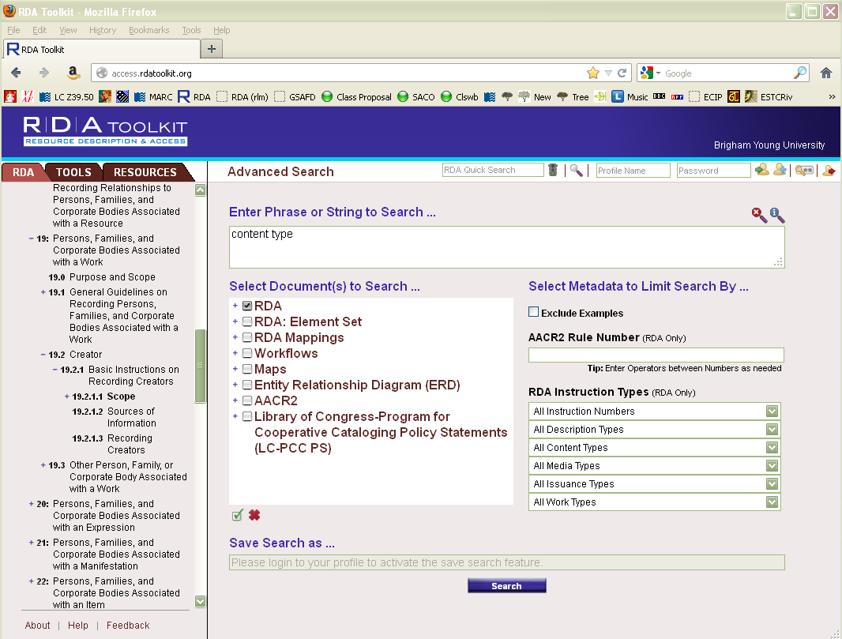
Notes:
Here you can enter a search, such as “content type” (click) if you don’t remember the guideline number. Boolean operators (and, or, not, etc.) can be used. You can also limit the search to RDA (click), or any of the other listed resources, such as AACR2 or the LC-PCC Policy Statements. Try out the search typing “content type” and hitting enter.

Slide 13
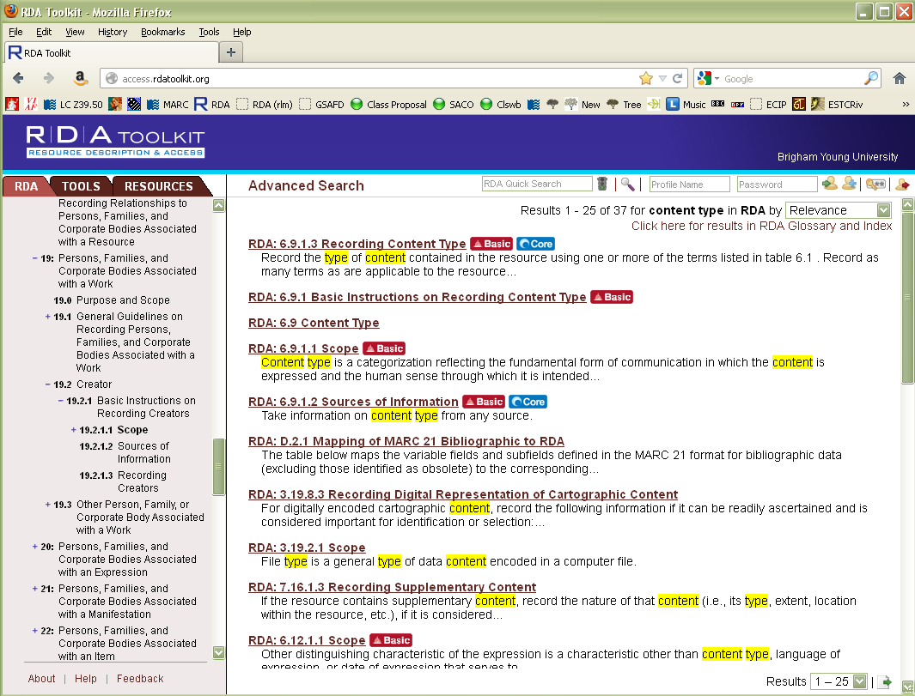
Notes:
Your screen should look like this. This is a keyword search result. 37 instances of “content” and “type” were found. Click on RDA 6.9, the third line down.

Slide 14
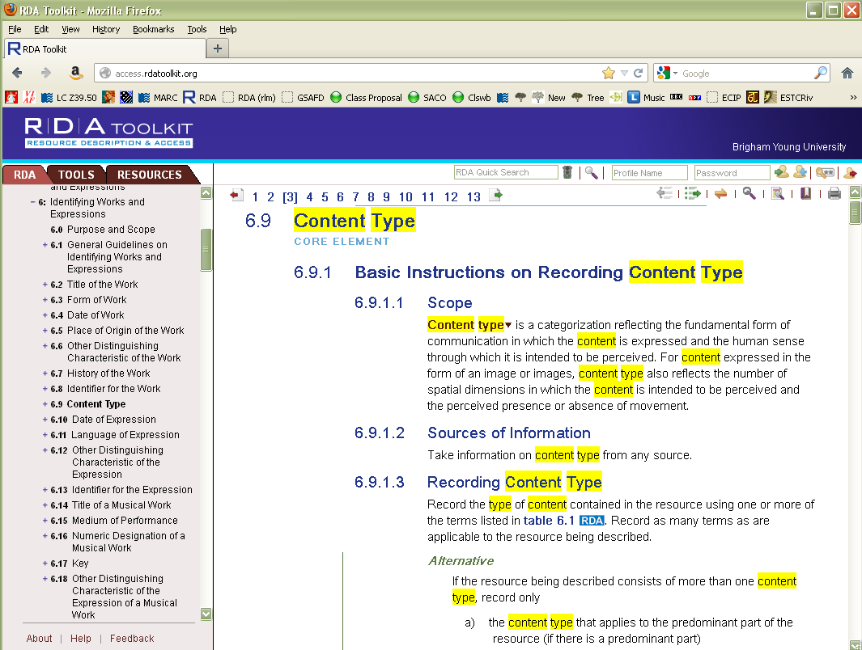
Notes:
Notice the table of contents column has changed, giving you the context of where you are. Now scroll down until you get to 6.11 Language of Expression.

Slide 15
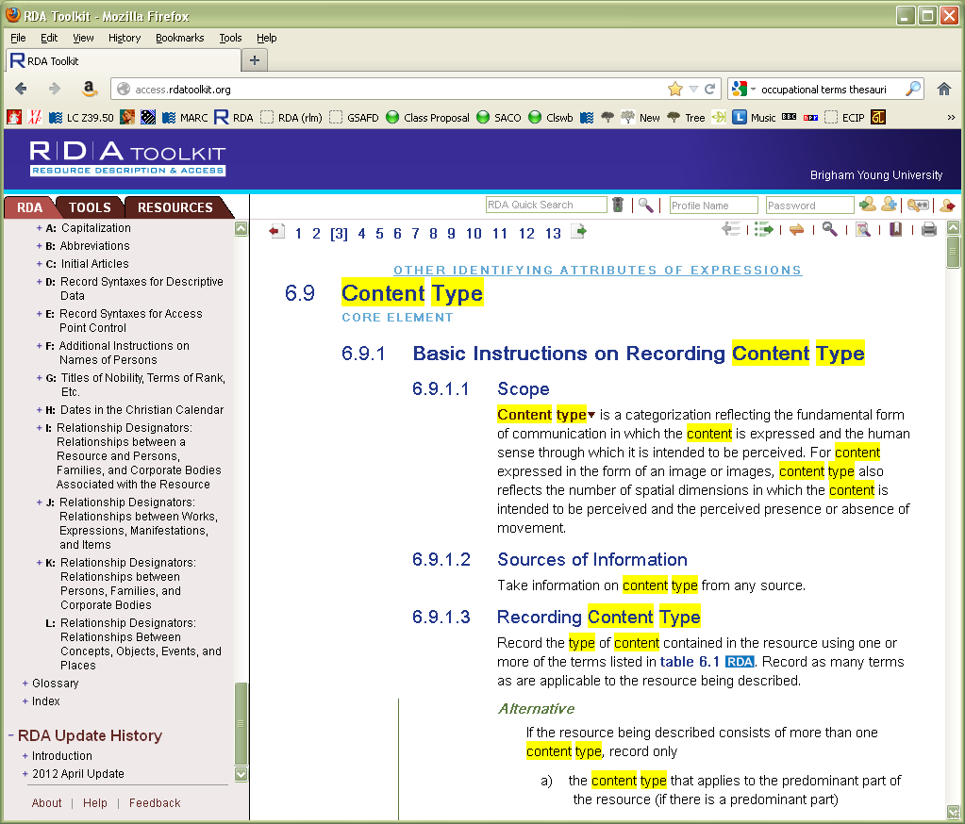
Notes:
Now have a look at the index, another way to find your way into the toolkit. Scroll down the left hand column until you come to the index.

Slide 16
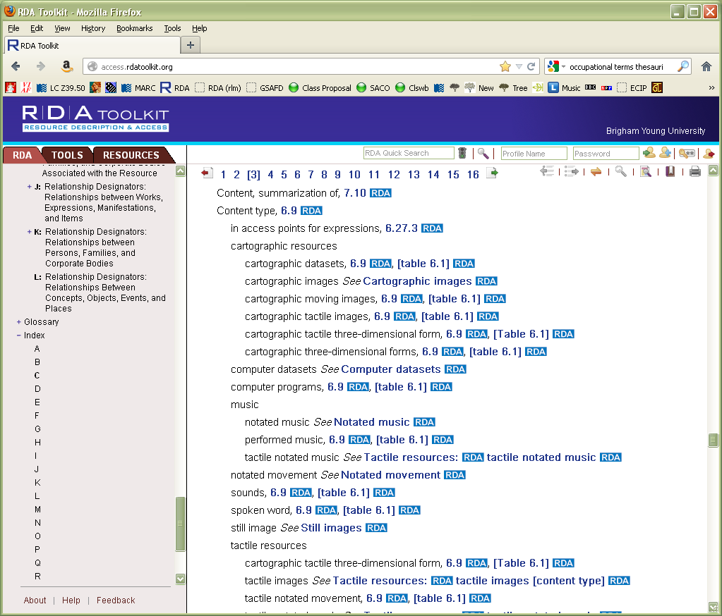
Notes:
Open it up and click on “c”; scroll down the right hand column until you find “content type”. Sometimes the index is a better bet than the keyword search because it brings together all the information about the topic in a logicl manner. Click on 6.9, which takes us to the same place as the keyword search did.

Slide 17
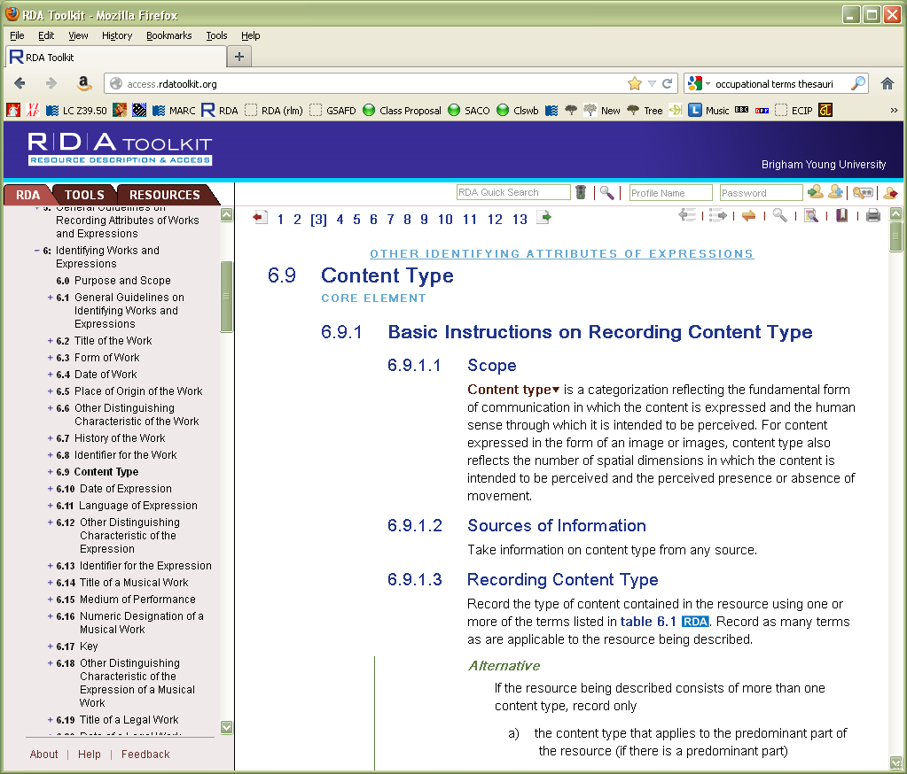
Notes:
Now scroll down the right hand column (the main text) until you come to 6.11.1.3.

Slide 18
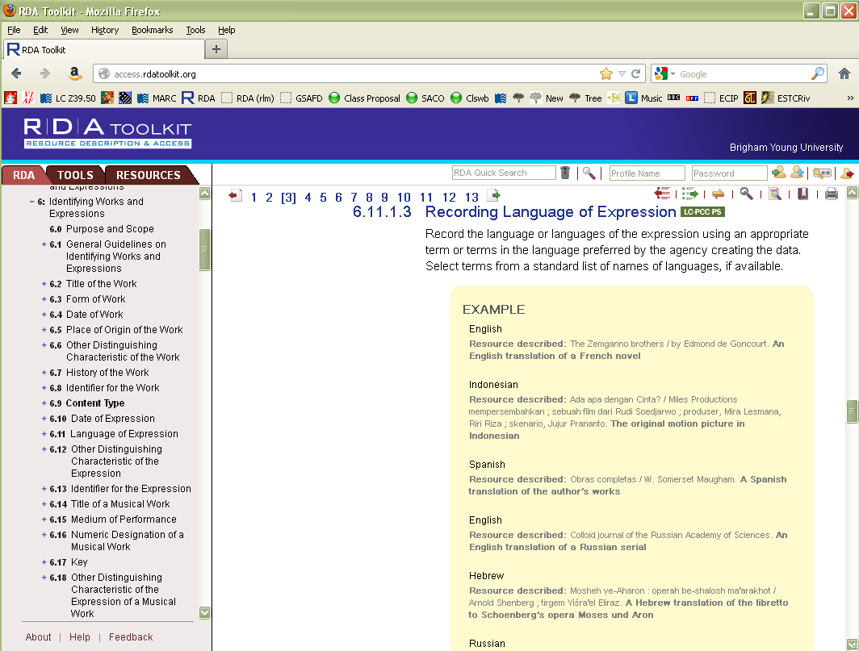
Notes:
Look at the table of contents column. It hasn’t changed. If you want the table of contents to be synchronized to where you currently are in RDA, click on the yellow double headed arrow (click)

Slide 19
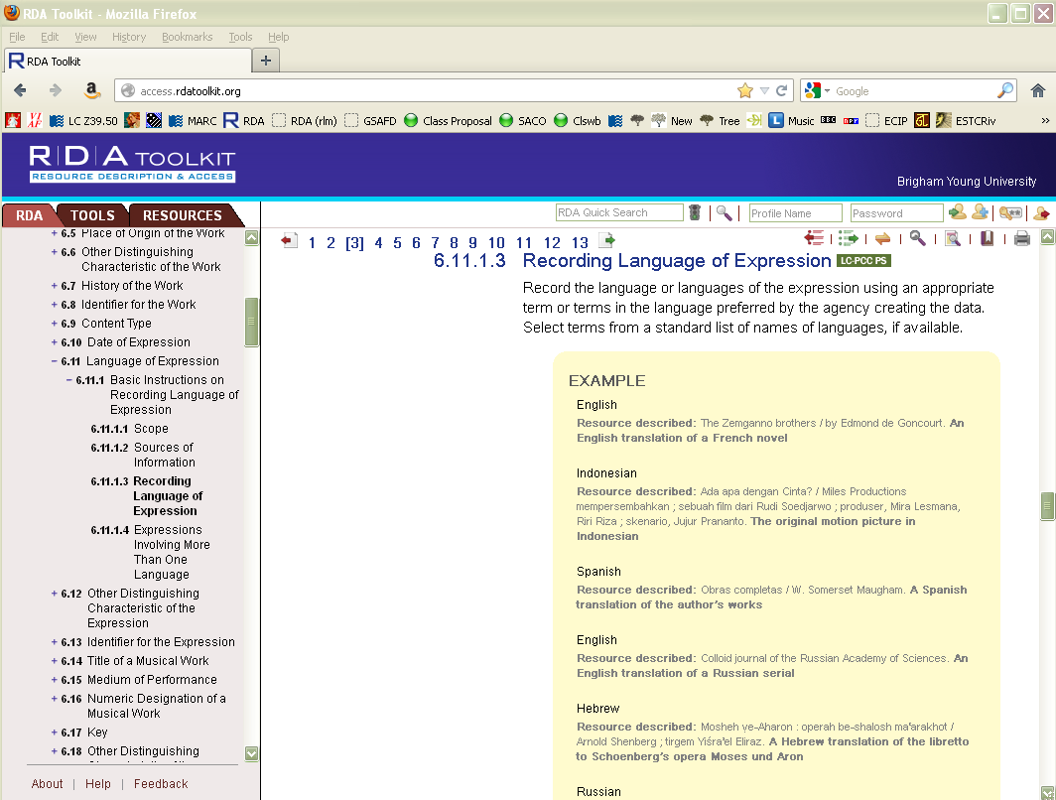
Notes:
The TOC has synchronized to the position of whatever is at the top of your screen. Now click on the green box next to “Recording language of expression”.

Slide 20
Notes:
This takes you to an LC-PCC Policy Statement related to the RDA guideline. To return to RDA, either click on the RDA number in the title of the policy statement (click) or the RDA tab (click)

Slide 21
Notes:
Now click on the Resources tab again (click twice).

Slide 22
Notes:
You can get directly to a section of AACR2 by opening up its section in the TOC screen. Scroll up to AACR2 if you need to, and click on the plus sign (click), then click on the plus sign before “part I” (click).

Slide 23
Notes:
You can go directly to any AACR2 rule you like. Let’s click on the plus sign in front of Chapter 2 and then find our way down to 2.7B3.

Slide 24
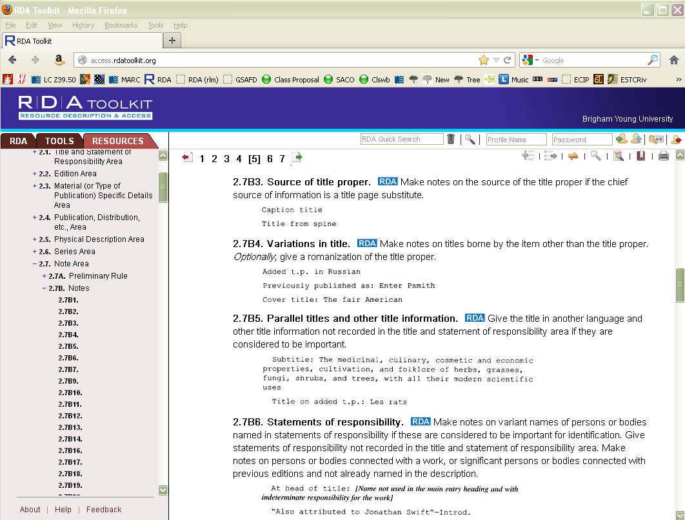
Notes:
If you’re wondering where RDA talks about a source of title note, click on “RDA” (click).

Slide 25
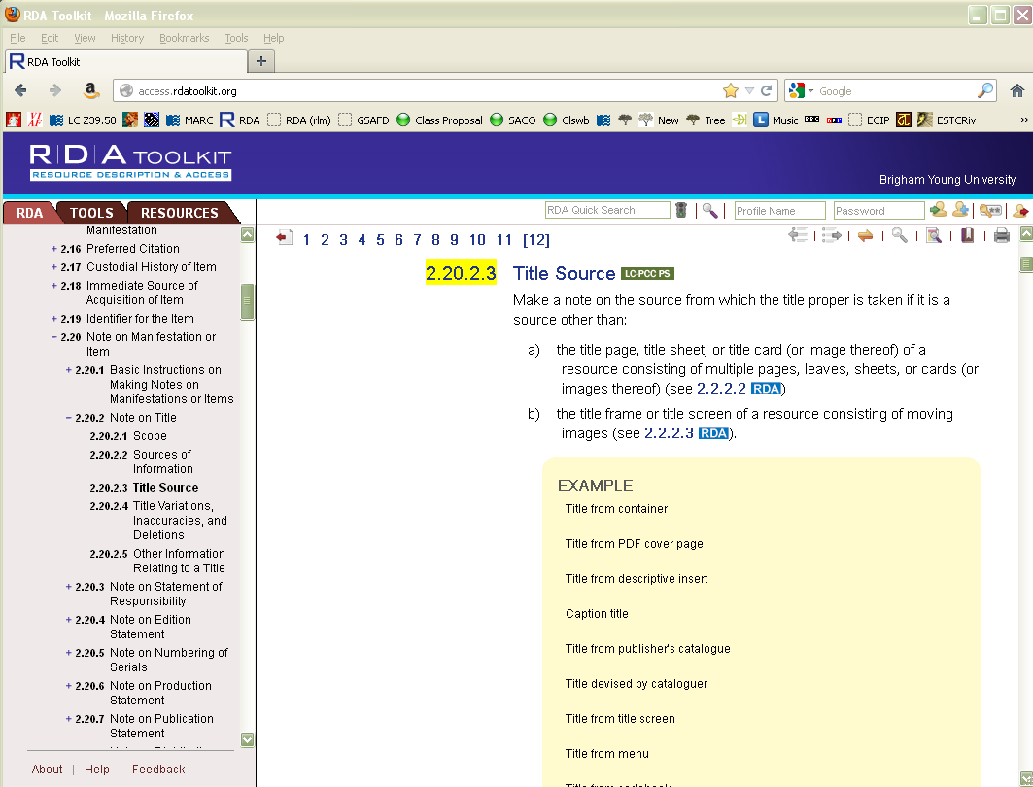
Notes:
You are taken to the corresponding RDA guideline (and notice the TOC has synchronized itself).
Now click on the Tools tab (click twice)

Slide 26
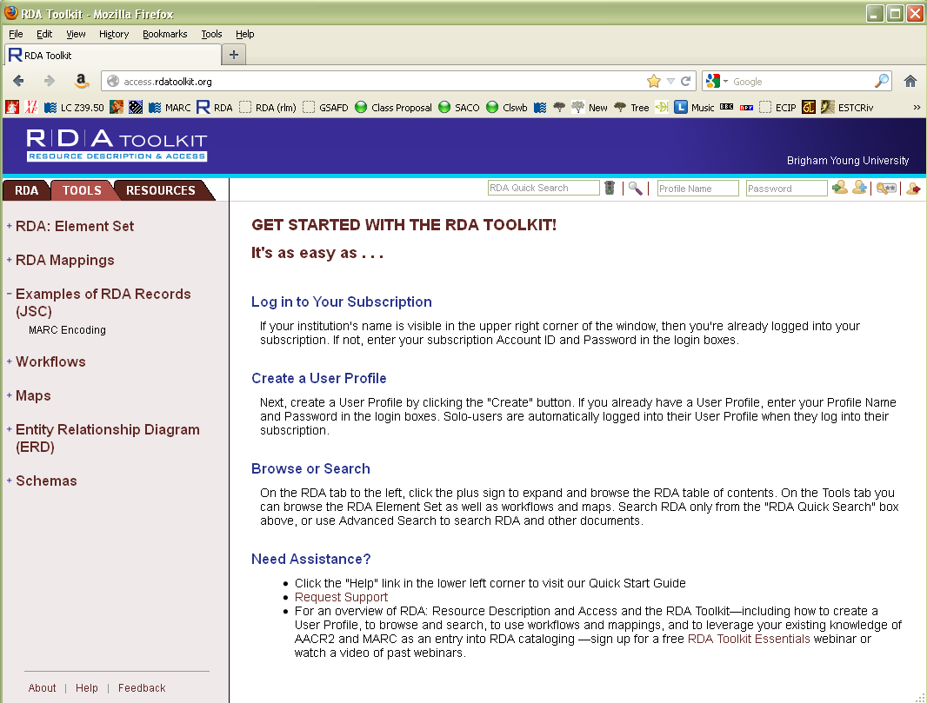
Notes:
Click on the plus sign next to RDA Mappings and then click on RDA to MARC Bibliographic Mapping (click twice)

Slide 27
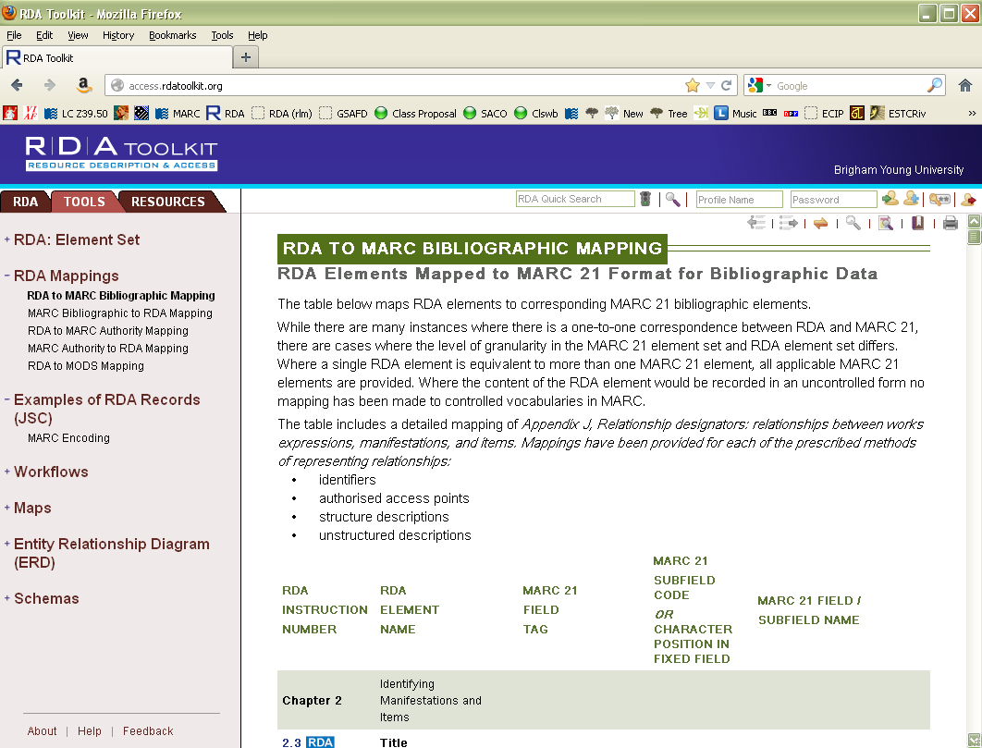
Notes:
Scroll down in the right hand screen until you come to 3.3, Carrier type (it’s a way down).

Slide 28
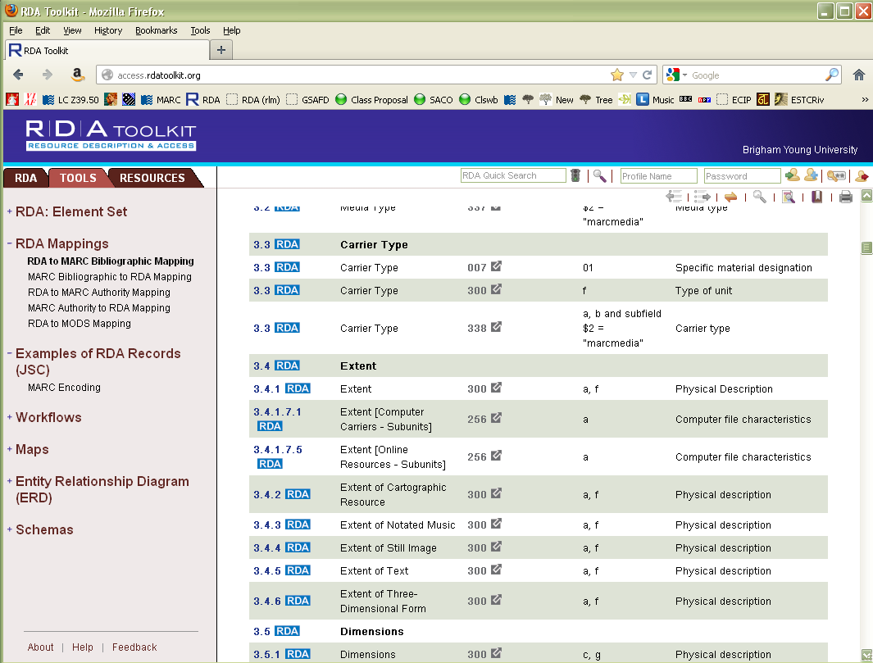
Notes:
Here we learn where in MARC this new RDA element can be coded. The third possibility, 338, is where we’re coding it. Click on “338”

Slide 29
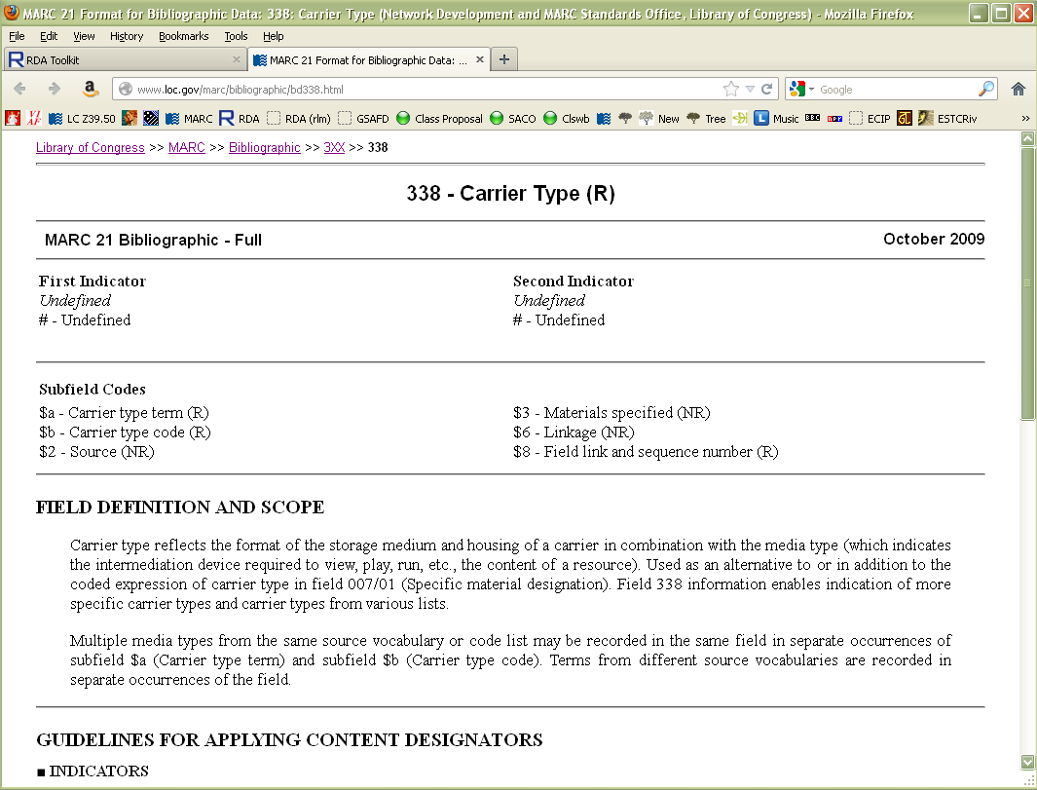
Notes:
You are taken to the section of the MARC documentation that covers the 338 field. We’ll come back to this later. Go back to the RDA toolkit (it should be waiting in another tab of your browser).

Slide 30
Notes:
You can also go the opposite direction. Click on MARC Bibliographic to RDA mapping (click twice). Scroll down in the right hand window to 245.

Slide 31
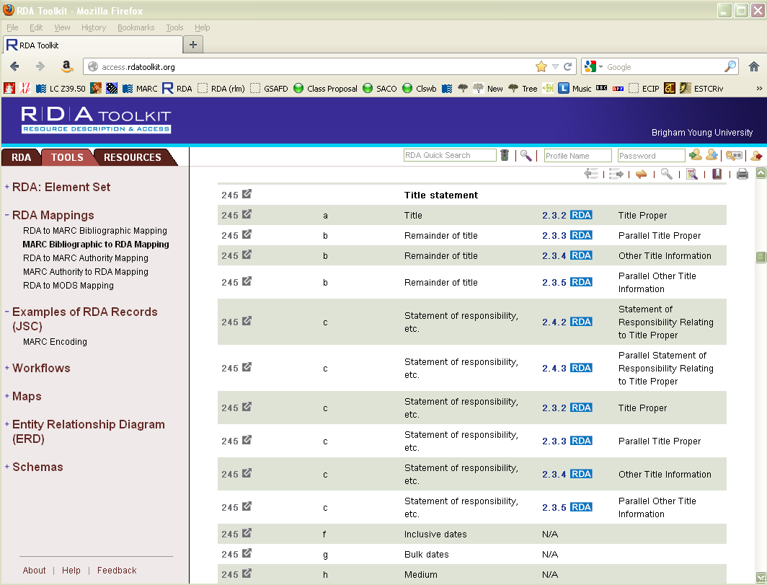
Notes:
Here you can see RDA elements that correspond to the MARC 245 field. If we can’t remember where the RDA guideline for title proper is, but we do remember it’s coded in MARC 245 subfield $a, we can approach RDA that way. Click on 2.3.2.

Slide 32
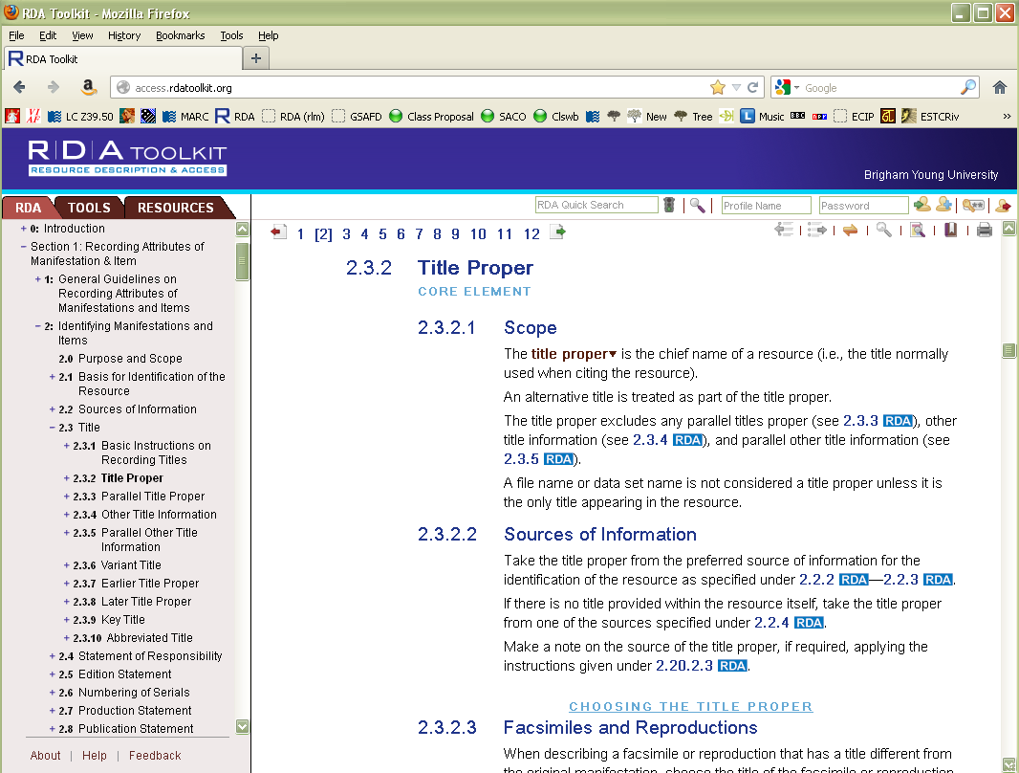
Notes:
We’re back to RDA.
If you need help, there are numerous help topics available. Just click “help” at the bottom left hand part of your screen.

Slide 33
Notes:
A new window appears.

Slide 34
Exercise
Take a few minutes to explore the Toolkit and the help topics.
Notes:
Find out what the digital file characteristic element is -- 3.19.
Find out where the illustrative content element is (i.e. how do you fill out the 300 $b) -- 7.15
Find rule 2.13.1.

Slide 35
Organization of RDA
Tab marked RDA = the RDA guidelines
Tab marked Tools = mappings, workflows, schemas
Tab marked Resources = other resources: AACR2, LC-PCC Policy Statements
Notes:
OK, lets return to RDA again.
Note the three tabs, RDA, Tools, Resources. We will concentrate on the RDA tab.

Slide 36
Organization of RDA
Introduction
Recording attributes of the FRBR entities
Chapters 1-7: Group 1 entities (WEMI)
Chapters 8-11: Group 2 entities (PFC)
Chapters 12-16: Group 3 entities (COEP)
Recording relationships (Chapters 17-32)
Appendixes
Abbreviation
Capitalization
Relationship designators
Glossary
Index
Notes:
The main sections of RDA have to do with recording attributes of the FRBR entities that we talked about the last hour; and recording the relationships between the entities. This is why it is so important that your cataloging staff have a firm grasp on FRBR; otherwise they won’t understand how RDA works and will have trouble finding information in it.

Slide 37
Organization of RDA (Introduction)
Chapter 0
Core elements: 0.6
Internationalization: 0.11
Notes:
Click on the RDA tab, then on the plus sign next to the “RDA” below the tab. Chapter 0 is the introduction, and is useful for reading in order to understand how RDA works. In this workshop I want to draw your attention to two subsections, 0.6 on the core elements and 0.11 on internationalization.

Slide 38
RDA Core Elements
AACR2 1.0D has three levels of description.
RDA 0.6 instead designates “core elements”
The core elements are intended to support the FRBR user tasks
identify and select a manifestation
identify works and expressions embodied in a manifestation
identify the creator or creators of a work
Notes:
Everyone please open to 0.6. The core elements are elements that are required in an RDA description.

Slide 39
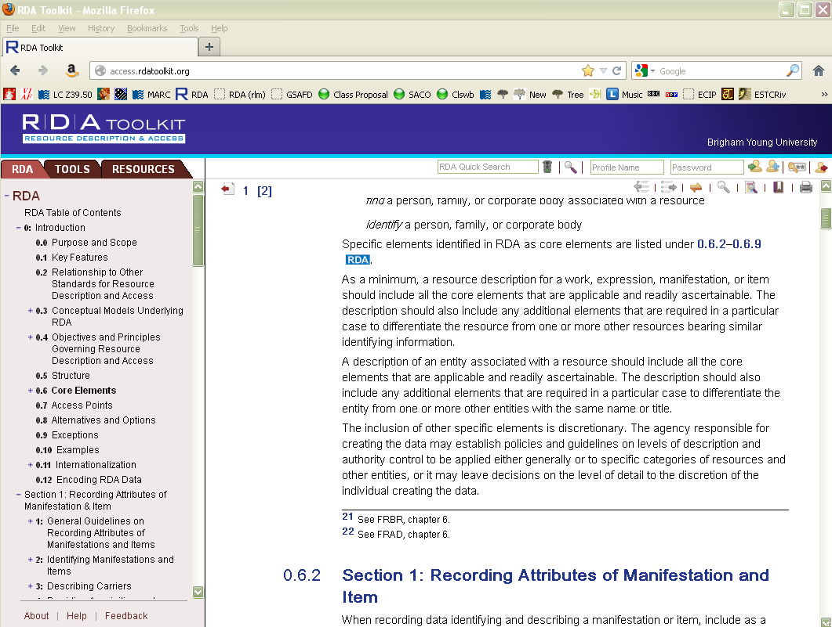
Notes:
Have someone read the text beginning with “Specific elements”.

Slide 40
Notes:
All the core elements are listed under 0.6, depending on what kind of an entity you are describing. For example, the core elements for manifestation are listed under 0.6.2. (Read some of them, including on the following screens).

Slide 41
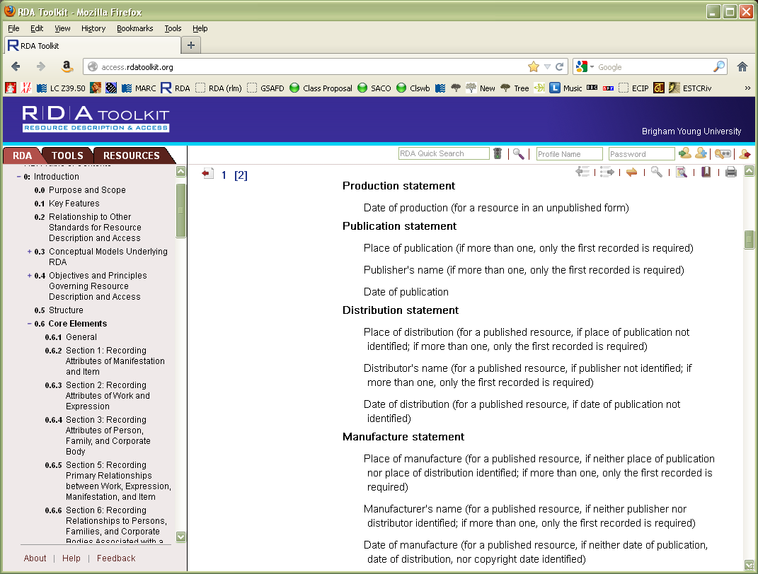
Notes:
Note distinction here between “core” and “core if” (distribution and manufactore only core if no publication statement has been recorded)

Slide 42
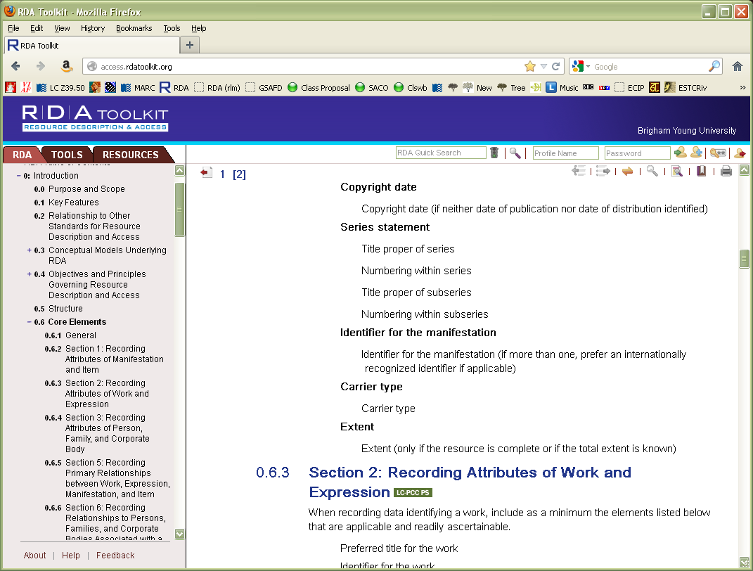
Notes:
So those are the core requirements for a description of a manifestation. If you look in the TOC column you can see that there are other core elements for descriptions of works and expressions, for persons, families, and corporate bodies, and so on.

Slide 43
Core Elements in RDA
In addition to the list in 0.6, Core elements are identified throughout RDA, as in this example.
Notes:
Elements that are core are also specified at the element definition--if the element is core it is marked as core when you look at the element itself (you don’t have to have memorized the core list in 0.6)
Everyone please now open RDA to 9.2

Slide 44
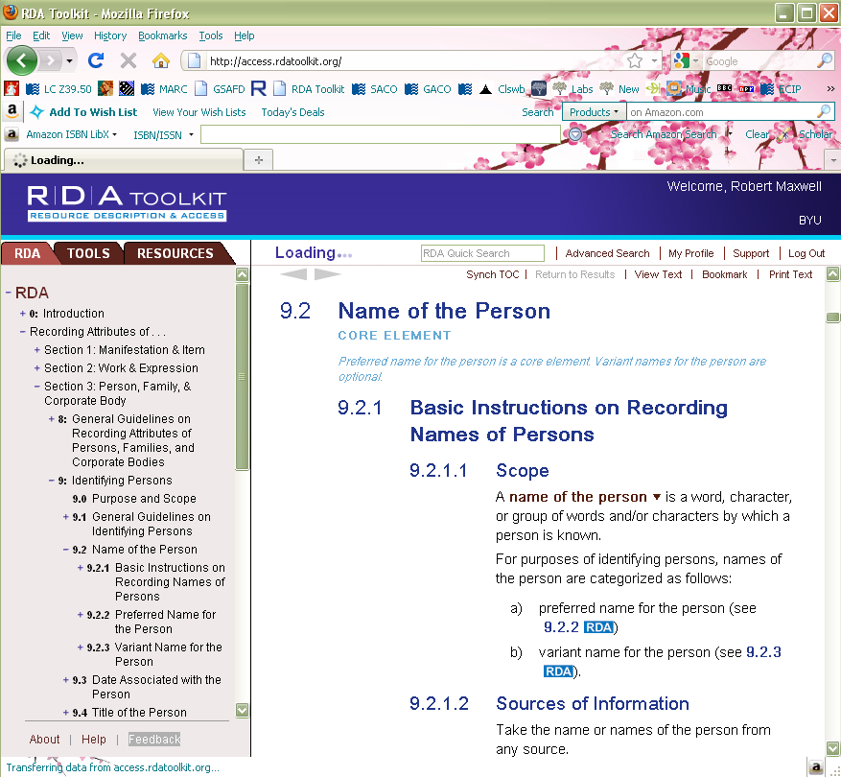
Notes:
In the next module of the workshop we’ll talk about about the person entity, so notice that “name” is a core element.

Slide 45
Core Elements in RDA
Catalogers are advised to “include any additional elements that are required in a particular case to differentiate the resource from one or more other resources bearing similar identifying information.” (RDA 0.6.1)
They may also include any other elements that in their judgment are needed.
Notes:
There are surprisingly few core elements compared with the rich data that can be created using RDA. Most of what we will be discussing will be elements beyond core.

Slide 46
Internationalization
0.11.2. Some elements are to be transcribed as they appear. “Other elements are generally recorded in the language and script preferred by the agency creating the data.”
Instructions calling for a controlled list in English may be modified to reflect the language of the agency.
Notes:
Please open to 0.11. Have someone read the first two paragraphs of 0.11.2. Note authorized translations (0.11.2) will give English-language terms in other languages, such as Spanish and German. The Spanish translation of RDA has been finished but it not yet published. Other translations are in the works.

Slide 47
Transcription vs. Recording
When RDA says to “transcribe” something it means “take what you see” (with some leeway for capitalization and punctuation)
When RDA says to “record” information it means follow the RDA instructions for that element, which may include manipulating the information in some way
Notes:
An example of “transcribe” is title proper; an example of “record” is numerals (including dates).

Slide 48
Organization of RDA (Attributes)
Section 1 (Ch. 1-4) = Manifestation & Item
Section 2 (Ch. 5-7) = Work & Expression
Section 3 (Ch. 8-11) = Person, Family, & Corporate Body
Section 4 (Ch. 12-16) = Concept, Object, Event, & Place
Notes:
These sections cover all the FRBR entities, and list the attributes that we are to record for each one. The chapters on concepts, events, and places (13-15) have not been written and Chapter 16, places, only includes instructions for jurisdictions, not non-jurisdictional places such as the Grand Canyon or the Sonoran Desert.
So where are we going to go to find out how to describe a person? (Look in RDA--which chapter?) (8 and 9) A corporate body? (8 and 11) A manifestation? (1-4 all are pertinent)

Slide 49
Structure of the Attributes Chapters
Structure of “attributes” chapters in RDA
Purpose and scope
General guidelines, including allowed sources
Guidelines for specific attributes
Guidelines for constructing access points (called “headings” in AACR2)
Notes:
All the chapters labelled “Identifying” something are chapters where we describe an entity. Chapter 9 is Identifying Persons. Please go to Chapter 9 in RDA and open up the table of contents outline for Chapter 9 to see how this plays out in an individual chapter.

Slide 50
Notes:
Note the introduction and general guidelines, 9.0-9.1. What are the possible attributes of a person? (read the headings for 9.2-9.18). Finally, at the very end, we’re told how to construct an access point for a person. Let’s look at the same thing for chapter 11, corporate bodies (please open to Chapter 11 and open the outline).

Slide 51
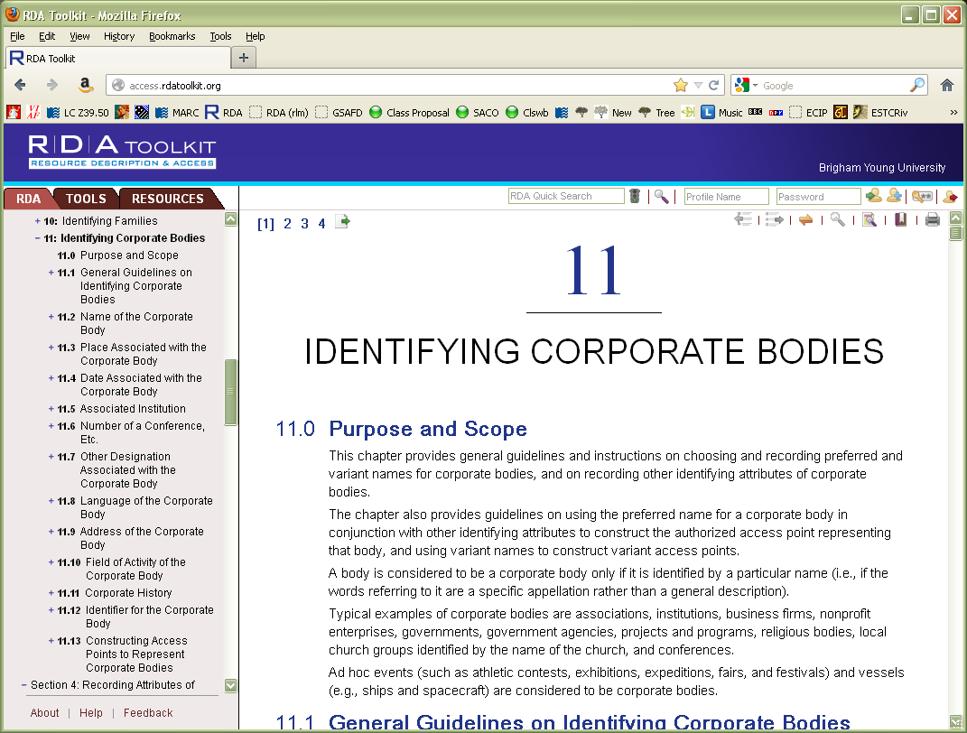
Notes:
Again, we begin with two general sections, 11.0 and 11.1; then there are sections about recording the attributes of corporate bodies, which are -- ??? (11.2-11.12); finally, at the very end, there is a section on how to create an access point for a corporate body. Are we getting a picture about what RDA is trying to have us do? We’re describing entities, not just creating headings.

Slide 52
Module 3 RDA Basics Using the RDA Toolkit
Questions?
RDA Training Brigham Young University,
Utah State Library,
University of Utah,
November 2012

Slide 53
This Presentation is available at
http://net.lib.byu.edu/~catalog/people/rlm/RDAUtah201211/index.htm
For further information
contact Robert L. Maxwell
robert_maxwell@byu.edu

