Slide 1
Module 1 RDA Basics FRBR, RDA and Authority Work
RDA Authority Control Cataloging
LACONI Technical Services Section
May 15, 2015
Notes:
Thank you for coming to this workshop. We will beging with a brief overview of FRBR and its relationship to RDA.

Slide 2
FRBR
Text available in print or at:
http://www.ifla.org/en/ publications/functional-requirements-for-bibliographic-records
Notes:
During the 1990s IFLA, the International Federation of Library Associations and Institutions, commissioned a new look at the bibliographic universe. The result was the document Functional Requirements for Bibliographic Records, or FRBR (published in 1998).

Slide 3
FRAD & FRSAD
Text available in print or as a PDF here:
http://www.ifla.org/publications/ifla-series-on-bibliographic-control-34
FRSAD Final Report:
http://www.ifla.org/files/assets/classification-and-indexing/functional-requirements-for-subject-authority-data/frsad-final-report.pdf
Notes:
FRBR was joined by a companion volume, Functional Requirements for Authority data, or FRAD, published in 2009. FRAD is an expansion of FRBR and adds a number of entities not found in FRBR. There is also an extension of FRBR called Functional Requirements for Subject Authority Data. This presentation will be based on FRBR and FRAD, but I will refer to the model as a whole as FRBR.
FRBR analyzes the bibliographic universe and divides it into a set of entities, such as persons, corporate bodies, concepts, works, and so forth.

Slide 4
FRBR
A conceptual model of the bibliographic universe
Based on the entity-relationship model developed for databases
Notes:
FRBR is not a cataloging code. It is a conceptual model of the bibliographic universe based on a database modeling technique called ...

Slide 5
Entity-Relationship Model
Entity: Something that can be distinctly identified.
Relationship: An association between two or more entities.
Attribute: A characteristic that may identify instances of entities or relationships.
Notes:
... “entity-relationship,” first introduced in the 1970s. This model is widely used in database design, but until recently hasn’t been used extensively in library databases. In this model a specific database universe is defined, and this universe is divided into specific entities linked by specific relationships.
An entity is something that can be distinctly identified within the context of the database. For example, a business database might define as entities “customers,” “employees,” “managers,” “stores,” “suppliers,” etc. A genealogical database might define as entities “persons,” “places,” “events.”
A relationship is an association between two or more entities. A business database might define a relationship between a particular store and an employee. A genealogical database might define a “father-child” relationship between a male person and his children.
In the model, entities and relationships are defined by attributes. An attribute is a characteristic that may identify instances of entities or relationships. For example, one of the attributes of a person is his or her birth date; other possible attributes for a person might be where he lives, his profession, his marital status, and so forth. Entity-relationship databases are designed with the entities, relationships, and attributes needed for the purpose of the database. A personnel database might need to define lots of attributes and relationships for persons (e.g., SSN, sex, marital status, position in the company, salary, etc.). A bibliographic database would not define all possible attributes and relationships for “person”, just those needed for the purposes of the database, such as name, possibly birth and death dates, relationship to works he/she created, etc. RDA, based on FRBR, defines entities, relationships, and attributes. Most of our cataloging under RDA consists of describing the attributes of the different FRBR entities. The FRBR attributs are called “elements” in RDA.

Slide 6
Entity-Relationship Diagramming
Entities
Relationships
Attributes
Entity
Relationship
Attribute
Notes:
There are many different conventions of diagramming the entity-relationship model. One of the most basic methods is to use a rectangle for an entity, a diamond for a relationship, and an oval for an attribute. I have found this model to be the most convenient for describing an actual database, and so I will be using this diagramming technique during most of this presentation.

Slide 7
Entity-Relationship Diagramming
Attribute 1
Entity 1
Attribute 2
Relationship
Attribute 1
Entity 2
Attribute 2
Notes:
In this diagramming method entites, relationships, and attributes are linked by lines. The simplest version uses single lines, as shown here. To illustrate more complex situations other types of lines may be used, including lines with arrows at either end to show whether the relationship is reciprocal or not. In this presentation most of the diagrams will have the simple lines shown here. In the basic model both entities and relationships can have attributes, but in FRBR attributes have only been defined for entities, so no attributes for relationships will be shown in this presentation.

Slide 8
FRBR Entities
Group 1: The products of intellectual or artistic endeavor. Sometimes called “the primary entities.”
Work: a distinct intellectual or artistic creation
Expression: the intellectual or artistic realization of a work in some form (e.g. alpha-numeric, musical notation)
Manifestation: the physical embodiment of an expression (e.g. a print publication)
Item: a copy of a manifestation
Notes:
To create a good entity-relationship database, careful planning is required. When you begin to design an entity-relationship database, one of the first things you need to do is define the entities and relationships. You need to define every entity and every relationship that is important to your particular database. On the other hand, one type of entity should not overlap with another. This careful planning process is exactly what the authors of FRBR, FRAD, and FRSAD have done, and it has taken years. The authors of FRBR thought about what types of things should be defined as entities in our bibliographic universe, and this is the result.
The entities in the FRBR model are divided into three groups. The first is defined as “the products of intellectual or artistic endeavor,” and the entities in this group are listed on this slide.
Work: “a distinct intellectual or artistic creation”
Expression: “intellectual or artistic realization of a work in the form of alpha-numeric, musical, or choreographic notation, sound, image,” etc.
Manifestation: “the physical embodiment of an expression of a work”
Item: “a single instance of a manifestation”--in other words, a copy

Slide 9
FRBR Entities
Group 1 (“Primary entities”)
Work
Expression
Manifestation
Item
Gone with the wind
Original English text of Gone with the wind
German translation of Gone with the wind
1936 publication by Macmillan
1937 publication of German translation by Bertelsmann
2006 publication by Scribner
BYU copy of 1937 publication (31197222656115)
1 of five BYU copies of 1936 publication (31197011774061)
BYU copy of 2006 publication (31197226590575)
Notes:
Here are some specific examples of these abstract entities.
All of these entities have attributes. Attributes are characteristics that would be necessary to describe each entity, to distinguish it from other entities of the same type.
Work: (what distinguishes it from other works?) title (“Gone with the wind”), form (novel), date of composition (pre-1936), etc. (music attributes include key, medium of performance)
Expression: (what distinguishes it from other expressions?) form (not literary form—physical form, i.e., text on paper, cassette, compact disc, electronic); date (in the case of the German translation, the date it was composed); language (1st expression = English; there may be other English expressions; language of the German translation is German, etc.); extent (e.g., the number of words, the duration of a recording, etc.)
Manifestation: (what distinguishes it from other manifestations?) title (i.e. exactly what is printed on the title page), statement of resp. (ditto), edition/issue designation, place of publication, publisher, date of publication, etc.
Item: (what distinguishes it from other items?) item identifier (e.g. barcode, possibly call number); provenance (who has owned the item?); marks/inscriptions; condition (missing its cover, etc.); access restrictions; location of the item (where is it vs. others?)
NOTE: Much of RDA consists of instructions for naming and describing the attributes of the entities. It looks to a situation where we might have a separate record or description for each entity, and so tells us what we should include in the descriptions of those entities—i.e., we’ll need to enter the attributes of the entities into our records.

Slide 10
FRBR Relationships (Group 1)
Work
realized through
Expression
embodied in
Manifestation
exemplified by
Item
Notes:
This is how the primary entities are related to each other (read from slide)

Slide 11
FRBR Relationships
Work-to-work relationships
Derivative relationship
derived from
Work: Gone with the wind (Novel)
Work: Gone with the wind (Movie)
described by
described by
Work: Vanity Fair
Descriptive relationships
Work: Gone with the wind on film: a complete reference
described by
Work: Vanity fair and Gone with the wind: a critical comparison
Notes:
To get more concrete, here are some specific instances of the FRBR work entity with various types of relationships. In this slide the novel is shown to have a relationship to two other works: a derivative relationship with the movie, and a descriptive relationship with the work Vanity fair and Gone with the wind: a critical comparison. In a real database the work Gone with the wind (the novel) would have relationships with many other works; and it would also potentially have relationships with instances of all the other types of FRBR entities. The database becomes like a web, with dozens, hundreds, or even thousands of relationship links between any one entity and other entities. In this slide you can see further relationships between the movie and a work that describes it, and the work Vanity Fair and the work that also describes Gone with the wind. In a FRBR/RDA based database each of these work entites would have separate descriptions that the user could examine.

Slide 12
FRBR/FRAD Entities
Group 2: entities responsible for Group 1 entities
Person
Family
Corporate body
Notes:
The second group of entities are those responsible for creating intellectual or artistic content in Group 1 entities. FRBR/FRAD have defined three: Person, Family, Corporate body. Note “family” is new to descriptive cataloging rules, and was added to the FRBR model through FRAD. RDA incorporates guidelines for describing instances of the family entity. This should be helpful to us as we move forward.
The three entities here are defined much as we would expect
Person: “an individual or persona established or adopted by an individual or group”
Family: “Two or more persons related by birth, marriage, adoption, or similar legal status, or who otherwise present themselves as a family.”
Corporate body: “an organization or group of individuals and/or organizations acting as a unit”

Slide 13
FRBR Entities
Group 2
Person
Corporate body
Family
Margaret Mitchell
Claude Debussy
George W. Bush
Brigham Young University
Ikea A/S
Jin (Dynasty : 265-420)
Peale (Family : Peale, Norman Vincent, 1898-1993)
Yan (Family : China)
Yan (Family : Philippines)
Notes:
Here are some concrete instances of these abstract entities.
Attributes have been defined for each of these entities.
For person, these include: name, dates, title, other designation, gender, place of birth, place of residence, language of person, field of activity. For example, Margaret Mitchell has a name, she has a gender, dates, and so on, as do Claude Debussy and George W. Bush. The fact that the attributes of each of these are different is what distinguishes them from one another.
For corporate body, attributes include: name, number (e.g. for meetings), place associated with the corporate body, date associated with the corporate body, type of corporate body, language of the corporate body, its field of activity
For family, attributes include: name, type of family (e.g. clan, dynasty, etc.), dates of family, places associated with family, history of family
The RDA chapters dealing with these entities tell us how to record the attributes of the entities and we’ll be looking at them in detail in upcoming modules. Again, RDA is looking toward a database structure where we would have a separate entity record or description for each person, corporate body, or family, and within that entity record we would describe the entity, or in other words, record its attributes. We would create such a record only once for each entity rather than our current practice in MARC of repeating much information every time we create a new bibliographic record. Entity records would be linked to other FRBR entity records, e.g., the entity record for Margaret Mitchell would be linked to the work record for Gone with the wind via a “creator” relationship link. Any entity record can be linked to any other entity record as appropriate.

Slide 14
FRBR Relationships (Gps 1-2)
Work: Gone with the wind
created by
Person: Margaret Mitchell
realized through
Expression: 1st German expression
Expression: 1st English Expression
has a translation
Person: Martin Beheim-Schwarzbach
translated by
Notes:
Here we have various relationships between entities. Margaret Mitchell has a creator relationship with Gone with the Wind. The work has a “realized through” relationship with the two expressions; and notice the expression entities also have a relationship to each other. Finally, the German expression has a “translated by” relationship with another person entity, Martin Beheim-Schwarzbach.

Slide 15
In this workshop we will be learning about authority records for FRBR Group 1 and 2 entities.
Person
Corporate Body
Work
Expression
Notes:
We will be covering four of the group 1 and 2 entities, all of which are described in authority records. In fact, we can think of a MARC authority record as a FRBR entity record if we want. We do not have time to cover one important group 2 entity, Family. If any of you are interested in creating RDA authority descriptions for families, let me know and I can send you a module I use for teaching description of families in RDA.

Slide 16
FRBR Entities not covered in this workshop
Group 3: entities that can be subjects of works
Any group 1 or group 2 entity, and
Concept
Object
Event
Place
Notes:
Group 3 entities are entities that can be subjects of works, expressions, manifestations, or items. Any of the entities can be the subject of a work—for example a person entity, from group 2, could be the subject of a biography.
The “new” entities in Group 3 are:
Concept: “an abstract notion or idea”
Object: “a material thing”
Event: “an action or occurrence”
Place: “a location”

Slide 17
FRBR Entities
Group 3 (subjects)
All entities in Groups 1 and 2
+
Concept
Object
Event
Place
Stone age
French language
Granite
Horses
Vesuvius (Italy)—Eruption, 79
Olympic Games (29th : 2008 : Beijing, China)
Salt Lake City (Utah)
Timpanogos, Mount (Utah)
Notes:
Here are some concrete examples of Group 3 entities. All the examples are LCSH or currently formed name access points.
Attributes of concept include: term of concept, type of concept
Attributes of object include: type of object, date of production, physical medium, place of production, etc.
Attributes of event include: Date associated with event, place associated with event
Attributes of place include: term for the place
The RDA guidelines for recording attributes of concept and objects are not yet written and do not appear with the first publication. Guidelines for recording attributes of events and jurisdictional places are in the current publication.

Slide 18
FRBR Group 3 Relationships
Work: Gone with the wind
Concept: Georgia—History—Civil War, 1861-1865—Fiction
created by
has a subject
Person: O'Hara, Scarlett —Fiction
Person: Margaret Mitchell
has a genre
Concept: War stories
Concept: Historical fiction
Notes:
Here are a few group three relationships to the work Gone with the wind. In order to keep on familiar ground I’ve used LCSH style subject strings. However, note that with current LCSH practice there is a mixture of FRBR entities when a subject string is subdivided. For example, Georgia is a FRBR place entity, History and fiction are concept entities, and Civil war is an event entity. When combined as a string the whole thing would probably be regarded as a concept. If the strings were broken up (faceted) it would be possible to be more precise about the entity. This needs thinking out. Another point to note: in RDA fictitious characters are grouped within the person entity, not the concept entity, so Scarlett O’Hara is labeled a “person” in this example. [Pause to look at the diagram.]

Slide 19
FRBR/RDA Attributes
FRBR, a model, defines attributes, but does not tell us how to record the data
RDA, a cataloging code, defines attributes and does tell us how to record the data
Notes:
FRBR defines a set of attributes for each entity in the model. Because it is not a cataloging code, FRBR does not define how the information is to be recorded. For example, “name of person” is one of the attributes of the “person” entity in FRBR. FRBR defines this attribute: “The name of a person is the word, character, or group of words and/or characters by which the person is known”, and points out that a person may be known by more than one name, and that libraries normally select one of the names as a uniform heading. But it does not tell us how to form the data to be recorded in this element, and if we are one of the libraries that wants to select one as a uniform heading, it does not tell us how to make that choice. That is the province of a cataloging code, such as RDA. RDA also defines attributes for entities, but because it is a cataloging code it also informs us how to record the data and in the case of the “name of person” attribute, it tells us how to choose between competing forms.

Slide 20
Please log in to RDA
http://access.rdatoolkit.org/login
ID: LACONI
Password: training
Please feel free to sign up later for a month’s free access if your library has not yet subscribed (see handout)
Notes:
From now on, as I show slides of RDA, please feel free to go ahead and look yourself in the Toolkit.

Slide 21
Attributes of Person in RDA
Notes:
For this workshop I will take one FRBR entity, “person”, and demonstrate how this works out in RDA. We will be looking at this entity in much more detail later.
FRBR and FRAD define several attributes of “person”. These are mostly taken directly into RDA, where they are worked out more fully, and in some cases refined with subelements. In RDA the act of recording attributes of an entity is referred to as “identifying” so RDA chapter 9 is called “Identifying Persons”. Chapter 9 is within a larger RDA section called “Recording attributes.” Within each “entity” chapter the guidelines begin with a scope note and general guidelines defining the entity, as you can see here. The central portion of each chapter consists of subsections detailing each attribute of the entity, including a definition of the attribute (also referred to as an “element” in RDA) and guidelines for recording the information. Finally, at the very end of each chapter, is a subsection detailing how to construct an access point to represent the entity. [Draw attention to 9.19.] It is extremely important that you understand this structure or you will get confused. The central subsections of the chapter do not necessarily have anything to do with the access point. They are intended to give guidance for recording attributes, not constructing an access point.

Slide 22
Person Entity Attributes
Person (Margaret Mitchell)
Preferred name: Mitchell, Margaret
Fuller form of (fore)name: Margaret Munnerlyn
Variant name: Marsh, John Robert, Mrs.
Date of birth: 1900 November 8
Date of death: 1949 August 16
Gender: female
Place of birth: Atlanta, Ga.
Language of the person: English
Notes:
How might this work in the real world? “Margaret Mitchell” is an instance of the “person” entity. Many of the RDA-defined attributes apply to her. How would we work RDA out in a FRBR-based database?
The first RDA attribute is “name of person”. RDA works this out into two subelements, “preferred name” and “variant name.” RDA instructs us, for all of these forms, to invert; and it instructs us to choose the commonly known form as the preferred name. In this demonstration I will record the preferred name and one variant name. The preferred name is based on usage. Variant names can come from any source. Regarding Mrs. John Robert Marsh, in RDA, as in AACR2, if a married person is identified only by a partner’s name, the term of address is considered an integral part of the name, and hence is recorded as part of the name attribute, as here.
In RDA a fuller form of name is not required to “fill out” elements already found in a preferred or variant name. Because Mitchell had a middle name, the fuller form of her forename is “Margaret Munnerlyn”.
“Date associated with the person” is an element which RDA has subdivided into subelements: date of birth, date of death, and period of activity. Note the RDA element only calls for the year to be recorded in most cases. I am giving the format RDA prescribes if two persons with the same name are born or died in the same year. We will see that this data is recorded slightly differently in MARC.
The attribute “gender” in RDA can be recorded either “male” “female”, or “unknown”. If none of these terms is appropriate, another may be provided by the cataloger.
Place of birth and language of the person are other possible attributes to record. RDA prescribes the forms shown.
There are many other elements and subelements called for in RDA. Note that only a few are core or required. Preferred name and dates are core. Remember this doesn’t mean the dates necessarily have to be part of the access point. It just means they need to be recorded as an element of the RDA record if known. There are a few other elements that are core if needed to distinguish one person from another.

Slide 23
Person Entity Attributes (MARC)
046 $f 19001108 $g 19490816
100 1 $a Mitchell, Margaret, $d 1900-1949
400 1 $a Marsh, John Robert, $c Mrs., $d 1900-1949
370 $a Atlanta (Ga.) $2 naf
375 $a female
377 $a eng
378 $q Margaret Munnerlyn
Notes:
These same RDA elements translate into MARC in this way.
There is no discrete field in current MARC for recording the preferred name. The only place to record it is as a part of the authorized access point in 100. Subfield $a and $c (not present in this example) contains the preferred name prescribed by RDA.
Similarly there is no discrete place to record the variant name. Until MARC expands to allow this, it has to be recorded as part of a variant access point, in $a and $c of a 4XX field.
The fuller form of name element is recorded in field 378.
The date subelements are recorded in field 046; subfield f is date of birth, subfield g is date of death. Note the MARC formatting is different from the formatting called for in RDA--MARC calls for YYYYMMDD or YYYY-MM.
Place elements associated with a person are recorded in 370; $a is the place of birth. Current practice is to record the form as established in the NAF.
375 contains the gender element. It is recorded in MARC exactly as RDA calls for it.
The language of the person element is recorded in 377. In current MARC practice, languages are recorded as the MARC language code in subfield $a, which is repeatable if the person used more than one language (we don’t record all languages the person knows, just the ones he or she actually produces works in).
To complete this record we would include notes for the sources we consulted to find the information. RDA instructions for this are in chapter 8; for the most part they would be recorded in 670 fields, just as NACO practice has been until now.

Slide 24
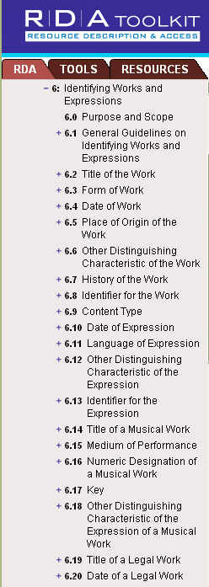
Attributes of
Work in RDA
Notes:
Now let’s create a record for a work. The attributes, or elements, of the work entity are found in RDA chapter 6, “Identifying works and expressions.” Elements or attributes of work include title, form, date of the work (date the work was created), other distinguishing characteristic, and special guidelines for particular kinds of works like musical works. There are more elements and subelements defining work in RDA than there were for person, so I can’t fit them all on the screen, but these are enough to get us started. Let’s create a record for Gone with the wind using some of these elements.
One thing to note before we start: “Author” or “Creator” is not an attribute of work in RDA or FRBR. The author is a person, family, or corporate body, and as such is a separate entity with a relationship to the work. In a pure RDA work record the author’s name would not appear in the record, but the record instead would be linked to the record for the author. This is a dramatic difference from current MARC practice.

Slide 25
Work Entity Attributes
Work (Gone with the wind)
Preferred title: Gone with the wind
Form of work: Novel
Date of work: 1936
History of the work: Romantic novel first published in May 1936; it won the Pulitzer Prize in 1937.
Summarization of the content: Scarlett O’Hara, the spoiled daughter of a well-to-do plantation owner, must overcome the challenges facing the South during and after the Civil War
Notes:
“The title of the work” element in RDA is subdivided into subelements “preferred title for the work” and “variant title for the work.” The preferred title is chosen as you would expect: choose the title by which the work is commonly known. I am not aware of any variant titles for this particular work, so this element isn’t recorded.
Gone with the wind does have a form. It is a novel.
We are instructed in RDA to record the date of the work, defined as the earliest date associated with the work. If we don’t know the complete history of the work, which we usually won’t, we can record the date of the first expression of the work; this date in turn may be the first time the expression was published in a manifestation. In this case that would be 1936.
History of the work is another possible element, as is summarization of the content (RDA 7.10). Both of these are totally free text. There isn’t a prescribed form.

Slide 26
Work Entity Attributes (Current MARC Practice)
046 $k 1936
100 1_ … . $t Gone with the wind
380 Novel
678 Romantic novel first published in May 1936; it won the Pulitzer Prize in 1937.
Notes:
This slide shows the elements of the entity “work” as currently recorded in the MARC authority format.
We’ve already noted that the creator is not one of the elements of “work.” The creator is a separate entity as we’ve already seen, and it is linked to the authority record for the work by recording the exact string found in the 1XX field of the creator’s own record at the beginning of the 1XX field in the authority record for the work. We will see this on the next slide.
Preferred title is recorded in $t of the 1XX field as part of the authorized access point because there is no discrete place to record the element outside the authorized access point.
Date of work is recorded in 046 subfield $k.
Form of work is recorded in 380 subfield $a.
History of the work is recorded in 678.
We recorded a summary of the work as one of the elements of the description in the previous (non-MARC) slide. There is no place to record the summary in the MARC authority format, so for the moment it will continue to be recorded redundantly in every bibliographic record for resources containing the work.

Slide 27
Entity-Relationship Linking
Person: Margaret Mitchell
created by
Work: Gone with the wind
Notes:
As a reminder, here is how the linking of the two entity descriptions we just created would appear in an entity-relationship diagram. The next slide shows how this same thing is done in MARC.

Slide 28
Linking in MARC
Authority Record for the Work Entity
046 $k 1936
100 1_ Mitchell, Margaret, $d 1900-1949. $t Gone with the wind
380 Novel
678 Romantic novel first published in May 1936; it won the Pulitzer Prize in 1937.
Mitchell, Margaret, $d 1900-1949
Authority record for the Person Entity
046 $f 19001108 $g 19490816
100 1_ Mitchell, Margaret, $d 1900-1949
400 1_ Marsh, John Robert, $c Mrs., $d 1900-1949
370 Atlanta (Ga.) $2 naf
375 female
377 eng
Notes:
We create links in MARC records by using text strings. In this case the work record for Gone with the wind is linked to the person record for Margaret Mitchell because an exactly-matching text string (the authorized access point for Margaret Mitchell) is in the appropriate fields in the linked records. The type of relationship seen on the previous slide, “created by”, is implied by the position of Mitchell’s authorized access point at the beginning of the 100 field in the work description. It would be possible to make this explicit in a MARC authority record by recording another link to Margaret Mitchell in a 500 field and recording with it the relationship designator “author”: 500 1_ $w r $i Author: $a Mitchell, Margaret, $d 1900-1949. This is not currently done in NACO authority records for works.
To repeat: “Mitchell, Margaret, $d 1900-1949” is not one of the elements of the work description. Its presence in the authority record for the work is only to create the link.
PAUSE HERE TO LET PEOPLE LOOK.

Slide 29
FRBR/Entity-Relationship structure
Why is an ER structure useful?
Only need to record attributes for an entity once rather than multiple times as in current MARC environment
Ease of navigation (“FRBRization”)
FRBR designed with user in mind
Notes:
Point 1: good for the cataloger
Point 2: good for the user
Point 3: Every piece of the FRBR study was based on perceived user needs to find, identify, select, and obtain library materials. RDA, following FRBR, also claims to be designed with the user in mind. It will be up to us in the coming months and years as we become familiar with RDA and begin to use it to decide whether it lives up to its promise; and where it doesn’t, to contribute to improving it.

Slide 30
The LC/NACO Authority File
No AACR2 work has been allowed in the File since March 31, 2013.
AACR2 authority records remain in the File, but will be converted to RDA as needed.
The file is available at:
authorities.loc.gov
or
in OCLC Connexion
Notes:
It is crucial that you start cataloging in RDA now, as soon as you’re done with this workshop, so that you don’t forget what you’ve learned.

Slide 31
Major revisions to the NACO Authority File
Phase One (early summer 2012). 667 field inserted in selected records reading:
667 $a THIS 1XX FIELD CANNOT BE USED UNDER RDA UNTIL THIS RECORD HAS BEEN REVIEWED AND/OR UPDATED
Notes:
Selected records in the authority file were revised to include this 667 note. These records were records that we know the authorized access point is likely to be incorrect according to RDA guidelines, but which were not able to be changed programmatically (phase 2). The 667 is a kind of flag meaning “Think carefully about this record! It may not have a correct access point for RDA.”
Included were Conference headings; headings with more than one language or “polyglot” named in them (Homer. Iliad. English & Greek); personal names with subfield $c (e.g. for something like “poet” or “clarinetist”); treaties; certain musical work headings;

Slide 32
Major revisions to the NACO Authority File
Phase two (completed March 2013). Programmatic changes to the NACO authority file and the OCLC bibliographic file, including:
Expand the abbreviations ‘arr.’, ‘acc.’ and unacc.’
Modify ‘Bible’ headings
Expand the abbreviation ‘Dept.’
Modify ‘violoncello’ headings
Modify ‘Koran’ headings
Modify ‘Selections’ uniform titles
Modify dates of persons (e.g. “b. 1850” => “1850-”)
Notes:
Some of the programmatic changes are listed here. ATTENTION!! If your library uses the NACO Authority File, you will be getting all these changes even if you aren’t a NACO participant. You will need to take steps to ensure that your bibliographic file changes in synch with the authority file.

Slide 33
Major revisions to the NACO Authority File
Phase Three
More programmatic changes, including
Insertion of ISNI identifiers
Addition of certain RDA elements that are identifiable by the machine, such as 046 (date of birth/death)
Recoding of RDA-acceptable records as RDA
This is going on throughout 2015
Notes:
Some of the programmatic changes are listed here. ATTENTION!! If your library uses the NACO Authority File, you will be getting all these changes even if you aren’t a NACO participant. You will need to take steps to ensure that your bibliographic file changes in synch with the authority file.

Slide 34
How do I recognize an RDA record?
040 $e rda
Presence of new RDA elements in the record
Bibliographic records: “Desc” fixed field = i (vs. “a” for AACR2)
Authority records: “Rules” fixed field = “z” (vs. “c” for AACR2)

Slide 35
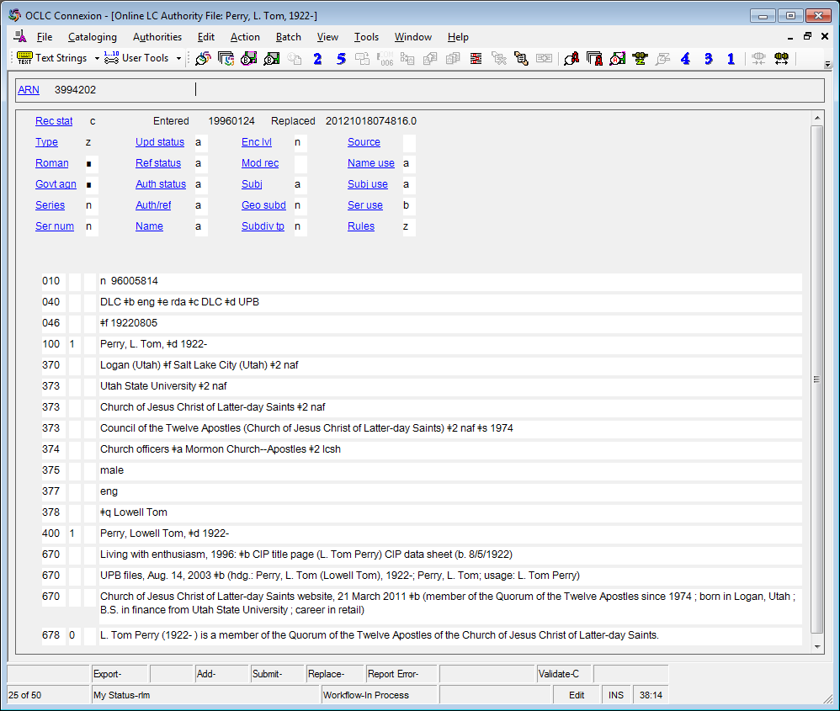
Notes:
What do you notice about this authority record that is different from AACR2?
040 rules
046 dates
370 associated places
373 affiliation
374 occupation
375 gender
377 language
378 fuller forms

Slide 36
Notes:
RDA stuff marked

Slide 37
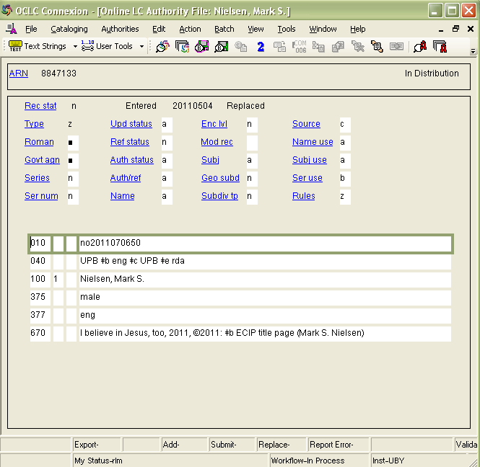
Notes:
Here’s another example, showing Rules, 040, gender, and an element we haven’t seen before, the language the person uses when creating works, in 377. This could have been included in the L. Tom Perry example. The cataloger just forgot to put it in.

Slide 38
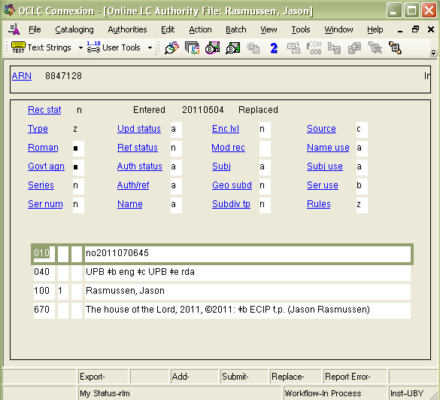
Notes:
On the other hand, an RDA authority record doesn’t HAVE to be complex. Except for the labeling of this record as RDA in 040 and Rules, there are no differences between this record and what it would have been had it been done in AACR2.

Slide 39
New Elements: Authority
Dates (046)
Content type (336)
Other attributes of person or corporate body (368)
Associated place (370)
Address (371)
Field of activity (372)
Affiliation (373)
Occupation (374)
Gender (375)
Family info (376)
Language (377)
Fuller form of personal name (378)
Form of work (380)
Medium of performance (382)
Musical work number (383)
Key of musical work (384)
Audience characteristic (385)
Creator/contributor characteristic (386)
Time period of creation (388)
Notes:
In the authority format there are a lot of new elements, some of which we’ve seen. Currently most of our systems cannot keyword search the contents of authority records, but would it be worth pressing our vendors to implement that? You CAN search these by keyword in OCLC. It seems to me it would be useful to our users to be able to pull out, for example, all persons in our catalog who are women (using the gender element) poets (using the occupation element) who write in Spanish (using the language element). This would be possible if we could perform keyword searches on authority records AND if we have consistently coded the information in them. Think about what you might want to do with this information, and how it could help your users even if we can’t convince our vendors to make it searchable.

Slide 40
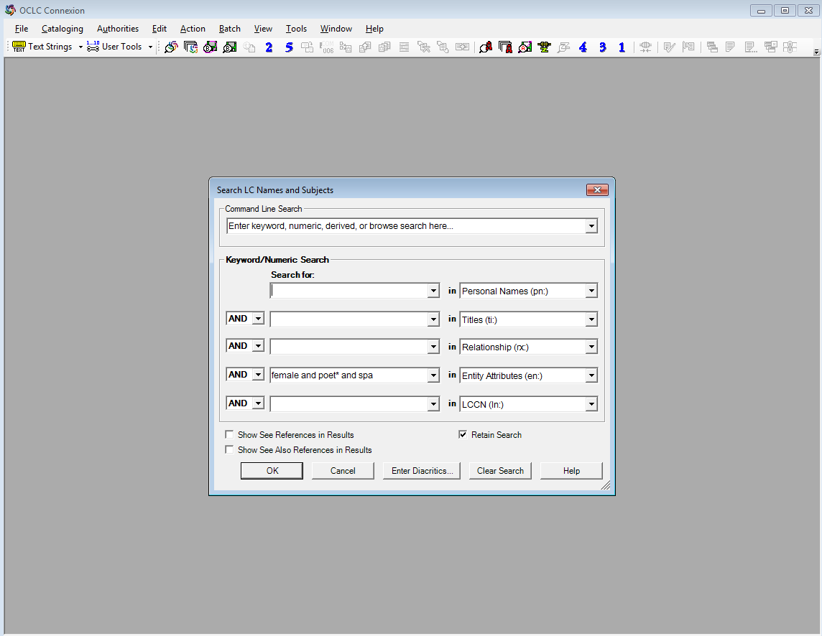
Searching by attribute in OCLC AF
Notes:
Choose the keyword authorities search; enter the attributes you want to search; choose the entity attributes search. Remember that this is a keyword search and most of these vocabularies aren’t controlled (yet).

Slide 41
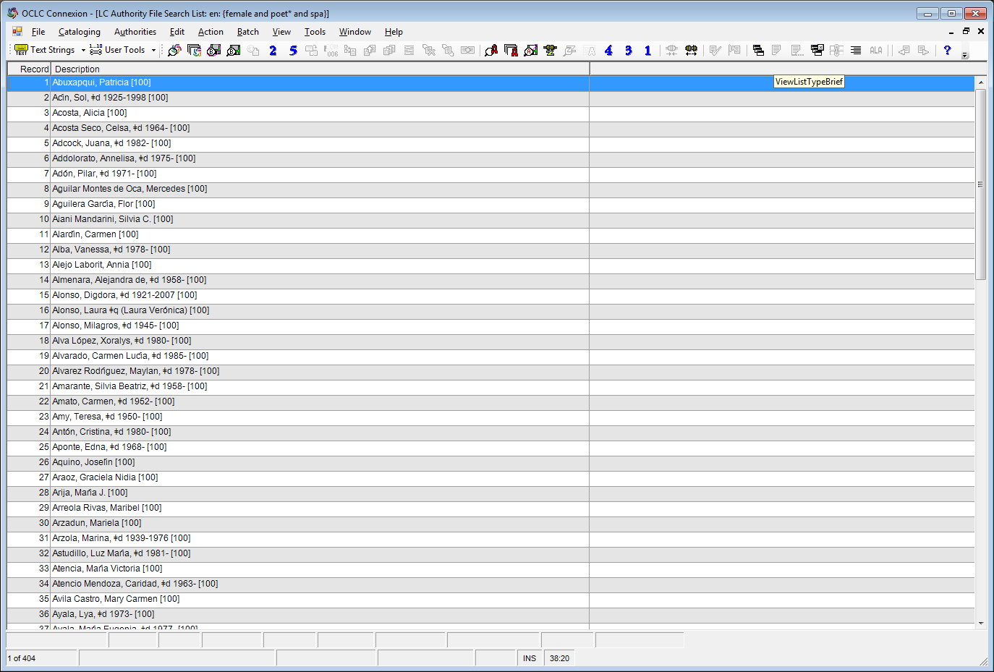
Notes:
There are currently 404 results for our search. There should probably be hundreds at least, but we’re just starting ...

Slide 42
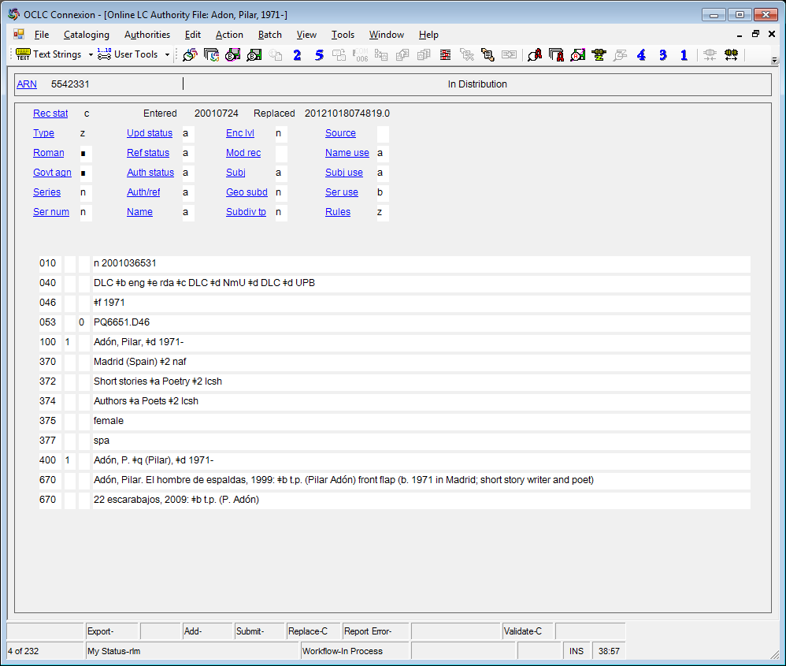
Notes:
Here’s the authority record for one of them. I’ve circled the keywords the search picked up.

Slide 43
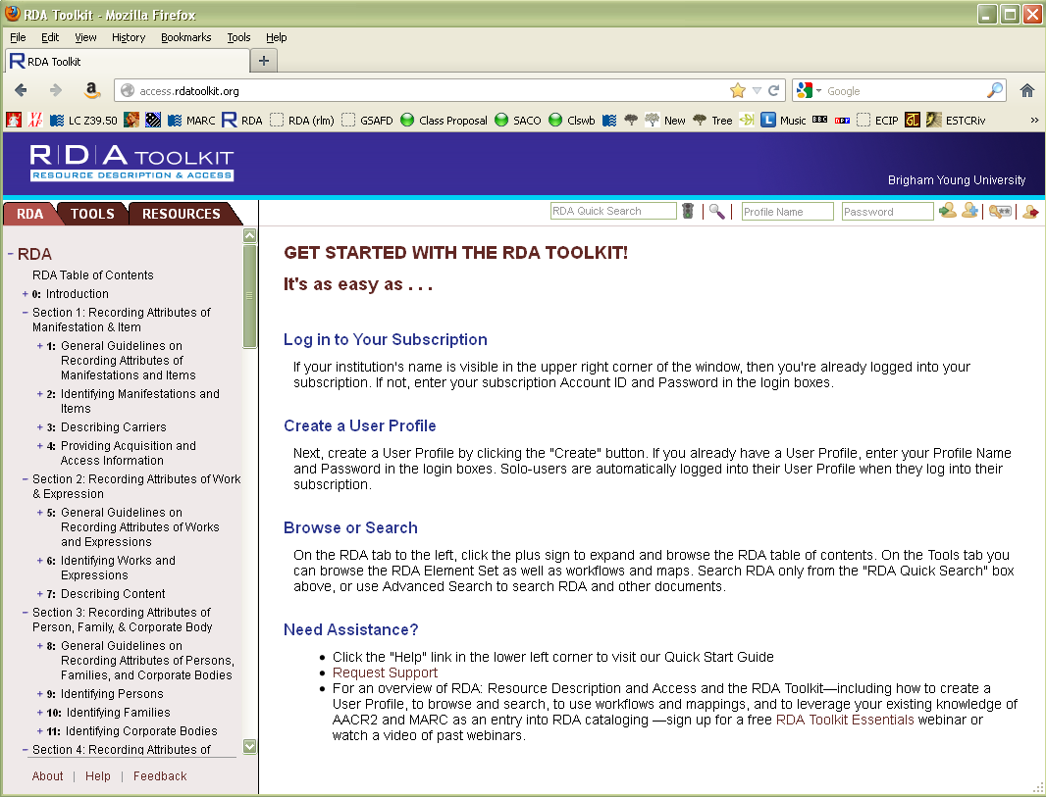
Notes:
Let’s have a look at how the Toolkit is organized. First, look at the tabs over the left hand column. The first tab (c lick) contains RDA itself. The second tab (click) contains Tools, including mappings between RDA and MARC. The third tab (click) contains resources, including the complete text of AACR2, The LC-PCC Policy Statements, and a link to Cataloger’s Desktop. We’ll come back to each of these tabs.

Slide 44
Notes:
I also want to draw your attention to the two search options on this initial page, the RDA quick search (click) and the advanced search (click)

Slide 45
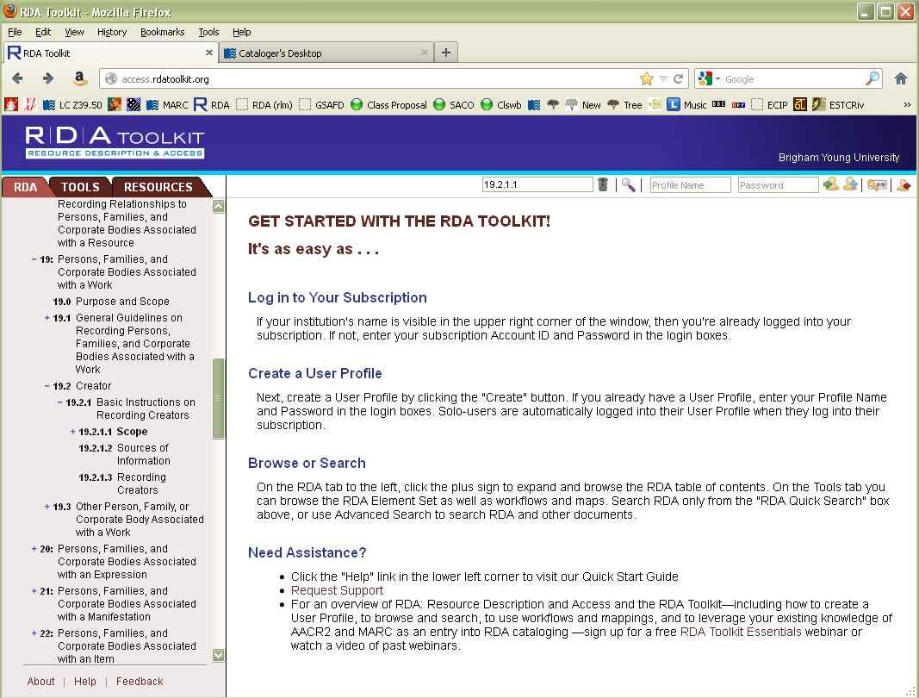
Notes:
You can put any words into the quick search, but it is also the quickest way to get directly to an RDA guideline if you know the RDA number. For example, type 19.2.1.1 in the box and hit enter.

Slide 46
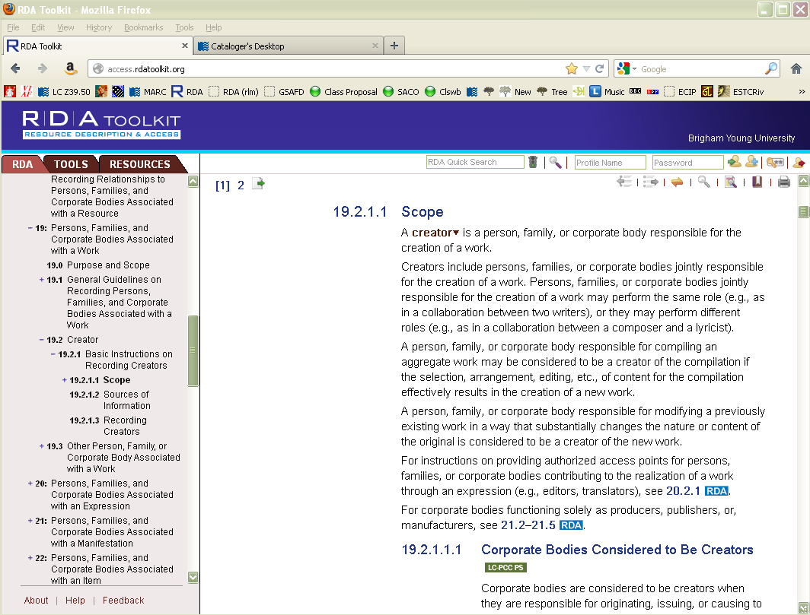
Notes:
You are taken directly to the guideline. This works in most cases, though sometimes you’re instead taken to an index page. Notice the outline to the left has expanded to give you the context of where you are in RDA (click). Now click on the advanced search button (click to show arrow)

Slide 47
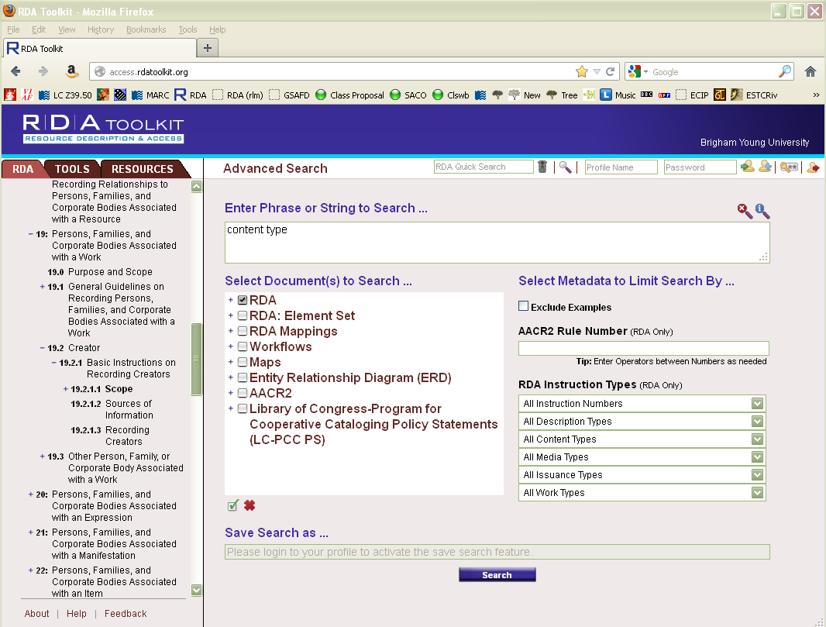
Notes:
Here you can enter a search, such as “content type” (click) if you don’t remember the guideline number. Boolean operators (and, or, not, etc.) can be used. You can also limit the search to RDA (click), or any of the other listed resources, such as AACR2 or the LC-PCC Policy Statements. Try out the search typing “content type” and hitting enter.

Slide 48
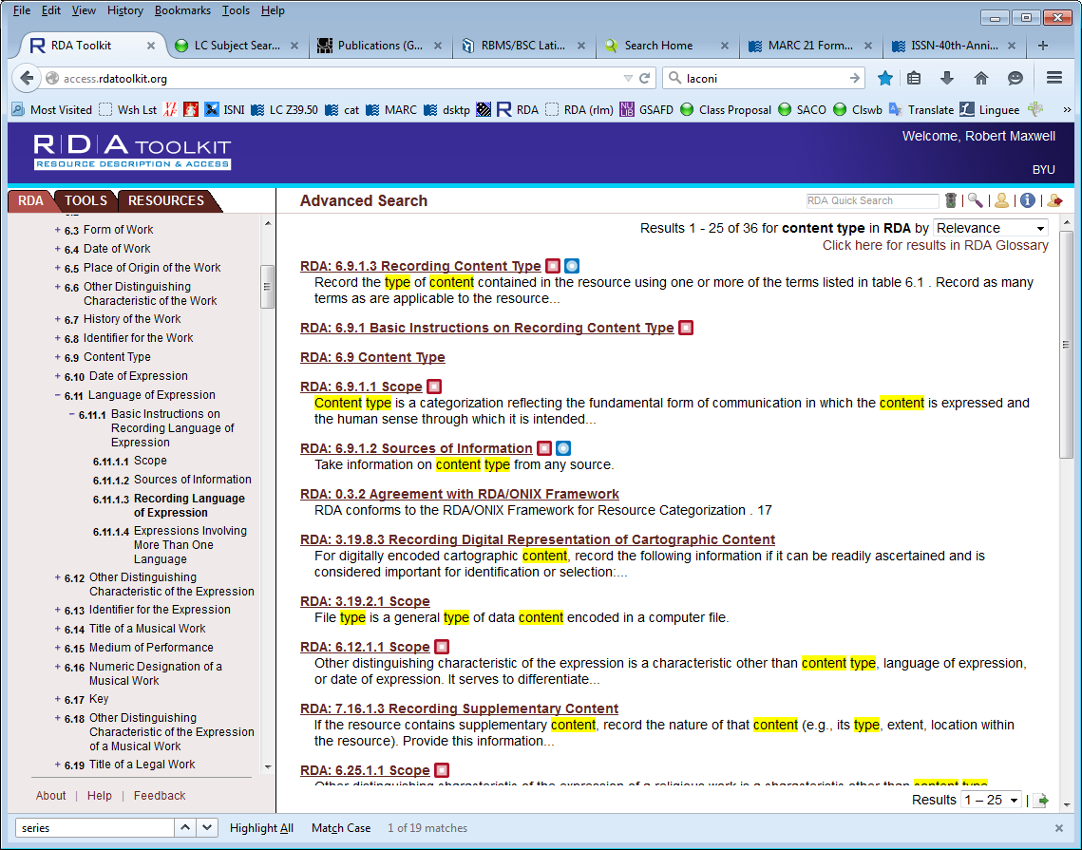
Notes:
Your screen should look like this. This is a keyword search result. 36 instances of “content” and “type” were found. Click on RDA 6.9, the third line down.

Slide 49
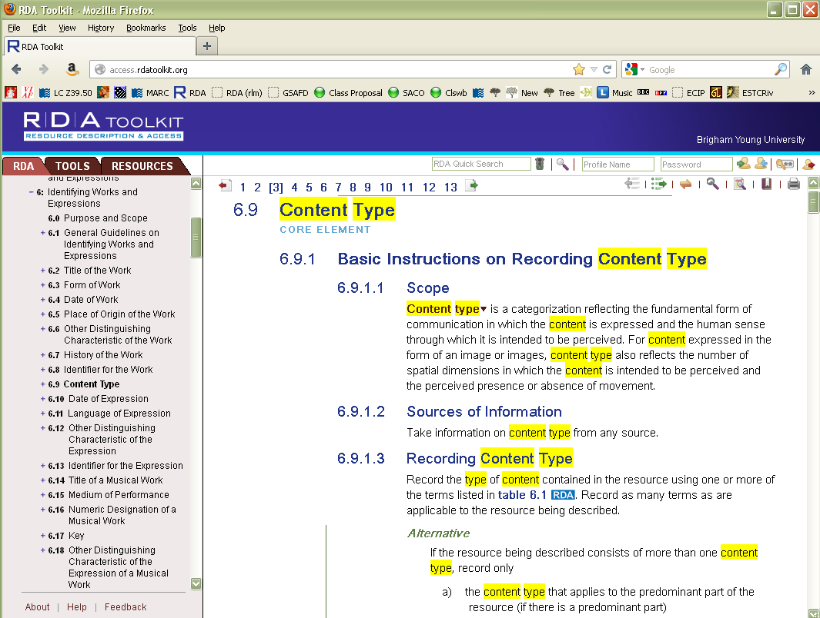
Notes:
Notice the table of contents column has changed, giving you the context of where you are.
Now scroll down the right hand column (the main text) until you come to 6.11.1.3.

Slide 50
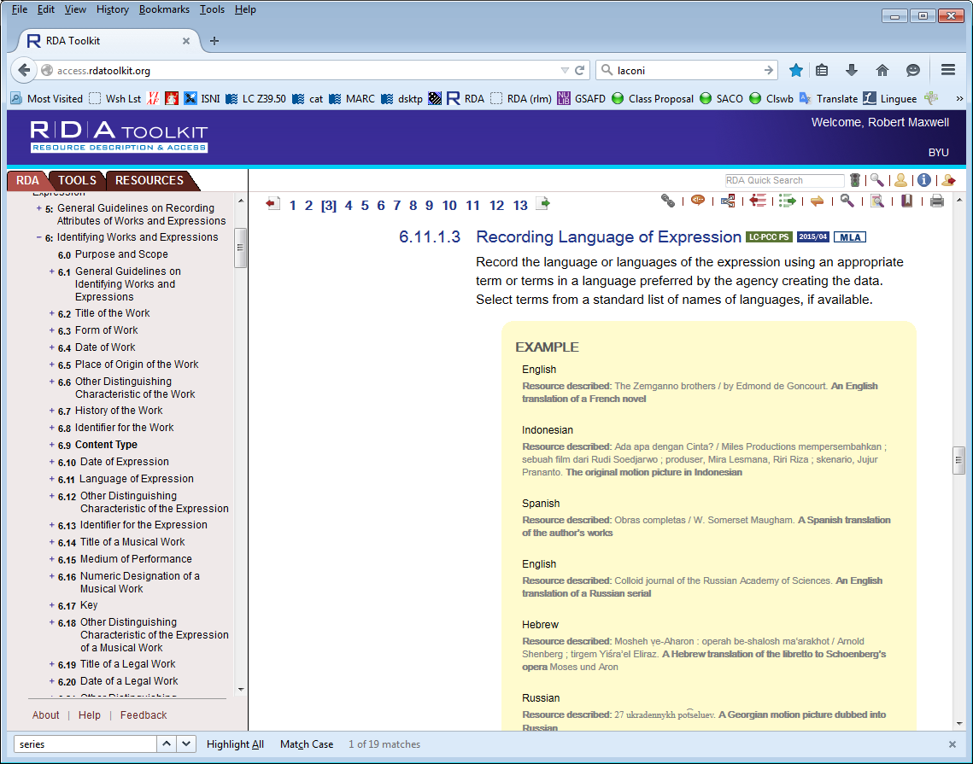
Notes:
Look at the table of contents column. It hasn’t changed. If you want the table of contents to be synchronized to where you currently are in RDA, click on the yellow double headed arrow (click)

Slide 51
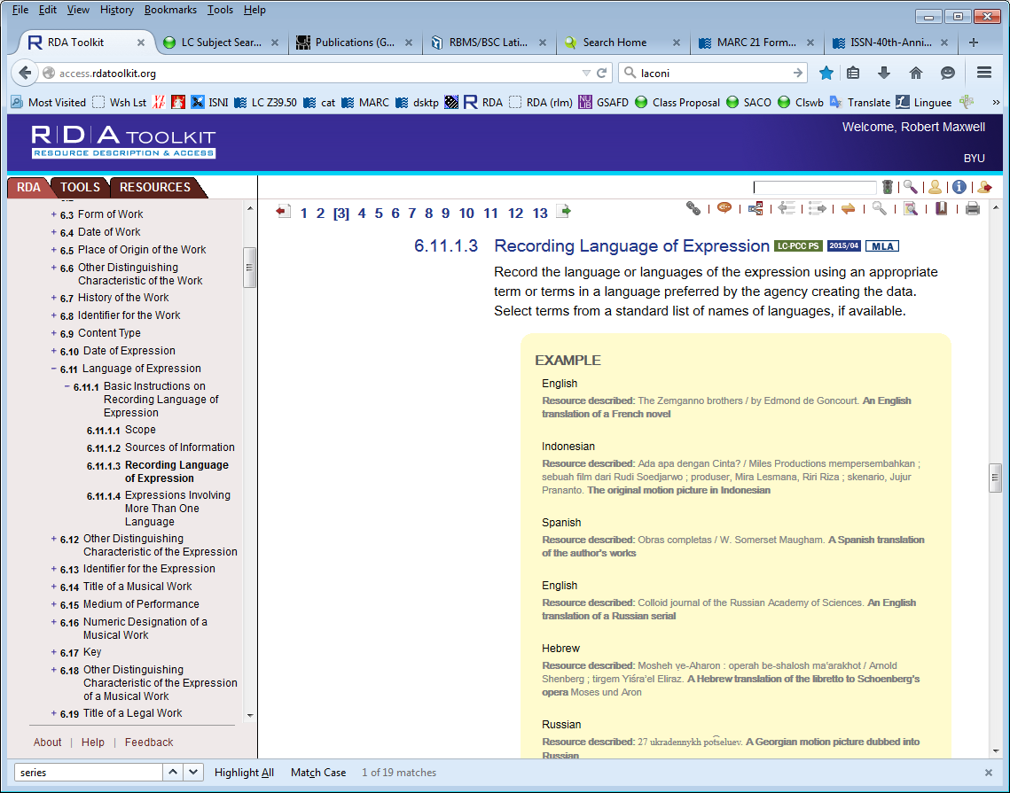
Notes:
The TOC has synchronized to the position of whatever is at the top of your screen. Now click on the green box next to “Recording language of expression”.

Slide 52
Notes:
This takes you to an LC-PCC Policy Statement related to the RDA guideline. To return to RDA, either click on the RDA number in the title of the policy statement (click) or the RDA tab (click)

Slide 53
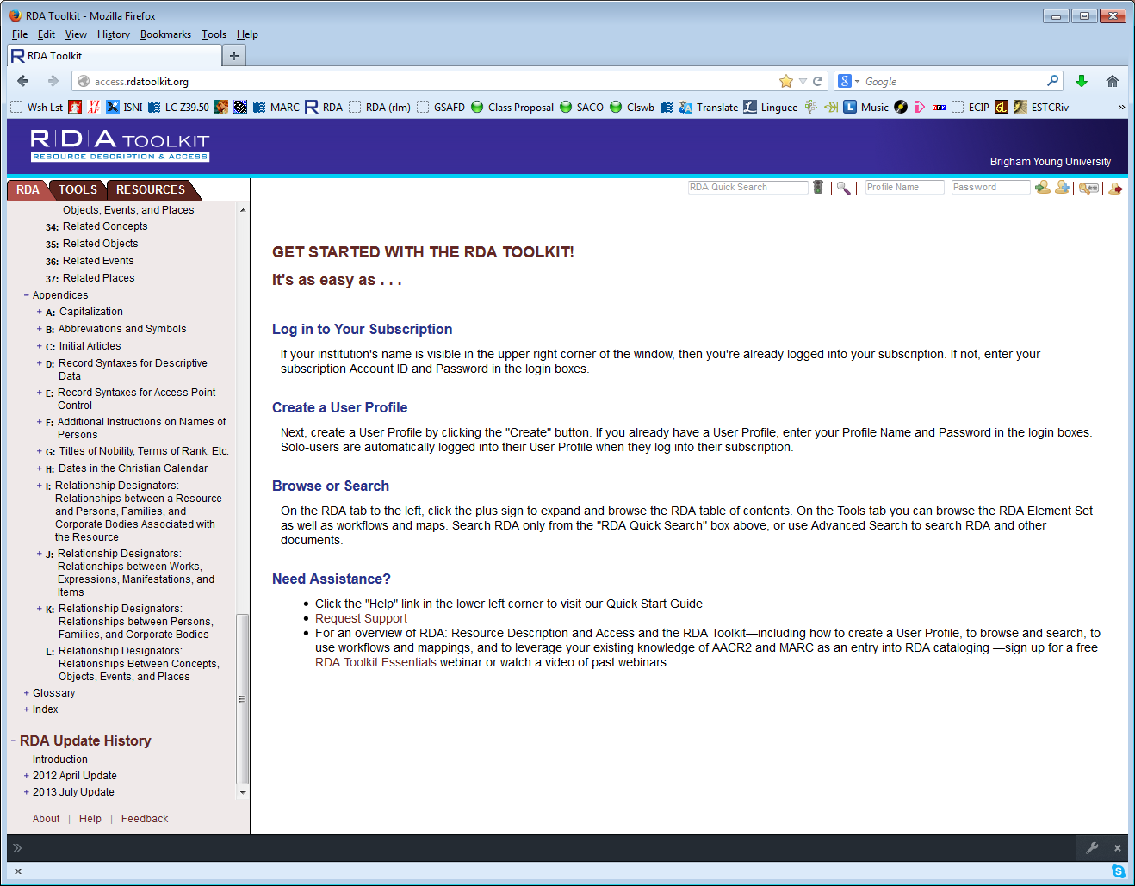
Notes:
Now click on the Tools tab (click twice)

Slide 54
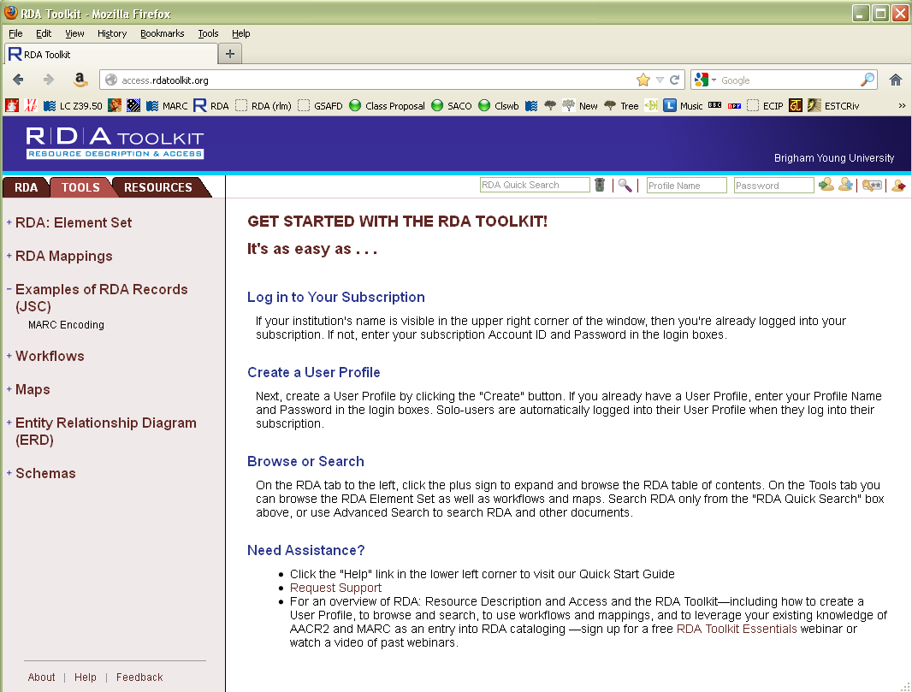
Notes:
Click on the plus sign next to RDA Mappings and then click on RDA to MARC Bibliographic Mapping (click twice)

Slide 55
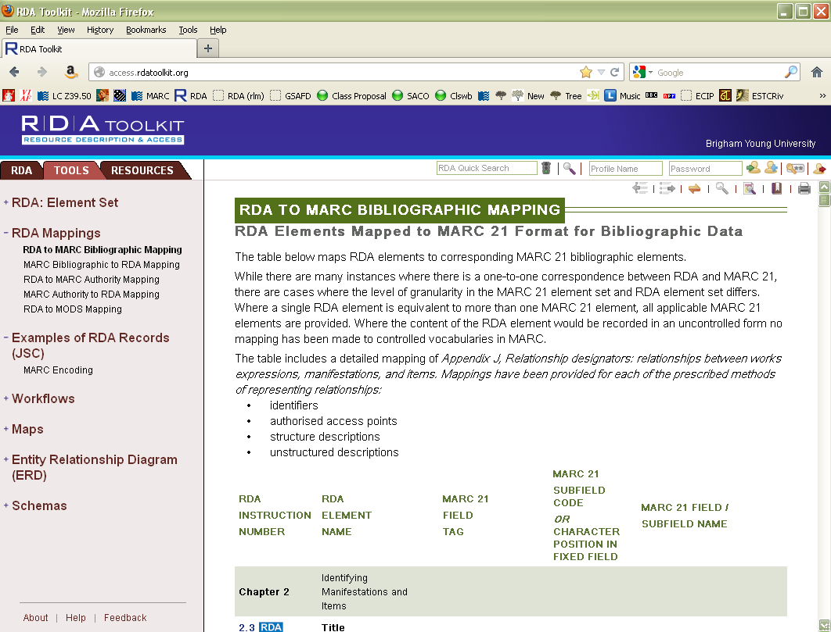
Notes:
Scroll down in the right hand screen until you come to 3.3, Carrier type (it’s a way down).

Slide 56
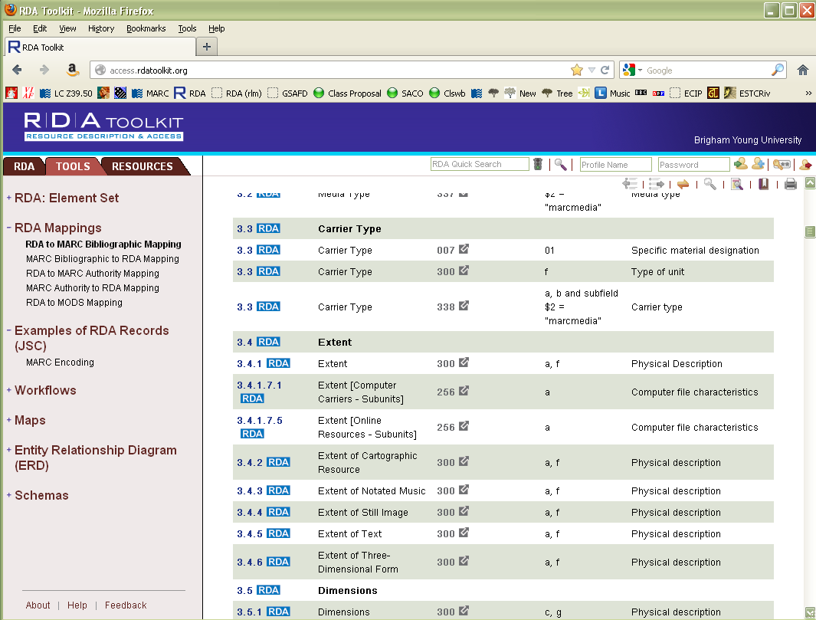
Notes:
Here we learn where in MARC this new RDA element can be coded. The third possibility, 338, is where we’re coding it. Click on “338”

Slide 57
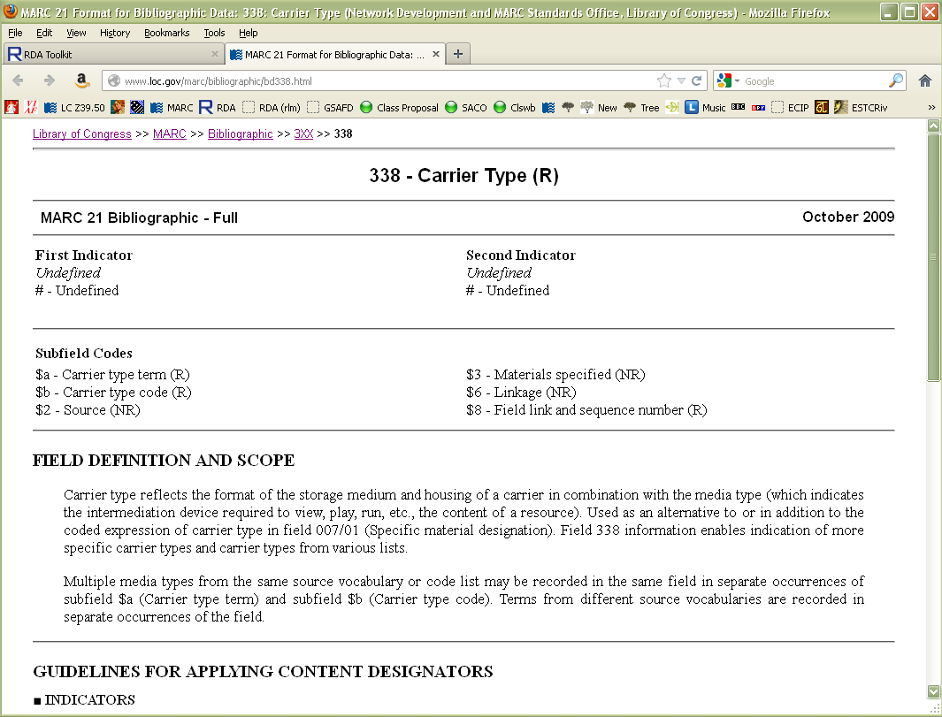
Notes:
You are taken to the section of the MARC documentation that covers the 338 field. We’ll come back to this later. Go back to the RDA toolkit (it should be waiting in another tab of your browser).

Slide 58
Notes:
You can also go the opposite direction. Click on MARC Bibliographic to RDA mapping (click twice). Scroll down in the right hand window to 245.

Slide 59
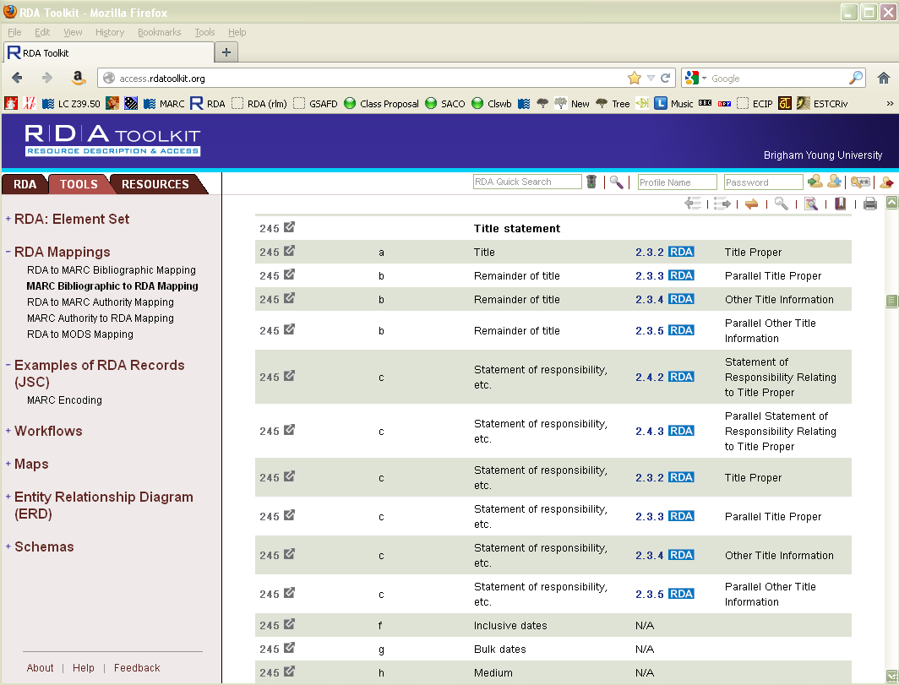
Notes:
Here you can see RDA elements that correspond to the MARC 245 field. If we can’t remember where the RDA guideline for title proper is, but we do remember it’s coded in MARC 245 subfield $a, we can approach RDA that way. Click on 2.3.2.

Slide 60
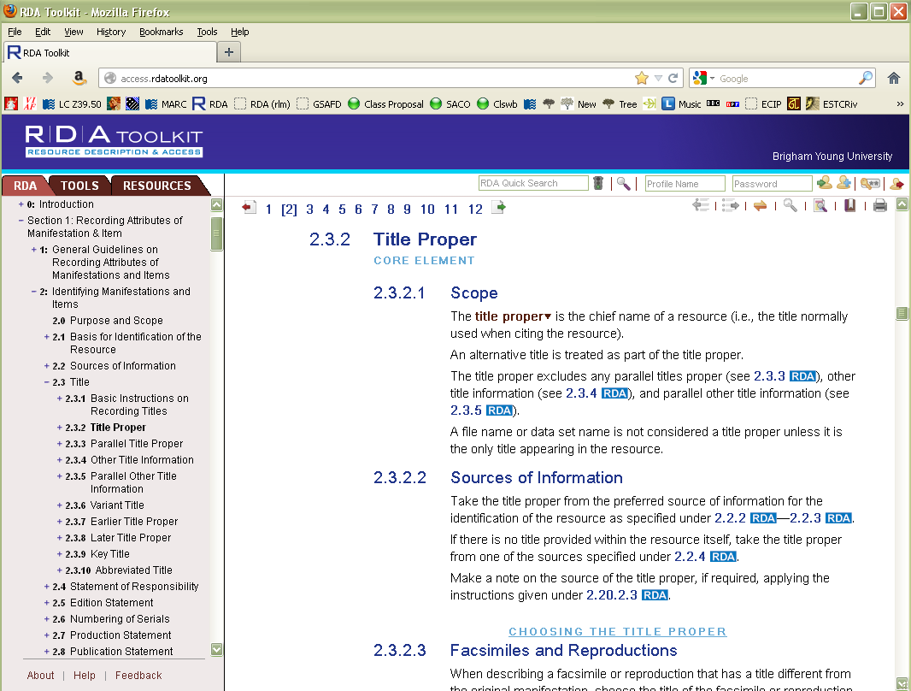
Notes:
We’re back to RDA.

Slide 61
Module 1 RDA Basics FRBR, RDA and Authority Work
Questions?
RDA Authority Control Cataloging
LACONI Technical Services Section
May 15, 2015

Slide 62
This Presentation is available at
http://net.lib.byu.edu/~catalog/people/rlm/RDALACONI201505/index.htm
For further information
contact Robert L. Maxwell
robert_maxwell@byu.edu

