Slide 1

Describing Series
Module 6a
Module 6a. Series
1
Notes:
March 2017
(Date of slide or last update given at the top of the notes for each slide)

Slide 2
Scope
The purpose of this module is to teach how to describe series, which are aggregate works with expressions
This module assumes an understanding of Modules 1-6, particularly building on Module 6 (Describing Works and Expressions)
This module will cover both RDA and non-RDA aspects of series authority work
It will also cover aspects of series in bibliographic records
Notes:
March 2017
In this module we will examine the attributes of works and expressions recorded found in the instructions in Chapters 5 and 6 as they pertain to series, and the instructions for creating work or expression authorized/variant access points for series. We will also examine treatment of series in bibliographic record, as well as non-RDA aspects of series authority work.
Presenter: This module may be presented either as a part of the regular NACO training series, or separately. If it is presented separately, be sure participants are very familiar with Modules 1-6 as well as 7-8 (for updating and NACO administration). If they are not, take time to review the concepts in the other modules.
This module can be used for music and other specialized series (e.g. law), and includes a few music examples. If participants want to do specialized authority work in these areas they should receive the music or law NACO training.

Slide 3
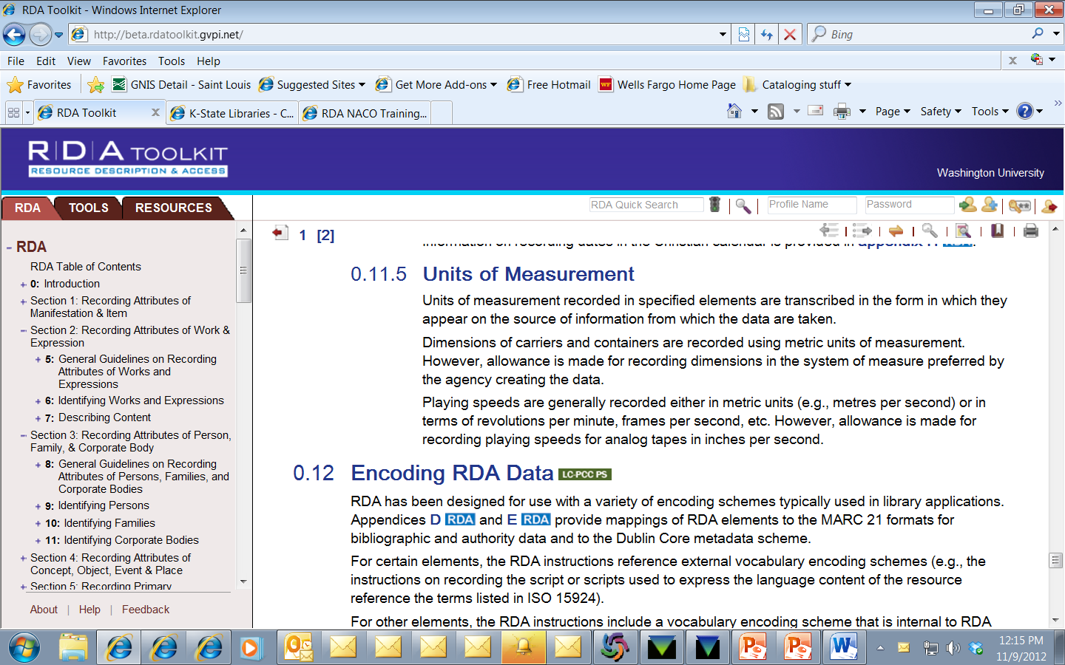
Pertinent Instructions
RDA Chapters 5 and 6
Other RDA chapters when constructing series access points that include a personal, corporate, or family name as a creator (chapters 8-11)
Notes:
March 2017

Slide 4
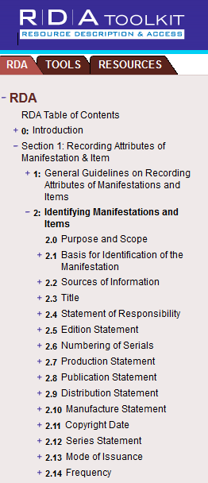
Pertinent Instructions
RDA Chapter 2
Choice of title, title change
Series in bibliographic records
Notes:
March 2017

Slide 5
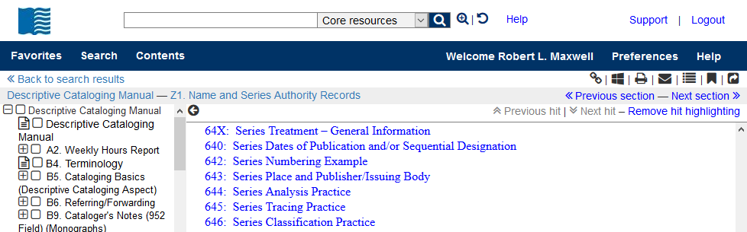
Pertinent Instructions
Descriptive Cataloging Manual Z1
  Treatment fields
  Other MARC authority policies
Notes:
March 2017

Slide 6
Definitions (RDA 5.1.2)
Work = a distinct intellectual or artistic creation (i.e., the intellectual or artistic content).
Expression = the intellectual or artistic realization of a work in the form of alpha-numeric, musical or choreographic notation, sound, image, object, movement, etc., or any combination of such forms.
Notes:
March 2017
Review definitions of work and expression

Slide 7
Definitions (RDA 5.1.2)
The terms work and expression can refer to individual entities, aggregates, or components of these entities (e.g., the term work can refer to an individual work, an aggregate work, or a component of a work)
Aggregate work is not defined in RDA. Possible definition: “A work formed by combining two or more other works.”
A series is an aggregate work. RDA guidelines using the term “work” or “expression” may apply to series
Notes:
March 2017
Note that the terms “work” and “expression” apply to aggregates. Series are aggregate works/expressions.
If workshop members are interested in more information about aggregates: For current work on aggregates, see the 2016 discussion paper of the RSC Aggregates Working group and responses to it, http://www.rda-rsc.org/RSC/AggregatesWG/1. For more background, see also https://www.ifla.org/files/assets/cataloguing/frbrrg/AggregatesFinalReport.pdf (dated September 12, 2011).

Slide 8
Definitions (RDA Glossary)
Series
Series. A group of separate manifestations related to one another by the fact that each manifestation bears, in addition to its own title proper, a collective title applying to the group as a whole with or without numbering.
Notes:
March 2017
Emphasis added. A series is a group of manifestations that all bear a collective title that applies to the group as a whole.

Slide 9
Definitions (RDA Glossary)
Series
A series may be issued as a serial. This is called a monographic series.
Or, a series may be issued as a multipart monograph.
Notes:
March 2017

Slide 10
Definitions (RDA Glossary)
Monographic series
Serial. A mode of issuance of a manifestation issued in successive parts, usually bearing numbering, that has no predetermined conclusion. A serial includes a periodical, monographic series, newspaper, etc.
The term “monographic series” is not defined in RDA other than to say that it is a serial.
Notes:
March 2017
Emphasis added. A series is a group of manifestations that all bear a collective title that applies to the group as a whole.

Slide 11
Definitions
Monographic series
A monographic series is
  a group of monographs
  that does not have a predetermined conclusion (serial definition)
  each of which bears, in addition to its own title proper, a collective title applying to the group as a whole (series definition)
Notes:
March 2017
Emphasis added. A series is a group of manifestations that all bear a collective title that applies to the group as a whole.

Slide 12
Definitions (RDA Glossary)
Multipart monograph
Multipart monograph. A mode of issuance of a manifestation issued in two or more parts, either simultaneously or successively, that is complete or intended to be completed within a finite number of parts.
A multipart monograph might or might not be a series.
If parts of the multipart monograph bear, in addition to their own titles proper, a collective title applying to the group as a whole, the multipart monograph is a series.
Notes:
March 2017
Emphasis added. A multipart monograph is a series if parts bear a collective title applying to the group as a whole in addition to their own titles proper.

Slide 13



Two types of series
Monographic series – no predetermined conclusion
Notes:
March 2017
Note: if someone asks: the number next to the title is the year of production of the film. The criterion collection is numbered, but the number in the series is found elsewhere on the container.
Note: if someone asks: currently in the authority file there are three SARs for this series, “Criterion collection”, “Criterion collection (Blu-ray discs)”, and “Criterion collection (DVD videodiscs)”. These were created under AACR2 procedures. They are all the same work and expression (changes in carrier do not create either a new work or expression in RDA), and so should be represented by a single work-level SAR.

Slide 14



Two types of series
Monographic series – no predetermined conclusion
Notes:
March 2017
Let’s-read-and-find-out science stage 2. Note that Germs make me sick! is also in the monographic series Reading rainbow book.

Slide 15

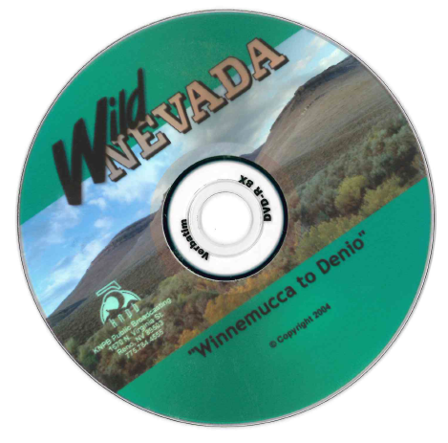
Two types of series
Monographic series – no predetermined conclusion
Notes:
March 2017
Wild Nevada is a television series. These DVDs are for two separate episode in the series, separately packaged, with titles proper “Fallon/Sheldon N.W.R./Wells” and “Winnemucca to Denio”. Notice also that one is numbered and the other is not. Presence or absence of number does not create a new series; these are the same series.
Television series with individually titled episodes, like this one, fit the RDA definition of series, “A group of separate manifestations related to one another by the fact that each manifestation bears, in addition to its own title proper, a collective title applying to the group as a whole with or without numbering,” and may have series authority records created for them.

Slide 16



Two types of series
Multipart monograph – predetermined conclusion
Notes:
March 2017
Multipart monograph. “Author” series are examples. All series by a single author are considered multipart monographs. Cataloging culture holds, practically, that they always have a predetermined conclusion, whatever the intent of the author might have been (because the author will eventually die and no longer be able to produce more parts.)

Slide 17



Two types of series
Multipart monograph – predetermined conclusion
Notes:
March 2017
Multipart monograph. In this example, the series title pages state: “When complete, the series will comprise 10 volumes, one each on ten significant tasks ... 1. Acting. 2. Animation. 3. Cinematography. 4. Costume, makeup, and hair. 5. Directing. 6. Editing and special visual effects. 7. Producing. 8. Screenwriting. 9. Art direction and production design. 10. Sound”

Slide 18

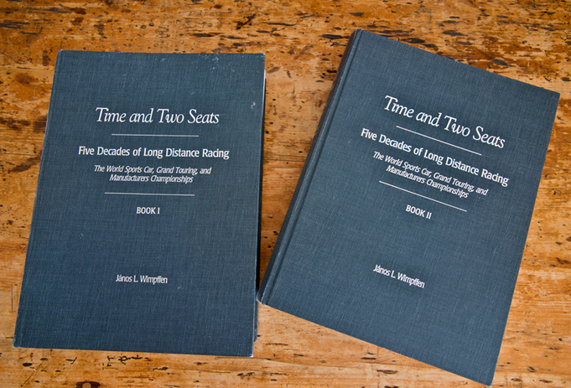
Aside: Not All Multipart Monographs are Series
Time and two seats and Encyclopaedia Britannica are multipart monographs, but are not series because the individual volumes do not have their own titles proper.
Notes:
March 2017
Presenter: Do not get into an argument over whether, e.g., “Reti-Soloverts” (Micropedia volume 10) could be a title proper. Most catalogers would not consider Encyclopaedia Britannica to be a series.
Images from
http://roadscholars.com/wp-content/uploads/2015/10/2015-11-04-01.jpg
http://i2.cdn.cnn.com/cnnnext/dam/assets/120406104003-encyclopedia-britannica-in-print-story-top.jpg

Slide 19
Why is the distinction important?
In most respects monographic series and multipart monographs are described in the same way, but
If the title changes …
  monographic series => create a new description (i.e., it is considered a new work)
  multipart monograph => use the same description (i.e., it is considered the same work)
Notes:
March 2017

Slide 20
Multipart Monographs
For more details on multipart monographs, see PCC Series training manual, Session 10 (Multipart Monographs)
https://www.loc.gov/catworkshop/courses/naco-full%20series-RDA/course%20table.html
Notes:
March 2017

Slide 21
Title change – Serials (Monographic series)
RDA 2.3.2.12.2 (see also 6.1.3.2)
If there is a major change (as defined at 2.3.2.13.1) in a title proper on a subsequent issue or part of a serial [e.g., a monographic series], create a new description for the issues or parts appearing under the new title
Notes:
March 2017
e.g. clause added for the presentation, not in RDA
“new description” = a new authority record, including a new authorized access point.

Slide 22
Title change - Major change
RDA 2.3.2.13.1.2
  the addition, deletion, change, or reordering of any component of the title proper that changes the meaning of the title or indicates a different subject matter
  a change of name for a corporate body included anywhere in the title if the changed name is for a different corporate body (e.g. a corporate body with a later name)
Notes:
March 2017

Slide 23
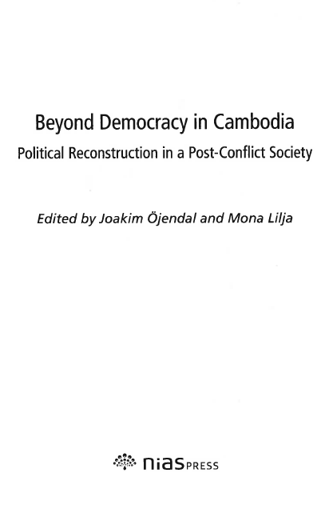





Title change – Major change
Series title change
Notes:
March 2017
Beyond democracy in Cambodia: Title page; title page verso; series title page
Politicized society: Title page, title page verso; series title page

Slide 24
Title change - Major change
LC-PCC PS 2.3.2.13.1
Additional Conditions for New Authorized Access Point: Subseries and the Omission/Addition of Main Series
PCC practice: When either of the situations below occurs, create a new series authority record (SAR) and link the two authorized access points via 5XX fields.
1. The title of a main series included in an existing authorized access point is no longer present on later issues or parts.
2. The title of a main series not included in an existing authorized access point appears on later issues or parts.
If the presence/absence of the title of the main series continues to be inconsistent, do not create additional SARs. Use the SAR for the later authorized access point and add information and variant access points as appropriate.
Notes:
March 2017

Slide 25
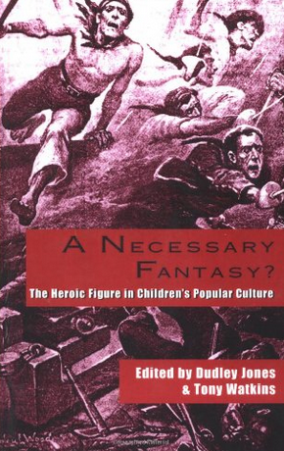




Title change - Major change
LC-PCC PS 2.3.2.13.1
Series title change
Notes:
March 2017
The first 20 or so volumes the series is presented as a subseries to Garland reference library of the humanities; beginning with volume 20 the main series disappears and the series is presented simply as “Children’s literature and culture.” (All boxes come from title page verso)
If presenter wishes to elaborate: this is actually a little more complicated than shown on the slide. There were two subseries, “Garland reference library of the humanities. Children’s literature and culture” and “Garland reference library of social science. Children’s literature and culture” which merged to become a main series “Children’s literature and culture”

Slide 26
Title change – Minor change
RDA 2.3.2.13.2
  a difference in the representation of a word, words, or other component
  the addition, deletion, or change of articles, prepositions, or conjunctions
  a difference involving the name of the same corporate body
  the addition, deletion, or change of punctuation
  a different order of titles when the title is given in more than one language, provided that the title chosen as a title proper still appears as a parallel title proper
Notes:
March 2017

Slide 27
Title change – Minor change
RDA 2.3.2.13.2
  the addition, deletion, or change of a word, words, or other component that links the title to the numbering
  two or more titles proper used on different issues of a serial according to a regular pattern
  the addition to, deletion from, or change in the order of a word, words, or other component in a list, provided that there is no significant change in the subject matter
  the addition, deletion, or rearrangement anywhere in the title of a word, words, or other component that indicates the type of resource, such as “magazine,” “journal,” or “newsletter”
  In case of doubt, consider the change to be minor.
Notes:
March 2017

Slide 28

Title change – Minor change
Minor change – not a new work, use same description (series authority record)
Notes:
March 2017
Subseries title Let’s-read-and-find-out science Stage 2 changes to Let’s read and find out science Level 2

Slide 29


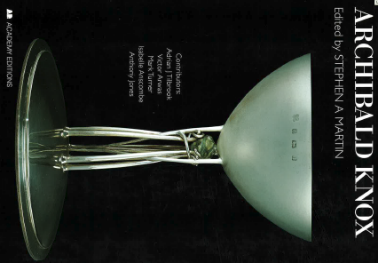
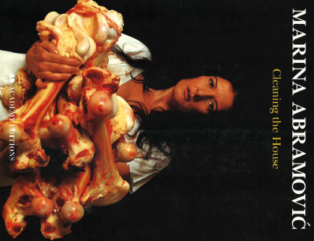

Title change – Minor change
Minor change – not a new work, use same description (series authority record)
Notes:
March 2017
Series statements all from title page versos.

Slide 30
Title change – Multipart monographs
RDA 2.3.2.12.1
If there is a change in a title proper on a subsequent part of a multipart monograph, and the change is considered important for identification or access, record the subsequent title as a later title proper
Notes:
March 2017

Slide 31


Multipart monograph series title change does not create a new work
Notes:
March 2017
This series was first published in an English text expression with the title “A novel of the Mither Mages”.

Slide 32


Multipart monograph series title change: same work, new expression
Notes:
March 2017
The series was recorded as an audiobook. This is a different expression from the original text expression, but remains the same work. Because this is a multipart monograph, the title change does not mean a new work exists. “The mither mages series” would be recorded as a variant title.
These two slides represent a single series work in two expressions.
NOTE: if anyone asks, differences in numbering (e.g. numbered vs. unnumbered) also does not create a new work in any series (multipart monograph or monographic series). It may signal a different expression, but not a new work. (In this case, the original English text expression is not numbered, but this spoken word expression is.)

Slide 33
Title Change
For more details on title changes, see PCC Series training manual, Session 8 (Related Series)
https://www.loc.gov/catworkshop/courses/naco-full%20series-RDA/course%20table.html
Notes:
March 2017

Slide 34

Series Work and Expressions
Notes:
March 2017
Three expressions of one work are shown here: the original English text expression; an English spoken word expression; and a French text expression.

Slide 35
Works and Expressions
WEMI relationships
Series work: A novel of the Mither mages
created by
Person: Orson Scott Card
realized through
Series expression: French text
Series expression: English spoken word
Series expression: English text
translated by
Person: Jean-Daniel Brèque
Notes:
March 2017
Here are some WEMI relationships to the series A novel of the Mither mages. On the French expression, Jean-Daniel Brèque is the translator of all the parts (so far).

Slide 36



Works
Whole-Part Relationships
Series work: A novel of the Mither mages
created by
contains
Person: Orson Scott Card
Work
Work
Work
Notes:
March 2017
Here are the whole-part work-level relationships between the series work and the individual works.
NOTE: Card has a “created by” relationship to the series work as well as to each of the individual works.

Slide 37



Expressions
Whole-Part Relationships
Series work: A novel of the Mither mages
created by
Person: Orson Scott Card
realized through
Series expression: French text
contains
Expression of contained work
Expression of contained work
Expression of contained work
Notes:
March 2017
Here are the relationships at the expression level of the French expression of the series work and the French expressions of the individual works.

Slide 38
When do you have to create an authority record? (DCM Z1 Introduction)
PCC/LC Practice. Transcription of the series (in MARC bibliographic 490) is mandatory if applicable. Series statement is a core element (RDA 2.12)
PCC Practice. Indexing (tracing) the series (in MARC bibliographic 8XX) is optional. If the cataloger chooses to index the series, it must be supported by a NACO series authority record.
LC Practice. LC does not index series, and generally does not create or update series authority records.
Notes:
March 2017

Slide 39
MARC Coding
Series works and expressions are coded in X00, X10, X11, and X30
If the access point begins with the authorized access point for the creator, use the same tag as the creator uses (X00, X10, or X11)
If the work/expression does not have an explicit creator, use X30
Notes:
March 2017

Slide 40
MARC Coding
RDA records for series works and expressions are coded “z” in 008/10 (“Rules”) and “rda” in 040 subfield $e.
000/12 (“Series”)
  a – Monographic series
  b – Multipart monograph
  c – Series-like phrase
Notes:
March 2017

Slide 41
MARC Coding
000/13 (“Ser num”)
  a – Numbered series
  b – Unnumbered series
  c – Numbering varies
000/16 (“Ser use”)
  a – Heading appropriate as series added entry
  b – Heading not appropriate as series added entry
Notes:
March 2017

Slide 42
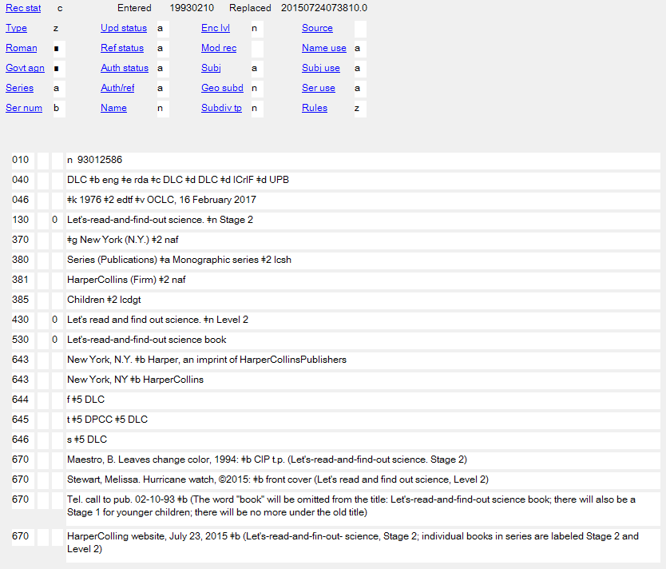
Notes:
March 2017
Note also that series are coded as valid for subject use (“Subj use a”)
In case someone asks: “DLC” in this record and others used as examples in this workshop means “Library of Congress”, meaning LC created and/or revised the record. This record and others like it predate LC’s decision not to create or revise series authority records.

Slide 43
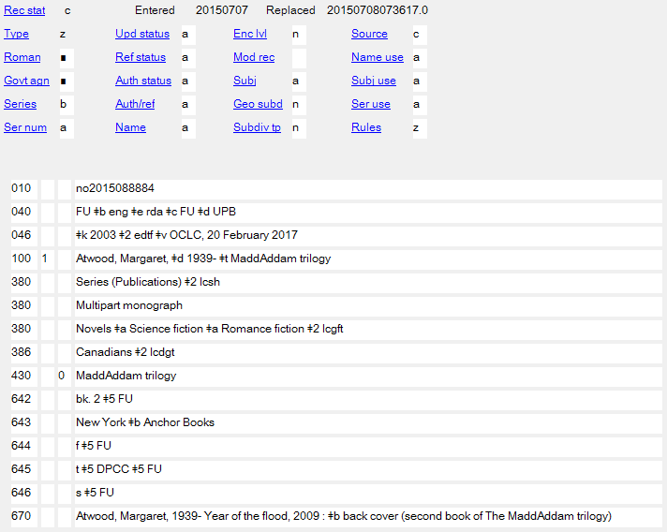
Notes:
March 2017

Slide 44
Identifying Works: Core Elements (RDA 0.6.6)
Preferred title for the work
Identifier for the work
Musical works with non-distinctive titles
  Medium of performance
  Numeric designation
  Key
Notes:
March 2017
Open to 0.6.6, looking for the core elements for works (click through as they find them)
Note again that core elements are required, but do not necessarily wind up in the authorized access point for the work.
Reminder: We are not covering music or legal works in this module.

Slide 45
Identifying Works:
Core if needed to distinguish
Form of work
Date of work
Place of origin of the work
Other distinguishing characteristic of the work
Musical works with distinctive titles
  Medium of performance
  Numeric designation
  Key
Notes:
March 2017
Reminder: We are not covering music or legal works in this module.

Slide 46
Identifying Works: Core Elements
Series can have authors, but the author / creator is not a core element of the work entity.
Authors can be persons, families, or corporate bodies, and they are separate entities, related to the work entity—an author has a relationship with a work
However, the access point will contain the name of the author, if there is one. This is a link, not an element of the work entity.
Notes:
March 2017

Slide 47
Identifying Expressions:
Core Elements (RDA 0.6.6)
Core in all cases
Identifier for the expression
Content type
Language of expression
Horizontal scale (maps)
Vertical scale (maps)
Core if needed to distinguish
Date of expression
Other distinguishing characteristic
Notes:
March 2017
Open to 0.6.6, find the core elements for expressions. Click to display points as located.
This module does not cover cartographic works. Presenter—if asked about recording scale in expression authority records, note that no explicit field for scale has been defined in the MARC authorities format, and that it’s unclear whether the data would be recorded in subfield $g or $s of a 1XX access point.

Slide 48
Source Consulted (RDA 5.8)
Record in 670 field, or 3XX subfield $u/$v
Always include one 670 for the resource being cataloged
Others included if needed to justify information in the description
Suggested format:
  670 Title proper, date: $b location within source (data found)
  670 Title proper, date [e.g. date of viewing] $b (data found)
Notes:
March 2017
Everyone go to RDA 5.8
The second 670 (without colon or location within source) is used for electronic resources such as websites and databases, or resources such as dictionaries where entries are in alphabetical order and locations are not necessarily found by locating a page number.

Slide 49
670 field examples
Series: Pluck and luck
His first drink, or, Wrecked by wine, 1900: $b title page (Pluck and luck)
670 OCLC, December 21, 2015 $b (title usage: Pluck and luck; Pluck and luck stories; Pluck and luck stories of adventure)
Series: Back off! Animal defenses
670 Armored animals, 2016: $b cover frame (Back off! Animal defenses)
670 OCLC, February 1, 2016 $b (books in series are by different authors and are all dated 2016)
Series: Middle English texts
The lyfe of Oure Lady, 1985: $b series title page (Middle English texts) spine (MET)
Series: Zolotoe nasledie
670 Kapitan Krokus, 2016: $b colophon (Золотое наследие = Zolotoe nasledie)
Notes:
March 2017
There are lots of ways to form these. The point is to record information justifying what you’ve included in other elements in the description.
The Pluck and luck examples show an OCLC note giving evidence for differing forms of the title.
The Back off! Examples show how to form an OCLC note; in this case the only information needed was the date of the beginning of the series. Differing forms of titles might also be recorded.
The Middle English texts example shows how to record information from different places in the same source.
The Zolotoe nasledie example shows how to record non-Roman script information (record it as found and then Romanize it following an equals sign)

Slide 50
Exercise: Source Consulted
Open a “series” workform in OCLC
Add the Source Consulted element for the first part of the series (published 2011). Include evidence about the series. (The first inset box is from the title page verso; the second is from the series title page.)
Notes:
March 2017
To open the workform, go to Authorities => Create => Single record, and then choose the type of workform. Participants can save their work to the online or local save file, whichever is better, but they should not produce the record, since it already exists in the NACO AF.

Slide 51
Exercise: Source Consulted
Open a “personal name” workform in OCLC
Change “Series” to “b”
Change “Ser num” to “b”
Change “Ser use” to “a”
Add the Source Consulted element for the first part of the series (published 2011). Include evidence about the series.
Notes:
March 2017
To open the workform, go to Authorities => Create => Single record, and then choose the type of workform. We are choosing a “personal name” workform this time instead of a “series” workform because the authorized access point for this series will be coded in a 100 field. Participants can save their work to the online or local save file, whichever is better, but they should not produce the record, since it already exists in the NACO AF.

Slide 52
RDA 5.8. Source Consulted
  670 Politicized society, 2011: $b series title page (Governance in Asia is the successor to NIAS’s “Democracy in Asia” series) title page verso (Governance in Asia, No. 1)
  670 The lost gate, 2011: $b title page (A novel of the Mither mages ; [by] Orson Scott Card)
Notes:
March 2017
Two examples. These 670s show the important information that needs to be recorded for works and expressions: presentations of the title, names of creators, names of contributors (e.g. translators).

Slide 53
Attributes of Works
Notes:
March 2017

Slide 54
Titles (RDA 6.2)
Information about titles of a work can be taken from any source (RDA 6.2.1.2)
Sources of information for the preferred title are found in RDA 6.2.2.2.
Creating the authorized access point is a further step (RDA 6.27)
Notes:
March 2017
Note the three-step procedure: title of the work→ preferred title→ authorized access point. Note too that RDA divides titles into preferred titles and variant titles.

Slide 55
Titles (RDA 6.2)
The series will be identified by its preferred title. Where can we find the preferred title of a series?
RDA 6.2.2.2
  Manifestations embodying the series
  Reference sources
Notes:
March 2017

Slide 56
Titles (RDA 6.2)
So, in order for a series to exist under RDA it must be identified by a title.
  Prefer a series title found in a manifestation
    Evidence: the item you have in hand; transcriptions in databases such as 490 fields in OCLC; digital images of manifestations
  If no series title is found in manifestations embodying the series, “reference sources” can be used. This might include the author’s or publisher’s website.
Notes:
March 2017
Publisher’s website may become a source for the series title of the first part or two of the series, if the publisher decided to put them in a series after they were published. It can also be a source even if a series title never appears on a manifestation.

Slide 57



Titles (RDA 6.2)
These books by Libba Bray are related, but the cataloger found no series statements on the manifestations in hand
Followed by
Followed by
Readers think of them as being in a series
Notes:
March 2017
Current manifestations of these do in fact include a series statement, but the cataloger did not find any statement on the manifestation he/she had in hand.

Slide 58
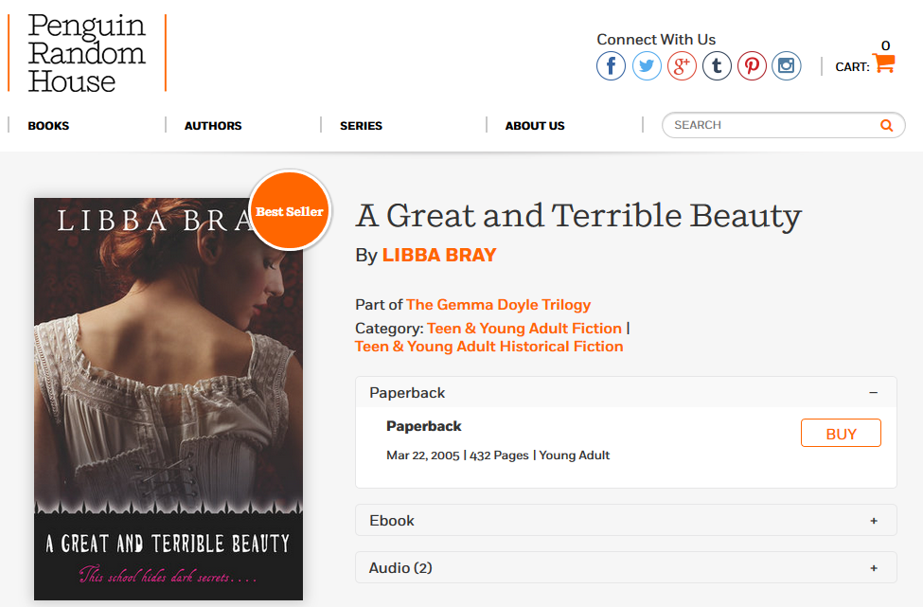
Titles (RDA 6.2)
A reference source (the publisher’s website) does identify the series by a title
This series has a title and may be established
Notes:
March 2017
Presenter note: If no series statement is found in the resource being cataloged, it is not required to go further, such as the publisher’s website. This and the following slides are intended to demonstrate that a series can be established in the absence of evidence on the manifestation(s), so long as there is evidence elsewhere and if in the judgment of the cataloger it is helpful to the users of the database.

Slide 59
Titles (RDA 6.2)
What counts as a reference source?
The author’s website?
The publisher’s website?
Encyclopedic databases like isfdb.org?
Wikipedia?
Goodreads?
Amazon?
Fan fiction sites like
  “Stop, you’re killing me!”?
  FantasticFiction?
Notes:
March 2017
Presenter: Take time to discuss with the group and brainstorm for other reference sources, including print and database sources that libraries might have. Any of the sources listed on this slide could be used.

Slide 60
Titles (RDA 6.2)
What counts as a reference source?
PCC has no policy answer to this question and is not likely to
RDA Glossary: “Reference source: A source from which authoritative information may be obtained”
Catalogers must use their judgment
However, if a series appears to be commonly known by a title in reference sources, including Internet sources, RDA permits these as sources for a series title
Notes:
March 2017

Slide 61
Titles (RDA 6.2)
RDA is much more permissive in terms of sources that can be used to find a series title than AACR2 was, but still …
Catalogers cannot just make up a series title because the resources seem to be related
So if no evidence of a title is found, a series cannot be established
Other ways to bring together resources:
  Subject headings (e.g. “[AAP for fictitious character] $v Fiction” in 600 field)
  Sequential relationships (“Sequel: …”/“Sequel to: …”) in 7XX field)
Notes:
March 2017

Slide 62




Titles (RDA 6.2)
Other ways to bring together resources:
  Subject headings (e.g. “[AAP for fictitious character] $v Fiction” in 600 field)
  600 10 Angstrom, Rabbit $v Fiction.
Notes:
March 2017
These novels are clearly related but (it seems) have never appeared with a series statement (so far), even in reference sources (Wikipedia and other sources talk about “The Rabbit novels” but that seems to be intended as a gathering device, not a title).

Slide 63
Titles (RDA 6.2)
Other ways to bring together resources:
  Sequential relationships (“Sequel:”/“Sequel to:” in 700 fields)
    100 1_ Updike, John, $e author
    245 10 Rabbit is rich / $c John Updike.
    …
    700 1_ $i Sequel to: $a Updike, John. $t Rabbit redux.
    700 1_ $i Sequel: $a Updike, John. $t Rabbit at rest.
Notes:
March 2017

Slide 64
Series-Like Phrases
LC-PCC PS 2.12
In NACO practice, some phrases that look like titles are not considered to be series titles
Some may be recorded in authority records, but they will not be used as series authorized access points
Details in LC-PCC PS 2.12 “Series or Phrases”
Judgment heavily involved
Notes:
March 2017
READ LC-PCC PS 2.12 with group

Slide 65
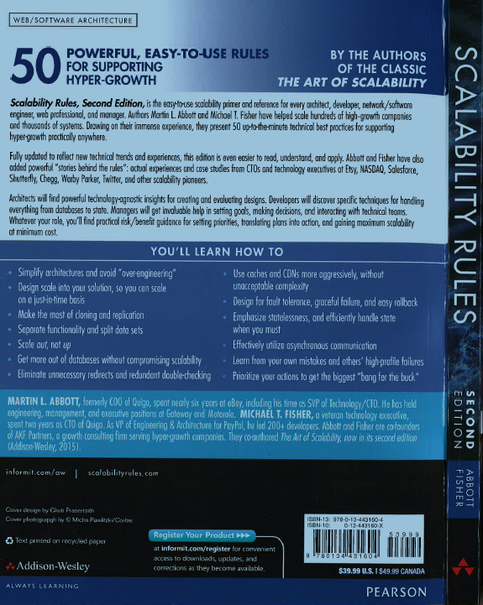


Series-Like Phrases
LC-PCC PS 2.12
Notes:
March 2017
“Web/software architecture” is just a label to help organize in a bookstore – “publisher’s listing … subdivided into broad categories” (LC-PCC PS)
“A Tom Doherty Associates book” is “a numbered/unnumbered statement of the commercial publisher” (LC-PCC PS)
“#1 New York times bestselling author” is not a series title, even though it appears on more than one manifestation; it’s just advertising.

Slide 66

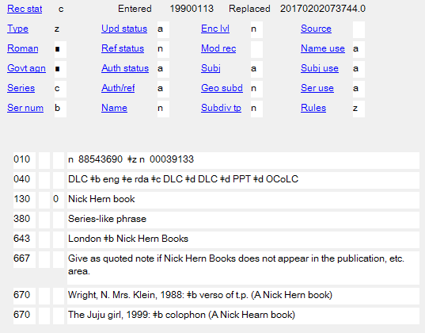

Series-like Phrase Authority Record
Notes:
March 2017
A series-like phrase can be recorded in an authority record in the NAF. Generally, don’t second guess other PCC catalogers: if a previous cataloger has recorded what you consider to be a series-like phrase in a regular series authority record, don’t revise it to become a series-like phrase record.

Slide 67
Series-Like Phrases
For more details on series-like phrases, see PCC Series training manual, Session 12 (Series-Like Phrases)
https://www.loc.gov/catworkshop/courses/naco-full%20series-RDA/course%20table.html
Notes:
March 2017

Slide 68
Transcription and Capitalization
Follow RDA 1.7, the general guidelines on transcription (not the alternatives)
RDA 6.2.1.4. Capitalization. Follow Appendix A.3 and A.4
RDA 6.2.1.6. Diacritical marks: record them as they appear; add them if it is certain that they are integral to the title but were omitted in the source
RDA 6.2.1.7. Omit initial articles (NACO follows the alternative)
RDA 6.2.1.9. Abbreviations. Record only abbreviations that are found in the source.
RDA 5.4. Language and script. NACO policy = Romanize vernacular scripts.
Notes:
March 2017
Review 1.7; LOOK at A.3-A.4 together.
The instructions here on Capitalization, Numbers, Diacritical Marks, Initial Articles Spacing of Initials and Acronyms, and Abbreviations are intended to “set up” the candidates for preferred title. Note the LC/PCC PS for the alternative in 6.2.1.7. Unlike AACR2, where 25.2C1 called for initial articles to be omitted unless intended to be filed on, RDA posits initial articles as being part of the title, preferred or variant; the alternative may be serving as a bridge until more agencies make use of software that can allow initial articles to be disregarded in the filing of name-title access points—or until character strings are no longer the principal means of conveying the name of a work or expression.

Slide 69
Transcription and Capitalization
LC-PCC PS 6.2.2.8:
  When recording the preferred title for the series, correct inaccuracies (inaccuracies can be recorded as variant titles, if thought important)
  Pre-modern forms of letters (i/j, u/v)
    I/J vowel = i (ITER = iter; ILIAS = Ilias)
    I/J consonant = j (IVS = jus; IVLIVS = Julius; MAJOR = major)
    U/V vowel = u (VRSA = ursa)
    U/V consonant = v (UOX = vox)
    UU/VV = w (VVINDELIA = Windelia)
Notes:
March 2017

Slide 70
Transcription Example
Form found for title:
LET’S-READ-AND-FIND-OUT SCIENCE® STAGE 2
Manipulation of title following Appendix A (capitalization) and LC-PCC PS 1.7.5 (omit trademark symbol):
Let’s-read-and-find-out science. Stage 2
Notes:
March 2017
Refer to A.1; A.3; A.4; LC PCC-PS 1.7.5 signs and symbols exception 2.
Note: This series title includes a subseries title. The subseries title is itself a title, and so is capitalized following A.3/A.4.1; it is separated from the main series title with a full stop and a space following E.1.2.5, “Precede a designation and/or title for a part or parts of a work by a full stop and a space.”

Slide 71
Choosing the Preferred Title
RDA 6.2.2.4-6.2.2.7
Two instructions:
  Works created after 1500 and works created before 1501
  Based on date of creation, not of publication
Notes:
March 2017

Slide 72
Choosing the Preferred Title
RDA 6.2.2.4 applies to series, 6.2.2.5 only rarely
  Remember series are aggregate works
  Monographic series may contain works that were created before 1500 (e.g. the series Penguin classics contains very early works such as Homer’s Odyssey)
  But series as a form of aggregate work is a modern phenomenon; no known monographic series was created before 1501
  Some multipart monograph series were created before 1501
Notes:
March 2017
NOTE: No known monographic series was created before 1501, but some multipart monographs now known by a series title were been created before 1501, including “complete works” series of pre-1501 authors and multipart monographs such as Aeschylus’s Oresteia, a trilogy consisting of the plays Agamemnon, Choephori, and Eumenides.

Slide 73
Choosing the Preferred Title
Conditions (RDA 6.2.2.4):
  Choose the title in the original language by which the work is most commonly identified
  The title can be found in resources embodying the work OR in reference sources
An alternative title is not recorded as part of the preferred title (RDA 6.2.2.8)
Notes:
March 2017

Slide 74
Choosing the Preferred Title
Series, by definition, have many parts, each of which bears a series title
The individual parts themselves may have different presentations of the series title
Choosing the preferred title for a series work, therefore, may require some searching to find out the title by which it is most commonly identified
Notes:
March 2017

Slide 75
Choosing the Preferred Title
Where should you search?
  Look through the manifestation you are cataloging
  Check your catalog and bibliographic utility (e.g. OCLC) for other parts of the same series. Look for examples of transcription of the series title (490 fields, quoted notes)
  Check to see if the publisher has created a website for the series or check other reference sources. How is the title presented there?
Notes:
March 2017

Slide 76
Choosing the Preferred Title
How do you decide?
  Considering all the evidence, choose the title by which you think the series is the most commonly identified
  However, prefer the presentation on the first part, or the earliest available part (LC-PCC PS 6.2.2.3)
    If the cataloger does not have the earliest part in hand, evidence can be taken from an LC-PCC bibliographic record for the earliest part
Notes:
March 2017

Slide 77
Choosing the Preferred Title
Art and design monograph? Art & design monograph? Art and design monographs?
The earliest part found in OCLC transcribes Art and design monographs in 490
This presentation is preferred; “Art and design monographs” is chosen as the preferred title
Notes:
March 2017
The earliest part in this series is Allen Jones (London, 1993)

Slide 78


Choosing the Preferred Title
If a work is simultaneously published in different languages and the original language cannot be determined choose the title proper of the first publication received
Canada close up
or
Canada vu de près?
Notes:
March 2017
This is a practical solution. The cataloger does not need to try to decide which title is better known or which one is the original language. Just choose based on which one comes to you first. However, if you have evidence about which title is the original, you should choose that title following the basic instruction at the beginning of 6.2.2.4.
In this case the cataloger likely would choose the series title on the first publication received by the agency. However, research might reveal that nearly all the authors of parts of the series appear to be English-speaking; all of the parts of the French series are also found in the English series, but some of the parts of the English series are not found in the French series; and most of the French titles have statements of responsibility naming a translator. The original language of the series as a whole is probably English.

Slide 79

Choosing the Preferred Title
What if individual parts appear in different languages but are not translations?
Generally, choose the series title proper found on the first part
Volumes in this series are published in English or German
The main content of the first part (Jaroslav Hašek, 1883‐1983) is in English
The English title is the series title proper (see 2.12.2.4), and will be chosen as the preferred title
Notes:
March 2017

Slide 80
Exercise
What is the preferred title?
Notes:
March 2017
Answer: A novel of the Mither mages—this is the title on the original “edition” (i.e. expression) of the series. Note that when the preferred title is recorded, the article will be dropped following PCC policy (6.2.1.7)

Slide 81
Choosing the Preferred Title
For more details on choosing the preferred title, see PCC Series training manual, Session 6b (Constructing the Series Authorized Access Point)
https://www.loc.gov/catworkshop/courses/naco-full%20series-RDA/course%20table.html
Notes:
March 2017

Slide 82
Preferred Title for a Part of a Work
A series may be organized in parts or sections
These are called subseries. RDA glossary definition:
  A series within a series, that is, a series that always appears in conjunction with another, usually more comprehensive, series of which it forms a section. Its title may or may not be dependent on the title of the main series.
Therefore, two series titles proper will always be present (that of the main series and that of the subseries)
LC-PCC PS 2.12.10.2: When recording the title proper of a subseries, “use a source that has both titles” (i.e., both the main series and the subseries)
Notes:
March 2017

Slide 83
Preferred Title for a Part of a Work
Because, when a subseries exists, two series titles proper will always be present (that of the main series and that of the subseries), there will always be this question:
  Do these titles represent a main series and subseries, or do they represent two different series?
How do you decide? Cataloger judgment, based on evidence (including presentation of the title in the manifestation, the results of searching for the series in OCLC, the publisher’s website, etc.)
Notes:
March 2017

Slide 84
Preferred Title for a Part of a Work (RDA 6.2.2.9)
The title proper of the subseries may be a generic part number
    ... $n Stage 2
or a particular title
    ... $p Children’s literature and culture
Notes:
March 2017

Slide 85

Preferred Title for a Part of a Work
If the subseries is part of a monographic series and is identified by both a part designation and a part title, record both, with designation first, and separated by a comma (6.2.2.9 serials exception)
    … $n Series A, $p Life sciences
Notes:
March 2017
NOTE: This does not apply to multipart monographs.

Slide 86
Preferred Title for a Part of a Work
For more details on the preferred title for subseries, see PCC Series training manual, Session 9 (Subseries)
https://www.loc.gov/catworkshop/courses/naco-full%20series-RDA/course%20table.html
Notes:
March 2017

Slide 87


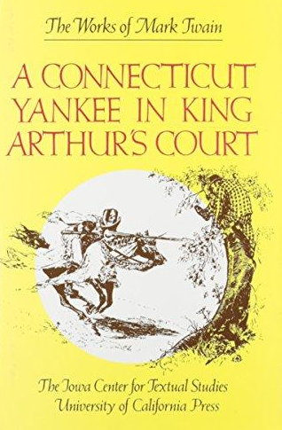
Compilations of Works by One Agent (RDA 6.2.2.10)
Compilations of works by one agent can be published as a series
Notes:
March 2017

Slide 88
Compilations of Works by One Agent (RDA 6.2.2.10)
Basic instruction: follow the general instructions for choosing preferred titles of works
  If the compilation is commonly identified by a title found in resources embodying it or in reference sources, choose that title as the preferred title
  Use the following instructions for conventional collective titles only if the compilation is not known by a title of its own
Notes:
March 2017
NOTE: This is a matter for cataloger judgment.

Slide 89
Compilations of Works by One Agent Commonly Identified by a Particular Title
Notes:
March 2017

Slide 90
Compilations of Works by One Agent (RDA 6.2.2.10)
If a compilation is not commonly identified by a particular title, use a conventional collective title (RDA 6.2.2.10.1-6.2.2.10.2)
  If the compilation purports to be the complete works of an author, use Works
  If the compilation purports to be the complete works of an author in a single form, use one of the following:
    Correspondence
    Essays
    Novels
    Plays
    Poems
    Prose works
    Short stories
    Speeches
    Or another appropriate specific collective title such as “Fragments” “Architectural drawings” etc.
Notes:
March 2017

Slide 91
Compilations of Works by One Agent (RDA 6.2.2.10)
Conventional collective titles (RDA 6.2.2.10.1-6.2.2.10.2)
  If the compilation is less than the complete works of the author
    Either record each work separately
    and/or append the term “Selections” to the appropriate conventional collective title, e.g.
      … $t Works. $k Selections
      … $t Plays. $k Selections
      … $t Speeches. $k Selections
Notes:
March 2017
Note: Preferred titles that include “Selections” will almost always need to be qualified in the authorized access point because there will usually be more than one aggregate work with the same conventional collective title. See below, under authorized access point instructions.

Slide 92
MARC Authority or MARC Bibliographic?
In most cases the cataloger can choose either
  to catalog parts of a series separately, describing the series in an authority record,
  or to catalog all parts on a single bibliographic record, as a non-series multipart monograph or serial
  or both (hierarchical description)
the authority record for the aggregate work will be coded as a series, but it can also be used to authorize the access point for the work in a non-series bibliographic record
Notes:
March 2017
In North American practice, cataloging the entire set on a single bibliographic record is most common with multipart monographs, but it can be done with monographic series as well. Hierarchical description is uncommon in North American practice.

Slide 93
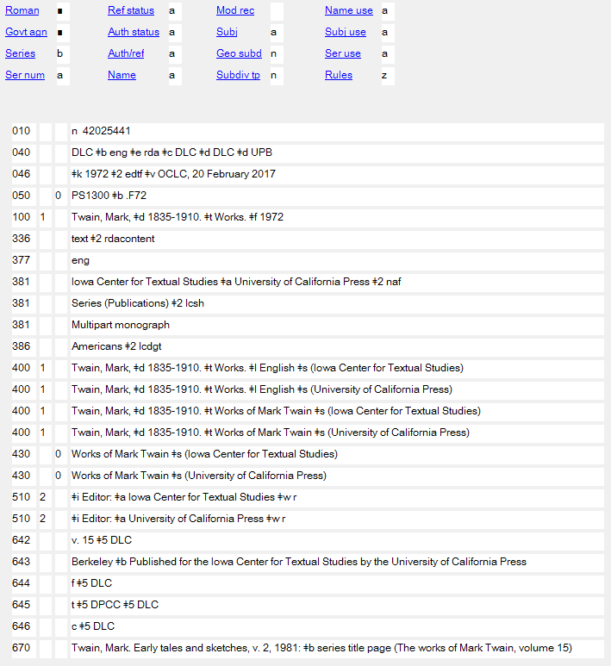
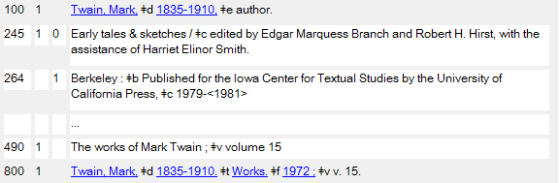
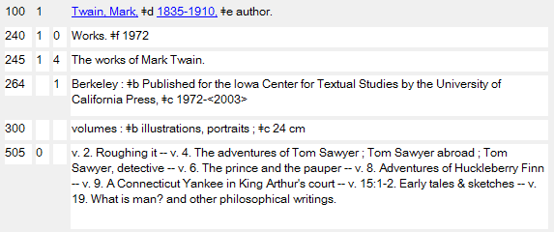
MARC Authority or MARC Bibliographic?
This series authority record authorizes either
or
Notes:
March 2017
NOTE: This applies to any series, not just series that use conventional collective titles as their preferred name.
NOTE: Even though the authority record is coded as a series authority record, it also authorizes/controls the authorized access point when it is used as a non-series access point (second bibliographic record example).
NOTE: This is an expression level series authority record. This is why 377 is present and the “series” and “multipart monograph” information is recorded in 381, and the date is recorded in the AAP following a period in subfield $f rather than in parentheses with no subfield coding.

Slide 94
Recording the Preferred Title (MARC)
Most RDA entity attributes have a discrete place in MARC to record them. Preferred title does not. It can only be recorded as part of the authorized access point for the work.
Record in the MARC authorities format 1XX field, indicators as appropriate to the field
Record the preferred title in subfield $t (100, 110, 111) or subfield $a (130). Other subfields may be appropriate
Notes:
March 2017
LOOK AT MARC authority format 100, 110, 111, 130 field.

Slide 95
Preferred Title (MARC examples)
The preferred title is bolded in each example
    100 1_ Peterson, Tracie. $t Brides of Seattle
    100 1_ Austen, Jane, $d 1775-1817. $t Works. $k Selections (2015)
    110 1_ Hong Kong. $t Annual departmental reports
    110 2_ Seminar on the Acquisition of Latin American Library Materials, Inc. $t Papers of the ... annual meeting of the Seminar on the Acquisition of Latin American Library Materials
    130 _0 Advances in experimental medicine and biology. $p Neuroscience and respiration
    130 _0 ATDM analysis brief
    130 _0 West Slavic contributions
    130 _0 Factsheet (United States. Environmental Protection Agency)
Notes:
March 2017
The preferred title element is bolded. Parts preceding the preferred title are not part of the RDA work description. They are links to the creator of the work, as seen in module I (NACO Foundations). Parts following the preferred title are not part of the preferred title (they are cataloger-added qualifiers)

Slide 96
Exercise: Preferred Title
Open your work form for this series in OCLC
Record the preferred title in subfield $a of the 130 field
Notes:
March 2017

Slide 97
Exercise: Preferred Title
Open your work form for this series in OCLC
Record the preferred title in subfield $t of the 100 field (don’t worry, we’ll add the author later)
Notes:
March 2017
To open the workform, go to Authorities => Create => Single record, and then choose the type of workform. Participants can save their work to the online or local save file, whichever is better, but they should not produce the record, since it already exists in the NACO AF.

Slide 98
Exercise: Preferred Title
130 _0 Government in Asia
100 1_ … $t Novel of the Mither mages
Notes:
March 2017

Slide 99
Variant Title(s) for Work (RDA 6.2.3)
Definition: Any version of the title that differs from the form chosen as the preferred title.
Can be recorded from any source
Record using basic instructions for recording titles (RDA 6.2.1)
Not core. Record if you think it would help a user, e.g.,
  Significantly different from preferred title
  Reasonable as a search string
Notes:
March 2017
Variant titles are not a core element, so cataloger judgment governs what is recorded.

Slide 100
Variant Titles
Alternate linguistic form (RDA 6.2.3.4)
  Language
    Annual report and accounts vs. Informe y memoria
  Script
    ادبيات مقاومت vs. Adabīyāt-i muqāvimat
  Spelling
    Colour of classics vs. Color of classics
  Transliteration
    Da shi ming zuo fang vs. Ta shih ming tso fang [Pinyin vs. Wade Giles transliterations of 大師名作坊]
Notes:
March 2017
Spelling: Generally, do not make up variant spellings. Variant spelling is normally recorded only if actually found in a resource embodying the series or a reference source.

Slide 101
Variant Titles
Other variants (RDA 6.2.3.5; inferred from examples)
  Introductory word or phrase
    Agave vs. Colección Agave
    Ashgate’s geographies of health series vs. Geographies of health series
  Title of larger work. Title of part
    Guides to the sources for the history of the nations. 3rd series, North Africa, Asia and Oceania vs. North Africa, Asia and Oceania
  Numbers vs. words
    One hundred places series vs. 100 places series
Notes:
March 2017

Slide 102
Recording a Variant Title (MARC)
Like the Preferred Title element, the Variant Title element (RDA 6.2.3) does not have a discrete place in MARC. It can only be recorded as part of the variant access point for the work.
Record in the MARC authorities format 4XX field, indicators as appropriate to the field
Record the variant title in subfield $t (400, 410, 411) or subfield $a (430). Other subfields may be appropriate
Notes:
March 2017
LOOK AT MARC authority format 400 field.

Slide 103
Variant Title (MARC examples)
The variant title is bolded in each example
    400 1_ Austen, Jane, $d 1775-1817. $t Classic Jane Austen
    410 1_ Hong Kong. $t Annual departmental report
    430 _0 Neuroscience and respiration
    430 _0 Active transportation and demand management analysis brief
    430 _0 Westslavische Beiträge
    430 _0 Factsheets (United States. Environmental Protection Agency)
    430 _0 Fact sheets (United States. Environmental Protection Agency)
Notes:
March 2017
The variant title element is bolded. Parts preceding the preferred title are not part of the RDA work description.

Slide 104
Variant Title
For more details on variant title, see PCC Series training manual, Session 7 (Variant Access Points)
https://www.loc.gov/catworkshop/courses/naco-full%20series-RDA/course%20table.html
Notes:
March 2017

Slide 105
Exercise: Variant Title
Open your work form for this series in OCLC
Record the variant title in subfield $t of the 400 field (we’ll add the author later)
Notes:
March 2017

Slide 106
Exercise: Variant Title
400 1_ … $t Mithermages series
Notes:
March 2017

Slide 107
Other Identifying Attributes of Works
There are many attributes of works aside from title
All may be recorded as separate elements
Some may also appear as part of the authorized access point
LC/PCC PS limitations apply to some
Notes:
March 2017

Slide 108
Other Identifying Attributes of Works
Work attributes:
  Form of Work (RDA 6.3)
  Date of Work (RDA 6.4)
  Place of Origin of the Work (RDA 6.5)
  Other Distinguishing Characteristic of the Work (RDA 6.6)
  History of the Work (RDA 6.7)
  Identifier for the Work (RDA 6.8)
Notes:
March 2017

Slide 109
Form of Work (RDA 6.3)
Core if needed to differentiate but can be recorded whether or not core
Definition: Class or genre to which a work belongs
Record in MARC field 380
Prefer controlled-vocabulary terms
Capitalize the first word
Notes:
March 2017
Form of work is not further defined beyond 6.3.1.1.
Useful controlled vocabularies for form of work: LCSH; Art and Architecture Thesaurus (AAT) http://www.getty.edu/research/tools/vocabularies/aat/; LCGFT.

Slide 110
Form of Work (RDA 6.3)
PCC recommends recording for all series:
  Monographic series
    380 Series (Publications) $a Monographic series $2 lcsh
  Multipart monograph
    380 Series (Publications) $2 lcsh
    380 Multipart monograph
Notes:
March 2017
Multipart monograph form must be recorded in two fields because “Multipart monograph” is not in a controlled vocabulary.
“Series-like phrase” may also be recorded in a 380 field if appropriate.

Slide 111
Form of Work (RDA 6.3)
If the parts of the series are predominantly a particular literary or other form, this may also be recorded
    380 Fantasy fiction $2 lcgft
    380 Feature films $2 lcgft
    380 Television series $2 lcgft
    380 Romance fiction $2 lcgft
    380 Novels $2 lcgft
    380 Maps $2 lcgft
    380 Posters $2 lcsh
    380 Wood engravings (Prints) $2 aat
Notes:
March 2017
“Fantasy fiction” and “Novels” could be recorded in the record for the A novel of the mither mages we’ve seen throughout this module; “Feature films” could be recorded in the record for the Criterion collection (slide 13); “Television series” could be recorded in the record for Wild Nevada (slide 15)

Slide 112
Exercise: Form of Work
Open your work form for this series in OCLC
Record the Form of Work element in 380(s)
Notes:
March 2017

Slide 113
Exercise: Preferred Title
Open your work form for this series in OCLC
Record the Form of Work element in 380(s)
Notes:
March 2017

Slide 114
Exercise: Form of Work
Suggested answers
380 Series (Publications) $a Monographic series $2 lcsh
380 Series (Publications) $2 lcsh
380 Multipart monograph
380 Fantasy fiction $a Novels $2 lcgft
Notes:
March 2017

Slide 115
Date of Work (RDA 6.4)
Definition: Earliest date associated with a work
  Date work was created
  If the date of creation is unknown, use the date the work was first published or released
  Can include ending date if work existed over a period of time (e.g. a series)
Date is core only if needed to differentiate between a work and other entities with the same name.
The element may be recorded whether needed to distinguish or not.
Notes:
March 2017
Despite the definition of “earliest date associated with a work,” a range of dates may be recorded if appropriate.
Presenter—there may be a question about how to code when only the ending date is known for a work whose creation span is greater than a year. The caption and scope note for subfield $l in 046 read in MARC21:
$l - Ending date created
Ending date of the date range for which the beginning date is recorded in $k.
Subfield $l is normally recorded with a corresponding subfield $k, but may be recorded alone if only the ending date, and not the beginning date, is known.

Slide 116
Date of Work (RDA 6.4)
Record dates according to the Gregorian calendar (LC/PCC PS)
Date is recorded in MARC 046
  Beginning date or single date = $k
  Ending date = $l
Except for century dates, this element is recorded in MARC 046 in the format YYYY-MM-DD or YYYY-MM or YYYY (using the EDTF format, with $2 edtf).
EDTF format: http://www.loc.gov/standards/datetime/. See this website for more complex situations.
Century dates do not follow the EDTF format. Simply record the first two digits of the century (e.g. “19” = all dates beginning with “19” = 20th century) with no $2.
Notes:
March 2017

Slide 117
Exercise
Governance in Asia
Record the date of work element in your record
046 $k 2011 $2 edtf
Notes:
March 2017
ANIMATED SLIDE: Suggested answer enters on click.
Speaker note: click after they’ve added the field to their record.

Slide 118
Exercise
Novel of the Mither mages
Record the date of work element in your record. The first part was published in 2011.
046 $k 2011 $2 edtf
Notes:
March 2017
ANIMATED SLIDE: Suggested answer enters on click.
Speaker note: click after they’ve added the field to their record.

Slide 119
Place of Origin of the Work (RDA 6.5)
Definition: country or other territorial jurisdiction from which a work originated
Not the setting of the work (what the work is “about”)
Information may be taken from any source.
Place of origin is core if needed to differentiate.
Whether core or not, the element may be recorded.
Place of origin is recorded in MARC 370 subfield $g
Associated dates may be recorded in MARC 370 subfields $s (start) and $t (end)
Notes:
March 2017
Speaker note: It seems unlikely that a place of origin would have a start and end date, but if necessary the subfields are available.

Slide 120
Place of Origin of the Work (RDA 6.5)
Form governed by RDA 16.2.2.4, but PCC policy is:
  Use the authorized form in LC/NACO Authority File: Paris (France)
  370 $g Paris (France) $2 naf
  370 $g United States $2 naf
  For details see Module 1 (NACO Foundations)
LCSH place names may also be used. Record in the exact form found, and add $2 lcsh
  370 $g Pompeii (Extinct city) $2 lcsh
Notes:
March 2017
Speaker note: The place does not need to be established in LC/NACO Authority File to record it in 370. If not established, record in the form it would have taken had it been established, and do not record $2.

Slide 121
Place of Origin of the Work (RDA 6.5)
Examples
  Ailleurs (Mulhouse, France)
    370 $g Mulhouse (France) $2 naf
    National Geographic kids readers. Level 1
    370 $g Washington (D.C.) $2 naf
    Gakujutsu sensho (Tsu-shi, Japan)
    370 $g Tsu-shi (Japan) $2 naf
    All in a day’s work (Teacher Created Materials, Inc.)
    370 $g Huntington Beach (Calif.) $2 naf
Notes:
March 2017
Teacher Created Materials, Inc. is located in Huntington Beach, California.
There is no particular place of origin of the work for the two series the group is working on.

Slide 122
Other Distinguishing Characteristic of the Work (RDA 6.6)
A characteristic other than form, date, place of origin
Core if needed to differentiate
May be recorded, whether needed to distinguish or not
Examples—names of corporate bodies or persons, characterizing words
MARC coding: Use 381 field
Notes:
March 2017

Slide 123
Other Distinguishing Characteristics
046 $k 2013 $2 edtf
130 _0 All in a day’s work (Teacher Created Materials, Inc.)
380 Series (Publications) $a Monographic series $2 lcsh
381 Teacher Created Materials, Inc. $2 naf
Notes:
March 2017

Slide 124
History of the Work (RDA 6.7)
Not core; record if you think it would help catalog users
Intended for public
Record a brief narrative concerning
  Publication history (dates, publishers, places, awards)
  Relationships with other works
  Variant titles
MARC field 678, no indicators
Notes:
March 2017
History of the work is not recorded as part of an access point. An example of the last point under the narrative bullet would be the example in RDA of the Book of the Dead, where this access point is used to name a corpus of works that varies in size and content from one manifestation to the next.

Slide 125
History of the Work
046 $k 1986 $l 2004 $2 edtf
130 _0 Archis
Series (Publications) $a Monographic series $2 lcsh
678 Archis was a series published by Stichting Archis in the Netherlands. In 2005, Archis merged with: Archis (English edition), to form: Volume (Amsterdam, Netherlands).
Notes:
March 2017

Slide 126
Identifier for the Work (RDA 6.8)
RDA 6.8
MARC field 010 – LCCN (system-assigned)
MARC field 020 – ISBN (multipart monograph)
MARC field 022 – ISSN (monographic series)
MARC field 024 – some examples
  ISTC (text)
  ISWC (music)
  ISAN (audio/visual)
  ISRC (recordings) (expression)
Notes:
March 2017
Identifiers, if present on manifestations or otherwise known, may be recorded in series authority records.
ISTC = International Standard Text Code
ISWC = International Standard Musical Work Code
ISAN = International Standard Audiovisual Number

Slide 127
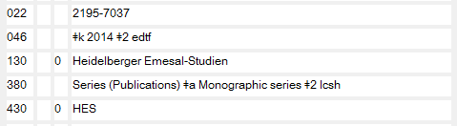
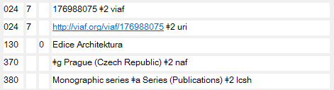
Identifier for the Work - 022
Notes:
March 2017
This slide shows the (optional) inclusion of identifiers in field 024 for a work.

Slide 128
ISSN
For more details on recording ISSN, including dealing with multiple ISSNs, see PCC Series training manual, Session 4 (Recording Series Attributes)
https://www.loc.gov/catworkshop/courses/naco-full%20series-RDA/course%20table.html
Notes:
March 2017

Slide 129
Non-RDA Attributes of Series Works
Audience Characteristics – MARC 385
Creator/Contributor Characteristics – MARC 386
Series treatment fields – MARC 64X
Call numbers – MARC 050
Notes:
March 2017
An introduction to the demographic group terms discussed in the following slides may be found at http://www.loc.gov/catdir/cpso/lcdgt-principles.pdf.

Slide 130
MARC 385 – Audience Characteristics
Indicators both blank
Subfields:
  $a – Audience term (R)
  $b – Audience term code (R)
  $m – Demographic group term (NR)
  $n – Demographic group code (NR)
  $0 – Authority record control number or standard number (R)
  $2 – Source (NR)
  $3 – Materials specified (NR)
Notes:
March 2017
Field Definition and Scope
A category of persons for which a resource is intended or a category of persons representing the intellectual level for which the content of a resource is considered appropriate.
If a demographic group is not specified then multiple audience characteristics from the same source vocabulary or code list may be recorded in the same field in separate occurrences of subfield $a and subfield $b. If a demographic group is specified then the characteristics in the field must all come from the same group. Terms from different source vocabularies are recorded in separate occurrences of the field.

Slide 131
MARC 386 – Creator/
Contributor Characteristics
Indicators both blank
Subfields:
  $a – Creator/contributor term (R)
  $b – Creator/contributor term code (R)
  $m – Demographic group term (NR)
  $n – Demographic group code (NR)
  $0 – Authority record control number or standard number (R)
  $2 – Source (NR)
  $3 – Materials specified (NR)
Notes:
March 2017
Field Definition and Scope
A group category to which the creator(s) of a work or compilation of works, or the contributor(s) to an expression or compilation of expressions, belongs.
If a demographic group is not specified then multiple creator/contributor group categories from the same source vocabulary or code list may be recorded in the same field in separate occurrences of subfield $a and subfield $b. If a demographic group is specified then the categories in the field must all come from the same group. Terms from different source vocabularies are recorded in separate occurrences of the field.

Slide 132
385/386 Fields
$m and/or $n are optional. For codes, see
  http://www.loc.gov/standards/valuelist/lcdgt.html
$2 is optional, but recommended if terms recorded are from a controlled vocabulary (e.g., LCDGT, LCSH). For controlled vocabularies, see
  https://www.loc.gov/standards/sourcelist/occupation.html
  https://www.loc.gov/standards/sourcelist/subject.html
Notes:
March 2017
No best practices have been published yet, but it is recommended that terms come from controlled vocabularies. The most common are LCDGT and LCSH.

Slide 133
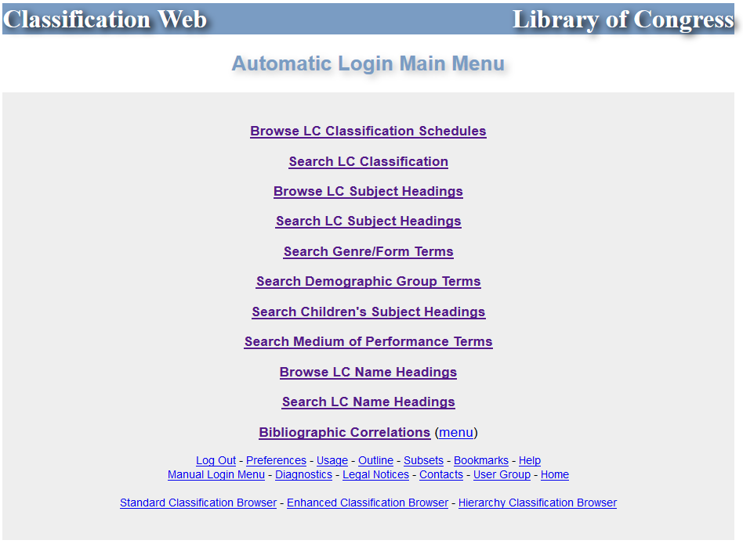
Notes:
March 2017
LCSH and LCDGT are in Classification Web (as well as id.loc.gov).

Slide 134
385/386 Fields
May repeat $a when terms are from the same vocabulary:
386 __ Catholics $a Canadians $a Librarians $2 lcdgt
A work or works created by Catholic Canadian librarians
Repeat the field if $m or $n is used and terms belong to different demographic categories:
386 __ $n rel $a Catholics $2 lcdgt
386 __ $n nat $a Canadians $2 lcdgt
386 __ $n occ $a Librarians $2 lcdgt
For full details for use of 385/386, see Module 6 of this NACO training
Notes:
March 2017
Except for this slide, this Module records the term only, not the demographic group code.

Slide 135
Recording
Audience Characteristics (385)
Notes:
March 2017
A library that uses MeSH could decide to use that vocabulary instead of or in addition to LCDGT. For example, a series geared toward emergency responders:
385 $a Emergency Responders $2 mesh

Slide 136
Recording Creator/Contributor Characteristics (386)
Notes:
March 2017

Slide 137
Exercise: Creator Characteristics
Novel of the Mither mages
Card is an American author. Record the creator characteristics element in your record. Use LCDGT.
386 Americans $2 lcdgt
Notes:
March 2017
ANIMATED SLIDE: Suggested answer enters on click.
Speaker note: click after they’ve added the field to their record.

Slide 138
Recording Series Numbering
Series may be numbered or unnumbered, or may have irregular numbering patterns
Record numbering information in
  008/13 (Ser num)
  641 (Series Numbering Peculiarities)
  642 (Series Numbering Example)
Notes:
March 2017

Slide 139
008/13 (Ser num)
Numbered/unnumbered series code
  a – Numbered series
  b – Unnumbered series
  c – Numbering varies
  n – Not applicable (i.e., the authority record does not represent a series)
Notes:
March 2017

Slide 140
008/13 (Ser num)
Notes:
March 2017

Slide 141
008/13 (Ser num)
Notes:
March 2017

Slide 142
Exercise: 008/13 (Ser num)
Record 008/13 (Ser num) in your records
Governance in Asia is numbered
A novel of the Mither mages is not numbered
Notes:
March 2017

Slide 143
642 (Series Numbering Example)
RDA 24.6 and LC-PCC PS 24.6.1.3
MARC authority 642 contains the series numbering example that is to be followed in the series access point (8XX) in bibliographic records for individual parts of the series
  base the example on the first, or earliest available, part
  abbreviate captions if they appear in RDA Appendix B; record numerals as Arabic numerals
  include $5 DPCC (this indicates the national-level decision on the form to be followed by libraries creating BIBCO records)
  include $5 with your library MARC code if your library traces (indexes) the series
Notes:
March 2017

Slide 144
642 (Series Numbering Example)
Series numbering is transcribed in 490 of the bibliographic record exactly as it appears, applying the general guidelines at 1.7 and 1.8 (RDA 2.12.19)
Record the numbering in the bibliographic record access point (8XX) following the pattern found in the 642 field of the authority record for the series.
Notes:
March 2017
Note LC-PCC PS 1.8.2 alternatives: record the numeral in the form in which it appears on the source of information, unless the numeral is found in certain non-Latin scripts.

Slide 145

642 (Series Numbering Example)
Authority record
008/13 (Ser num): a
130 _0 Papyrologica Florentina
642 v. 1 $5 DPCC
Bibliographic record
490 1_ Papyrologica Florentina ; $v volume XLIV
830 _0 Papyrologica Florentina ; $v v. 44
Notes:
March 2017

Slide 146
Exercise:
642 (Series Numbering Example)
Record 642 in your record for Governance in Asia
Notes:
March 2017

Slide 147
Exercise:
642 (Series Numbering Example)
642 no. 1 $5 DPCC $5 [your MARC library code]
Notes:
March 2017

Slide 148
641 (Series Numbering Peculiarities)
If necessary, numbering peculiarities can be recorded in a 641 field. The source of the information may be recorded in $z.
    Some items issued: with numeric/alpha or alpha numeric designation (447P; X042); some with double numbering (3092R-3092T); and some with numeric sub-subdivision (825/1)
    Numbering begins with no. 3
    Numbering ceases after v. 47
    642 Double numbering discontinued with t. 179 $z t. 179, title page
Notes:
March 2017

Slide 149
Series Numbering
For more details on series numbering, see PCC Series training manual, Session 4 (Recording Series Attributes)
https://www.loc.gov/catworkshop/courses/naco-full%20series-RDA/course%20table.html
Notes:
March 2017

Slide 150
643 (Place/Publisher)
643 contains the place of publication and the name of the publisher/issuing body of manifestations in the series described in the authority record
Generally matches 264 subfields $a and $b of the bibliographic record for the first part
May be repeated if the publisher changes
Dates or volumes applicable to changes may be recorded in $d, if known
Notes:
March 2017
For more information on field 643, see the NACO Series manual, session 4 (Recording Series Attributes), https://www.loc.gov/catworkshop/courses/naco-full%20series-RDA/course%20table.html.

Slide 151
643 (Place/Publisher)
Notes:
March 2017

Slide 152
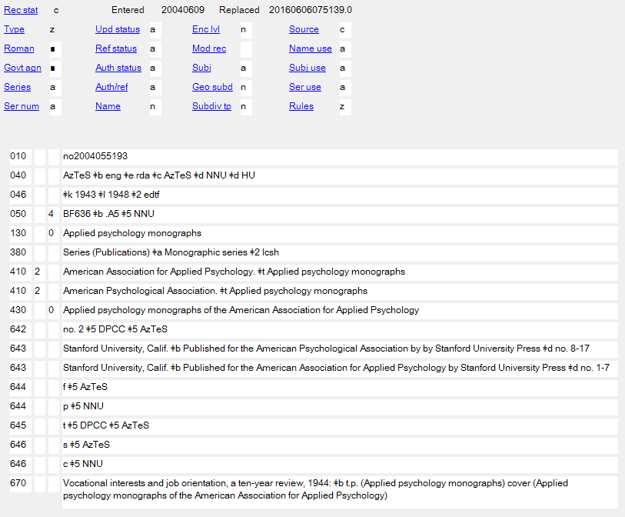
643 (Place/Publisher)
Notes:
March 2017

Slide 153
Exercise: 643 (Place/Publisher)
Record 643 (Place/Publisher) in your records
Governance in Asia: NAIS Press is located in Copenhagen
Notes:
March 2017

Slide 154
Exercise: 643 (Place/Publisher)
Copenhagen $b NIAS Press
643 New York $b Tor
Notes:
March 2017

Slide 155
Place/Publisher
For more details on recording information about place/publisher, see PCC Series training manual, Session 4 (Recording Series Attributes)
https://www.loc.gov/catworkshop/courses/naco-full%20series-RDA/course%20table.html
Notes:
March 2017

Slide 156
Recording Local Treatment
Individual libraries make decisions regarding treatment of series to suit their local workflow, shelving, acquisition, and user needs
These decisions are recorded in
  MARC 644 (Series Analysis Practice)
  MARC 645 (Series Tracing Practice)
  MARC 646 (Series Classification Practice)
Notes:
March 2017
NOTE: 642 can also be used to record local decisions if the library wants to record the numbering in access points differently from the national (DPCC) decision

Slide 157
Recording Local Treatment
PCC policy is to record “default” treatment decisions of analyzed in full, traced, and classified separately. These will be discussed on following slides.
PCC participants may make decisions that do not follow the defaults
Local decisions that differ from decisions recorded in the NAF may be recorded in local copies of the record
644 and 646 are not required, but in practice most NACO catalogers record them
Notes:
March 2017

Slide 158
Recording Local Treatment
644 (Series Analysis Practice)
“Analysis” refers to whether bibliographic records are created for individual parts in the series or not.
Recorded in MARC 644
  f Analyzed in full (bibliographic records are created for every part in the series)
  p Analyzed in part (bibliographic records are created only for some of the parts)
  n Not analyzed (no bibliographic records are made for parts; a bibliographic record is made for the series as a whole)
The PCC “default” is “f”
Notes:
March 2017

Slide 159
Recording Local Treatment
644 (Series Analysis Practice)
Record your library’s MARC symbol in $5
Only one “local” $5 is allowed (generally the library that initially created the record)
The field may be repeated to show another library’s treatment, but this is generally done in the library’s local copy of the series authority record
Notes:
March 2017

Slide 160
Recording Local Treatment
644 (Series Analysis Practice)
If the treatment changes or differs from part to part, include the parts to be analyzed in subfield $d
    644 n $d v. 49- $5 [MARC library code]
    644 f $d v. 1-48 $5 [MARC library code]
    --
    644 f $d analyzable parts $5 [MARC library code]
    --
    644 n $d items processed after May 27, 1993 $5 [MARC library code]
    644 f $d items processed before May 28, 1993 $5 [MARC library code]
Notes:
March 2017

Slide 161
Recording Local Treatment
644 (Series Analysis Practice)
Notes:
March 2017

Slide 162
Recording Local Treatment
645 (Series Tracing Practice)
“Tracing” refers to whether the library indexes the series or not
The authorized access point of a “traced” series will be recorded in an 8XX field in the bibliographic record
Recorded in MARC Authority 645
  t Series authorized access point is “traced” (indexed) in bibliographic 8XX field (series statement recorded in 490 1_)
  n Series authorized access point is not indexed (no 8XX, the series is only recorded in 490 0_)
The PCC “default” is “t”
Notes:
March 2017
Note: The word “tracing” derives from catalog card practice. If something was to be indexed (e.g. a series) a new set of cards was made for the resource and the access point was “traced” on the top of the cards; the tracing was then used to file the card set in the catalog.

Slide 163
Recording Local Treatment
645 (Series Tracing Practice)
This field is required in NACO practice for series
Record $5 DPCC, plus your library’s MARC symbol in a second $5
Only one “local” $5 is allowed (generally the library that initially created the record)
The field may be repeated to show another library’s treatment, but this is generally done in the library’s local copy of the series authority record
Notes:
March 2017
“DPCC” is the symbol meaning the national PCC decision.

Slide 164
Recording Local Treatment
644 (Series Analysis Practice)
Notes:
March 2017

Slide 165
Recording Local Treatment
646 (Series Classification Practice)
Is the series classified together, or separately?
Recorded in MARC 646
  s Volumes are classified separately
  c Volumes are classified as a collection
  m Volumes are classified with a main or other series
The PCC “default” is “s”
If the decision is “c”, 050 must also be included in the record showing the classification number for the series. Record second indicator “4” (assigned by an agency other than LC)
Notes:
March 2017

Slide 166
Recording Local Treatment
646 (Series Classification Practice)
Record your library’s MARC symbol in $5
Only one “local” $5 is allowed (generally the library that initially created the record)
The field may be repeated to show another library’s treatment, but this is generally done in the library’s local copy of the series authority record
Notes:
March 2017

Slide 167
Recording Local Treatment
646 (Series Classification Practice)
Generally, only numbered series can be classed together
Normal practice is to class “author” series separately (i.e., they are Cuttered by title within the author’s classification number rather than by the number in the series), but libraries can make a different local decision
Notes:
March 2017

Slide 168
Recording Local Treatment
646 (Series Classification Practice)
Notes:
March 2017

Slide 169
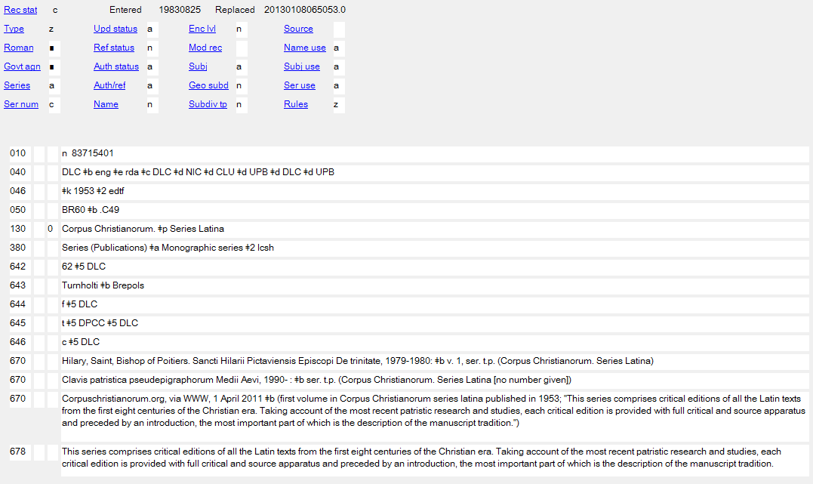
Recording Local Treatment
646 (Series Classification Practice)
Notes:
March 2017

Slide 170
Exercise: Local Series Treatment
Record Local Series Treatment (644, 645, 646) in your records
Notes:
March 2017

Slide 171
Local Series Treatment
For more details on recording local series treatment information, see PCC Series training manual, Session 5 (Treatment decisions)
https://www.loc.gov/catworkshop/courses/naco-full%20series-RDA/course%20table.html
Notes:
March 2017

Slide 172
Call Number – MARC 050
If the series is classed together, record the call number in MARC 050, second indicator 4
Record your library’s MARC identification code in subfield $5
LC-assigned series classification numbers are coded in MARC 050, second indicator 0, with no subfield $5
Notes:
March 2017

Slide 173
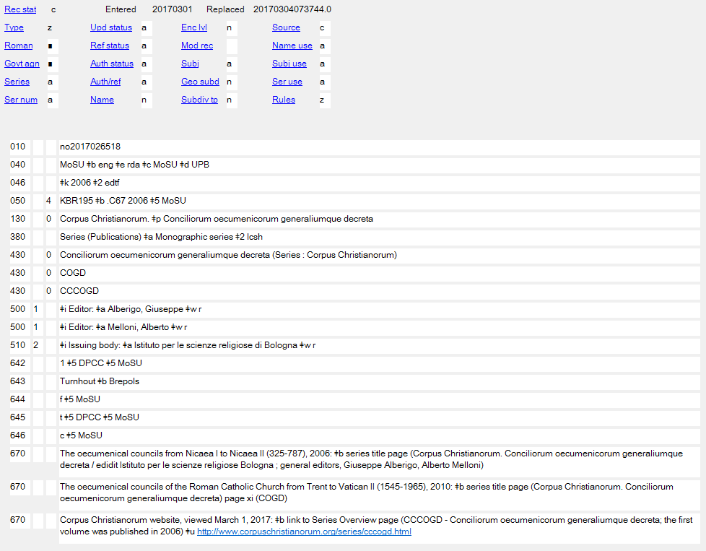
Call Number – MARC 050
PCC Member Assigned Number
Notes:
March 2017

Slide 174
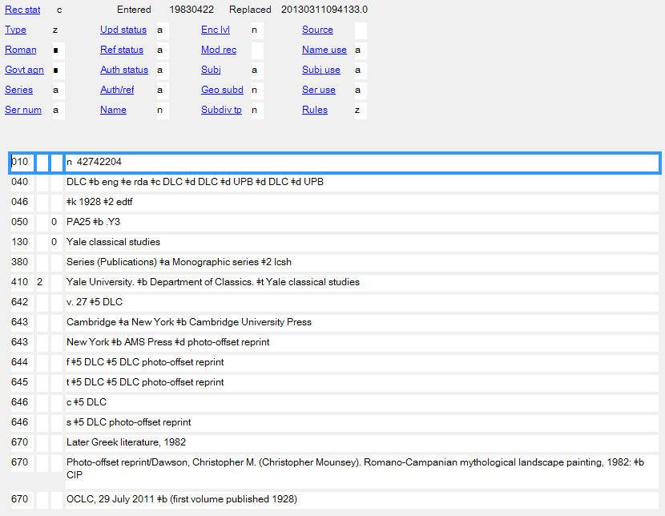
Call Number – MARC 050
LC Assigned Number
Notes:
March 2017

Slide 175
Attributes of Expressions
Notes:
March 2017

Slide 176
Expressions of Series Works
A series is an aggregate work
As with any work, series also exist in expressions, and a series authority record may be created for a series expression
The series authority record for an expression contains
  The authorized access point for the expression
  RDA series elements related to the expression
  Non-RDA elements, such as treatment decisions
Notes:
March 2017
Emphasize that expression elements and work elements should not be mixed; a SAR for a work should contain only work-related elements; a SAR for an expression should contain only expression-related elements

Slide 177
Three expressions of a single series work
Notes:
March 2017
ASK: how to these expressions differ?
The first is an English-language, text, expression. It is unnumbered and has a title associated with it, “A novel of the Mither mages”
The second is an English-language, spoken word, expression. It is numbered and has a different title associated with it, “The Mithermages series”
The third is a French-language, text, expression. It is numbered (the numbering doesn’t show on the image), and has yet another title associated with it, “Les mages de Westil”

Slide 178
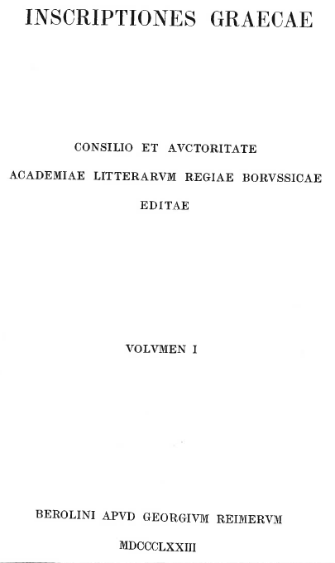
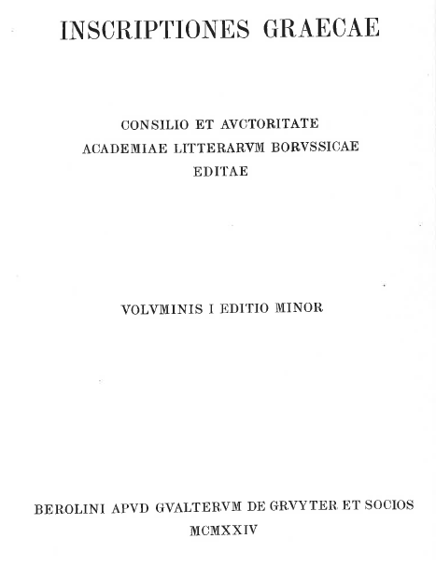
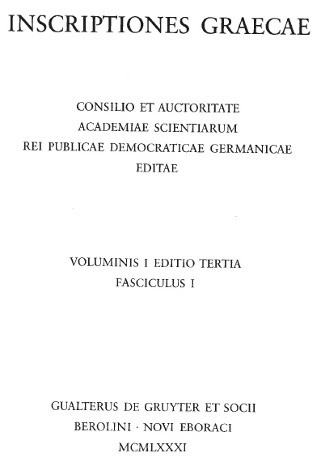
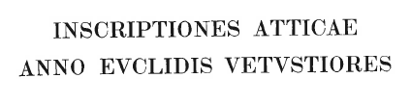


Three expressions of a single series work
Notes:
March 2017
ASK: how to these expressions differ?
Three different editions of the series. This series publishes Greek inscriptions found around the world. All three editions are ongoing, but as new evidence about the inscriptions becomes available individual volumes are reedited in a second edition (“edition minor”) and then a third edition (“editio tertia”). The individual volumes exist in separate expressions, and so does the series.

Slide 179
Two expressions
of a single series work
Notes:
March 2017
This series is published in English and French. The original language appears to have been English. Not all the parts have been translated into French (yet).

Slide 180
Language
Multiple languages, no translation or other expression
Individual parts of the series appear in different languages but are not translations, and no other expression exists (e.g. spoken word)
  The series exists in only one expression
  Only one (work-level) SAR needed
Notes:
March 2017
Only one work-level SAR is needed; however, if a library needs to create an expression-level SAR for this series, it is permitted.

Slide 181

Language
Multiple languages, no translation
Notes:
March 2017

Slide 182
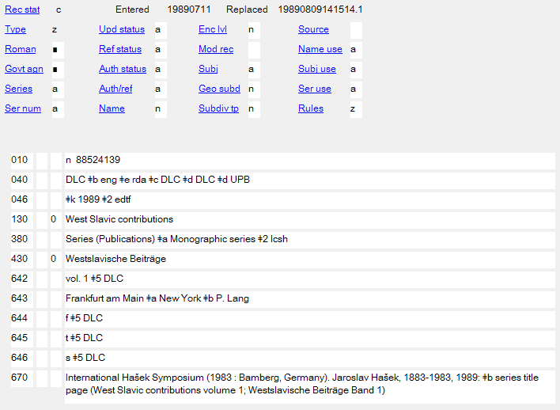
Language
Multiple languages, no translation
Notes:
March 2017

Slide 183
RDA and LC Practice for Translations
RDA (and FRBR) expect separate expression descriptions to be distinguished from one another, just as any other entity description is distinguished from others
Generally, LC follows this practice except for translations
Notes:
March 2017

Slide 184
RDA and LC Practice for Translations
LC Practice for translations (LC-PCC PS 0.6.3, 6.27.3)
LC catalogers do not record elements in authority records or add elements to authorized access points to differentiate separate expressions in the same language
For example, Shakespeare’s Hamlet in French would, for LC, be represented by a single authority record and a single authorized access point even though there are more than one translation
  100 1_ Shakespeare, William, $d 1564-1616. $t Hamlet. $l French
  = all French translations of Hamlet.
Notes:
March 2017
This is a non-series example.

Slide 185
RDA and LC Practice for Translations
LC Practice for expressions in the original language
LC does not describe the original language expression separately from the work.
For LC, expressions in the original language are represented by the authorized access point for the work, which will be used for any expression in the original language
  100 0_ Homer. $t Iliad
  = the work Iliad and all original Greek expressions of the Iliad
Notes:
March 2017
See Mail Carrier example in LC-PCC PS 6.27.3.
This is a non-series example.

Slide 186
RDA and LC Practice for Translations
Since LC does not do series authority work, it is not clear how LC might apply LC-PCC PS 6.27.3 to series
PCC Catalogers may follow this LC practice when doing series authority work, or may apply RDA and describe distinct expressions in separate authority records and assign them distinct authorized access points depending on the needs of their users
Notes:
March 2017
Note that the previous two slides, citing the LC practice language, did not give series examples.

Slide 187
When Does a Series Work Exist in Translation?
If one or more parts is translated into another language
and
the translated part bears a form of the series statement (usually in the new language)
then
the series exists in translation (i.e., in more than one expression)
Notes:
March 2017

Slide 188
Series in Translation
PCC catalogers may follow LC practice
  One series authority record for the work (this will represent all expressions in the original language)
  One series authority record for the language of translation (this will represent all expressions in the translated language)
  or
Notes:
March 2017

Slide 189
Series in Translation
PCC catalogers may follow RDA
  One series authority record for the work
  One series authority record for each expression
    Separate series authority records for separate expressions in the same language (e.g. different translations)
    A series authority record for the original-language expression (if the cataloger wishes to specify the expression in the bibliographic record)
Notes:
March 2017

Slide 190
Series in Translation Example
Authority record for the series-work
040 __ [MARC library code] $b eng $e rda $c [MARC library code]
046 __ $k 2005 $2 edtf
130 0_ Canada close up
380 __ Series (Publications) $a Monographic series $2 lcsh
551 __ $i Subject: $a Canada $w r
643 __ Toronto $a New York $b Scholastic Canada
644 __ f $5 [MARC library code]
645 __ t $5 DPCC $5 [MARC library code]
646 __ s $5 [MARC library code]
670 __ Sun and storms, 2005: $b title page (Canada close up)
670 __ Scholastic Canada website, 7 December 2016 $b (Canada close up; titles also appear in French with series title Le Canada vu de près; original language appears to be English)
Notes:
March 2017

Slide 191
Series in Translation Example
Authority record for the French expression
040 __ [MARC library code] $b eng $e rda $c [MARC library code]
046 __ $k 2005 $2 edtf
130 0_ Canada close up. $l French $s (Éditions Scholastic)
377 __ fre
381 __ Series (Publications) $a Monographic series $2 lcsh
381 __ Éditions Scholastic $2 naf
430 0_ Canada vu de près
643 __ Toronto, Ontario $b Éditions Scholastic
644 __ f $5 [MARC library code]
645 __ t $5 DPCC $5 [MARC library code]
646 __ s $5 [MARC library code]
670 __ Gouvernements du Canada, 2013: $b title page (Le Canada vu de près)
670 __ OCLC, April 28, 2015 $b (Canada vu de près = Canada close up; 2005- )
Notes:
March 2017

Slide 192
Series in Translation Example
Authority record for the English expression if specified in bibliographic record
040 __ [MARC library code] $b eng $e rda $c [MARC library code]
046 __ $k 2005 $2 edtf
130 0_ Canada close up. $l English $s (Scholastic Canada)
377 __ eng
381 __ Series (Publications) $a Monographic series $2 lcsh
381 __ Scholastic Canada $2 naf
643 __ Toronto $a New York $b Scholastic Canada
644 __ f $5 [MARC library code]
645 __ t $5 DPCC $5 [MARC library code]
646 __ s $5 [MARC library code]
670 __ Canadian government, 2013: $b title page (Canada close up)
Notes:
March 2017

Slide 193
Exercise: Expression-level Series Authority Records
Open two “personal name” workforms in OCLC
Change “Series” to “b”
Change “Ser num” to “b”
Change “Ser use” to “a”
Notes:
March 2017
To open the workform, go to Authorities => Create => Single record, and then choose the type of workform. Participants can save their work to the online or local save file, whichever is better, but they should not produce the record, since it already exists in the NACO AF.

Slide 194
Exercise: Expression-level Series Authority Records
Add the Source Consulted element for the first part of this expression (published 2011)
Include information about the translator (Jean-Daniel Brèque) and numbering (you find “1” on the spine—this is the series numbering)
Notes:
March 2017

Slide 195
Exercise: Expression-level Series Authority Records
Add the Source Consulted element for the first part of this expression (published 2011)
Include information about the narrators (Emily Janice Card and Stefan Rudnicki) and the series numbering, all found on the container
Notes:
March 2017
NOTE: The container says ℗2010 ©2011, which would suggest that the publication date is 2011. The recording took place in 2010, before publication.

Slide 196
Attributes of Expressions
Expression attributes:
  Content Type (RDA 6.9)
  Date of Expression (RDA 6.10)
  Language of Expression (RDA 6.11)
  Other Distinguishing Characteristic of the Expression (RDA 6.12)
  Identifier for the Expression (RDA 6.13)
Notes:
March 2017

Slide 197
Content Type (RDA 6.9)
Content type is a core element (RDA 5.3)
Definition: Content type is a categorization reflecting the fundamental form of communication in which the content is expressed and the human sense through which it is intended to be perceived.
Terms are from a controlled vocabulary listed in RDA 6.9.1.3, Table 6.1
Notes:
March 2017

Slide 198
Content Type (RDA 6.9)
Content type is recorded in MARC 336
Record the term in subfield $a; record “rdacontent” in subfield $2
  336 spoken word $2 rdacontent
  336 text $2 rdacontent
Notes:
March 2017
Presenter: If somebody asks, for a few years PCC did not authorize recording content type in authority records. This is no longer the case.

Slide 199
Exercise: Content Type
Record the content type in your two expression records.
Notes:
March 2017

Slide 200
Date of Expression (RDA 6.10)
6.10.1.1. This element records the earliest date associated with an expression. It is core if needed to distinguish between expressions.
In the absence of other evidence, the date of the earliest manifestation embodying the expression may be treated as the date of expression.
Date of expression may be recorded whether or not it is needed to distinguish
Notes:
March 2017

Slide 201
Attributes of Expressions: Date
Record dates according to the Gregorian calendar (LC/PCC PS)
Date is recorded in MARC 046
  Beginning date or single date = $k
  Ending date = $l
Except for century dates, this element is recorded in MARC 046 in the format YYYY-MM-DD or YYYY-MM or YYYY (using the EDTF format, with $2 edtf).
EDTF format: http://www.loc.gov/standards/datetime/. See this website for more complex situations.
Century dates do not follow the EDTF format. Simply record the first two digits of the century (e.g. “19” = all dates beginning with “19” = 20th century) with no $2.
Notes:
March 2017

Slide 202
Exercise: Date of Expression
The French translation was first published in 2011.
The English spoken word version was first published in 2011, but the container also says ℗2010, indicating that the recording was made in 2010.
Exercise: Record the date of expression element in the series authority records for these expressions
Notes:
March 2017
NOTE: For purposes of choosing the preferred title, the title proper of the English text manifestation was chosen since they were published simultaneously.

Slide 203
Language of Expression (RDA 6.11)
Language of expression is a core element (see RDA 5.3)
Definition: “language in which a work is expressed”
RDA 6.11.1.3. “Record the language or languages of the expression using an appropriate term or terms in the language preferred by the agency creating the data.”
Preference of NACO: Record in MARC 377, using the MARC language codes
http://www.loc.gov/marc/languages/language_name.html
NOTE: this element is not recorded in work-level authority records.
Notes:
March 2017
The underlining reinforces that in FRBR and in RDA, language is an expression-level attribute of a resource. Until or if FRBR and/or RDA incorporate a concept of Language of Work, this element will be recorded only in authority records for expressions.
For more information about recording information in the 377 field, see the NACO Foundations module.

Slide 204
Exercise: Language of Expression
Record the language of expression in 377 fields on the expression worksheets or OCLC workforms you’ve started.
377 eng
377 fre
NOTE: Do not record any language on the workforms representing works. Language is not an attribute of the Work entity.
Notes:
March 2017
ANIMATED SLIDE: Trainees do not have answers in their version. Suggested answer enters on click.

Slide 205
Other Distinguishing Characteristic of the Expression (RDA 6.12)
Definition: “characteristic other than content type, language of expression, or date of expression that serves to differentiate an expression from another expression of the same work”
Core when needed to differentiate
MARC field 381
Notes:
March 2017

Slide 206
Other Distinguishing Characteristic of the Expression (RDA 6.12): all series
PCC recommends recording for all series:
  Monographic series
    381 Series (Publications) $a Monographic series $2 lcsh
  Multipart monograph
    381 Series (Publications) $2 lcsh
    381 Multipart monograph
Notes:
March 2017

Slide 207
Other Distinguishing Characteristic of the Expression (RDA 6.12)
In addition to the “series” other distinguishing characteristic, you may include an instance of the element to distinguish the expression from others
Use whatever distinguishes the expressions best.
  the surname of an editor or translator
  the name of a version
  the name of a publisher closely associated with the expression
  etc. ...
Notes:
March 2017

Slide 208
Exercise: Other Distinguishing Characteristic of the Expression
Record Other Distinguishing Characteristics in the two expression records
Notes:
March 2017

Slide 209
Exercise: Other Distinguishing Characteristic of the Expression
In addition to the “series” 381 fields, what might you use to distinguish these expressions?
Record your choice in 381
  Possible answers:
    381 Rankin and Rudnicki
    381 Rankin $a Rudnicki
    381 Brèque
Notes:
March 2017
ANIMATED SLIDE: Trainees do not have answers in their version. Suggested answers enter on clicks.
In the case of both of these expressions the related contributors (the narrators, or the translator) remain the same for all the parts so far published. Even if they didn’t this information could still be recorded as Other Distinguishing Characteristic of the Expression if it helps distinguish this expression from others.
The first two are possibilities for the spoken word expression. If the names of the narrators are used in the authorized access point (perhaps because there are more than one English recording of the work), the qualifier would be recorded “Rankin and Rudnicki” and the 381 would also be so recorded. If the names of the narrators do not appear in a qualifier in the authorized access point, they could each be recorded in separate subfields $a as separate instances of Other Distinguishing Characteristic of the Expression.

Slide 210
Identifier for the Expression (RDA 6.13)
MARC field 010 – LCCN (system-assigned)
MARC field 020 – ISBN (multipart monograph)
MARC field 022 – ISSN (monographic series)
MARC field 024 – some examples
  ISTC (text)
  ISWC (music)
  ISAN (audio/visual)
  ISRC (recordings) (expression)
Notes:
March 2017
Identifiers, if present on manifestations or otherwise known, may be recorded in series authority records for expressions.
ISTC = International Standard Text Code
ISWC = International Standard Musical Work Code
ISAN = International Standard Audiovisual Number

Slide 211
Non-RDA Attributes of
Series Expressions
Audience Characteristics – MARC 385
Creator/Contributor Characteristics – MARC 386
Series treatment fields – MARC 64X
Call numbers – MARC 050
Notes:
March 2017
Review slides 129ff if necessary.
Point out here that these attributes can differ between expressions of the same series work. For example, different expressions may have differing numbering patterns (different expressions may have differing captions; some expressions might be unnumbered where others are numbered; occasionally different expressions might even number parts differently from others (an example is the various numbering patterns of C.S. Lewis’s Chronicles of Narnia)

Slide 212
Non-RDA Attributes of
Series Expressions
Exercise: Record non-RDA Attributes on your two series expression authority records (see slides 111 and following)
  Publication information for Les mages de Westil as found in the manifestation for the first part is
  Nantes : L’Atalante
  Publication information for the spoken word version as found in the manifestation for the first part is
  Ashland, OR : Blackstone Audio, Inc.
Notes:
March 2017

Slide 213
Non-RDA Attributes of
Series Expressions
642 1 $5 DPCC $5 [MARC library symbol]
643 Nantes $b L'Atalante
644 f $5 [MARC library symbol]
645 t $5 DPCC $5 [MARC library symbol]
646 s $5 [MARC library symbol]
Notes:
March 2017
Participants should have recorded the numbering pattern in the 670 for this series (“1” is found on the spine of the book)
Probably no audience or contributor characteristics for this series expression; they could be recorded if appropriate.

Slide 214
Non-RDA Attributes of
Series Expressions
642 bk. 1 $5 DPCC $5 [MARC library symbol]
643 Ashland, OR $b Blackstone Audio, Inc.
644 f $5 [MARC library symbol]
645 t $5 DPCC $5 [MARC library symbol]
646 s $5 [MARC library symbol]
Notes:
March 2017
Numbering pattern: don’t forget that the caption is abbreviated in the numbering pattern (it wouldn’t be abbreviated in the transcription in 490 of the bibliographic record)
Probably no audience or contributor characteristics for this series expression; they could be recorded if appropriate.

Slide 215
Authorized Access Points
Notes:
March 2017
Once you’ve recorded all the elements, creating the authorized access point for a work is quite easy. It is simply a matter of taking elements already recorded or found and combining them in a particular order.

Slide 216
Creating the Authorized Access Point
Follow RDA 6.27
Subject usage—series authorized access points can be used as subjects in bibliographic records
Notes:
March 2017
This workshop does not deal with subject usage, but most authorized RDA access points for works and expressions can be used as subjects.

Slide 217
Constructing the Authorized Access Point for a Work (RDA 6.27.1)
In order to create the authorized access point for a work, including series, you must first ask yourself what kind of work it is:
  A work created by one person, family, or corporate body (RDA 6.27.1.2)?
  A collaborative work (RDA 6.27.1.3)?
  A compilation of works by different persons, families, or corporate bodies (RDA 6.27.1.4)?
Notes:
March 2017
Have workshop participants carefully think about the difference between a collaborative work and a compilation. Have examples if possible.

Slide 218
Constructing the Authorized Access Point for a Work (RDA 6.27.1)
Works created by one person, family, or corporate body (RDA 6.27.1.2)
  Record the authorized access point for the person, family, or corporate body (this serves as a link to the record for the creator)
  Record the preferred title of the work
Series created by one person are multipart monographs
Series created by one family or corporate body may be monographic series or multipart monographs
Use MARC 1XX field.
  Authorized access point for creator identical to form in its own authority record, with identical subfield coding
  Preferred title of work in subfield $t, $n, $p, $k
Notes:
March 2017

Slide 219
Constructing the Authorized Access Point for a Work (RDA 6.27.1)
Collaborative works (RDA 6.27.1.3)
  Record the authorized access point for the person, family, or corporate body with principal responsibility for the work (this serves as a link to the record for the creator) [NOTE: No “rule of three”]
  Record the preferred title of the work
Series that are collaborative works may be monographic series or multipart monographs
Use MARC 1XX field.
  Authorized access point for principal creator identical to form in its own authority record, with identical subfield coding
  Preferred title of work in subfield $t, $n, $p, $k
Notes:
March 2017
THIS IS A SLIGHT CHANGE FROM AACR2: No rule of three; so the person, family, or corporate body with principal responsibility is usually the first named author, no matter how many there are. This means there will be more works entered under an author’s name than there were in AACR2.
The takeaway here is that with the exception of most moving-image material, collaborative works will by and large include a name in the authorized access point.

Slide 220
Constructing the Authorized Access Point for a Work (RDA 6.27.1)
Collaborative works (RDA 6.27.1.3)
  Corporate bodies can be creators of series (RDA 19.2.1.1.1)
    Series of an administrative nature dealing with the body itself
    Series that record the collective thought of the body
    Series that record hearings conducted by legislative, judicial,
    governmental, and other corporate bodies
    d. Series that report the collective activity of a conference, expedition, or event
    e. Series that result from the collective activity of a performing group as a whole where the responsibility of the group goes beyond that of mere performance, execution, etc.
    f. Cartographic series originating with a corporate body
    Certain legal works issued as series (seven types listed)
    h. Named works of art by two or more artists acting as a corporate body
Module 6a. Series
220
Notes:
March 2017
Read together 19.2.1.1.1. Not all of these are likely to crop up with series, but potentially any of them could (though category “h” seems extremely unlikely).
NOTE: Corporate body authorship of series works is often overlooked. Many catalogers appear to think that the authorized access point of all series, especially monographic series, are formed from the preferred title only. Series such as the annual report of a corporate body (or any of the other types of works listed in this slide) should be formed using the authorized access point for the corporate body followed by the preferred title.
220

Slide 221
19.2.1.1.1 Series Examples
Type a
110 2_ United Nations Development Programme. $t UNDP annual report
110 2_ National Archives of India. $t Gilgit manuscripts in the National Archives of India facsimile edition
Type b
110 2_ United States Commission on International Religious Freedom. $t Policy brief
110 2_ Waikato (N.Z.). $b Environment Waikato. $t Environment Waikato policy series
Type c
110 2_ United States. $b Congress. $b Senate. $t S. hrg.
Notes:
March 2017

Slide 222
19.2.1.1.1 Series Examples
Type d
110 2_ International Union of Prehistoric and Protohistoric Sciences. $b World Congress $n (16th : $d 2011 : $c Florianópolis, Santa Catarina, Brazil). $t Proceedings of the XVI World Congress (Florianópolis, 4-10 September 2011)
Type f
110 1_ Canada. $b Lands Directorate. $t Environmental map series
110 1_ Great Britain. $b Ordnance Survey. $t Ordnance Survey wall map series
Type g
110 1_ New Zealand. $b Department of Building and Housing. $t Determination
Notes:
March 2017

Slide 223
Constructing the Authorized Access Point for a Work (RDA 6.27.1)
Collaborative works exception (RDA 6.27.1.3)
  Moving image works
    The access point is created by recording the preferred title alone (does not begin with access point for a creator)
    Series can be issued as moving image works
Notes:
March 2017
“Star wars” is an example, although it hasn’t been established as of March 2017. Current manifestations of the films include the title “Star wars” in addition to the part title (e.g. The empire strikes back)

Slide 224
Constructing the Authorized Access Point for a Work (RDA 6.27.1)
Compilations of works by different persons, families, or corporate bodies (RDA 6.27.1.4)
  The access point is created by recording the preferred title alone (does not begin with access point for a creator)
  The preferred title is the collective title for the compilation (an aggregate work)
  If there is no collective title, separate access points are constructed for the individual works in the compilation
Most series are compilations. Series that are compilations may be monographic series or multipart monographs
Use MARC 130 field.
  Preferred title of work in subfield $a, $n, $p, $k
Notes:
March 2017
Contrast compilation with collaborative work

Slide 225
Constructing the Authorized Access Point for Part of a Work (Subseries)
For monographic series, follow the exception for serials at 6.27.2.2
  Begin with the authorized access point for the main series
  Add the preferred title for the part
Notes:
March 2017
Compare with discussion above at 6.2.2.9.
Note: Nearly all subseries are parts of monographic series. Multipart monographs rarely have subseries. If one is found, it would not follow the exception; instead, if the part title is a particular title (not generic), its preferred title would stand on its own rather than attached to the preferred title of the main series.

Slide 226
Constructing the Authorized Access Point for Part of a Work (Subseries)
    130 _0 Let’s-read-and-find-out science. $n Stage 2
    130 _0 Garland reference library of the humanities. $p Children’s literature and culture
Notes:
March 2017

Slide 227
Constructing the Authorized Access Point for Part of a Work (Subseries)
Reminder: if the part is identified both by a designation and a title, both are included in the preferred title (RDA 6.2.2.9 exception)
Preferred title
    … $n Series A, $p Life sciences
      Authorized access point
      130 _0 NATO science series. $n Series A, $p Life sciences
Notes:
March 2017

Slide 228
Additions to Authorized Access Points for Works
When to make additions (RDA 6.27.1.9)
  If access point is the same or similar to the access point for a different work
  If access point is the same or similar to the access point that represents a person, family, corporate body, or place
Looking for conflicts (LC/PCC PS)
  Where to look? The “catalog” (e.g. local catalog, LC, OCLC). This is required.
  Conflict exists if an identical access point for a different work appears in the bibliographic file, even if it hasn’t been established in the authority file.
  Any resource the cataloger searches, whether in a catalog or not. This is optional.
  Do not predict conflicts
Notes:
March 2017

Slide 229
Access Point Same or Similar to Access Point for a Different Work
100 1_ Lund, Gerald N. $t Only the brave (Novel)
100 1_ Lund, Gerald N. $t Only the brave (Series)
100 1_ Card, Orson Scott. $t Pathfinder series
100 1_ Card, Orson Scott. $t Pathfinder (Novel)
130 _0 Under Capricorn (Motion picture)
130 _0 Under Capricorn (Series)
130 _0 Under Capricorn (Television program)
Notes:
March 2017
Note coding: no subfield coding before a qualifier for a work.
This slide illustrates only one kind of element that can be added: form of work.

Slide 230
Access Point Same or Similar to Access Point for a Different Work
130 _0 Christianity in late antiquity
[a collection (monograph) published in 2004]
130 _0 Christianity in late antiquity (North American Patristics Society)
[a series issued by the North American Patristics Society)
130 _0 Clásicos americanos (Buenos Aires, Argentina)
130 _0 Clásicos americanos (Paris, France)
130 _0 Picture play
130 _0 Picture play (St. Martin’s Press)
Notes:
March 2017
This slide shows a significant change from AACR2 for monograph catalogers. In RDA, works named by title alone will need to be qualified to distinguish them from other works named by title alone. This includes conflicts between monographs and serials (including series)
Christianity in late antiquity is the preferred title of both a monograph and a series
Clásicos americanos is the preferred title of two series
Picture play is the preferred title of two series. When the unqualified authorized access point was established the conflict didn’t exist. Generally, we don’t go back and qualify authorized access points already established in the authority file; rather, we qualify the new one.

Slide 231
Needed to Distinguish Access Point from one that Represents an Agent or Place
130 _0 Adventures in nature (PowerKids Press)
110 2_ Adventures In Nature (Organization)
130 _0 European Music Archaeology Project (Series)
110 2_ European Music Archaeology Project
130 _0 France (Éditions Rieder)
151 France
130 _0 Out of this world (Bearport Publishing)
110 2_ Out of This World (Firm)
Notes:
March 2017
The second reason to make an addition to an access point for a work is when the access point needs to be distinguished from one that represents a person, family, corporate body, or place. This is a significant change from AACR2 cataloger, particularly for monographs. It means that many works named by title only when the title is the same as that of an access point for a person, family, corporate body, or place will need to be to have an authorized access point for the title with a qualifier added to bibliographic records.

Slide 232
Needed to Distinguish Access Point from ones that Represent Other Works as well as an Agent or Place
130 _0 Warriors (Motion picture : 2015) [monograph]
130 _0 Warriors (QEB Publishing) [series]
130 _0 Warriors (Smart Apple Media) [series]
130 _0 Warriors (Television program)
130 _0 Warriors (Vero Beach, Fla.) [series]
130 _0 Warriors (Washington, D.C.) [series]
110 2_ Warriors (Gospel group)
110 2_ Warriors (Heavy metal group)
110 2_ Warriors (Musical group)
110 2_ Warriors (Rockabilly group)
Notes:
March 2017

Slide 233
Needed to Distinguish Access Point from ones that Represent Other Works as well as an Agent or Place
Plus …
410 2_ Warriors (Basketball team)
410 2_ Warriors (Basketball team : Philadelphia, Pa.)
410 2_ Warriors (Basketball team : Wasilla High School)
430 _0 Warriors (Capstone Press)
430 _0 Warriors (HarperCollins (Firm))
430 _0 Warriors! (Minneapolis, Minn.)
430 _0 Warriors (Motion picture : 1970)
410 2_ Warriors (Rugby team)
Notes:
March 2017

Slide 234
Additions to Authorized Access Points for Works
Other considerations (LC/PCC PS)
  Resolve conflicts by adding qualifier to the new authorized access point, not the old one (with some exceptions)
  For reproductions of series (e.g. microform or digital), use the authorized access point of the original (because it’s the same work/expression)
Notes:
March 2017

Slide 235
Additions to Authorized Access Points for Works: What to Add
Not a priority order—add what is appropriate. What makes the two works different?
Add what you’ve already recorded as elements. Do not add any subfield coding before the qualifier
  form of work (RDA 6.3) (MARC 380)
    100 1_ Harrison, Harry, 1925-2012. $t Bill, the galactic hero (Series)
  date of the work (RDA 6.4) (MARC 046 $k and/or $l)
    130 _0 First peoples (2010)
  place of origin of the work (RDA 6.5) (MARC 370 $g)
    130 _0 Studies in economic theory (Berlin, Germany)
    and/or
  another distinguishing characteristic of the work (RDA 6.6) (MARC 381)
    130 _0 Bulletin (Geological Survey (South Africa))
    130 _0 Fact sheet (Otago Medical School (1990-1996). Injury Prevention Research Unit)
Notes:
March 2017
If you’ve been recording these attributes as elements as you’ve been building up the record it is a simple matter to choose one or more of them to finish the authorized access point.
NOTE: Date of work goes in parentheses when qualifying a work. When qualifying an expression it follows a full stop.

Slide 236
Authorized Access Points for Series Identified by Conventional Collective Titles
Reminder: if a compilation of works is not commonly identified by a particular title, use a conventional collective title (RDA 6.2.2.10)
This applies to series just as it applies to any other compilation
Notes:
March 2017

Slide 237
Authorized Access Points for Series Identified by “Complete” Conventional Collective Titles
If the compilation purports to be complete, use Works
If the compilation purports to be a complete set in a single form, use a conventional collective title for that form
  Essays
  Plays
  Short stories
  Etc. (see 6.2.2.10.2)
Notes:
March 2017

Slide 238
Authorized Access Points for Series Identified by “Complete” Conventional Collective Titles
There can only be one complete set of an agent’s works (or plays, essays, short stories, etc.)—all such compilations theoretically contain the same set of works
Differing compilations purporting to be an agent’s complete works (plays, etc.) are considered to be the same aggregate work for practical reasons (the cataloger is not required to verify that they’re all there)
Notes:
March 2017
The cataloger is not required to verify the completeness of compilations purporting to be complete. Therefore, for practical reasons, all compilations purporting to be complete are considered to contain the same works. This applies to compilations created during an author’s lifetime (even though he/she might create more after publication of the compilation).

Slide 239
Authorized Access Points for Series Identified by “Complete” Conventional Collective Titles
The authorized access point for an author’s complete works is formed
[Authorized access point for the author]. Works
This will never conflict with the authorized access point of another work because all such compilations are the same aggregate work.
For this reason, “complete” authorized access points using conventional collective titles never need to be qualified at the work level
If it is thought necessary to qualify (e.g. because there is more than one version), this is done at the expression level (coming in a few slides!)
Notes:
March 2017

Slide 240
Authorized Access Points for Series Identified by Conventional Collective Titles with “Selections”
Compilations that do not purport to be complete and are not identified by a particular title append “Selections” to the conventional collective title (6.2.2.10.3 alternative):
Works. Selections
Plays. Selections
Essays. Selections
etc.
Since differing “incomplete” compilations almost inevitably contain different sets of works, if a conventional collective title is used it will almost always need to be qualified at the work level
Notes:
March 2017

Slide 241
Authorized Access Points for Series Identified by Conventional Collective Titles with “Selections”
As a practical matter, always consider different incomplete compilations to be different aggregate works
Their authorized access points will always need to be qualified to differentiate between them
Notes:
March 2017

Slide 242
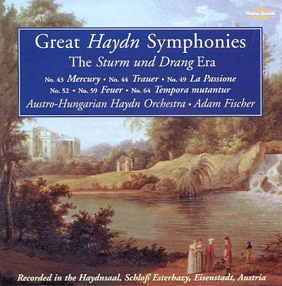

Authorized Access Points for Series Identified by Conventional Collective Titles with “Selections”
Notes:
March 2017
Note: This series module can be used to create series authority records of any kind. The following two examples are series authority records for aggregate musical works. The principles apply to any kind of compilation. Participants who wish to create authority records for musical works, however, should first take the NACO training for musical work authorities.

Slide 243
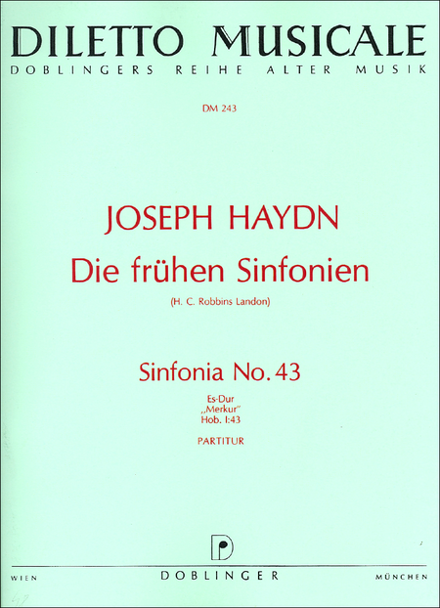
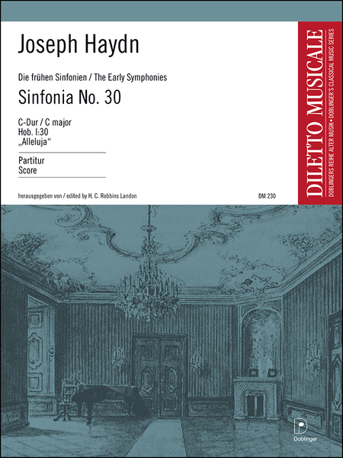
Authorized Access Points for Series Identified by Conventional Collective Titles with “Selections”
Notes:
March 2017

Slide 244
Authorized Access Points for Series Identified by Conventional Collective Titles with “Selections”
Two incomplete compilations of Haydn’s symphonies
Neither has a particularly memorable title
  Great Haydn symphonies
  Die frühen Sinfonien (or in English, The early symphonies)
Neither title identifies very well which symphonies are included
Notes:
March 2017

Slide 245
Authorized Access Points for Series Identified by Conventional Collective Titles with “Selections”
These series are good candidates for using a conventional collective title for the preferred title
  Symphonies. Selections
But if they both use the conventional collective title, the authorized access point for the series will conflict
  100 1_ Haydn, Joseph, $d 1732-1809. $t Symphonies. $k Selections
The authorized access point needs to be qualified to distinguish between the two
Notes:
March 2017

Slide 246
Authorized Access Points for Series Identified by Conventional Collective Titles with “Selections”
Possibilities:
  100 1_ Haydn, Joseph, $d 1732-1809. $t Symphonies. $k Selections (Österreichisch-ungarische Haydnphilharmonie)
  100 1_ Haydn, Joseph, $d 1732-1809. $t Symphonies. $k Selections (Nimbus Records (Firm))
  100 1_ Haydn, Joseph, $d 1732-1809. $t Symphonies. $k Selections (Great Haydn symphonies)
  100 1_ Haydn, Joseph, $d 1732-1809. $t Symphonies. $k Selections (1999)
Notes:
March 2017
Österreichisch-ungarische Haydnphilharmonie – the authorized access point for the performer (Austro-Hungarian Haydn Orchestra)
Nimbus Records (Firm) – the authorized access point of the record label issuing the compilation
Great Haydn symphonies: the title of this series—problems: not very distinctive, could be misleading (which ones are the “great” ones?); and there could easily be other compilations of Haydn’s “great” symphonies, which would leave this qualifier liable to conflict with the AAP for another compilation
1999 – The date of the first release in the series (this seems unlikely to be very meaningful to library users)

Slide 247
Authorized Access Points for Series Identified by Conventional Collective Titles with “Selections”
Possibilities:
  100 1_ Haydn, Joseph, $d 1732-1809. $t Symphonies. $k Selections (Doblinger)
  100 1_ Haydn, Joseph, $d 1732-1809. $t Symphonies. $k Selections (Diletto musicale)
  100 1_ Haydn, Joseph, $d 1732-1809. $t Symphonies. $k Selections (Landon)
  100 1_ Haydn, Joseph, $d 1732-1809. $t Symphonies. $k Selections (Die frühen Sinfonien)
  100 1_ Haydn, Joseph, $d 1732-1809. $t Symphonies. $k Selections (1962)
Notes:
March 2017
Doblinger: the publisher
Diletto musicale: a series issued by the publisher that appears with Die frühen Sinfonien (Note: “Die frühen Sinfonien” could be considered a subseries, but it does not fall under the serials exception to 6.27.2.2 because it is a multipart monograph, not a monographic series)
Landon: the surname of the editor of all the symphonies in the series
Die frühen Sinfonien: the title of this series—problems: not very distinctive, could be misleading (which ones are the “early” symphonies? Is there agreement about which ones these are?)’ and there could easily be other compilations of Haydn’s “early” symphonies, which would leave this qualifier liable to conflict with the AAP for another compilation
1962: publication date of the first part (this seems unlikely to be very meaningful to library users)

Slide 248
Additions to Authorized Access Points for Works: Conventional Collective Titles
The AACR2 headings for such collections may not be appropriate for use in RDA, even if they are coded as RDA, because they usually represented more than one work
If authorized access points are needed in RDA, they should be established on separate records
Notes:
March 2017
Many authority records were inappropriately recoded as RDA in the various phased batch changes that were done to the NACO authority file during the transition to RDA.

Slide 249
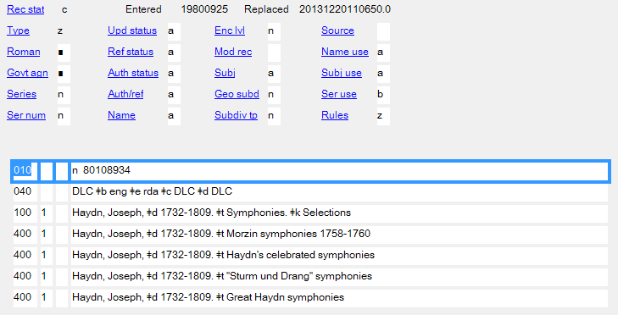
Additions to Authorized Access Points for Works: Conventional Collective Titles
This AACR2 heading cannot be used as an RDA authorized access point because it represents different aggregate works, even though it has been coded (by machine) as appropriate for RDA
Notes:
March 2017
Some of these are series, others are not, but it doesn’t matter—qualification has to happen whether the authorized access point represents a series work or any other aggregate work.

Slide 250
Authorized Access Point for a Work
(MARC)
Series created by one agent, or collaborative work
  Code in 100, 110, or 111, as appropriate
  Begin with the authorized access point for the agent or principal agent, exactly as it appears in its own authority record’s 1XX field (it must be established)
  Code the preferred title in
    $t Title $n Number of part/section
    $k Form (e.g. “Selections”) $p Name of part/section
      Qualifiers in parentheses, no subfield coding
Notes:
March 2017
NOTE: DO NOT USE subfield $f “Date of a work”. In RDA subfield $f is only used in expression access points
The following subfield coding might be used in musical work series:
$m Medium of performance (Music)
$r Key for music

Slide 251
Authorized Access Point for a Work
(MARC)
Series that is a compilation of works by different agents
  Code in 130
  Code the preferred title in
    $a Title $n Number of part/section
    $k Form (e.g. “Selections”) $p Name of part/section
      Qualifiers in parentheses, no subfield coding
Notes:
March 2017
NOTE: DO NOT USE subfield $f “Date of a work”. In RDA subfield $f is only used in expression access points
The following subfield coding might be used in musical work series:
$m Medium of performance (Music)
$r Key for music

Slide 252
Exercise: Authorized Access Point
Record the authorized access point for these two series-works
Notes:
March 2017

Slide 253
Exercise: Authorized Access Point
130 _0 Governance in Asia
100 1_ Card, Orson Scott. $t Novel of the Mither mages
Notes:
March 2017

Slide 254
Variant Access Point for a Work
(RDA 6.27.4)
Variant access points are not core. Include them if in your judgment they would help the user find or identify the work.
  Base on a variant title (RDA 6.2.3) or the preferred title (RDA 6.2.2)
  Record in appropriate 4XX fields
  Construct the variant access point by combining the authorized access point for the creator with the variant title or a qualified preferred title or by giving the variant or preferred title alone
  Make further additions to the access point if you consider them to be important for identification in the same way such additions would have been added to a preferred title. These additions are not required.
Notes:
March 2017
Read 6.27.4 together.
First bullet point: this is a change with the April 2017 release (previous language only mentioned variant title). Presenter: verify this after the April 2017 release.
Third bullet point. If the variant access point is based on the preferred title, it must not match the authorized access point.

Slide 255

Variant Access Point for a Work
(RDA 6.27.4)
Typical work-level variant access points for series
  Differing forms of title in the same language as the original expression, or in the same language as the preferred title (if that is different)
  Differing forms of title in any language appearing on a manifestation of the original expression
130 _0 West Slavic contributions
430 _0 Westslavische Beiträge
Notes:
March 2017

Slide 256
Variant Access Point for a Work
(RDA 6.27.4)
Some typical variant access points in series authority records
  Name-title variant(s) beginning with authorized access point for co-author(s)
  100 1_ Pistoia, Sara. $t Let’s do math!
  400 1_ Whelan, Piper. $t Let’s do math!
  Name-title variant(s) beginning with authorized access point for a responsible corporate body when authorized access point formed without it
  130 _0 Acta classica. $p Supplementum
  410 20 Classical Association of South Africa. $t Acta classica. $p Supplementum
Notes:
March 2017

Slide 257
Variant Access Point for a Work
(RDA 6.27.4)
Some typical variant access points in series authority records
  Title of subseries when authorized access point includes main series
  130 _0 A+ books. $p Bugs are beautiful!
  430 _0 Bugs are beautiful!
  This may require qualification if the title itself conflicts with that of another work
  130 _0 Pebble plus. $p Life science
  430 _0 Life science (Capstone Press)
Notes:
March 2017
This variant is only recorded if title of subseries is distinctive.

Slide 258
Variant Access Point for a Work
(RDA 6.27.4)
Some typical variant access points in series authority records
  Title of series when authorized access point is formed beginning with the authorized access point for an agent
  100 1_ Rake, Matthew. $t If extinct beasts came to life
  430 _0 If extinct beasts came to life
  This may require qualification if the title itself conflicts with that of another work
  100 1_ Pettiford, Rebecca. $t Festivals
  430 _0 Festivals (Bullfrog Books)
Notes:
March 2017
This is an optional practice that lingers from pre-RDA NACO series practice based on the limited indexing ability of some systems. Most systems now can index the contents of subfield $t of a 1XX or 4XX field without recording a separate 430 for the title alone. The pre-RDA NACO practice was only applied to series, not to other works, so even then it was inconsistent.

Slide 259
Variant Access Point for a Work
(MARC)
Variant access point beginning with the authorized access point for an agent
  Code in 400, 410, or 411, as appropriate
  Begin with the authorized access point for the agent or principal agent, exactly as it appears in its own authority record’s 1XX field (it must be established)
  Code the title in
    $t Title $n Number of part/section
    $k Form (e.g. “Selections”) $p Name of part/section
      Qualifiers in parentheses, no subfield coding
Notes:
March 2017
NOTE: DO NOT USE subfield $f “Date of a work”. In RDA subfield $f is only used in expression access points
The following subfield coding might be used in musical work series:
$m Medium of performance (Music)
$r Key for music

Slide 260
Variant Access Point for a Work
(MARC)
Variant access point not beginning with the authorized access point for an agent
  Code in 430
  Code the title in
    $a Title $n Number of part/section
    $k Form (e.g. “Selections”) $p Name of part/section
      Qualifiers in parentheses, no subfield coding
Notes:
March 2017
NOTE: DO NOT USE subfield $f “Date of a work”. In RDA subfield $f is only used in expression access points
The following subfield coding might be used in musical work series:
$m Medium of performance (Music)
$r Key for music

Slide 261
Exercise: Variant Access Point
Record variant access points for this series
  Note the issuing body (NIAS = The Nordic Institute of Asian Studies)
  No. 4 in the series (China’s contested Internet, 2015) has the title “Governance in Asia series” on the title page verso
Notes:
March 2017

Slide 262
Exercise: Variant Access Point
Possible variants:
430 _0 Governance in Asia series
410 2_ Nordic Institute of Asian Studies. $t Governance in Asia
Notes:
March 2017

Slide 263
Exercise: Variant Access Point
Record variant access points for this series
Notes:
March 2017

Slide 264
Exercise: Variant Access Point
Possible variants:
400 1_ Card, Orson Scott. $t Mithermages series
430 _0 Novel of the Mither mages
430 _0 Mithermages series
Notes:
March 2017

Slide 265
Constructing the Authorized Access Point for an Expression (RDA 6.27.3)
The authorized access point for an expression always begins with the authorized access point for the work. Record it in 1XX exactly as it was recorded in the description of the work.
Notes:
March 2017

Slide 266
Constructing the Authorized Access Point for an Expression (RDA 6.27.3)
Exercise: Begin to create the authorized access point for the two expressions we’re working on by recording the authorized access point for each one’s work.
Notes:
March 2017
Begin filling out the 1XX fields in your authority worksheets/OCLC workforms by recording the form of the authorized access point for the work. We just finished creating a record for this.

Slide 267
Constructing the Authorized Access Point for an Expression (RDA 6.27.3)
RDA 6.27.3 says to add at least one other element
  Content type (RDA 6.9)
  Date (RDA 6.10)
  Language (RDA 6.11)
  Other distinguishing characteristic (RDA 6.12)
Other elements beyond the first may be added as needed to distinguish the expression from others. These may already have been recorded in the record as elements
Cataloger’s judgment about which element(s) to add. What best distinguishes between the expressions?
Notes:
March 2017

Slide 268
Constructing the Authorized Access Point for an Expression (MARC)
The first part, the authorized access point for the work, is coded exactly as in the 1XX field of its own authority record
Make additions as follows:
  Content type
    Capitalize, precede by a period, code in subfield $s (after the period)
    100 1_ Collins, Suzanne. $t Hunger Games (Series). $l French. $s Spoken word
  Date of expression
    Precede by a period, code in subfield $f (after the period)
    100 1_ Mrożek, Sławomir. $t Works. $l German. $f 1980
Notes:
March 2017
Content type: The MARC subfield coding should be subfield $h, but the use of that subfield has not yet been validated either by LC or OCLC.
Date of expression: Note the MARC format documentation calls subfield $f “date of a work” but in NACO practice it is only used to code the date of an expression

Slide 269
Constructing the Authorized Access Point for an Expression (MARC)
Make additions as follows:
  Language of expression
    Precede by a period, code in subfield $l (after the period)
    130 _0 Baby Einstein (Disney Press). $l Spanish
  Other distinguishing characteristic
    Enclose in parentheses, code in subfield $s (before the first parenthesis)
    100 1_ Manfredi, Valerio. $t Odysseus. $l English $s (Overlook Press)
  Subfield $s cannot be repeated, so if both content type and other distinguishing characteristic are needed:
    100 1_ Alexander, Lloyd. $t Chronicles of Prydain. $l English. $s Spoken word (Langton)
Notes:
March 2017
Last bullet point: when subfield $h is authorized, this would be coded: 100 1_ Alexander, Lloyd. $t Chronicles of Prydain. $l English. $h Spoken word $s (Langton)
Last bullet point: in case someone asks, RDA does not forbid recording the language of the original expression in an authorized access point for an expression as AACR2 did.

Slide 270
Constructing the Authorized Access Point for an Expression (RDA 6.27.3)
Translations
  Always begin by adding the language in subfield $l
  Reminder: LC practice stops there, even though there may be more than one expression in the language
  There is one French-language expression of A novel of the Mither mages
  There is also a Spanish-language expression
Notes:
March 2017

Slide 271
Constructing the Authorized Access Point for an Expression (RDA 6.27.3)
Exercise: open your work form for the French expression
Start by adding language to the access points for each expression to see if that’s enough to distinguish them from other expressions of the work.
    100 1_ Card, Orson Scott. $t Novel of the Mither mages. $l French
Is it? Since there are no other French-language expressions, it is enough. If there were others we could add something more.
  Possible answer (qualify by surname of translator):
  100 1_ Card, Orson Scott. $t Novel of the Mither mages. $l French $s (Brèque)
Notes:
March 2017
Note: The qualified version may become the norm even if there is no conflict if the proposed PCC policy for translations is implemented.

Slide 272
Constructing the Authorized Access Point for an Expression (RDA 6.27.3)
Original language editions
  Reminder: LC practice is to use the authorized access point for the work to represent any expression in the work’s original language
  PCC catalogers may follow this practice, but in some cases may find it necessary to distinguish between expressions in the original language
  RDA 6.27.3 says to begin with the authorized access point for the work and then add one or more elements
    Content type (RDA 6.9)
    Date (RDA 6.10)
    Language (RDA 6.11)
    Other distinguishing characteristic (RDA 6.12)
  Note: the RDA language element can be any language, including the language of the original expression
  Best practices have not yet developed
Notes:
March 2017

Slide 273
Constructing the Authorized Access Point for an Expression (RDA 6.27.3)
In some fields it is important to distinguish between editions in the original language. Premodern literatures are such fields.
  Some possibilities:
    Begin with language, add further elements as needed
      100 0_ Bernard, $c of Clairvaux, Saint, $d 1090 or 1091-1153. $t Works. $l Latin $s (Sources chrétiennes)
    Begin with some other element
      100 0_ Bernard, $c of Clairvaux, Saint, $d 1090 or 1091-1153. $t Works $s (Sources chrétiennes)
Notes:
March 2017
Premodern literatures are fields where it is important to distinguish between editions in the original language because there are often many different editions or versions in the original language for these texts.
Problem with the second possibility: the only thing that identifies this as an authorized access point for an expression is the subfield $s coding (at the work level there would be no coding before the qualifier). This seems an extremely tenuous distinction.
Note: Best practices have not yet been established for original-language expressions, so more than one practice is shown in these slides, but from a collocation standpoint it seems best to add the original language as the first expression element when creating an authorized access point for an expression in the original language. Otherwise expression additions will scatter original language expressions among other languages in the file. This also parallels practice for expressions in languages other than the original language (i.e. translations).

Slide 274
Constructing the Authorized Access Point for an Expression (RDA 6.27.3)
Other examples of varying practice for original language expressions of series in the NACO Authority File (these are all English language expressions)
    100 1_ Anders, Lou. $t Thrones & bones. $s Spoken word
    100 1_ Card, Orson Scott. $t Pathfinder series. $l English. $s Spoken word
    100 1_ Card, Orson Scott. $t Pathfinder series. $l English. $s Text
    100 1_ Chainani, Soman. $t School for Good and Evil. $s Spoken word
Notes:
March 2017

Slide 275
Constructing the Authorized Access Point for an Expression (RDA 6.27.3)
Exercise: open your work form for the English spoken word expression
Add expression elements to the authorized access point to distinguish it from other expressions
Notes:
March 2017

Slide 276
Constructing the Authorized Access Point for an Expression (RDA 6.27.3)
Possible answers:
100 1_ Card, Orson Scott. $t Novel of the Mither mages. $s Spoken word
100 1_ Card, Orson Scott. $t Novel of the Mither mages. $l English. $s Spoken word
100 1_ Card, Orson Scott. $t Novel of the Mither mages. $l English $s (Blackstone Audio)
etc.
Notes:
March 2017

Slide 277
Constructing the Authorized Access Point for an Expression (RDA 6.27.3)
“Works”
REMINDER:
The authorized access point for an author’s complete works is formed
[Authorized access point for the author]. Works
This will never conflict with the authorized access point of another work because all such compilations are the same aggregate work.
For this reason, “complete” authorized access points using conventional collective titles never need to be qualified at the work level
If it is thought necessary to qualify (e.g. because there is more than one version), this is done at the expression level
Notes:
March 2017
See discussion above at slide 210 ff.

Slide 278
Constructing the Authorized Access Point for an Expression (RDA 6.27.3)
“Works”
This applies to all compilations purporting to be complete: “Works”, “Plays”, “Essays,” etc.
Recommendation: such compilations issued as series should always be differentiated at the expression level, even if there is (currently) only one such compilation
Same available elements as for other expressions:
  Content type
  Date of expression
  Language of expression
  Other distinguishing characteristic of expression
Notes:
March 2017

Slide 279
Constructing the Authorized Access Point for an Expression (RDA 6.27.3)
“Works”
Examples of authorized access points for compilations purporting to be complete issued as series
100 1_ Austen, Jane, $d 1775-1817. $t Novels $s (Chapman). $f 1932
100 0_ Bernard, $c of Clairvaux, Saint, $d 1090 or 1091-1153. $t Works. $l Latin $s (Sources chrétiennes)
100 0_ Cyril, $c Saint, Patriarch of Alexandria, $d approximately 370-444. $t Works. $l Greek $s (Griechischen christlichen Schriftsteller der ersten drei Jahrhunderte)
100 0_ Galen. $t Works. $l English $s (Cambridge Galen translations)
100 1_ Hemingway, Ernest, $d 1899-1961. $t Correspondence. $f 2011
100 1_ Mann, Thomas, $d 1875-1955. $t Essays $s (Hans Bürgen)
100 1_ Régio, José, $d 1901-1969. $t Plays $s (Editorial Inquérito)
100 1_ Régio, José, $d 1901-1969. $t Plays $s (Portugália Editora)
100 1_ Wilde, Oscar, $d 1854-1900. $t Works $s (Doubleday, Page & Company)
Notes:
March 2017
Examples showing a variety of ways of distinguishing the expressions.

Slide 280
Constructing the Authorized Access Point for an Expression (RDA 6.27.3)
“Works”
100 1_ Twain, Mark, $d 1835-1910. $t Works. $f 1972
Represents this English series expression of Twain’s works
Notes:
March 2017

Slide 281
Bilingual/polyglot resources by a single author (multipart monographs)
Bilingual or polyglot editions issued as series containing the works of one person
  In RDA practice these represent more than one expression of the person’s “Works”
  Unlike AACR2 practice, we will not use a single authority record or authorized access point to represent such a series in RDA
  100 1_ Shakespeare, William, $d 1564-1616. $t Works. $l French & English. $f 1930
Notes:
March 2017
REMEMBER: One author can have only one aggregate containing all of his/her complete works, represented by the conventional collective title “Works”
“Collection Shakespeare”—bilingual series of Shakespeare’s works in French & English published by Les Belles Lettres; first part issued in 1930.

Slide 282



Bilingual/polyglot resources by a single author (multipart monographs)
Under AACR2, Collection Shakespeare was treated as a single series with a single authorized access point:
AACR2 heading for the series:
100 1_ Shakespeare, William, $d 1564-1616. $t Works. $l French & English. $f 1930
Notes:
March 2017
“Collection Shakespeare”—bilingual series of Shakespeare’s works in French & English published by Les Belles Lettres; first part issued in 1930.

Slide 283
Bilingual/polyglot resources by a single author (multipart monographs)
  Under RDA, create separate descriptions for each language expression
    Authority records:
      French expression AAP
      100 1_ Shakespeare, William, $d 1564-1616. $t Works. $l French. $f 1930
      or
      100 1_ Shakespeare, William, $d 1564-1616. $t Works. $l French $s (Collection Shakespeare)
      or
      100 1_ Shakespeare, William, $d 1564-1616. $t Works. $l French $s (Belles Lettres)
      etc.
      English expression AAP
      100 1_ Shakespeare, William, $d 1564-1616. $t Works. $l English. $f 1930
      or
      100 1_ Shakespeare, William, $d 1564-1616. $t Works. $f 1930
      or
      100 1_ Shakespeare, William, $d 1564-1616. $t Works. $l English $s (Collection Shakespeare)
      or
      100 1_ Shakespeare, William, $d 1564-1616. $t Works. $l English $s (Belles Lettres)
      etc.
Notes:
March 2017
The second possible AAP for the English expression follows the traditional AACR2 method of not including the language for versions in the original language.
Problems with continuing to follow AACR2 practice:
(a) RDA doesn’t forbid using the original language of the expression;
(b) most users do not know that the work access point without language represents the original language;
(c) using something else to differentiate the expressions scatters the English-language expressions throughout the file, intermingled with the other-language expressions, unless date only is used for original-language expressions, and date is generally pretty meaningless to catalog users.

Slide 284
Bilingual/polyglot resources by a single author (multipart monographs)
Record one access point for each series expression in the bibliographic record:
      100 0_ Shakespeare, William, $d 1564-1616, $e author.
      245 10 Comme il vous plaira / $c William Shakespeare ; traduction de Lucien Wolff.
      264 _1 Paris : $b Société d'Édition “Les Belles Lettres”, $c 1935.
      …
      490 1_ Collection Shakespeare
      …
      800 1_ Shakespeare, William, $d 1564-1616. $t Works. $l English $s (Collection Shakespeare)
      800 1_ Shakespeare, William, $d 1564-1616. $t Works. $l French $s (Collection Shakespeare)
Notes:
March 2017

Slide 285
Bilingual/polyglot resources by multiple authors (monographic series)
Bilingual or polyglot editions issued as series containing the works of different persons are monographic series
In RDA practice, even though they contain bilingual texts, this sort of series is not separated into different expressions
Notes:
March 2017

Slide 286




Bilingual/polyglot resources by multiple authors (monographic series)
Fábulas bilingües – Monographic series
One description of the series-work (authority record)
Use one series access point in the bibliographic record
Notes:
March 2017

Slide 287
Bilingual/polyglot resources by multiple authors (monographic series)
Fábulas bilingües – Monographic series
Use one series access point in the bibliographic record
      100 0_ Herrmann, Marjorie E., $e author.
      245 14 Las manchas del sapo = $b How the toad got his spots / $c Marjorie E. Hermann.
      264 _1 Skokie, Illinois : $b National Textbook Company, $c [1978]
      …
      490 1_ Fábulas bilingües = $a Fables in Spanish and English
      …
      830 _0 Fábulas bilingües
Notes:
March 2017
Other examples of monographic series containing bilingual texts: Portuguese insights ; The defiant muse ; The Loeb classical library

Slide 288
Constructing a Variant Access Point for an Expression (RDA 6.27.4.5)
No variant access points are core. The decision rests with the cataloger: would it help a user find the expression?
Recorded in 4XX
Two kinds of variants
  Variants created by adding different expression attributes to authorized access point for the work
    100 1_ Alexander, Lloyd. $t Chronicles of Prydain. $l English. $s Spoken word (Langton)
    400 1_ Alexander, Lloyd. $t Chronicles of Prydain. $l English. $s Spoken word (Listening Library)
  Variants based on a variant title for the work closely associated with a particular expression of the series
    100 1_ Collins, Suzanne. $t Hunger Games (Series). $l Chinese
    400 1_ Collins, Suzanne. $t 飢餓遊戲
    400 1_ Collins, Suzanne. $t Ji e you xi
Notes:
March 2017
In the first example, the cataloger qualified this spoken word expression with the name of the narrator, but thought some catalog users might more readily identify the expression by the name of the recording company.
The second type of variant is very common with translations. In this case the Chinese title, technically a variant title for the work, is obviously closely associated with this expression, and inclusion of it as a variant access point will help guide the user to the expression.
RDA cites these two types of variants, but gives a lot of leeway—the last sentence of 6.27.4.5 reads “Construct additional variant access points if considered important for access.” I.e., anything you think would help lead the user to the resource.

Slide 289
Related Works (RDA 25)
Related works are recorded in 5XX fields, and may include a relationship indicator in subfield $i (from RDA Appendix J), with $w r.
    130 _0 Annual of the Hebrew Union College Biblical and Archaeological School in Jerusalem
    530 _0 $i Continued by (work): $a Annual of the Hebrew Union College/Nelson Glueck School of Biblical Archaeology $w r
    130 _0 CHERUB (Hodder Children’s Books)
    500 1_ $i Adaptation of (work): $a Muchamore, Robert. $t CHERUB $w r
Notes:
March 2017

Slide 290
Related Works (RDA 25)
Whole-part:
    100 1_ Burroughs, Edgar Rice, $d 1875-1950. $t Moon maid (Trilogy)
    500 1_ $i Series container of: $a Burroughs, Edgar Rice, $d 1875-1950. $t Moon maid $w r
    500 1_ $i Series container of: $a Burroughs, Edgar Rice, $d 1875-1950. $t Moon men $w r
    500 1_ $i Series container of: $a Burroughs, Edgar Rice, $d 1875-1950. $t Red hawk $w r
Notes:
March 2017
It may in some cases be appropriate to record whole-part relationships to series, particularly multipart monographs with a limited number of contained works.

Slide 291
Related Expressions (RDA 26)
Related expressions are recorded in 5XX fields, and may include a relationship indicator in subfield $i (from RDA Appendix J), with $w r.
    100 0_ Euripides. $t Works. $l French $s (Collection des universités de France)
    500 0_ $i Translation of: $a Euripides. $t Works. $l Greek $s (Collection des universités de France) $w r
Notes:
March 2017

Slide 292
Related Persons, Families, or Corporate Bodies (RDA 30-32)
Related persons, families, or corporate bodies are recorded in 500 or 510 fields, and may include a relationship indicator in subfield $i (from RDA Appendix I), with $w r.
    130 _0 Annual of the Hebrew Union College Biblical and Archaeological School in Jerusalem
    510 2_ $i Issuing body: $a Hebrew Union College/Nelson Glueck School of Biblical Archaeology $w r
    100 1_ Brooks, Terry. $t Shannara trilogy. $l Spanish
    500 1_ $i Translator: $a Alba, Pilar $w r
    130 _0 Collection Michel Sadanowsky
    500 1_ $i Editor: $a Sadanowsky, Michel $w r
Notes:
March 2017

Slide 293
Related Subjects (RDA 33-37)
Subject relationships to works may be recorded in 5XX fields, as long as the related entity is in the LC/NACO Authority File. Include a relationship indicator in subfield $i (see RDA Appendix M), with $w r.
    130 _0 Canada close up
    551 $i Subject: $a Canada $w r
Notes:
March 2017
REMEMBER: Do not attempt to record relationships to subjects that are outside of LC/NAF (e.g., it is not currently permitted to record relationships to subjects in LCSH).
The relationship designator “Subject” may be used. Since it is highest level in Appendix M it may be used even though not explicitly listed.

Slide 294
Relationships
For more details on relationships, see PCC Series training manual, Session 8 (Related Series)
https://www.loc.gov/catworkshop/courses/naco-full%20series-RDA/course%20table.html
Notes:
March 2017

Slide 295
Exercise: Relationships
Any relationships to record?
Notes:
March 2017
Think about the relationships you’ve already recorded in the 670 for some of these (e.g. the narrators, the translator). See slide 33 for other books in the series-work.
On Governance in Asia note also what the series title page (second inset) has to say about a relationship to another series.

Slide 296
Exercise: Relationships
Possible relationship:
  130 _0 Governance in Asia
  530 _0 $i Continuation of (work): $a Democracy in Asia $w r
Notes:
March 2017

Slide 297
Exercise: Relationships
Possible relationships:
  100 1_ Card, Orson Scott. $t Novel of the Mither mages
  500 1_ $ Series container of: $a Card, Orson Scott. $t Lost gate $w r
  500 1_ $ Series container of: $a Card, Orson Scott. $t Gate thief $w r
  500 1_ $ Series container of: $a Card, Orson Scott. $t Gatefather $w r
Notes:
March 2017
See slide 33 for other works contained in this series

Slide 298
Exercise: Relationships
Possible relationship:
  100 1_ Card, Orson Scott. $t Novel of the Mither mages. $l French
  500 1_ $i Translator: $a Brèque, Jean-Daniel $w r
Notes:
March 2017

Slide 299
Exercise: Relationships
Possible relationships:
  100 1_ Card, Orson Scott. $t Novel of the Mither mages. $l English. $l Spoken word
  500 1_ $i Narrator: $a Rankin, Emily $w r
  500 1_ $i Narrator: $a Rudnicki, Stefan, $d 1945- $w r
Notes:
March 2017

Slide 300
RDA Authority Record Core and Non-Core: Work Record
040 [MARC library code] $b eng $e rda $c [MARC library code]
046 $k 2011 $2 edtf
130 _0 Governance in Asia
380 Series (Publications) $a Monographic series $2 lcsh
430 _0 Governance in Asia series
410 2_ Nordic Institute of Asian Studies. $t Governance in Asia
530 _0 $i Continuation of (work): $a Democracy in Asia $w r
642 no. 1 $5 DPCC $5 [MARC library code]
643 Copenhagen $b NIAS Press
644 f $5 [MARC library code]
645 t $5 DPCC $5 [MARC library code]
646 s $5 [MARC library code]
670 Politicized society, 2011: $b series title page (Governance in Asia ; successor to NIAS’s ‘Democracy in Asia’ series) title page verso (Governance in Asia, No. 1)
670 China's contested Internet, 2015: $b series title page (Governance in Asia) book title page verso (Governance in Asia series, no. 4)
Notes:
March 2017

Slide 301
RDA Authority Record Core and Non-Core: Work Record
040 [MARC library code] $b eng $e rda $c [MARC library code]
046 $k 2011 $2 edtf
100 1_ Card, Orson Scott. $t Novel of the Mither mages
380 Series (Publications) $2 lcsh
380 Multipart monograph
380 Fantasy fiction $a Novels $2 lcgft
386 Americans $2 lcdgt
400 1_ Card, Orson Scott. $t Novel of the Mithermages
400 1_ Card, Orson Scott. $t Mithermages series
430 _0 Novel of the Mither mages
430 _0 Novel of the Mithermages
430 _0 Mithermages series
643 New York $b Tor
644 f $5 [MARC library code]
645 t $5 DPCC $5 [MARC library code]
646 s $5 [MARC library code]
670 The lost gate, 2011: $b title page (A novel of the Mither mages)
670 Gatefather, 2015: $b title page (A novel of the Mithermages)
670 The lost gate, [2010]: $b disc label (The Mithermages series)
Notes:
March 2017

Slide 302
RDA Authority Record Core and Non-Core: Expression Record
040 [MARC library code] $b eng $e rda $c [MARC library code]
046 $k 2011 $2 edtf
100 1_ Card, Orson Scott. $t Novel of the Mither mages. $l French
336 text $2 rdacontent
377 fre
381 Series (Publications) $2 lcsh
381 Multipart monograph
381 Brèque
400 1_ Card, Orson Scott. $t Mages de Westil
400 1_ Card, Orson Scott. $t Conte de Westil
430 _0 Mages de Westil
430 _0 Conte de Westil
500 1_ $i Translator: $a Brèque, Jean-Daniel $w r
641 La porte perdue and Le voleur de portes are numbered; Père-des-pierres is unnumbered)
642 1 $5 DPCC $5 UPB
643 Nantes $b L'Atalante
644 f $5 [MARC library code]
645 t $5 DPCC $5 [MARC library code]
646 s $5 [MARC library code]
670 La porte perdue, 2011: $b title page (Les mages de Westil; traduit de l'Américain par Jean-Daniel Brèque) spine (1)
670 Le voleur de portes, 2014: $b title page (Les mages de Westil; traduit de l'Américain par Jean-Daniel Brèque) spine (2)
670 Père-des-pierres = Stonefather, 2015: $b title page (Les mages de Westil; traduit de l'Américain par Jean-Daniel Brèque) cover (Un conte de Westil, le monde des mages) jacket flap (La porte perdue, Les mages de Westil, livre 1; Le voleur de portes, Les mages de Westil, livre 2)
Notes:
March 2017

Slide 303
RDA Authority Record Core and Non-Core: Expression Record
040 [MARC library code] $b eng $e rda $c [MARC library code]
046 $k 2010 $2 edtf
100 1_ Card, Orson Scott. $t Novel of the Mither mages. $l English. $s Spoken word
336 spoken word $2 rdacontent
377 eng
381 Series (Publications) $2 lcsh
381 Multipart monograph
381 Rankin and Rudnicki
400 1_ Card, Orson Scott. $t Mithermages series
400 1_ Card, Orson Scott. $t Mither mages series
430 _0 Mithermages series
500 1_ $i Narrator: $a Rankin, Emily $w r
500 1_ $i Narrator: $a Rudnicki, Stefan, $d 1945-$w r
642 bk. 1 $5 DPCC $5 UPB
643 Ashland, OR $b Blackstone Audio, Inc.
644 f $5 [MARC library code]
645 t $5 DPCC $5 [MARC library code]
646 s $5 [MARC library code]
670 The lost gate, 2011: $b disc label (The Mithermages series) container (book 1) container (℗2010 ©2011)
670 OCLC, 14 March 2017 $b (all volumes performed by Emily Rankin and Stefan Rudnicki)
Notes:
March 2017

Slide 304
Congratulations!
You have now created four series authority records
Participants: revise existing or create new “real” series authority records for examples you’ve brought with you
Notes:
March 2017

